Slide 1

Team Members-
Shefali Kolge
Raviraj Dixit
Akshay Nimbalkar
Sangeeth Kumar
Harish Fegade

Slide 2
Business Case
While searching for books online we get many recommendations of same book from same website, that’s because different sellers have different selling price, which confuses the buyers and leads them to visit website again and again.
bookपेdeal.in™ helps you find the books at lowest price available across all shopping portals in India as well as provides forecast for next few days.

Slide 3
Business Benefits
One stop shop for all books price comparison.
User will be redirected to the shopping portal to complete the purchase.
bookपेdeal.in™ helps you save time and effort, by choosing the lowest online price for the book you are interested in.
With forecast ready at hand user can be benefitted with price drop possibility.

Slide 4
Data Collection
Scraping of books details such as title, author, price , genre, image and product url from different websites.
Selenium and bs4 for data extraction.
Data extracted on daily basis and updated in database using MySQL, hence ensuring the latest price in database for comparison.
Data collected used for forecasting.

Slide 5
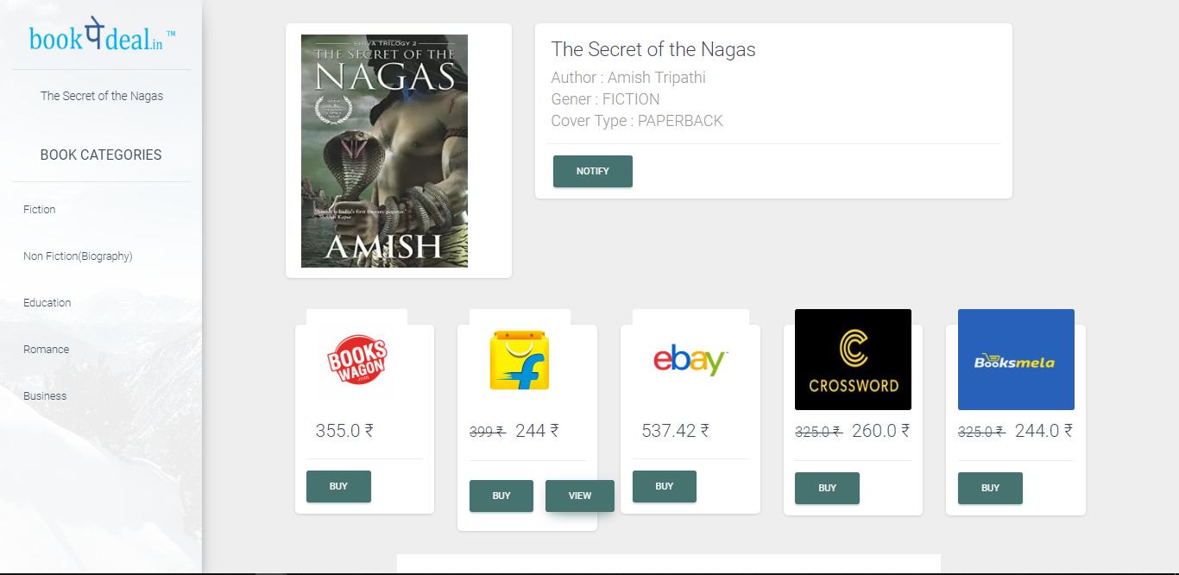
Comparison screen

Slide 6
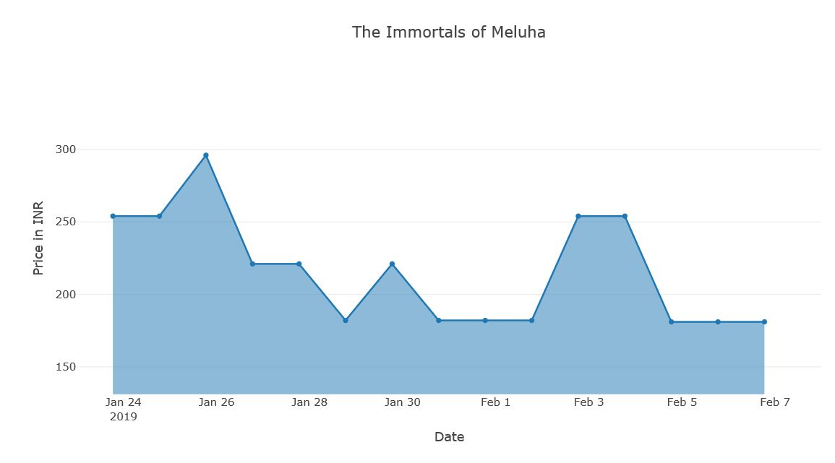
Price Graph

Slide 7
Challenges
Unavailability of long term data.
Scraping of well known websites not allowed unless rights are purchased.

Slide 8
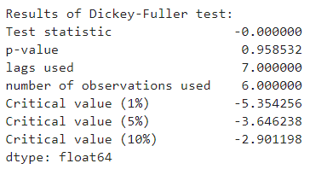
Forecasting
Long term data makes it possible to understand trend, seasonality and noise in data which helps to make forecasts for near future.
Using ARIMA or SARIMA models such forecasts can be done with higher accuracy and lower errors.
Dickey-Fuller test Values:

Slide 9
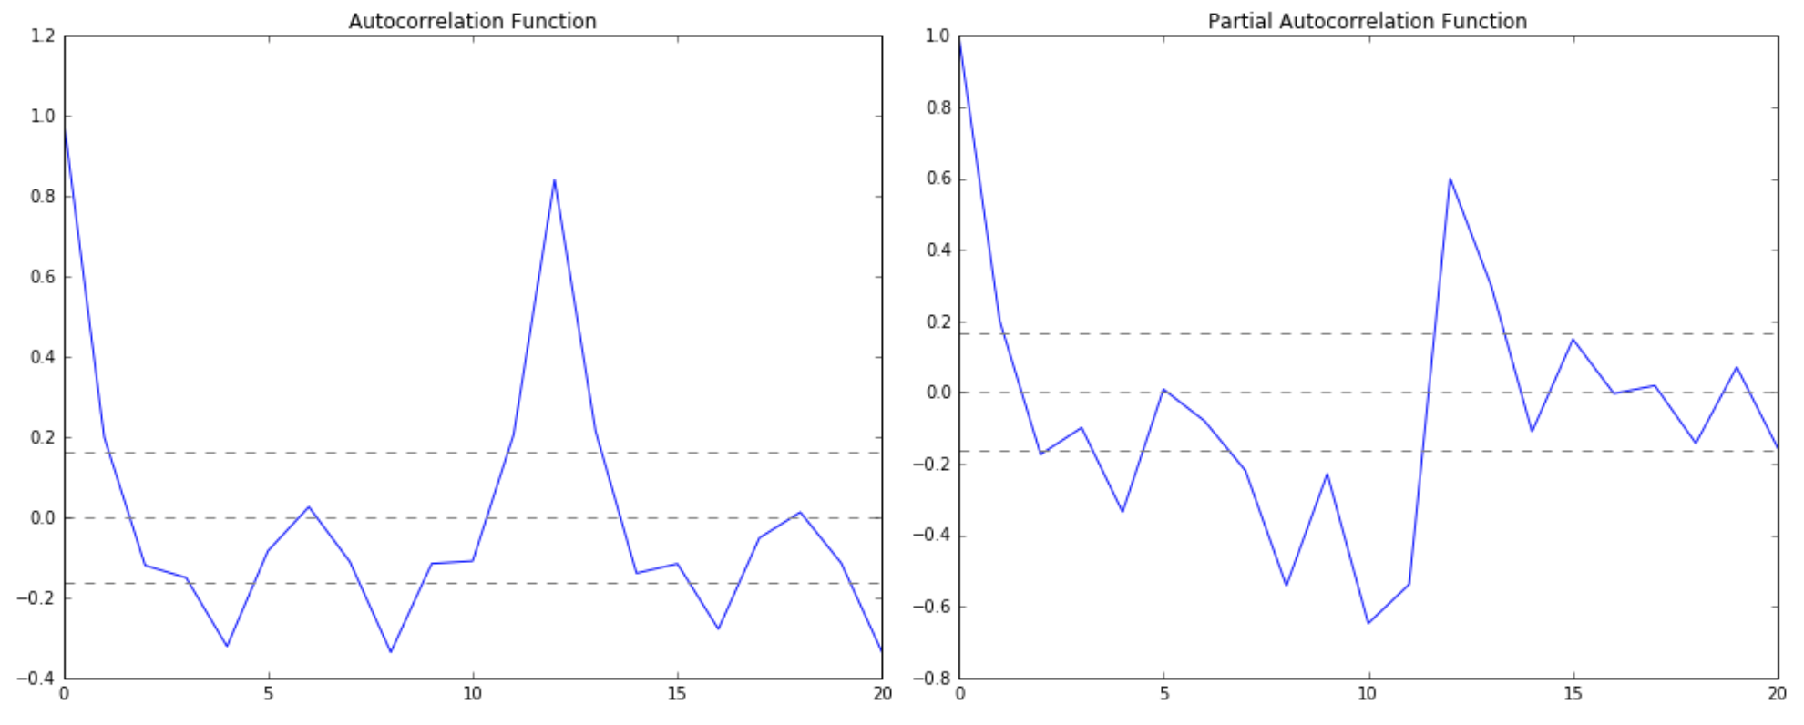
ACF(q) and PACF(p) Graphs

Slide 10
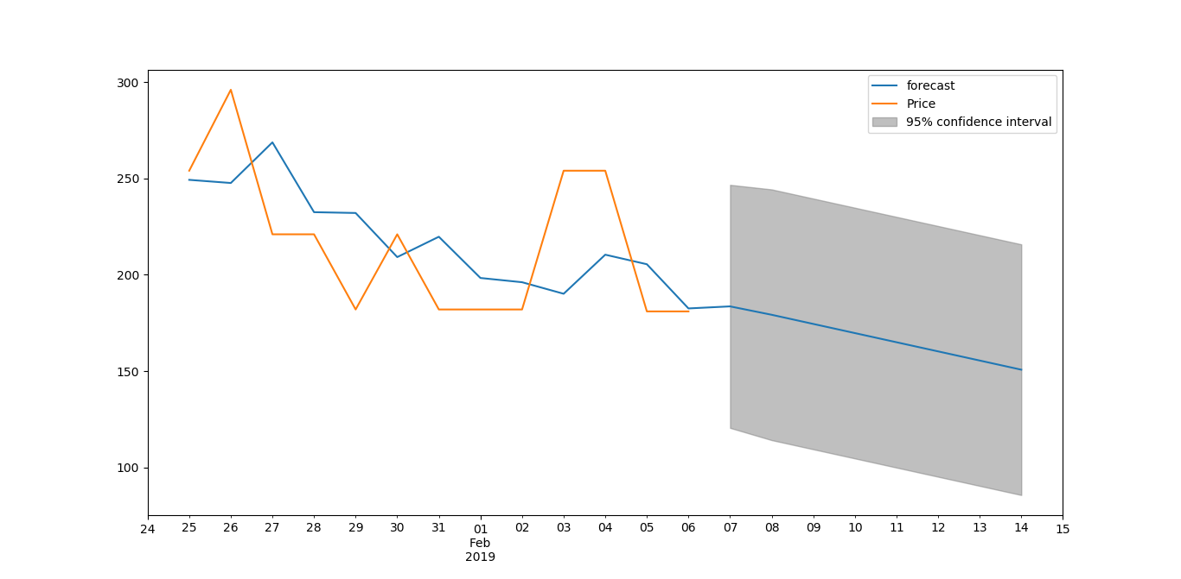
Forecast – The Immortals of Meluha
date | price (INR)
24-01-2019 | 254
25-01-2019 | 254
26-01-2019 | 296
27-01-2019 | 221
28-01-2019 | 221
29-01-2019 | 182
30-01-2019 | 221
31-01-2019 | 182
01-02-2019 | 182
02-02-2019 | 182
03-02-2019 | 254
04-02-2019 | 254
05-02-2019 | 181
06-02-2019 | 181
07-02-2019 | 181
08-02-2019 | 184
09-02-2019 | 179
10-02-2019 | 175
11-02-2019 | 170
12-02-2019 | 165
13-02-2019 | 160
14-02-2019 | 156

Slide 11
Road Forward
Right now bookपेdeal.in™ being under construction, with availability of daily data concrete forecasts can be made.
Creating the Cron Job for scheduled scraping.
Implementation of NLP for title search in database.

