Slide 1


Pizza Sales Analysis Interactive Dashboard Report
By: Shefa’ Alkilany

Slide 2
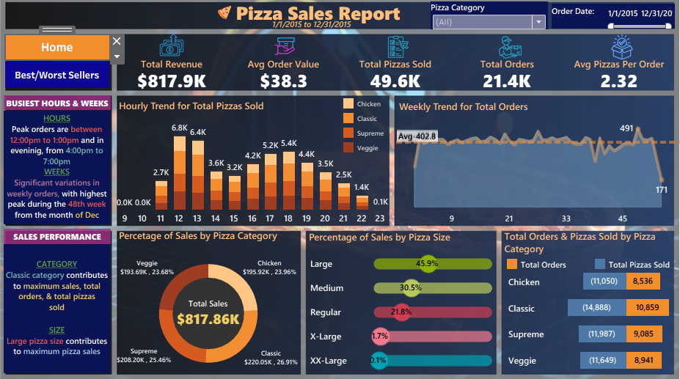

Slide 3
Key Analysis & Insights
$817.9K
Total Revenue
21.4K
Total Orders
49.6K
Pizzas Sold
$38.3
Avg Order Value
2.32
Avg Pizzas / Order
When Demand Peaks
What Sells Best
Orders peak daily between 12–1 PM and again from 4–7 PM, matching the lunch and dinner rush.
Weekly order volume swings widely across the year, with the sharpest spike in week 48 (late November).
Staffing and prep should flex around these windows rather than assume steady demand through the day.
Classic-style pizzas lead in both orders and pizzas sold, and edge out other categories in revenue at $220.05K (26.9%).
Large is the most popular size, driving 45.9% of orders, followed by Medium (30.5%) and Regular (21.8%).
Category revenue is fairly balanced overall — Supreme ($208.2K), Chicken ($195.9K) and Veggie ($193.7K) all trail Classic closely.
Takeaway: Staff up for the midday and evening rushes, keep Large and Classic pizzas well stocked, and use the Best/Worst Sellers view to fine-tune the menu.

Slide 4
Dashboard Link:
https://public.tableau.com/views/pizzasales1/Home?:language=en-GB&:sid=&:redirect=auth&:display_count=n&:origin=viz_share_link

