Slide 1
Project 1 Hashing Algorithms Data Structure 261p
Due May 2nd

Slide 2
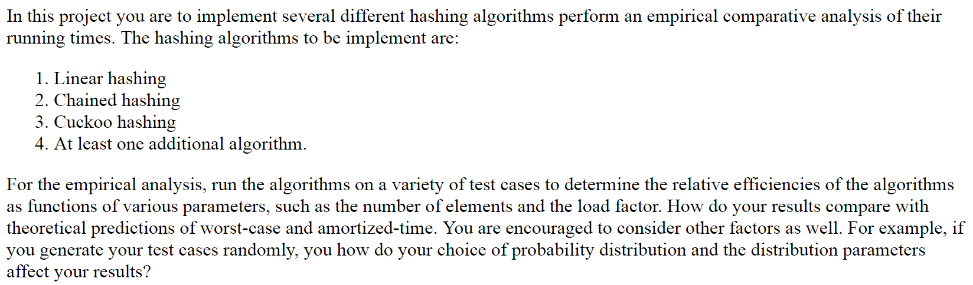
Hashing algorithms

Slide 3
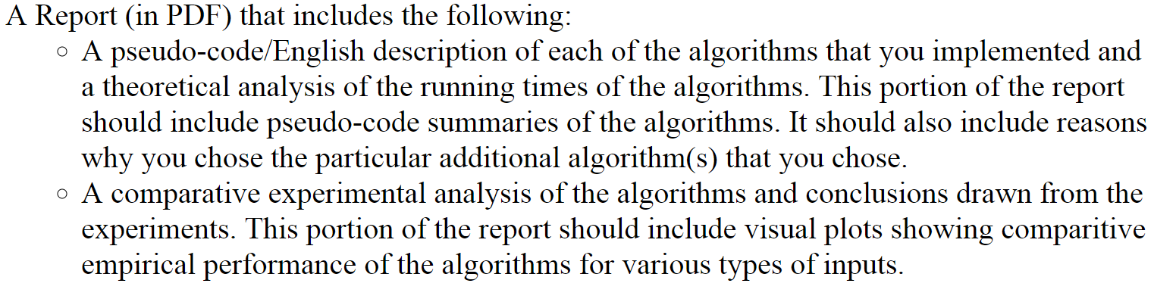
Hashing algorithms

Slide 4

Example
Test case is a randomly generated numbers. These are the keys. How to generate test case?
input = [83, 14, 29, 70, 10, 55]
Hash function: H(key) = key % 11
Better to select a prime a number with size of hashtable? What is a good size for hashtable?
Operations:
Set: efficiently in O(1)
Search: efficiently in O(1)
Delete: efficiently in O(1)

Slide 5
Linear probing
Test case: [83, 14, 29, 70, 10, 55, 72]
Hash function: H(k) = k % 11
Load factor = n/ N <=1
n = number of elements = 7
N = size of hashtable =11
Higher value of load factor => increasing in number of collision?
When a linear probing method fails?
What Delete method do you prefer to select? Eager or Lazy?
0 | 1 | 2 | 3 | 4 | 5 | 6 | 7 | 8 | 9 | 10
55 |  |  | 14 | 70 |  | 83 (collision72) | 29 | 72 |  | 10

Slide 6
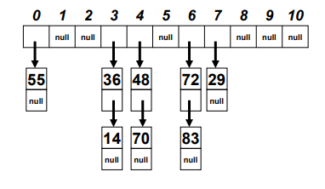
Hash Chaining
Test case: 36, 48, 72, 29, 55, 14, 70, 83
Hash function: H(k) = k % 11

Slide 7
Analysis
Load factor L = n / N
n = number of entries occupied in the hash table
N = number of buckets
Potential Questions in analysis:
The probability of a collision increases as the load factor increases?
Larger load factor makes hash table slower?
Plot average time for successful and unsuccessful search as a function of load factor?
Is it beneficial to have load factor near to zero?
Higher load factor => slower hashtable.
Lower load factor => wasted memory.
What are the advantaes and distadvantages of each of hashing algorithms?
Discuss the results based on your experiments.

