Slide 1
RENTKARO Online Rental System

Slide 2
Team Members
Navya Prabhu M
Shefali B S
Shreshta M Naik
Sreejitha N
Swarna
Yadavi

Slide 3
Introduction
The main objective of the project is to provide users a one stop rental portal.
It provides services such as hiring automobiles, furnitures and appliances.
Customers can view products based on the city.
Customers should register on the portal inorder to add the product to cart .

Slide 4
Problem Statement
Easy renting of products
Interactive approach to order products for rent!
Enables users to view and buy products based on city

Slide 5
Scope of the Project
This application will help users to find different categories of product in a single platform.
This application can be accessed easily.Easy to rent the products.
Application also provides users easy way to pay the bill through payment gateway.

Slide 6
Technology Stack Used
BackEnd
MySQL
Front End
HTML
CSS3
JQuery
JavaScript
Bootstrap 4
Angular 8
MiddleWare
Java 8.x
Spring 5.1.9
Spring Boot 2.1.8
Eureka Discovery Client
Feign Client 1.2.6
Hibernate
JPA
Lombok

Slide 7
Database Architecture

Slide 8
category
city
mycart
id: int
categoryid: String
category: String
id: int
cityid: String
city: String
id: int
customerid: String
productid: String quantity: int
customer
product
id: int
customerid: String
customername: String
customeremail: String
customercontact: String
customerpassword: String
customeraddress: String
customergender: String
customerwallet: int
id: int
orderid: String
customerid: String
productid : String quantity: int
id: int
productid: String
productname: String
productcategory: String
productsubcategory: String
productdescription: String
productquantity: int
productprice: int
productavailability: tinyint
productimage: String
categoryid: String
cityid: String
orders

Slide 9
Angular Architecture

Slide 10
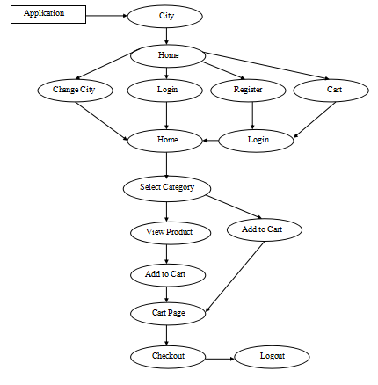

Slide 11
Microservice Architecture

Slide 12
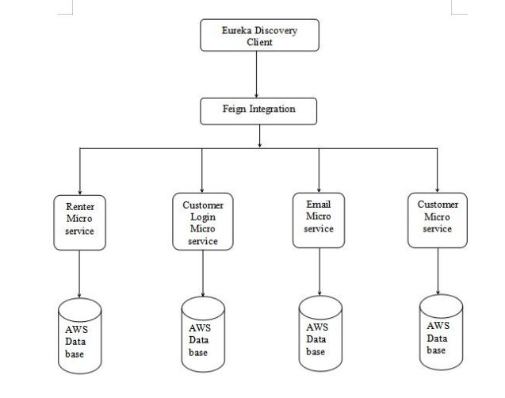

Slide 13
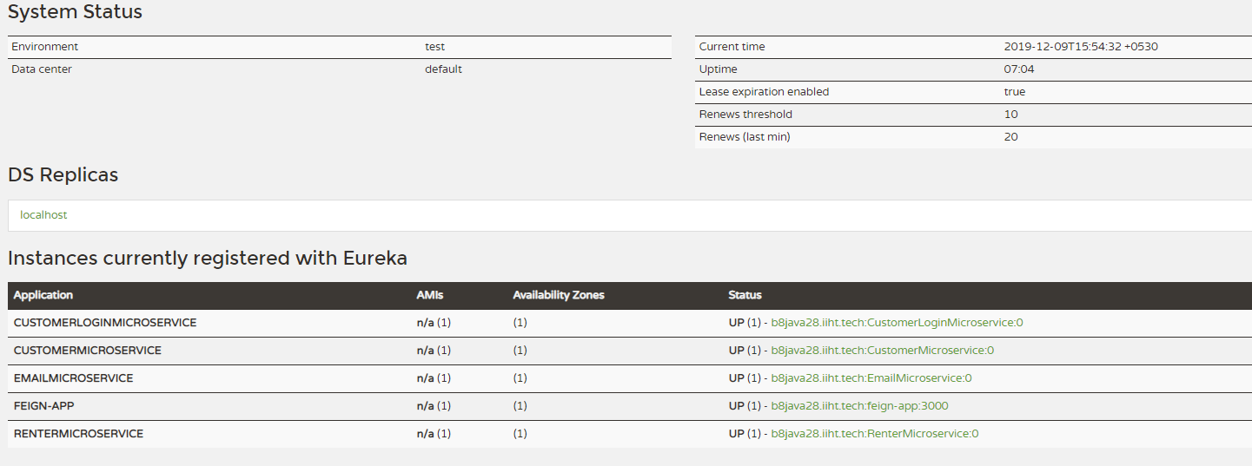
Microservices

Slide 14
Deployment
Amazon Web Services
Pivotal Cloud Foundry

Slide 15
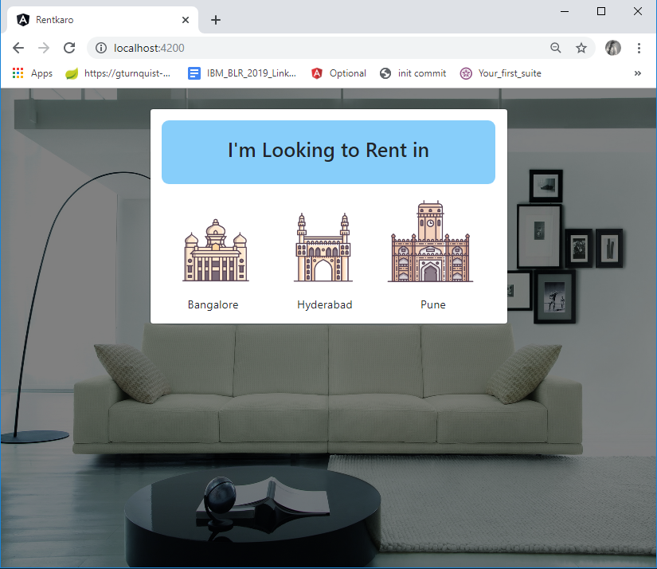
Demo

