Slide 1



Statistics for biological data
Statistics summary
Aya Elwazir
Teaching assistant of medical genetics, FOMSCU
PhD student, University of Sheffield

Slide 2
Types of data
Numeric
Categorical
Continuous
Discrete
Nominal
Ordinal

Slide 3
Categorical variables
1
2
3
Contingency table
Descriptive statistic
Significance tests
Variable1 in rows
Variable2 in columns
Cell count
>5
Chi square
no (%)
<5
Fisher Exact
 |  | Categorical Var. 2
 |  | Group 1 | Group 2
Categorical Var. 1 | Group 1 | no (%) | no (%)
 | Group 2 | no (%) | no (%)
P value
XX

Slide 4
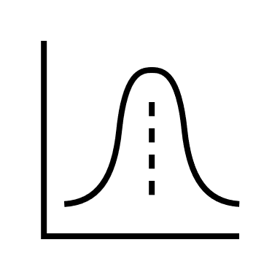

Numeric variables
1
Plots
Histogram
Q-Q plot
Boxplot
Tests
Shapiro-Wilk W
Anderson-Darling
Kolmogorov-Smirnov
Test for
normality
2
Select
descriptive
statistic
Normal
Not Normal
Mean ± SD
Median (IQR)
3
Select
significance
test
≤2 groups
t-test
Wilcoxon
> 2 groups
ANOVA
Kruskal Wallis

