Slide 1

Sheffield Hackspace
But what is a Hackspace ?

Slide 2


A Hacker the Media Myth
Black Hat Hacker
Bad
Doing
Good
Versus
Good
Doing
Bad
White Hat Hacker

Slide 3
Profile of a Hacker
Self Starter.
Subject enthusiast.
Personal learning journey.
Practices the subject.
Usually becomes proficient in the chosen subject.
Promotes the subject.
Loves to share the results of the journey.
Is interested in sharing the results of others journeys.
So what has a Hackspace got to do with this ?

Slide 4
Profile of a Hackspace
A communal workspace for hackers.
Sustainable through subscription.
Not for profit.
Run by members for members.
Do-ocracy.
Shared tooling and making opportunities.
Pooled acquisition of materials, tooling and more space.
Skills exchange.
Show & Tell.
Social opportunities.
How was the Journey ?

Slide 5
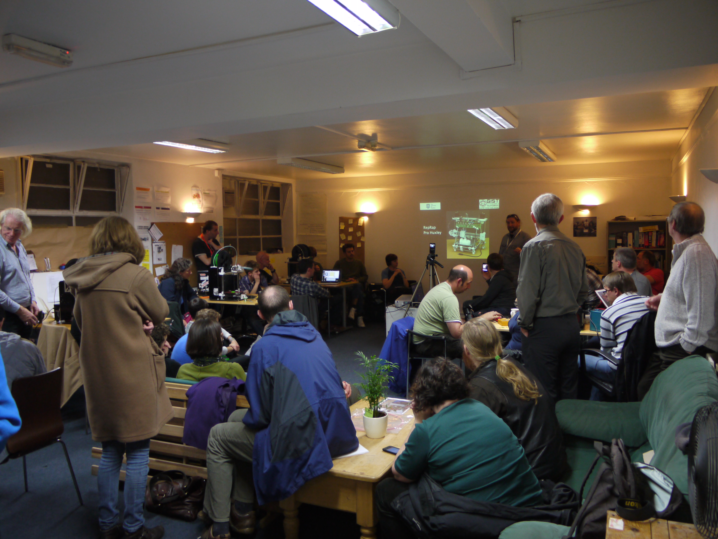
Workstation Years
FoTM 2012

Slide 6
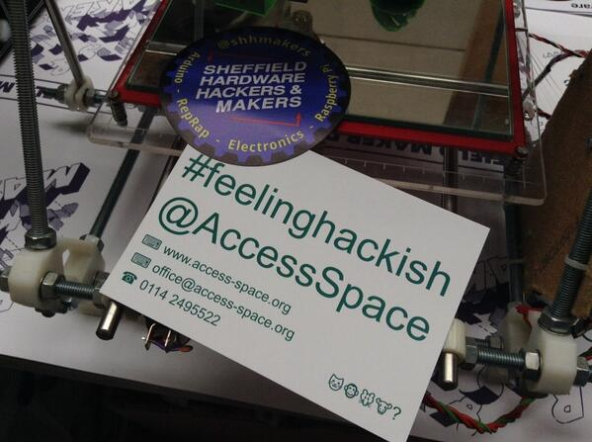
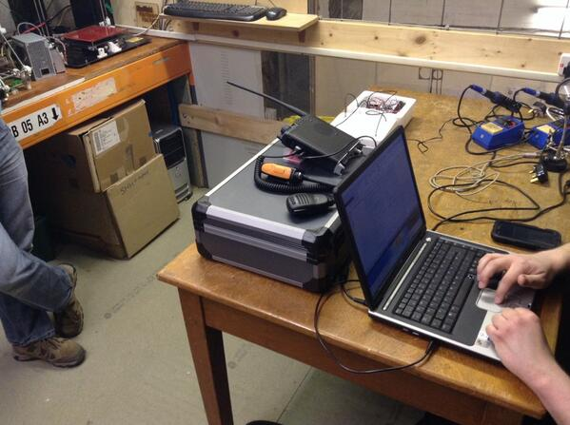
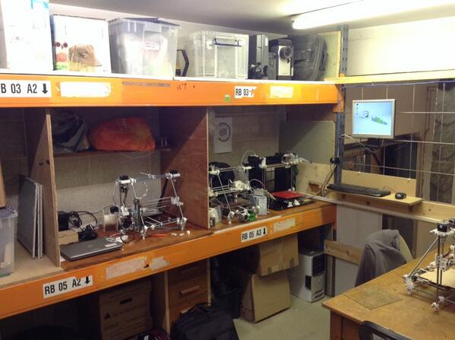
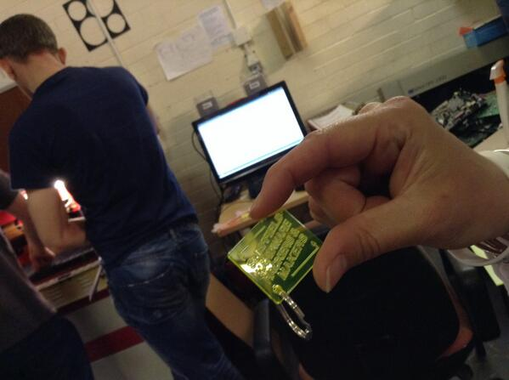
Access Space Years
http://access-space.org/

Slide 7
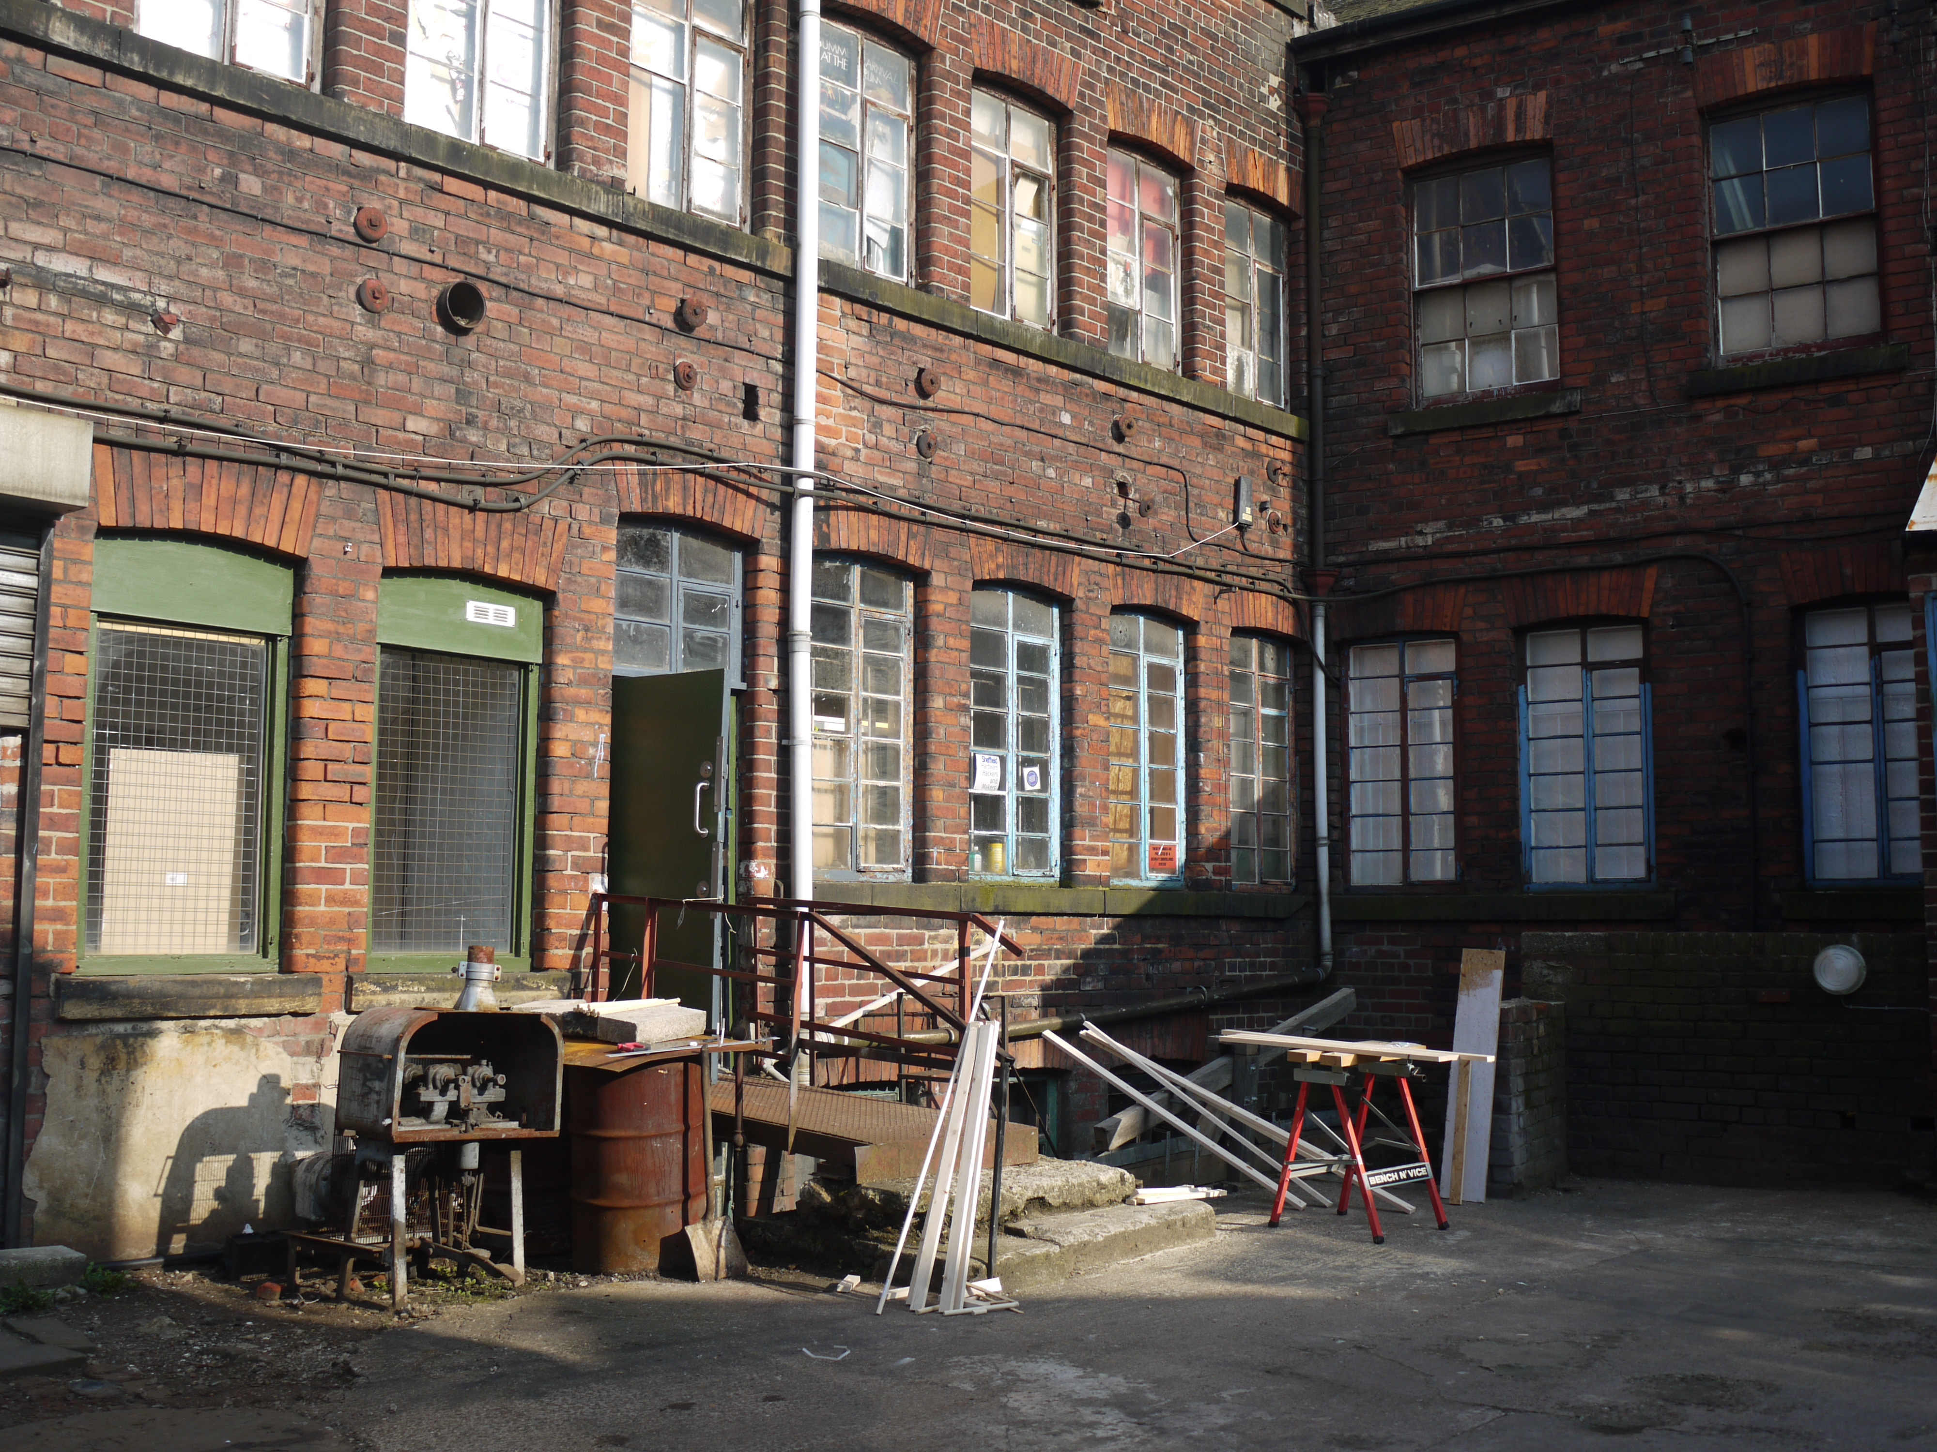
Birth of a Hackspace
Unit 2D2, Portland Works

Slide 8
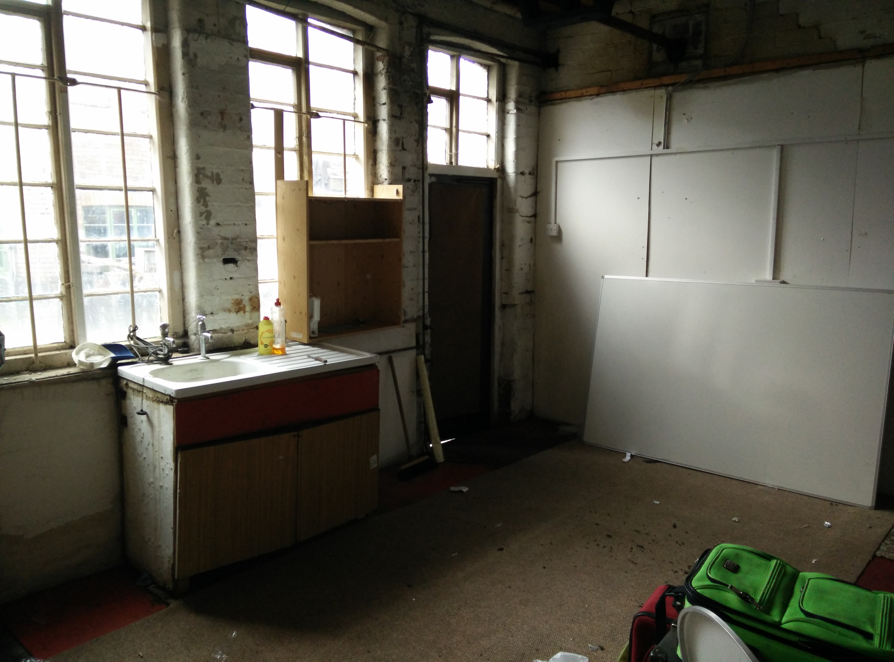
Then

Slide 9
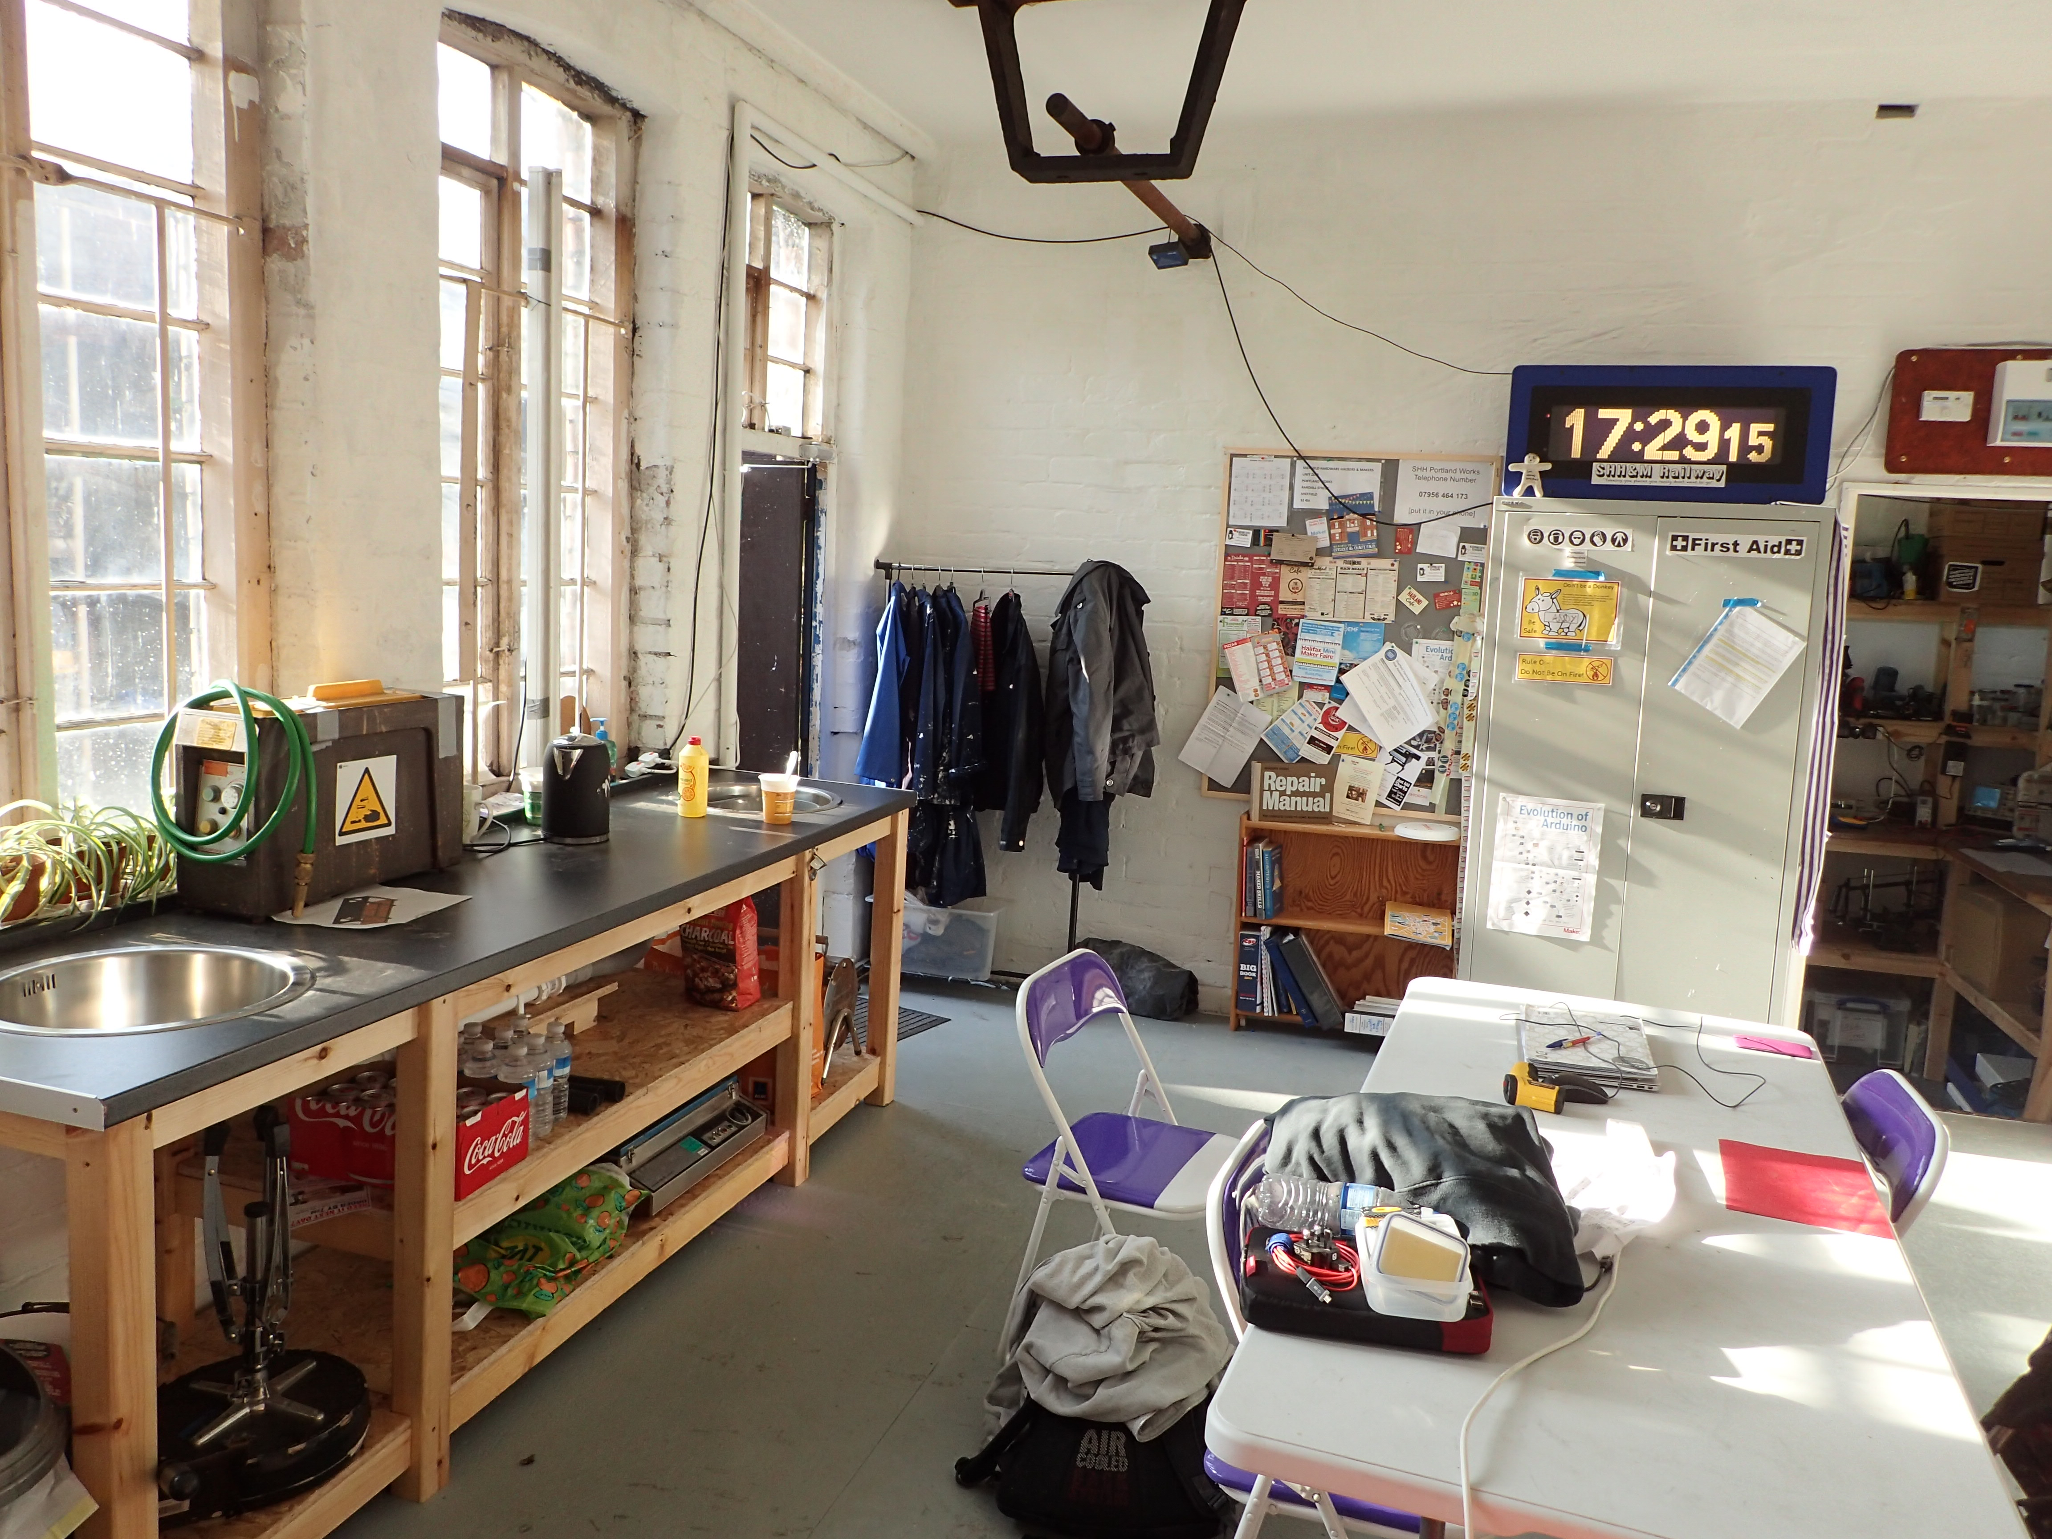
Now

Slide 10
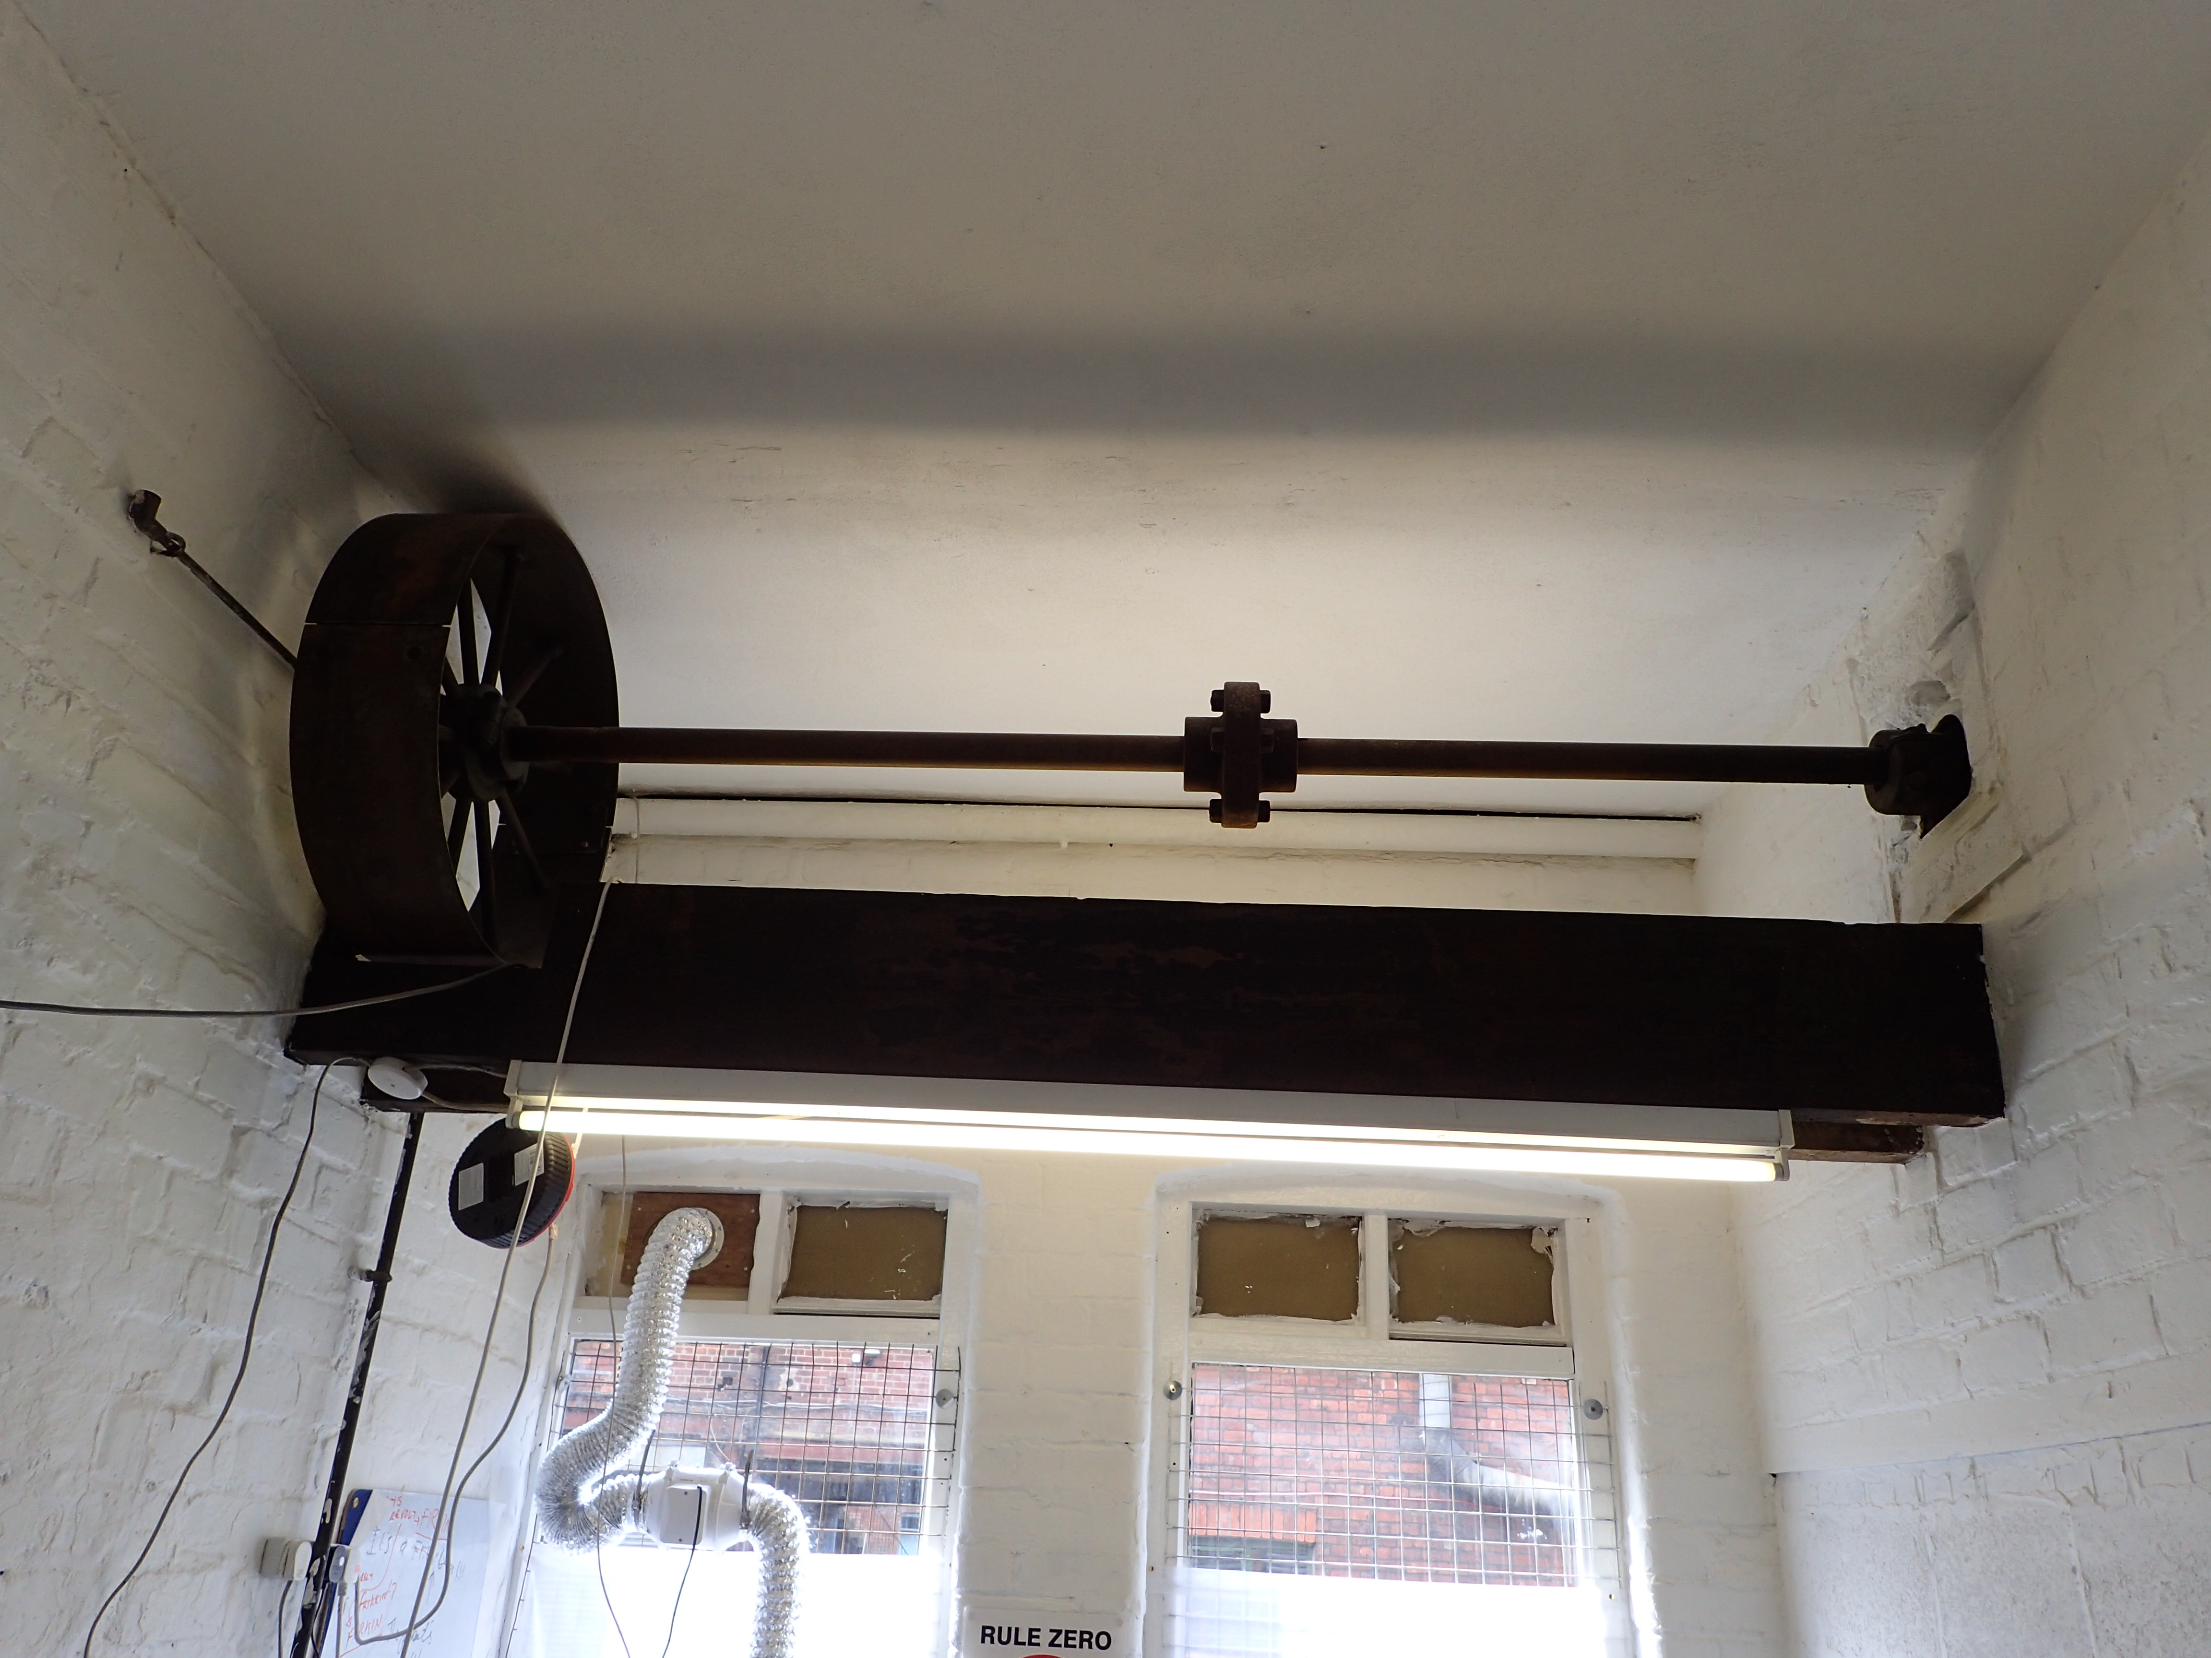
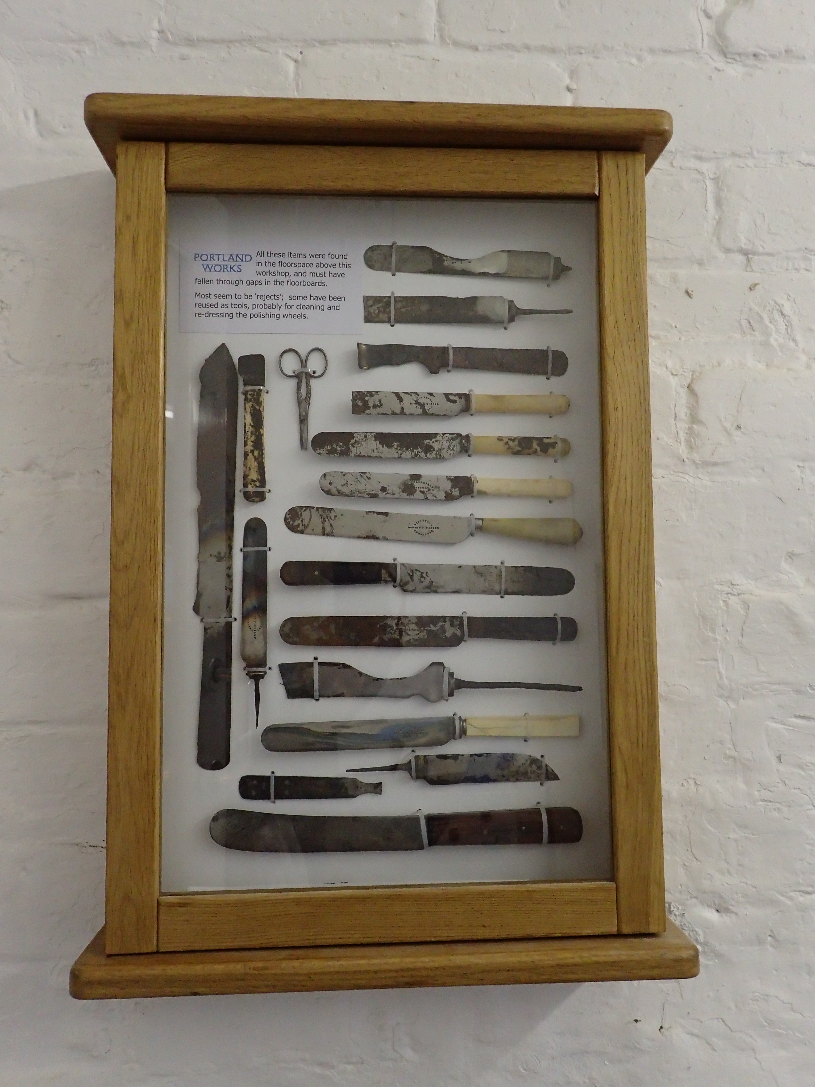
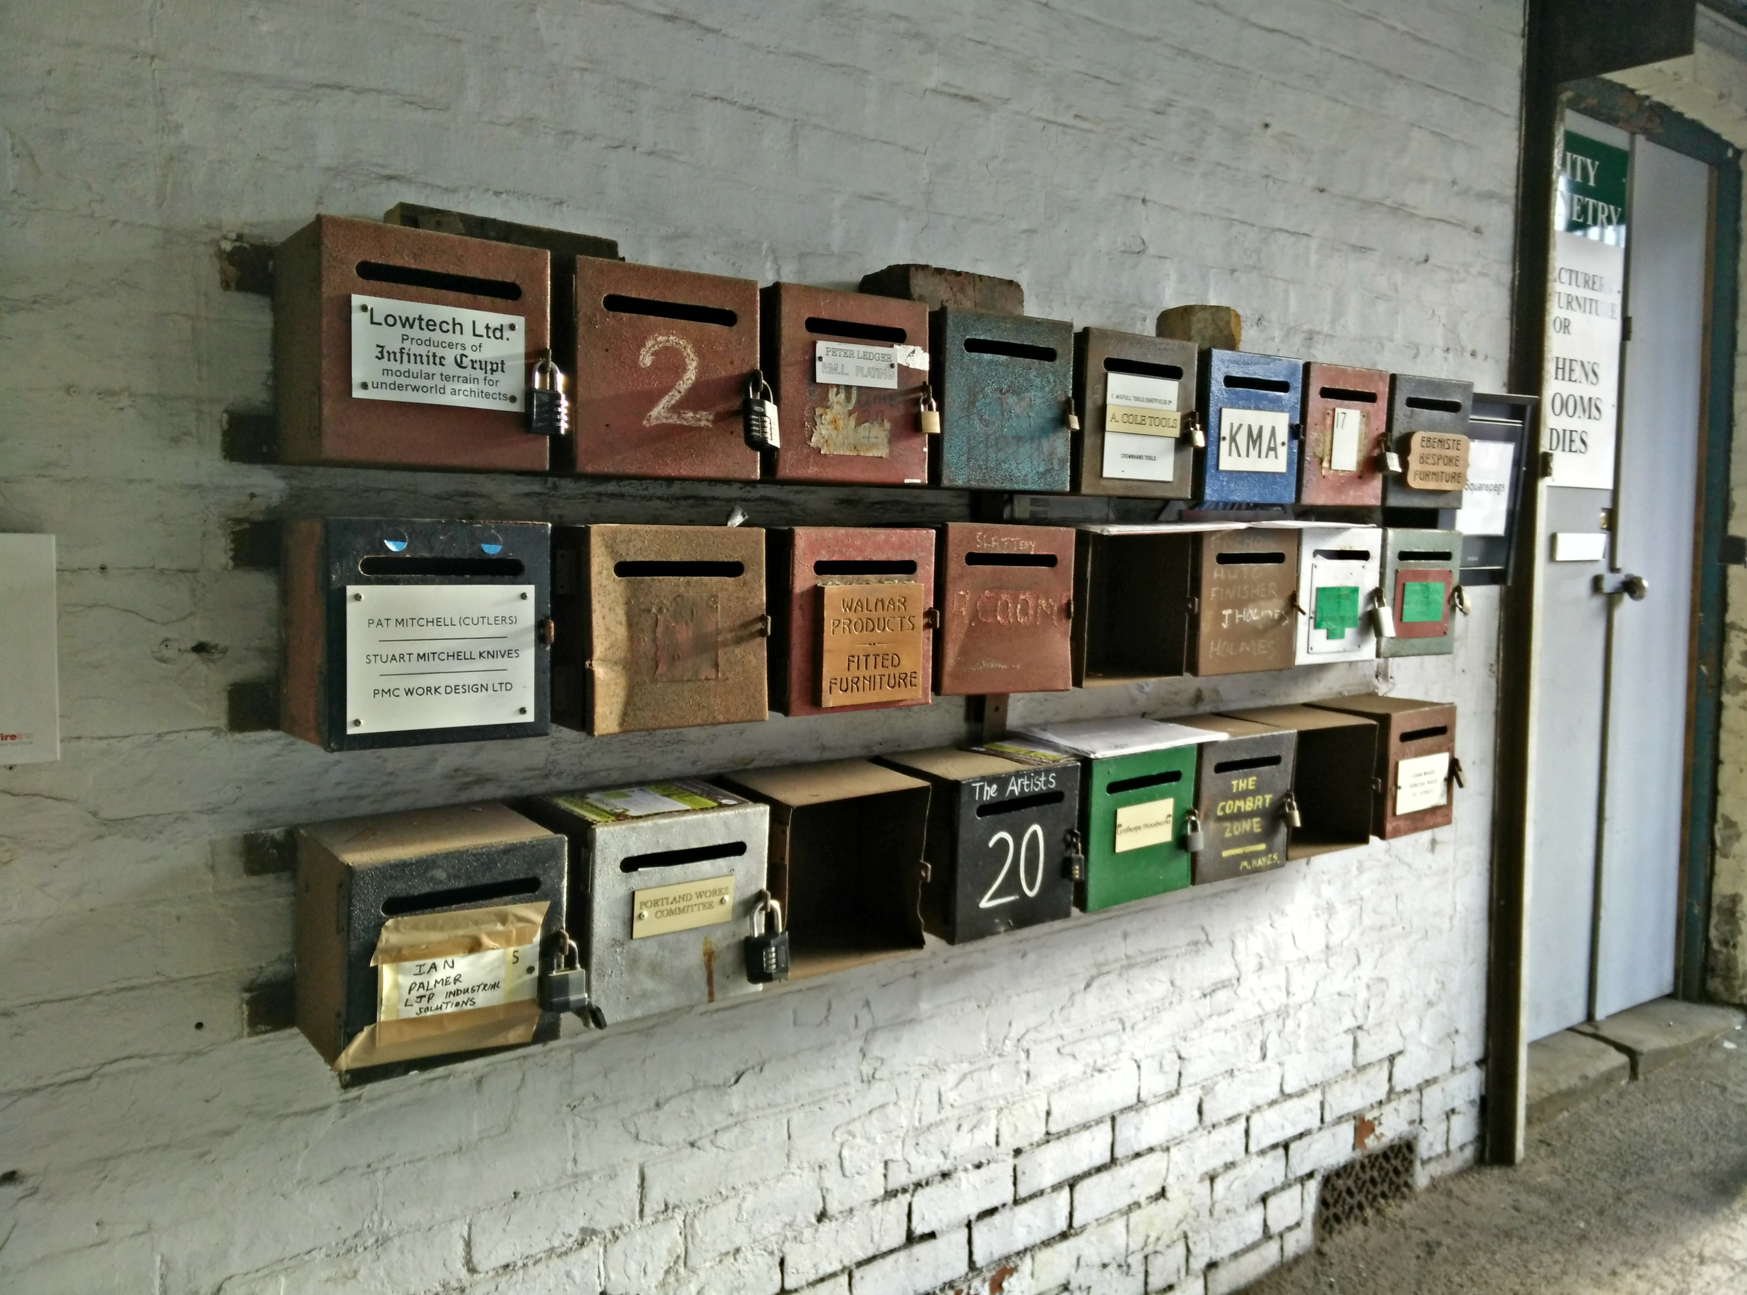
Treasure
http://www.portlandworks.co.uk/

Slide 11
Group Projects
Space Automation (SHHNoT)
Hacking the Space
High Altitude Ballooning
Environmental Monitoring
Outernet Link
Full Mesh WIFI Networking (Freifunk)
CNC tool builds (Laser, Router, Refurbs)

Slide 12
Individual Projects
Cabinet Making
NoT Coding
RfID Door Entry System
Home Automation
Repair, Reuse, Recycling
Textiles
PCB Making
Food Tech
Metal Working
Wood Working
High Voltage (Tesla Coil etc)
Radio Telemetry
Hybrid Projects
Software Defined Radio
RF Construction
Furniture Making
Electro Etching
Embedded engineering
3D Printing
Robotics

Slide 13
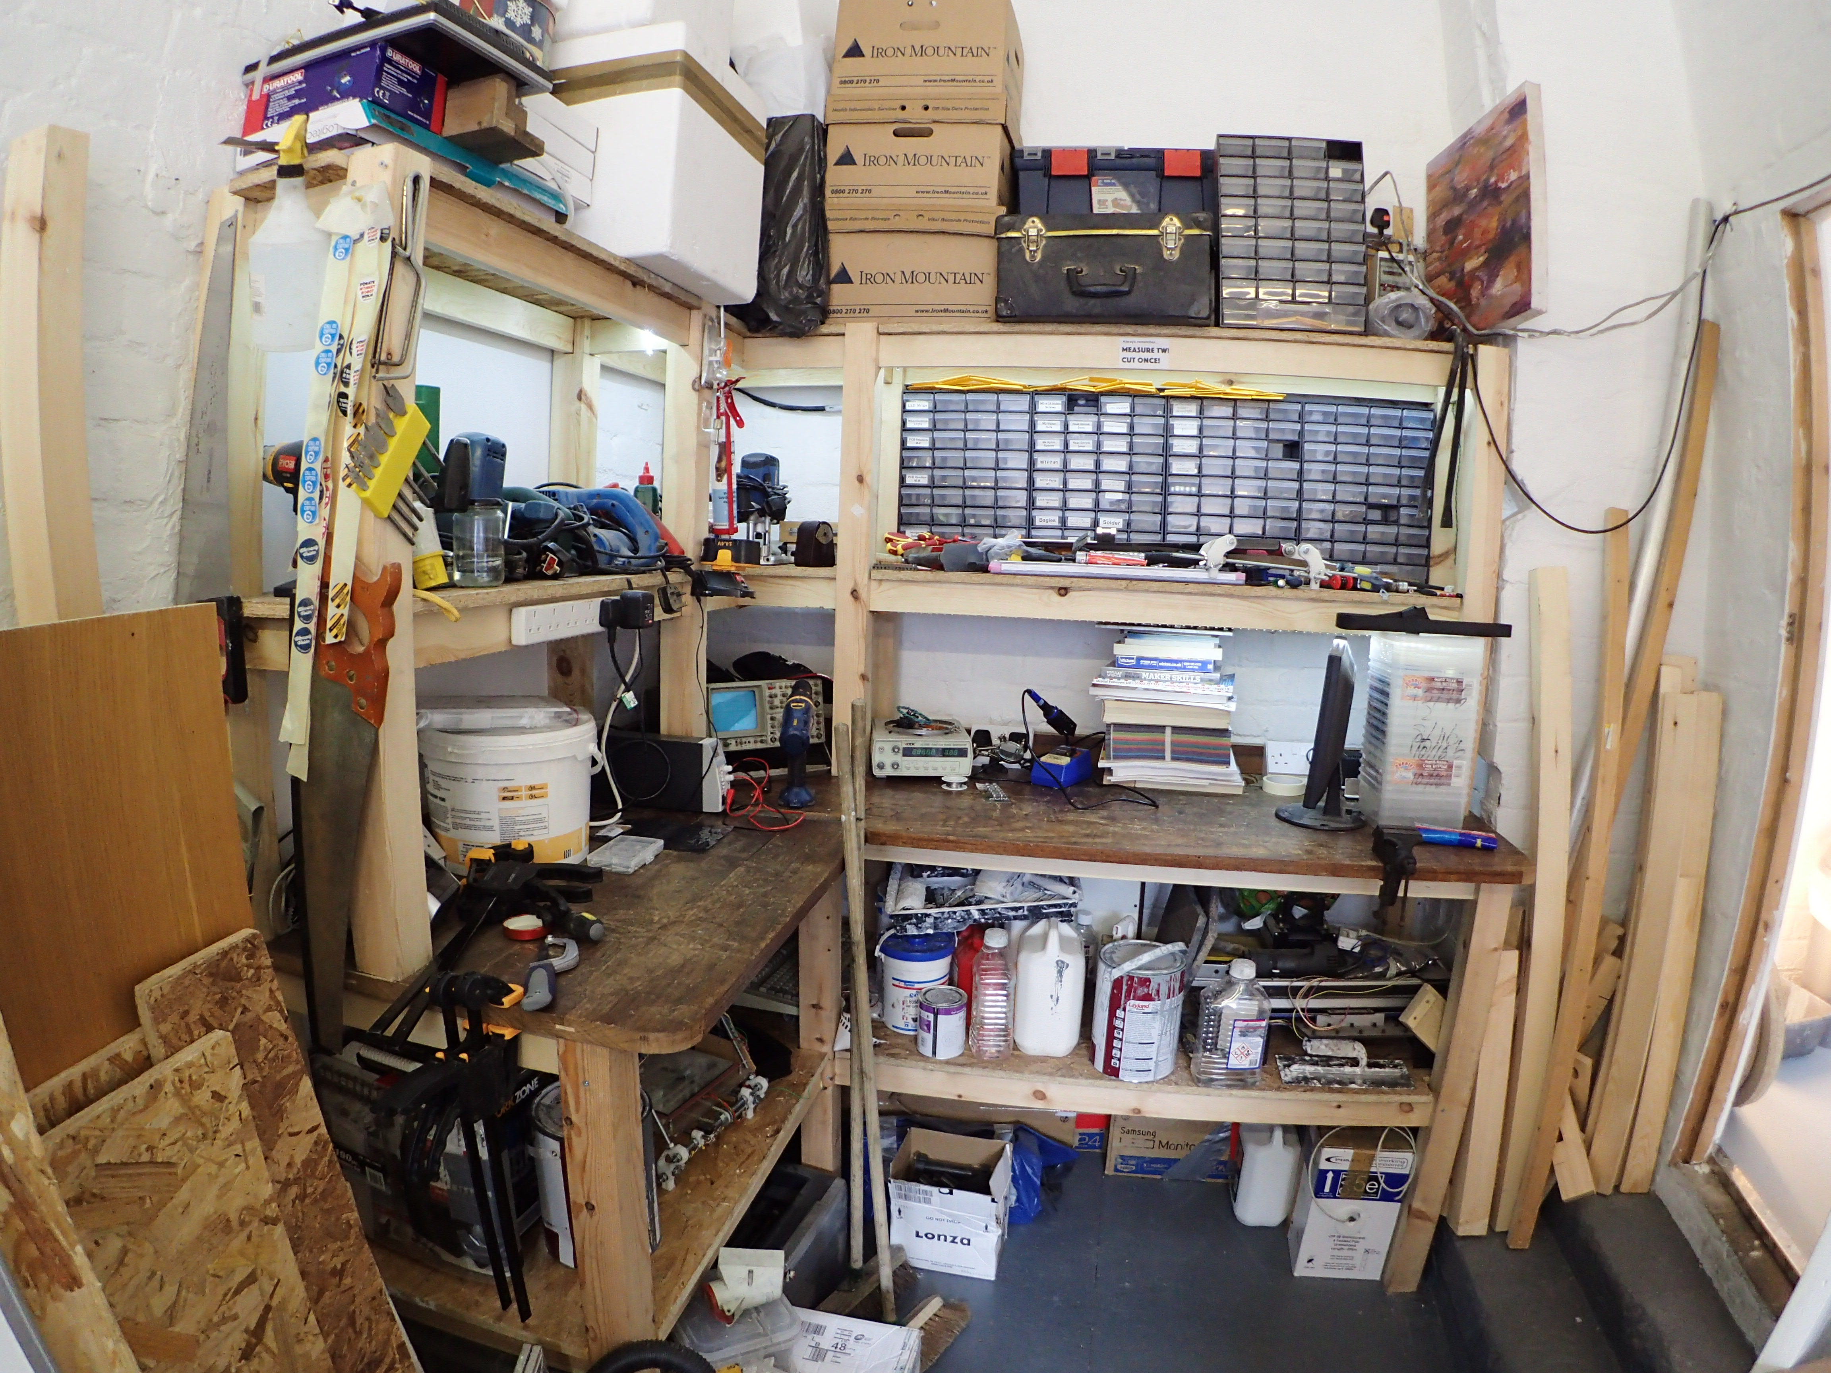
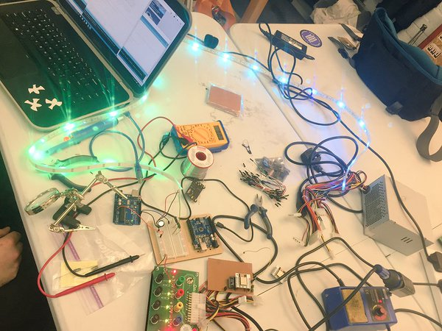
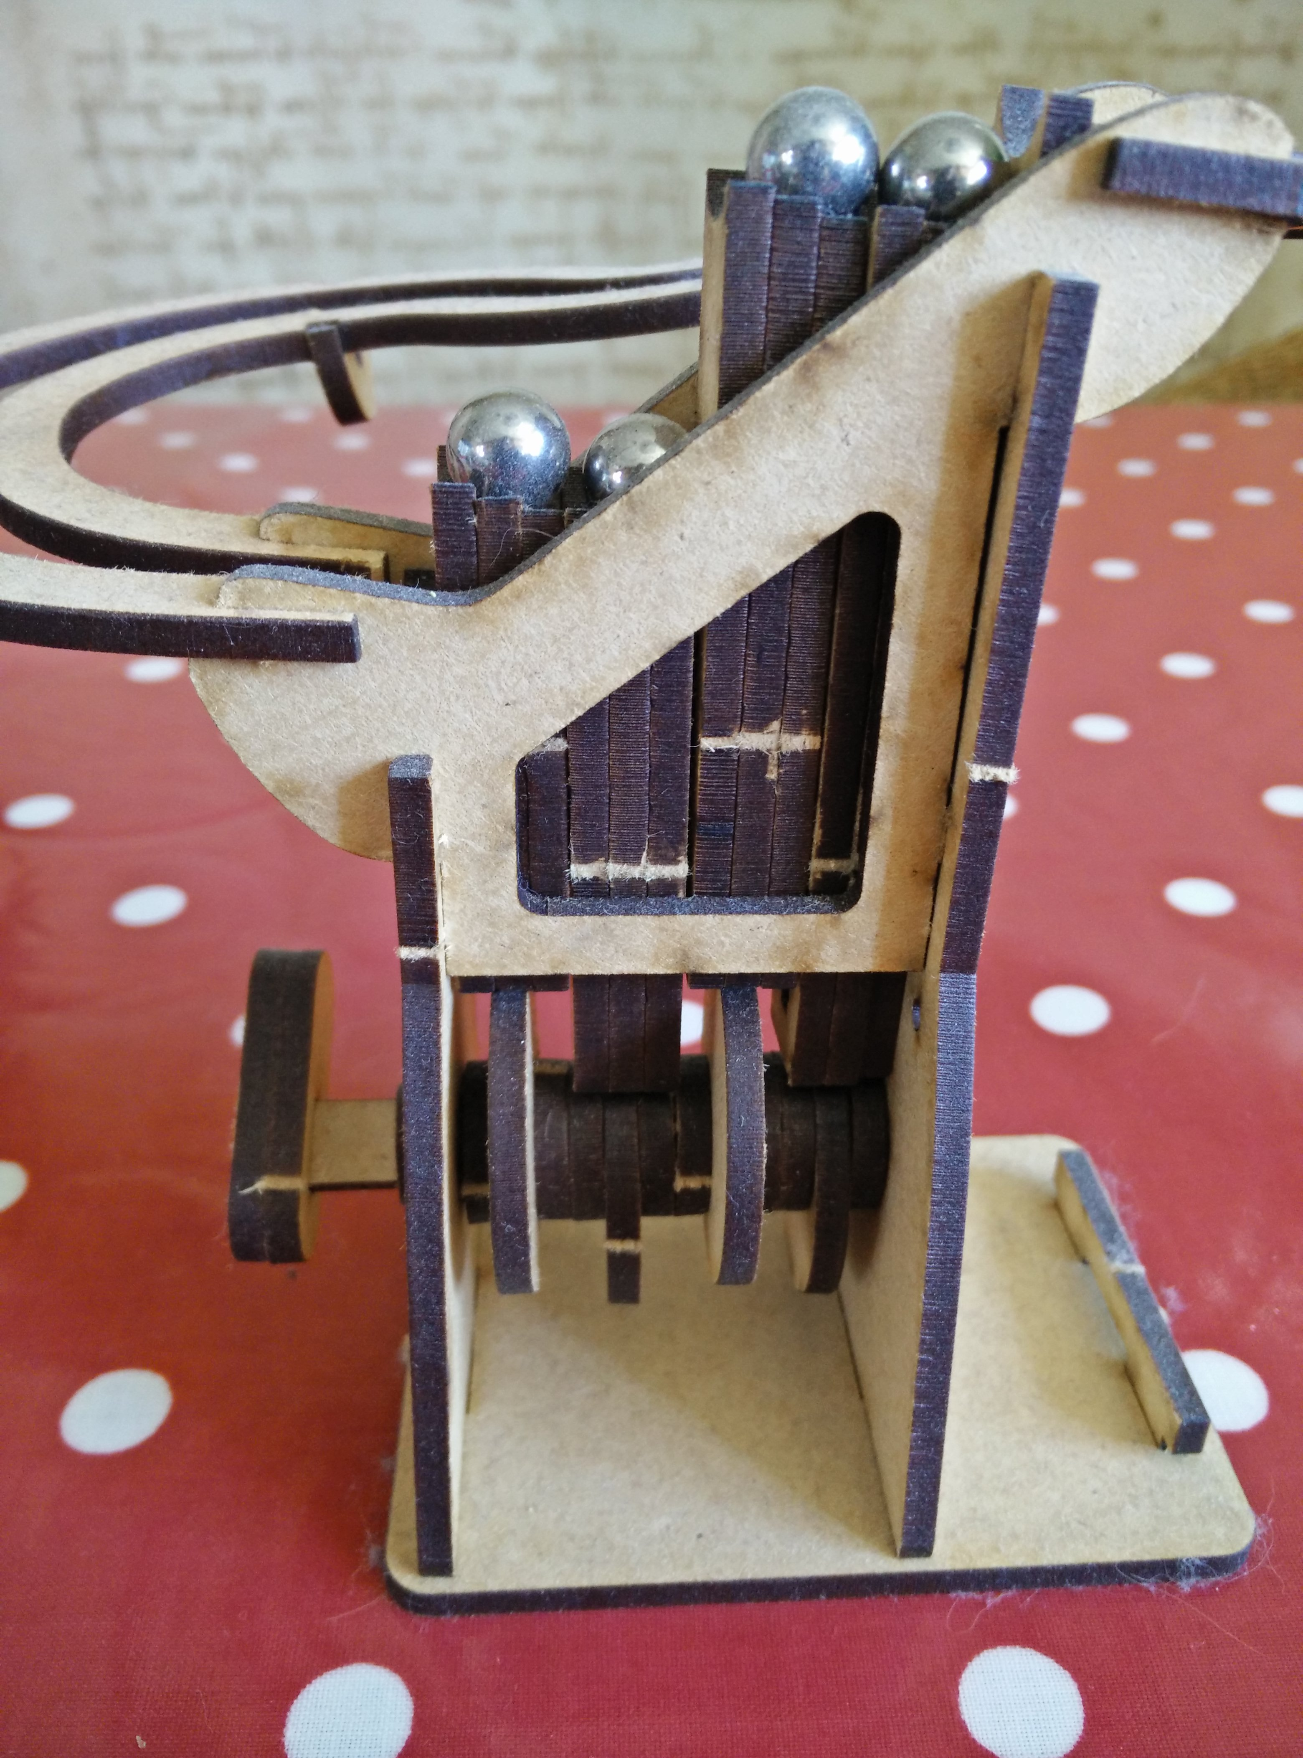
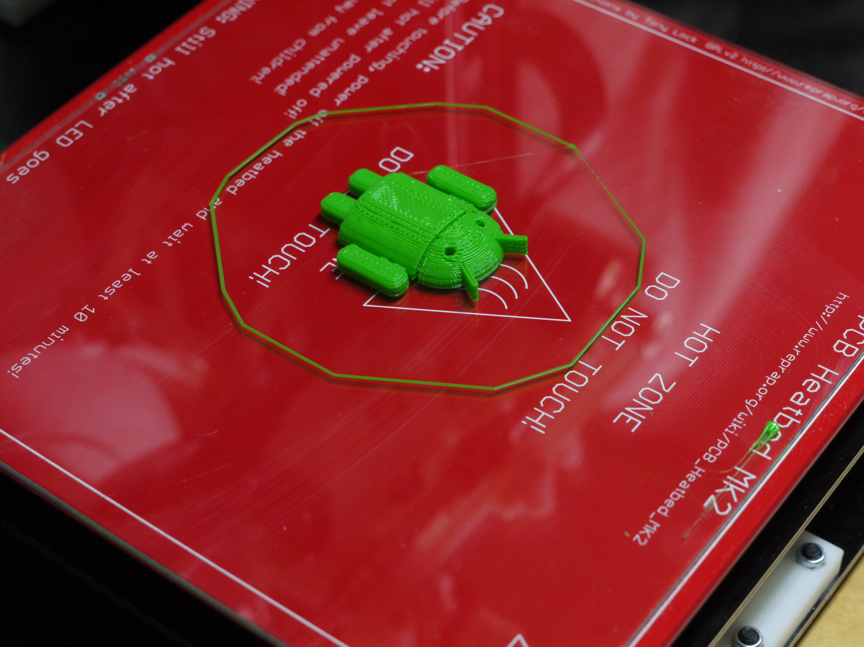
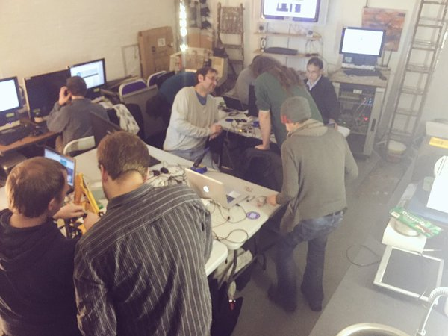
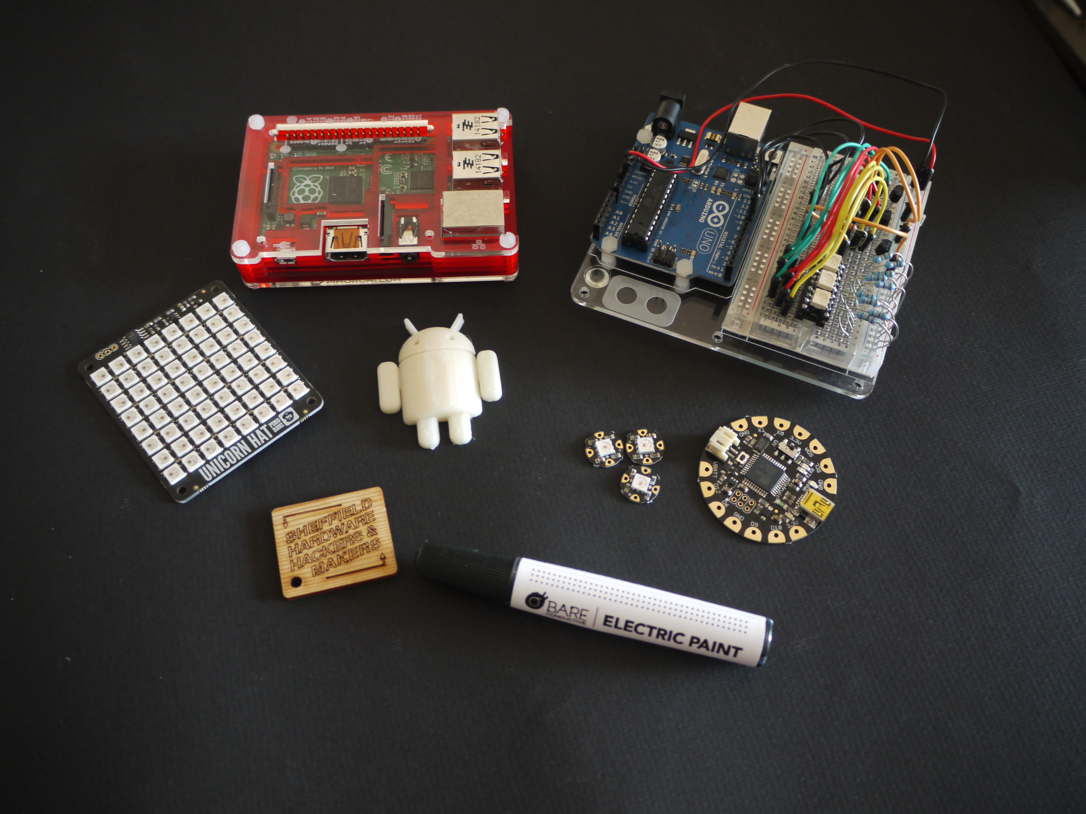
Show & Tell

Slide 14
Outreach
Festival of the Mind (UoS)
Sheffield Mini Maker Fair
Halifax Mini Maker Fair
Derby Maker Fair
Newcastle Maker Fair
Electro Motive Fields
Make:Shift:Do (V&A)
Portland Works Open Days
Workshops, Presentations, Tutorials
Kids Coding
Social Media (Twitter, Facebook etc)
Hackspace Visits

Slide 15

Thankyou For Listening
Q&A

