Slide 1
Y2K
Nate Sheffield, Nathan Critchfield
ECE 5780

Slide 2
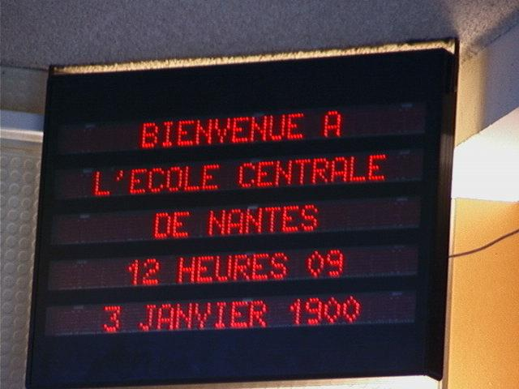
Background – The Millenium Bug
A technique used to save space in files and databases
Stored only the last two digits of the year instead of the entire thing
First publicly addressed by Bob Bemer in 1958
Continued primarily unresolved until the mid-1990s
Notes:
Critchfield

Slide 3
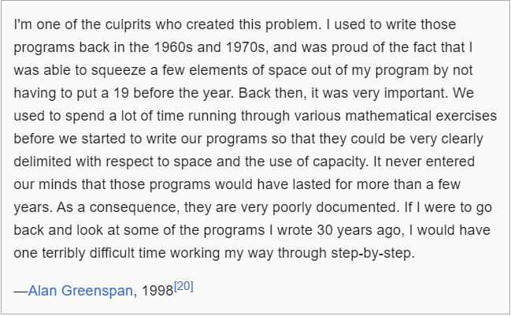
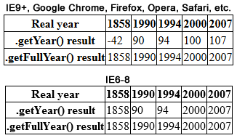
Background – Technical Problem
In the 60s core memory cost $1 per bit
Popular computers shipped with as little as 2 kilobytes of memory
Notes:
Critchfield

Slide 4

Fears
Some stocked up on food, water, and firearms, purchased backup generators, and withdrew large sums of money in anticipation of a computer-induced apocalypse.
Cause massive power outages
Shut down power plants and nuclear reactors
Corrupt databases
Shut down transportation systems
Shut down banking systems
Cause widespread chaos
Notes:
Sheffield

Slide 5
Upgrade Solutions
Date Expansion
Two-digit years were expanded to four-digits to include the century.
Permanent solution but costly to test and convert systems.
Date Windowing
Two-digit years were retained, and programs determined the century value only when needed
Required installing small patches of code into programs, was simpler to test and implement.
Date Compression
Dates can be compressed into binary 14-bit numbers. Allows retention of data structure alignment.
Using integer value for century, can represent 16384 different years.
Real Time Clock Upgrades
Other fixes worked at the BIOS level as TSRs (Terminate and Stay Resident), intercepting BIOS calls.
Y2000RTC worked as a device driver and replaced the functionality of the faulty RTC with a compliant equivalent.
Date Re-Partitioning
In legacy databases whose size could not be economically changed, six-digit year/month/day codes were converted to three-digit years
1999 represented as 099 and 2001 represented as 101 and three-digit days (ordinal date in year).
This delays the eventual roll-over problem to the end of the year 2899.
Notes:
Sheffield
Date expansion
Two-digit years were expanded to include the century (becoming four-digit years) in programs, files, and databases. This was considered the "purest" solution, resulting in unambiguous dates that are permanent and easy to maintain. This method was costly, requiring massive testing and conversion efforts, and usually affecting entire systems.
Date windowing
Two-digit years were retained, and programs determined the century value only when needed for particular functions, such as date comparisons and calculations. This technique, which required installing small patches of code into programs, was simpler to test and implement than date expansion, thus much less costly.
Date compression
Dates can be compressed into binary 14-bit numbers. This allows retention of data structure alignment, using an integer value for years. Such a scheme can represent 16384 different years; the exact scheme varies by the selection of epoch.
Real Time Clock Upgrades
One unique solution found prominence. While other fixes worked at the BIOS level as TSRs (Terminate and Stay Resident), intercepting BIOS calls, Y2000RTC was the only product that worked as a device driver and replaced the functionality of the faulty RTC with a compliant equivalent. This driver was rolled out in the years before the 1999/2000 deadline onto millions of PCs.
Date re-partitioning
In legacy databases whose size could not be economically changed, six-digit year/month/day codes were converted to three-digit years (with 1999 represented as 099 and 2001 represented as 101, etc.) and three-digit days (ordinal date in year). Only input and output instructions for the date fields had to be modified, but most other date operations and whole record operations required no change. This delays the eventual roll-over problem to the end of the year 2899.

Slide 6
Upgrade Problems
In late 1998, Commonwealth Edison reported a computer upgrade caused them to send the village of Oswego, Illinois an erroneous electric bill for $7 million.
On 8 February 1999, while testing Y2K compliance in a computer system monitoring nuclear core rods at Peach Bottom Nuclear Generating Station, Pennsylvania, instead of resetting the time on the external computer meant to simulate the date rollover a technician accidentally changed the time on the operation systems computer. This computer had not yet been upgraded, and the date change caused all the computers at the station to crash. It took approximately seven hours to restore all normal functions, during which time workers had to use obsolete manual equipment to monitor plant operations.
In December 1999, in the United Kingdom, a software upgrade intended to make computers Y2K compliant prevented social services in Bedfordshire from finding if anyone in their care was over 100 years old, since computers failed to recognize the dates of birth being searched.
On 31 December, as a direct result of a patch intended to prevent the Y2K glitch, computers at a ground control station in Fort Belvoir, Virginia crashed and ceased processing information from five spy satellites, including three KH-11 satellites. All normal functionality was restored on 2 January 2000.
Notes:
Sheffield
Overall, there were not many problems with the Y2K upgrades but there were some issues.

Slide 7
Effects of the Bug
Contrary to published expectations, few major errors occurred in 2000.
the US Naval Observatory, which runs the master clock that keeps the country's official time, gave the date on its website as 1 Jan 19100.
Microsoft reported that, after the year rolled over, Hotmail e-mails sent in October 1999 or earlier showed up as having been sent in 2099, although this did not affect the e-mail's contents or the ability to send and receive e-mails.
In New York, a video store accidentally generated a $91,250 late fee because the store computer determined a tape rental was 100 years overdue.
There have been similar glitches reported to other instances of date overflow including the destruction of NASA’s Deep Impact spacecraft in 2013
Notes:
Critchfield

Slide 8
Over vs Under Preparation
Overpreparation
The US government followed a three-part approach to the problem: (1) outreach and advocacy, (2) monitoring and assessment, and (3) contingency planning and regulation.
Supporters believe that many problems were fixed correctly, and the money spent was at least partially justified. The lack of problems reflects the completeness of the project, and that many computer applications would not have continued to function into the 21st century without correction or remediation.
Expected problems that were not seen by small businesses and small organizations were prevented by Y2K fixes embedded in routine updates to operating system and utility software.
Federal spending estimated at $7.5 billion and corporate spending estimated at $121.96 billion.
Under Preparation
Critics argued that even in countries where very little had been done to fix software, problems were minimal. The same was true in sectors such as schools and small businesses where compliance with Y2K policies was patchy at best.
Countries such as South Korea, Italy, and Russia invested little to nothing in Y2K remediation, yet had the same negligible Y2K problems as countries that spent enormous sums of money.
International Data Corporation estimated that the US might have wasted $40 billion.
Notes:
Sheffield

Slide 9
Things They Should Have Done Differently
Originally make the date four-digits.
Spend the extra money for the additional bytes of memory to make the systems future proof.
Assume that your system will last more than a few year.
Notes:
Sheffield

Slide 10
Questions?

Slide 11
References
https://en.wikipedia.org/wiki/Year_2000_problem
https://guides.loc.gov/this-month-in-business-history/january/y2k#:~:text=Federal%20spending%20was%20estimated%20to,came%20in%20at%20%24121.96%20billion.&text=Final%20estimates%20globally%20did%20not,%24134%20billion%20in%20the%20U.S.
https://education.nationalgeographic.org/resource/Y2K-bug/
https://americanhistory.si.edu/collections/object-groups/y2k

