Slide 1
AI SOLUTION PROPOSAL
Reducing Outpatient Wait Times
with Predictive AI
Prepared for Mindtone Mental Health Clinic
Client Presentation · Task 5 Final Project

Slide 2
AGENDA
What we'll cover today
01
02
03
The challenge
Business impact
Our AI solution
Current wait times & root causes
What long waits cost the clinic
How predictive scheduling works
04
05
06
Prototype results
Architecture & tech
Plan & investment
Model accuracy & projected impact
How it fits your clinic
Timeline, cost, risk
Mindtone Mental Health Clinic
2

Slide 3
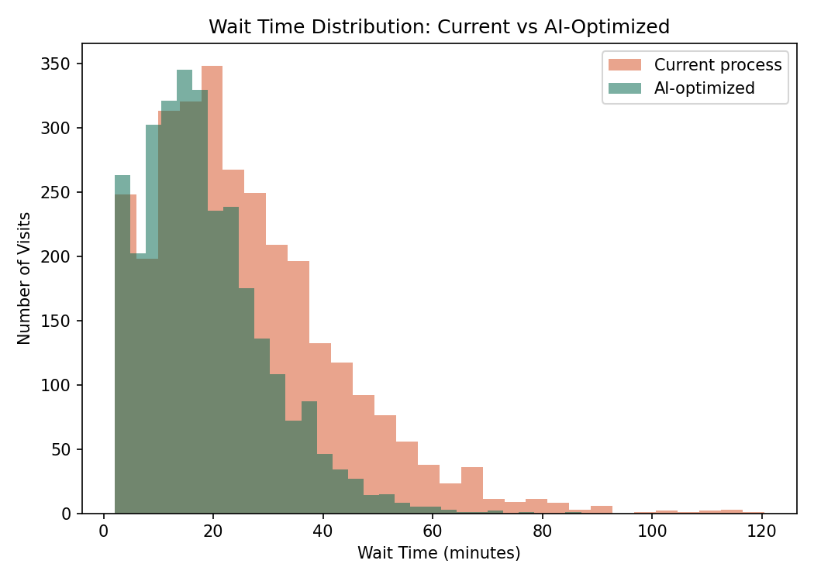
THE CHALLENGE
Patients are waiting too long, today
26.0 min
49.0 min
~20%
+40%
Average wait time
90th-percentile wait
Walk-in share
Peak-hour wait vs. off-peak
across all departments
1 in 10 patients wait this long
highest source of queue disruption
midday & late afternoon
Source: 6-month analysis of 2,976 outpatient visit records at Mindtone.
Wait-time distribution today: a long tail of 45–90+ minute waits drives complaints and no-shows.
Mindtone Mental Health Clinic
3

Slide 4
WHY IT'S HAPPENING
Five root causes behind the delay
1
Static scheduling
Slots assume a fixed consultation length, regardless of doctor or department.
2
Unmanaged walk-ins
Walk-ins are inserted into the queue with no load-aware routing.
3
Peak-hour concentration
Bookings cluster at midday and late afternoon, creating predictable bottlenecks.
4
No live visibility
Neither staff nor patients can see a real-time wait estimate.
5
Manual, reactive staffing
Front-desk staffing is fixed, not adjusted to predicted daily load.
Mindtone Mental Health Clinic
4

Slide 5
BUSINESS IMPACT
What long waits are costing the clinic
Patient experience
No-shows & abandonment
Staff strain
Long, unpredictable waits are the #1 complaint in patient feedback.
Patients leave unseen when they can't see a live wait estimate.
Front-desk and clinical staff absorb the pressure of an unmanaged queue.
Revenue leakage
Competitive exposure
Every unseen or non-rebooking patient is lost revenue and lost outcomes.
Newer clinics offering live wait visibility are a growing threat.
Mindtone Mental Health Clinic
5

Slide 6
OUR SOLUTION
An AI-powered outpatient flow assistant
Purpose-built for Mindtone's Psychiatry, Counseling, and Addiction Therapy departments.
Predict
Optimize
Inform
Wait-time prediction engine
Queue & load optimizer
Patient & staff dashboards
Estimates each patient's expected wait in real time, using queue depth, staffing, and doctor pace.
Routes walk-ins to the least-loaded doctor and proactively smooths peak-hour bottlenecks.
Shows live wait estimates and queue health to patients, front desk, and clinicians.
Mindtone Mental Health Clinic
6

Slide 7
HOW IT WORKS
From check-in to consultation
1
2
3
4
Patient checks in
Model predicts wait
Optimizer rebalances
Patient is informed
App, kiosk, or front desk
Real-time inference from live queue data
Walk-ins routed, peak hours smoothed
Live wait estimate + SMS/app updates
The same feedback loop retrains the model on a rolling schedule as new outcomes are logged, so accuracy keeps improving.
Mindtone Mental Health Clinic
7

Slide 8
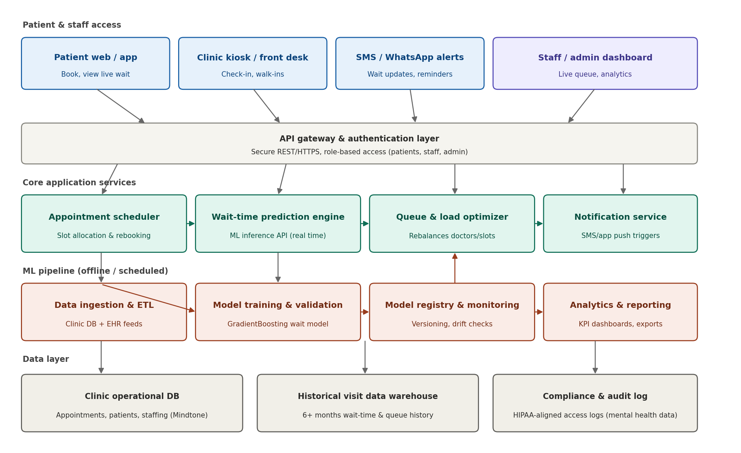
UNDER THE HOOD
System architecture
Mindtone Mental Health Clinic
8

Slide 9
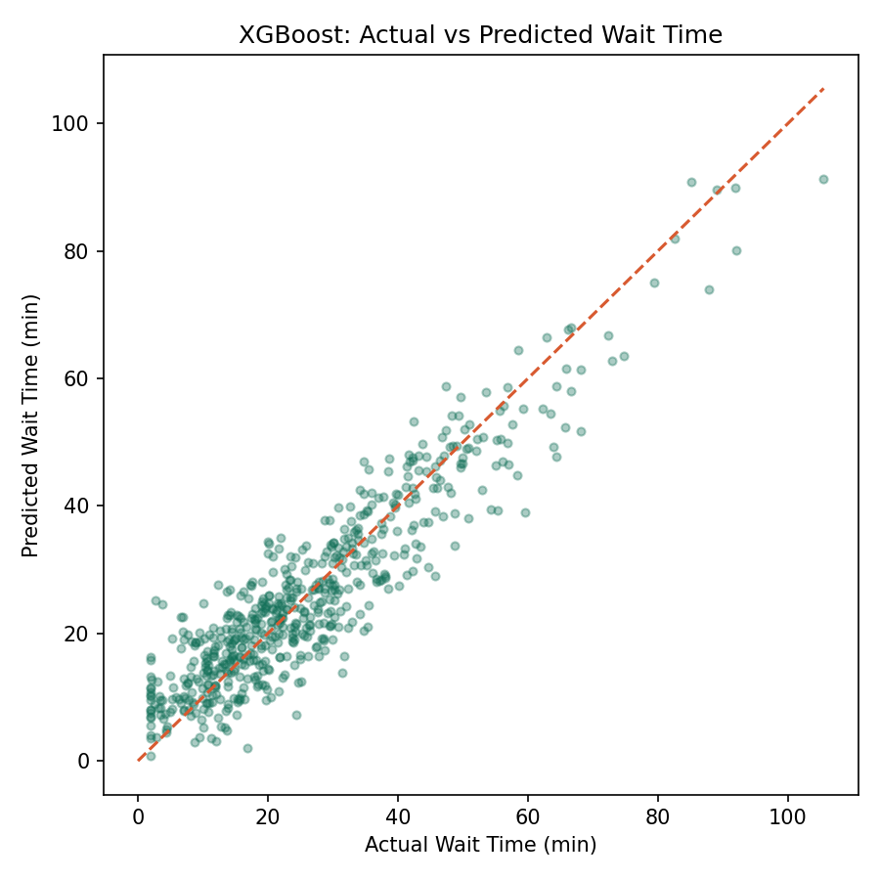
PROTOTYPE RESULTS
The prediction model is accurate
Model | MAE (min) | RMSE (min) | R²
XGBoost (selected) | 5.25 | 6.61 | 0.845
Gradient Boosting | 5.37 | 6.74 | 0.839
Random Forest | 6.51 | 8.14 | 0.765
XGBoost was selected as the production model: on held-out data it predicts wait time within about 5 minutes on average, explaining 85% of the variation in actual wait times — and trains 4–8x faster than the alternatives, which matters for scheduled retraining.
Predicted vs. actual wait time on the held-out test set — points cluster tightly around the diagonal.
Mindtone Mental Health Clinic
9

Slide 10
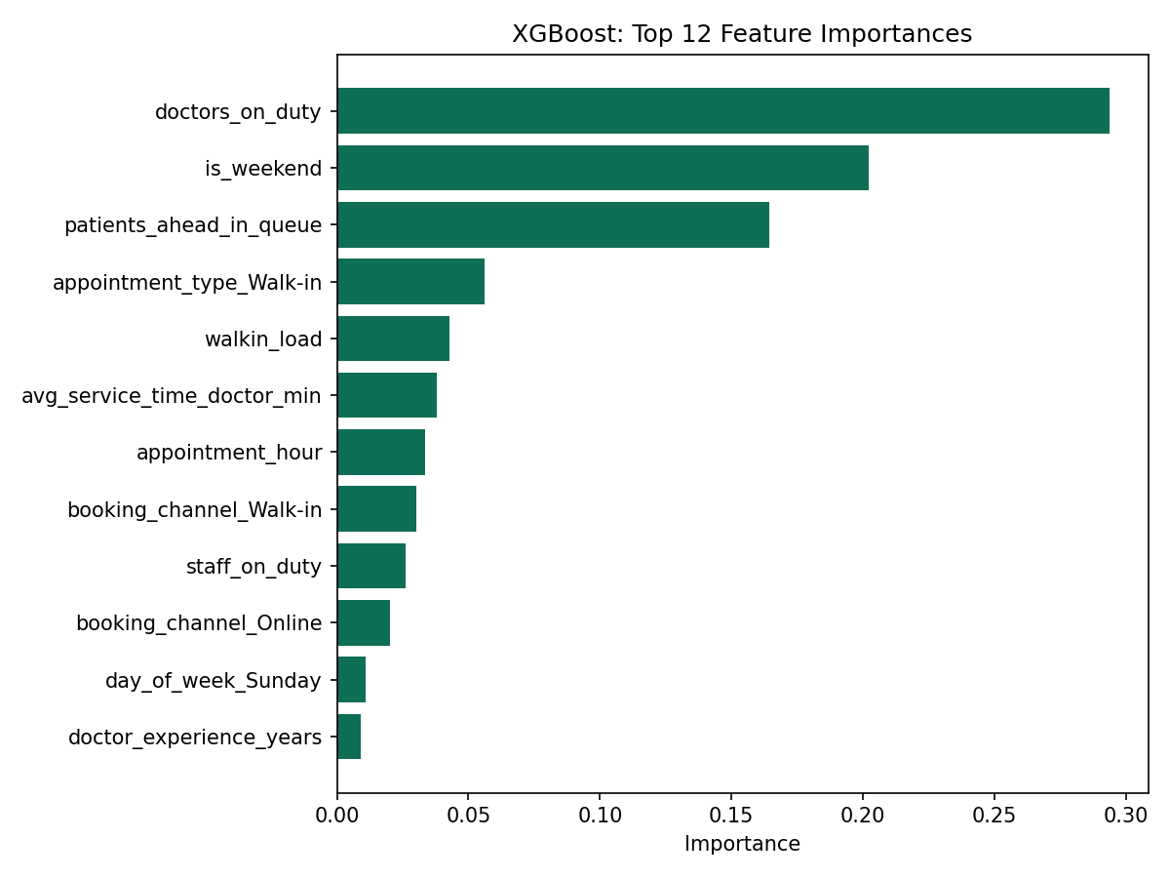
MODEL INSIGHT
What actually drives wait time
Confirms the business diagnosis:
Patients ahead in queue is the single strongest predictor.
Doctors on duty and average service time matter more than any patient attribute.
Walk-in load and time of day are meaningful secondary factors.
Patient age and demographics have almost no effect — the bottleneck is operational, not clinical.
Mindtone Mental Health Clinic
10

Slide 11
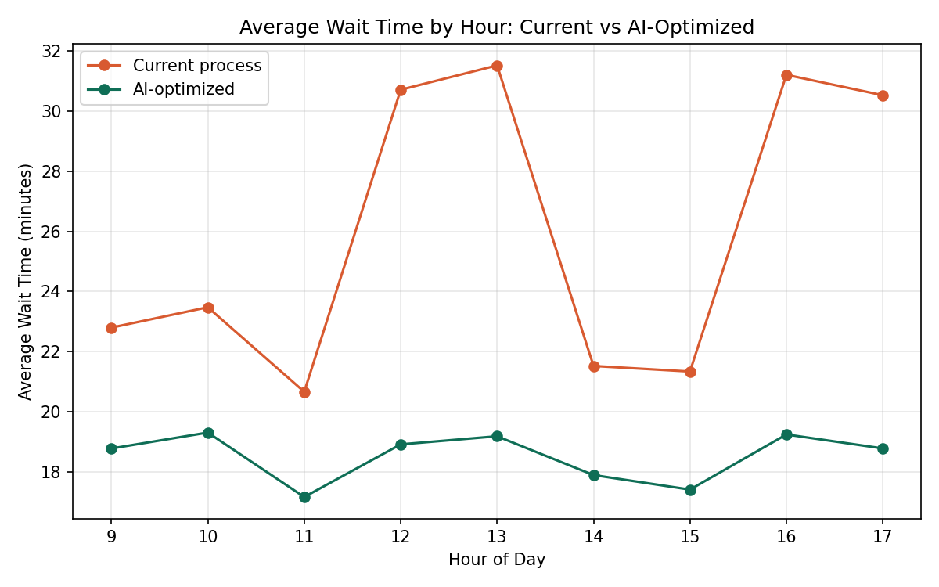
PROJECTED IMPACT
Simulated results: current vs. AI-optimized
-28.6%
Average wait time
26.0 → 18.5 minutes
-30.2%
90th-percentile wait
49.0 → 34.2 minutes
Mindtone Mental Health Clinic
11

Slide 12
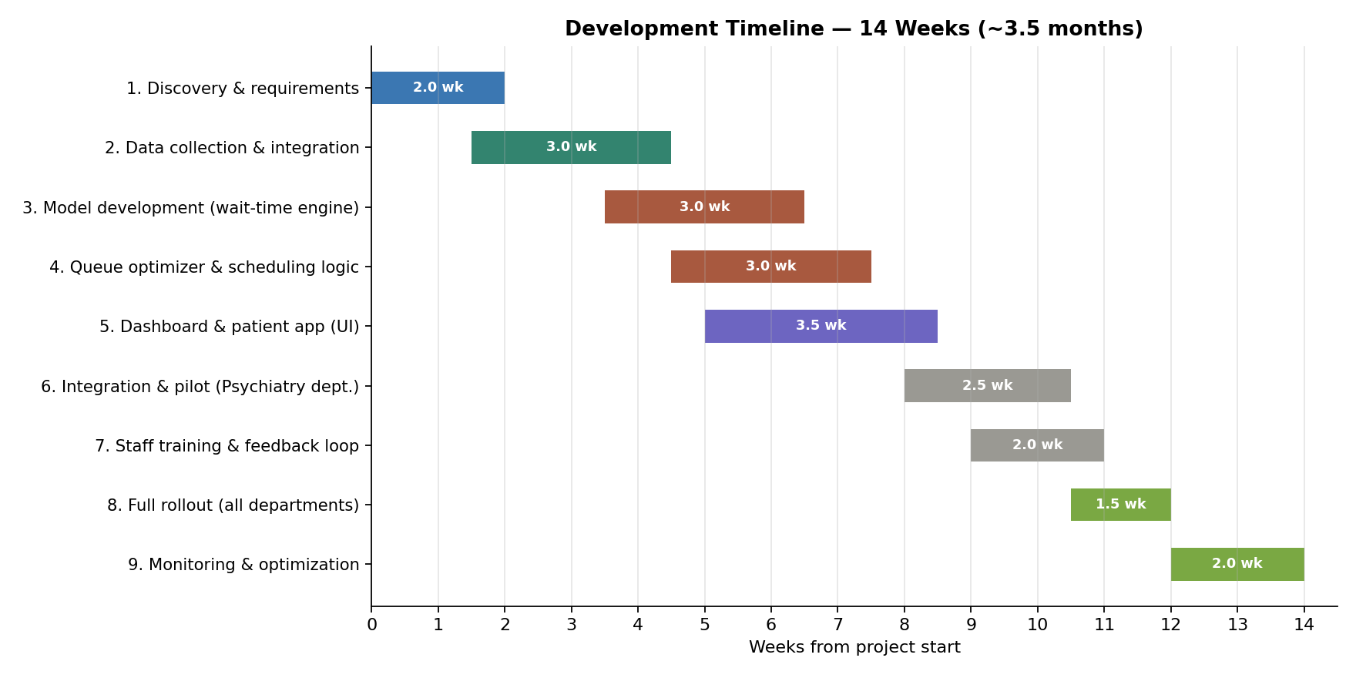
PLAN
14-week rollout, Mindtone Mental Health Clinic
Mindtone Mental Health Clinic
12

Slide 13
INVESTMENT
Year 1 cost summary
Item | Amount
One-time development (pilot build, 9 phases) | $75,200
Ongoing costs — 11 months post-pilot ($1,850/mo) | $20,350
Year 1 total investment | $95,550
Why this is a sound investment
Pilot in one department first — validate before full spend commitment.
Projected 28–30% wait-time reduction directly targets the top patient complaint.
Same platform extends to Counseling and Addiction Therapy — no separate build per department.
Reduced no-shows and abandonment recover revenue currently being lost.
Ongoing monthly breakdown
Cloud hosting & infrastructure
$300
Model monitoring & retraining
$800
SMS / WhatsApp gateway
$150
Support & maintenance
$600
Mindtone Mental Health Clinic
13

Slide 14
RISK MANAGEMENT
What we're watching, and how
High
Data quality
Data audit during discovery; minimum viable fields defined before build.
Medium
Legacy system integration
Early technical discovery with Mindtone's IT team; export-based fallback available.
Medium
Patient data privacy
Operational fields only — no clinical notes; encryption + role-based access.
Medium
Staff adoption
Staff involved in pilot design; human override on every recommendation.
Full risk register (technical, operational, compliance, financial) is provided in the Risk Analysis document.
Mindtone Mental Health Clinic
14

Slide 15
NEXT STEPS
Let's start with a focused pilot
1
Confirm scope & data access
2-week discovery at Mindtone
2
Build & validate the model
Using Mindtone's real historical data
3
Pilot in one department
Measure wait-time reduction directly
4
Roll out to all departments
Same platform, department-specific configuration
Mindtone Mental Health Clinic
15

