Slide 1
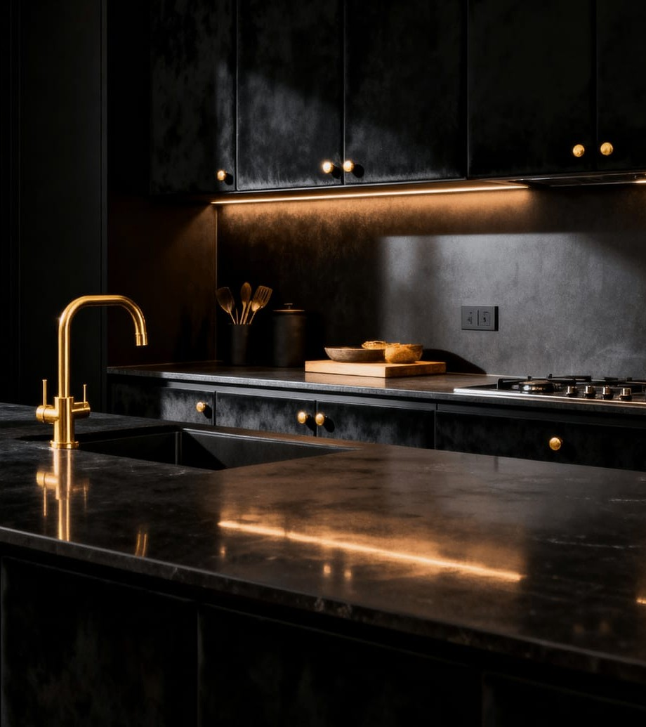

HS WOOD INDUSTRIES
MMXXVI
IV.
FOURTH GENERATION · INDUSTRY 4.0
A fixed-furniture manufactory,
engineered for those who specify.
COMPANY PROFILE
01 · 20

Slide 2
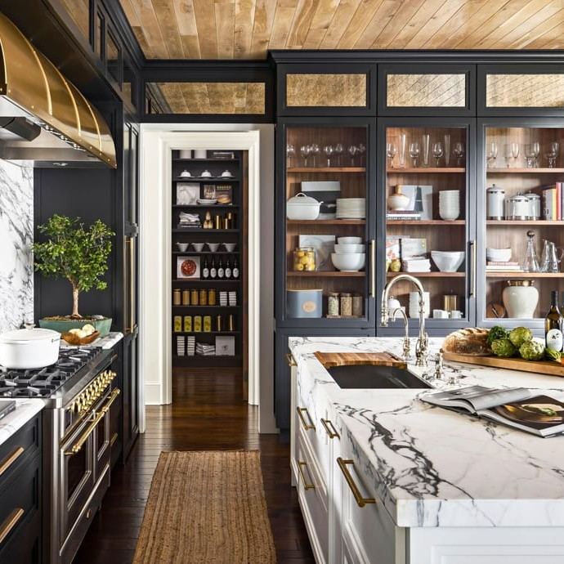
IV · COMPANY PROFILE
02 · 20
INDEX
Contents.
A journey through our craft — from the story behind IV
to the projects we build.
I.
The Brand & the Story
03–07
II.
The Craft & the Machine
08–13
III.
The Projects & the Partnership
14–20
— Signature kitchen, IV production line
AT A GLANCE
450.
96%
<0.4%
units / month
on-time delivery
defect rate, 2025
HS WOOD INDUSTRIES
CONTENTS

Slide 3
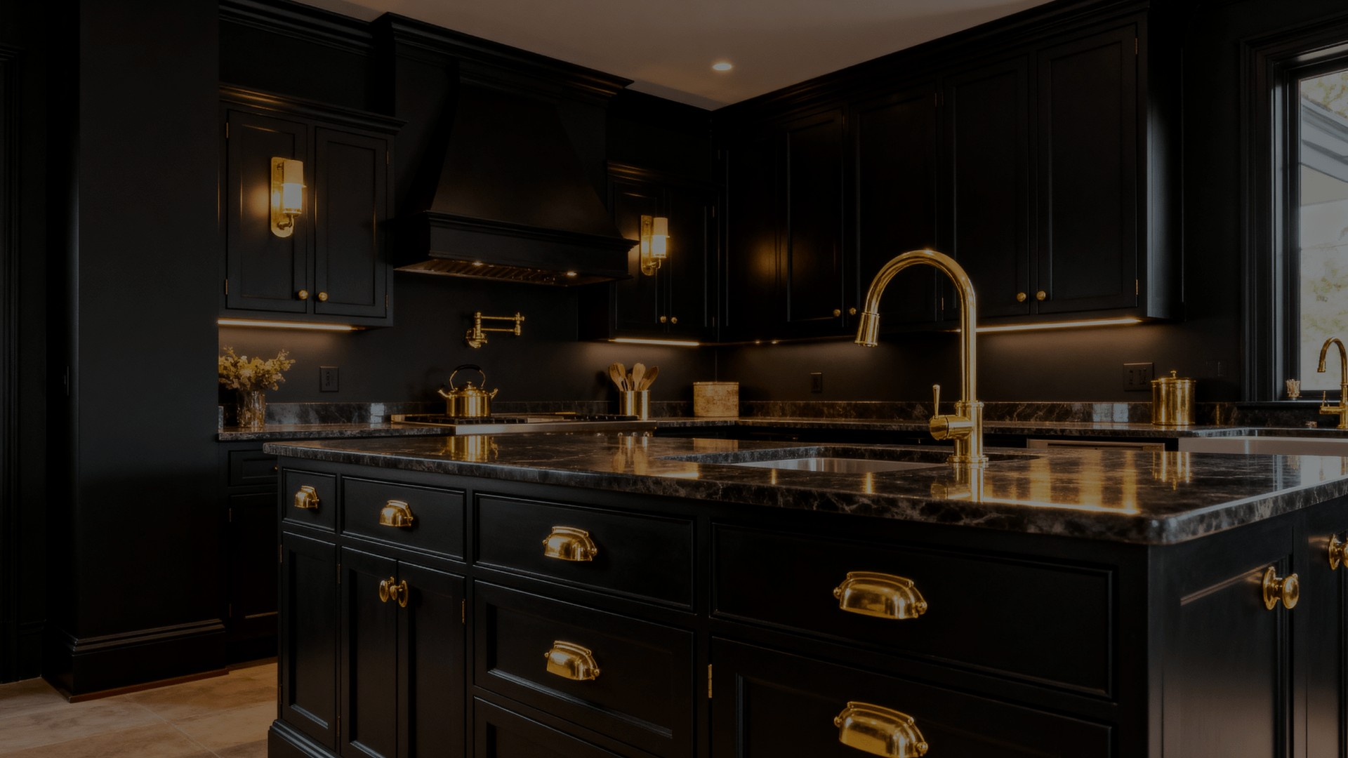

IV · COMPANY PROFILE
03 · 20
CHAPTER ONE
I.
The Brand
& the Story.
◆ WHO WE ARE · WHERE WE COME FROM · WHAT WE BELIEVE

Slide 4
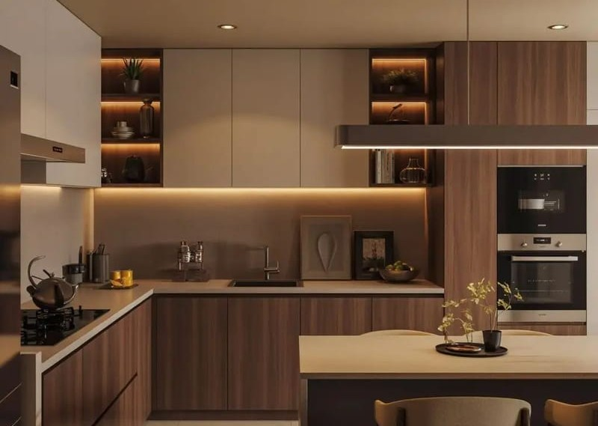
I · ABOUT IV
04 · 20
EXECUTIVE SNAPSHOT
Built for those
who specify.
IV is the fixed-furniture manufacturing brand of HS Wood Industries — built to serve B2B clients who need consistent quality across volume, not just a single well-finished showpiece.
01
02
03
04
CNC
450 /mo
4 gens
8,500 m²
Precision manufacturing
Units delivered monthly
HS Wood craft lineage
Industry-4.0 production facility
HS WOOD INDUSTRIES
ABOUT IV

Slide 5
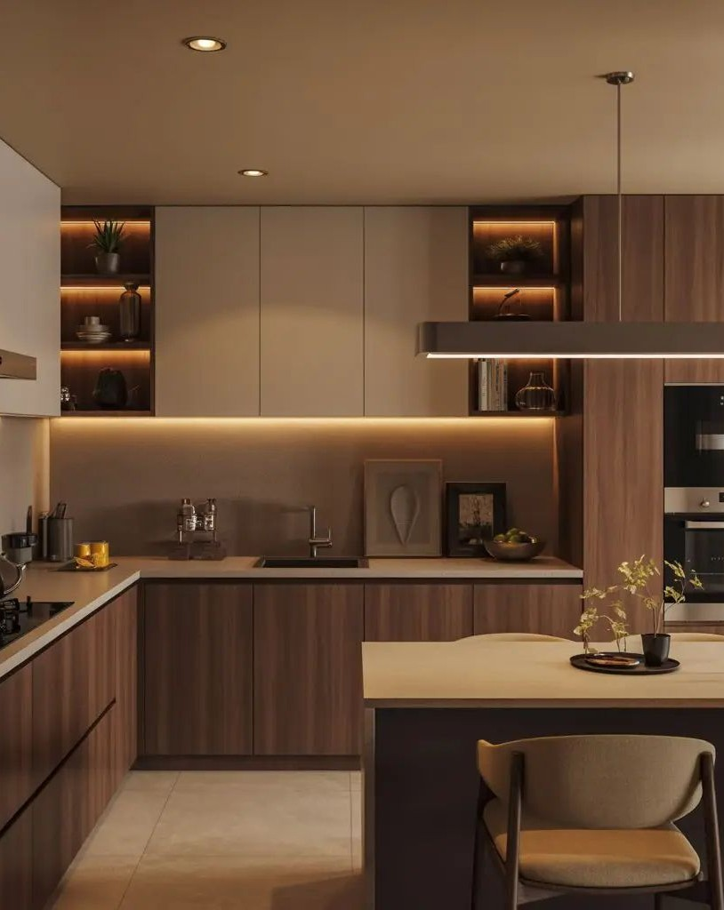
I · OUR STORY
05 · 20
THE OBSERVATION
“Between low-cost
workshops and imported
franchises — a gap.”
For decades, Egyptian homeowners have chosen between two extremes — workshops that compromise on precision, and imported franchises that compromise on price.
IV was built to close that gap. Real local manufacturing capacity, delivered with the discipline of a digital, systemized process.
— Signature cabinetry, IV workshop
HS WOOD INDUSTRIES

Slide 6
I · VISION · MISSION · PROMISE
06 · 20
WHAT WE STAND FOR
Vision, Mission & Promise.
I.
II.
III.
VISION
MISSION
PROMISE
The reference standard for fixed furniture in the region.
Unit 1 and unit 340 — cut from the same digital file.
In writing — not in hope.
Committed timelines. Warranty terms we're prepared to sign. A named project manager. What we promise is what we build.
To become the brand developers and architects name when specifying finish — not compromise.
Deliver the same standard — for every unit, every project — through a manufacturing discipline that removes variability.
OPERATING PRINCIPLES

Slide 7
I · WHY CHOOSE IV
07 · 20
THE DIFFERENTIATORS
Why Choose IV.
Six reasons developers, architects and homeowners specify us by name.
01
02
03 · FLAGSHIP
Consistent at scale.
Committed timelines.
One named contact.
Every panel — from unit 1 to unit 340 — is cut from the same digital file. Not a claim; a manufacturing constraint.
Delivery dates tracked against a live production schedule — in writing, not a verbal estimate. 96% on-time rate in 2025.
Every account gets one dedicated project manager — from brief to walkthrough. Not a rotating cast.
04
05
06
Reputable hardware.
In-house crews.
Warranty in writing.
Blum · Egger · Kronospan · Hettich — the same components used by luxury OEMs.
The people who install unit 1 are the people who install unit 340. Not ad-hoc subcontractors.
5-year structural warranty · lifetime Blum hardware · 72-hour response commitment.

Slide 8


IV · COMPANY PROFILE
08 · 20
CHAPTER TWO
II.
The Craft
& the Machine.
◆ WHAT WE BUILD · HOW WE BUILD · WHAT WE BUILD IT FROM

Slide 9
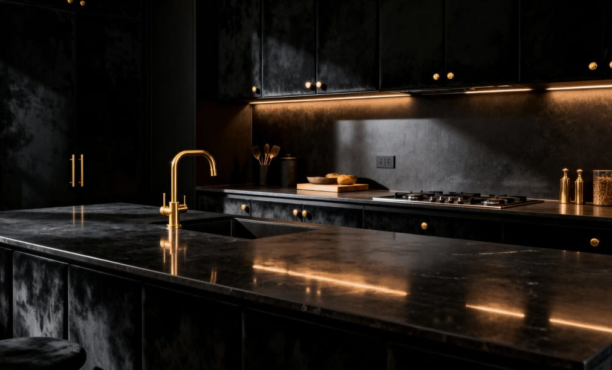
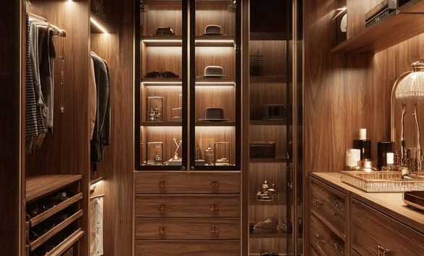
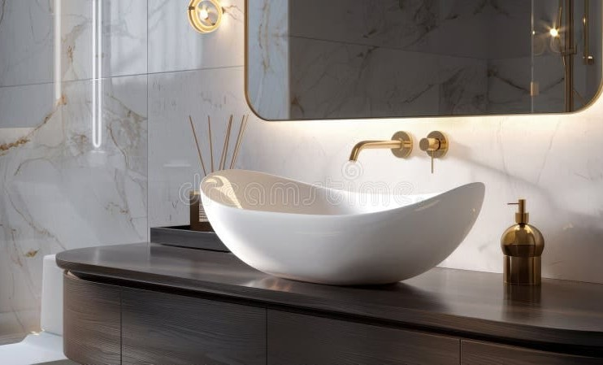
II · WHAT WE OFFER
09 · 20
PHASE 1 · LAUNCHING 2026
Three product families —
unified by the same digital-first standard.
Three signatures.
One standard.
01 KITCHENS
02 DRESSING ROOMS
03 VANITIES
Kitchens.
Dressing Rooms.
Vanities.
The heart of the home — engineered to endure.
A private ritual space — tailored to your wardrobe.
The quiet luxury of a well-made vanity.

Slide 10
II · OUR PROCESS
10 · 20
METHOD · STAGES 01–04
Production Process.
Seven stages. Every stage has a checkpoint. Every checkpoint has a signature.
STAGE 01
STAGE 02
STAGE 03
STAGE 04 · CORE
Measurement
3D Design
Engineering
CNC Cutting
On-site verified vs. architectural drawings.
Full digital model for client approval.
Fit, function & hardware placement review.
Panels cut to exact digital spec — the discipline moment where the file becomes the object.
✓ CLIENT SIGN-OFF
✓ ARCHITECT SIGN-OFF
✓ ENG SIGN-OFF
✓ DIMENSIONAL CHECK
Continues — stages 05 → 07 & the operating doctrine.
NEXT →
OPERATING DOCTRINE · IV PRODUCTION
PART 1 / 2

Slide 11
II · OUR PROCESS
11 · 20
METHOD · STAGES 05–07
From CNC to handover.
Assembly. Inspection. Installation. Three stages between a cut panel and a signed-off room.
STAGE 05
STAGE 06
STAGE 07
Assembly
QC Inspection
Installation
Edge banded, hardware fitted — every joint aligned before it leaves the assembly bay.
Every unit checked against spec — nothing ships on faith.
Trained in-house team on site — the same hands from unit 1 to unit 340.
✓ STRUCTURAL CHECK
✓ PASS/FAIL CHECK
✓ CLIENT WALKTHROUGH
“Quality isn't a claim we make — it's a checklist we follow, on every unit, every time.”
OPERATING DOCTRINE · IV PRODUCTION
PART 2 / 2

Slide 12

II · TECHNOLOGY
12 · 20
INDUSTRY 4.0
Guided by the machine.
Refined by the maker.
Every panel begins as a digital file and becomes a physical piece with exact repeatability — the difference between a workshop and a factory.
01
02
CNC Cutting
Edge Banding
HOMAG 5-axis flatbed · tolerance < 0.3 mm.
Automated PU/EVA — factory-grade finish.
03
04
Drilling & Boring
Design Stack
Multi-spindle CNC for hinges, slides, connectors.
AutoCAD + Cabinet Vision + 3D-Max — versioned.
<0.5 mm
100%
1 : 1
— Precision CNC in operation, HS Wood facility
TOLERANCE
DIGITAL TRACEABILITY
DESIGN → MFG MATCH

Slide 13
II · QUALITY & MATERIALS
13 · 20
MATERIALS & PARTNERS
Materials with a name.
Great furniture is only as good as its hardest-working parts. IV specifies each component by name — not by convenience.
01 · PANELS
E1-grade MDF, plywood carcasses & premium Egger / Kronospan melamine facings.
FEATURED PARTNER
Core Board.
Blum.
02 · HARDWARE
Blum soft-close hinges & TANDEM drawer systems — same as luxury OEMs.
Movement.
EGGER.
Kronospan.
Hettich.
03 · FINISHES
PU lacquers · matte melamines · natural veneers — colour-matched across batches.
Austrian manufacturer, globally recognised for hinges & drawer systems that move quietly and last decades.
Surface.
The invisible detail that separates good work from great.

Slide 14
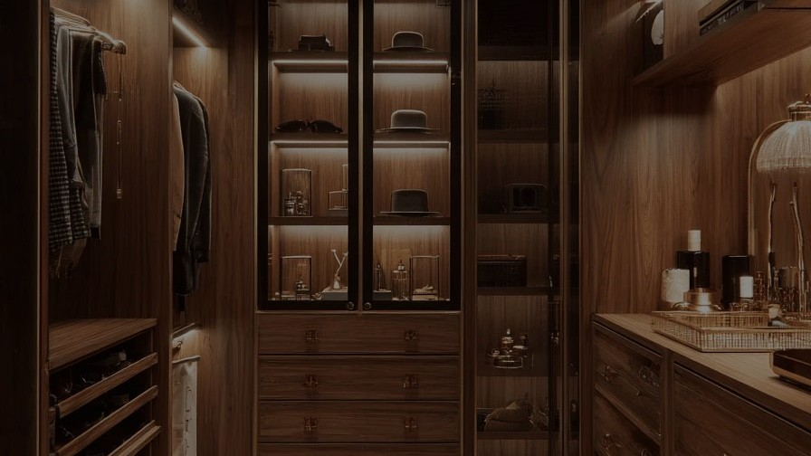

IV · COMPANY PROFILE
14 · 20
CHAPTER THREE
III.
The Projects
& the Partnership.
◆ WHO WE SERVE · FEATURED WORK · WHY PARTNER WITH IV

Slide 15
III · WHO WE SERVE
15 · 20
ENGAGEMENT MODELS · 01–02
Four ways to engage.
Pick the model that fits your project — IV shapes to it, not the other way around.
01
02 · FLAGSHIP
Single Project.
Developer Program.
BEST FOR
BEST FOR
One-off kitchen, dressing room, or vanity fit-out. Villa & residential clients — the same discipline, scaled to a single home.
Ongoing multi-project relationships with volume pricing & reserved capacity. 51–200+ units per project, phased delivery.
ENGAGEMENT MODELS
Models 03 & 04 continue overleaf.
NEXT →
PART 1 / 2

Slide 16
III · WHO WE SERVE
16 · 20
ENGAGEMENT MODELS · 03–04
Or plug IV into your workflow.
When the account belongs to someone else — a contractor, an architect — IV operates as the manufacturing arm.
03
04
Sub-contracted Mfg.
Architect Program.
BEST FOR
BEST FOR
Contractors needing IV as the manufacturing arm — CNC-precise cabinet output, white-label if required.
Architects requiring precise execution of custom-specified designs — full engineering review before manufacturing.
ENGAGEMENT MODELS
Four models. One manufacturing discipline behind all of them.
PART 2 / 2

Slide 17
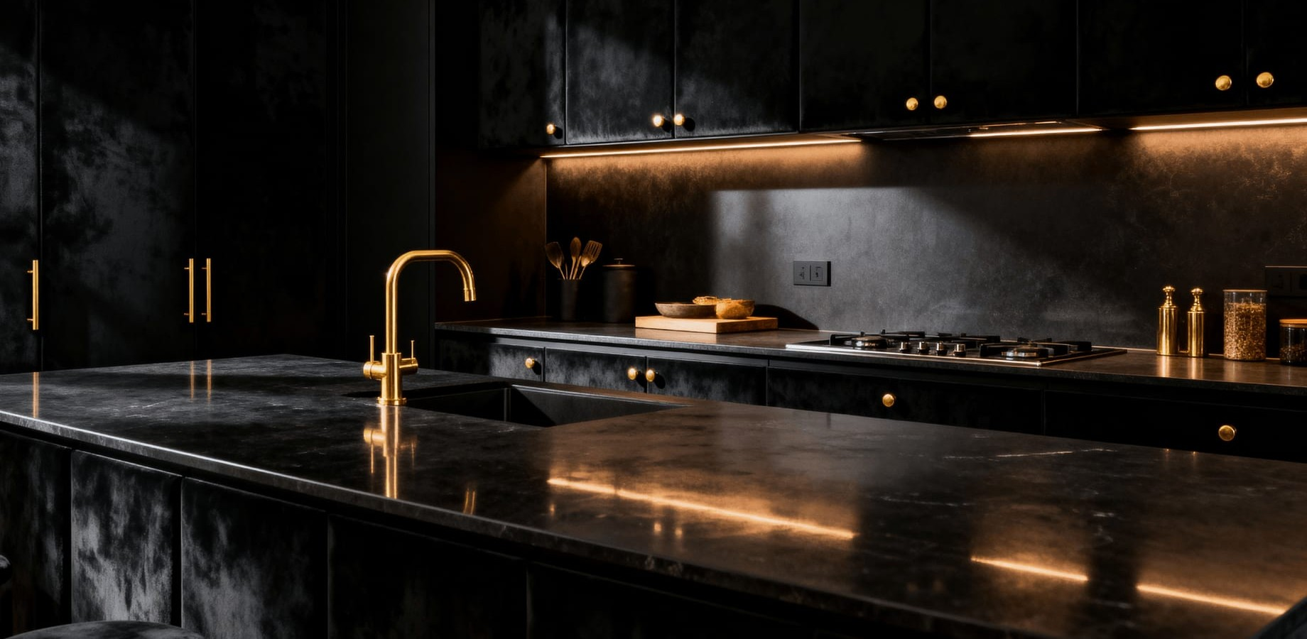
III · FEATURED PROJECTS · 2025
17 · 20
PROOF OF WORK
Capacity, proven.
A capability deck without delivered projects is a brochure. This is not a brochure.
PROJECT · 01 · FLAGSHIP CASE
Zed East Residences.
NEW CAIRO · DEVELOPER
340 kitchen units · full tower fit-out · phased delivery across 6 months.
340 units
6 months
KITCHEN UNITS DELIVERED
PHASED DELIVERY WINDOW
✓ ON TIME · ZERO REJECTS
— Signature kitchen, Zed East delivery batch (2025)
PROOF OF WORK
FLAGSHIP CASE · 01 / 03

Slide 18
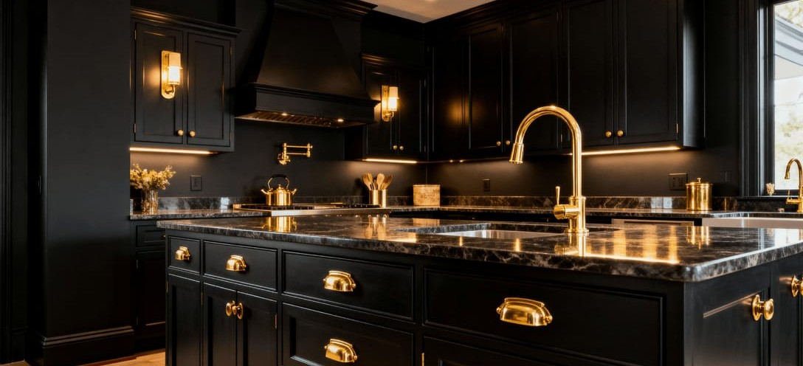
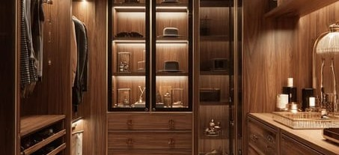
III · FEATURED PROJECTS · 2025
18 · 20
DELIVERED · 2025 · PROJECTS 02–03
Two more, delivered.
PROJECT · 02
PROJECT · 03
Marassi North Coast.
Palm Hills Katameya.
SIDI ABDEL RAHMAN · SEASONAL
NEW CAIRO · PRIVATE VILLA
86 villa kitchens + dressing rooms · coastal-grade PU finish · 14-week turnaround.
Full interior fit-out · 4 dressing rooms, 3 bathrooms, kitchen, home office.
✓ HANDED OVER JUNE 2025
✓ ARCHITECT SPECIFIED
PROOF OF WORK
CASES · 02 & 03 / 03

Slide 19
III · WHY PARTNER WITH IV
19 · 20
A ONE-PAGE FIT CHECK
Fit Check.
A one-page reference for whoever is evaluating IV against their project's requirements. Read left to right.
YOUR REQUIREMENT |  | IV'S CAPABILITY
Consistent quality across many units | → | CNC manufacturing to a single digital spec — unit 1 = unit 340.
Fixed handover date | → | Committed, tracked production schedule in writing — not a verbal estimate.
Single accountable contact | → | One named project manager per account, from brief to walkthrough.
Visibility during production | → | Scheduled digital progress updates — photos + milestones + ETA.
Ability to scale with your project | → | Reserved capacity block for 51–200+ unit projects, phased handover.
"Our warranty terms are what we're prepared to put in writing — not what we hope you'll never have to use."
IV · OPERATING PRINCIPLE

Slide 20


GET IN TOUCH
20 · 20
IV.
THE IV SIGNATURE
Fourth-generation craft — powered by Industry 4.0.
Let's begin your project.
Every space is measured, designed & manufactured to fit only itself. Reach out for a consultation — the first conversation is where every IV project begins.
STUDIO
ENQUIRIES
DIGITAL
By appointment
projects@iv-hswood.com
iv-hswood.com
Cairo, Egypt
+20 · on request
@iv · Instagram · LinkedIn
CAIRO, EGYPT · MMXXVI

