Slide 1


Slide 2


Slide 3
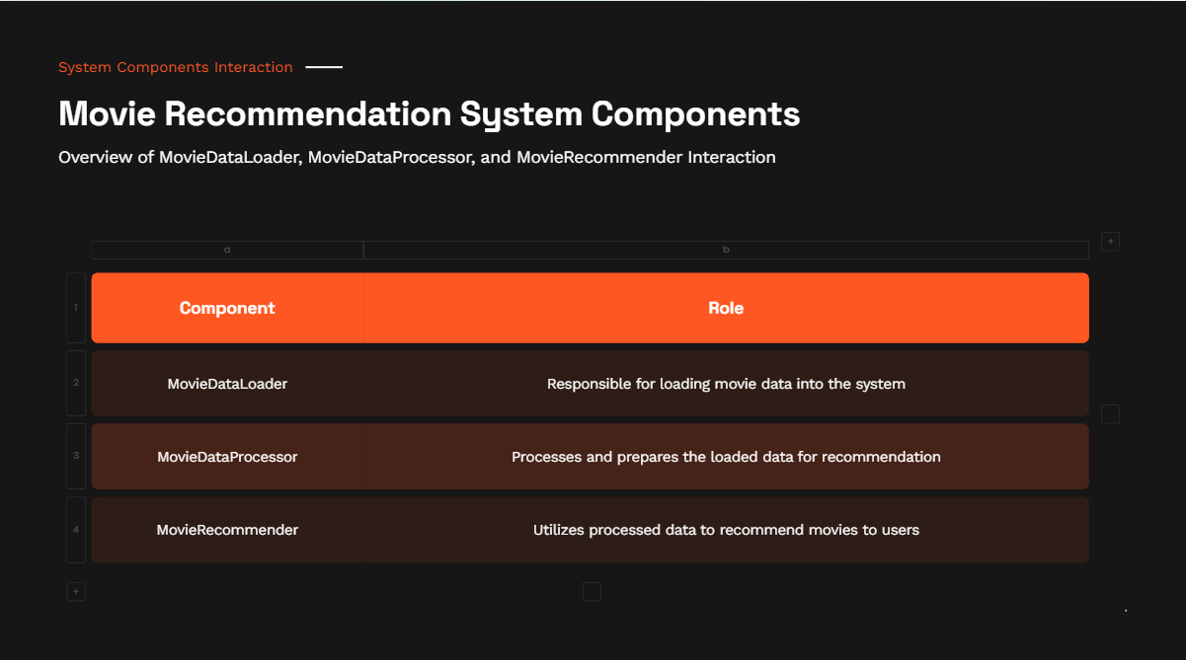

Slide 4
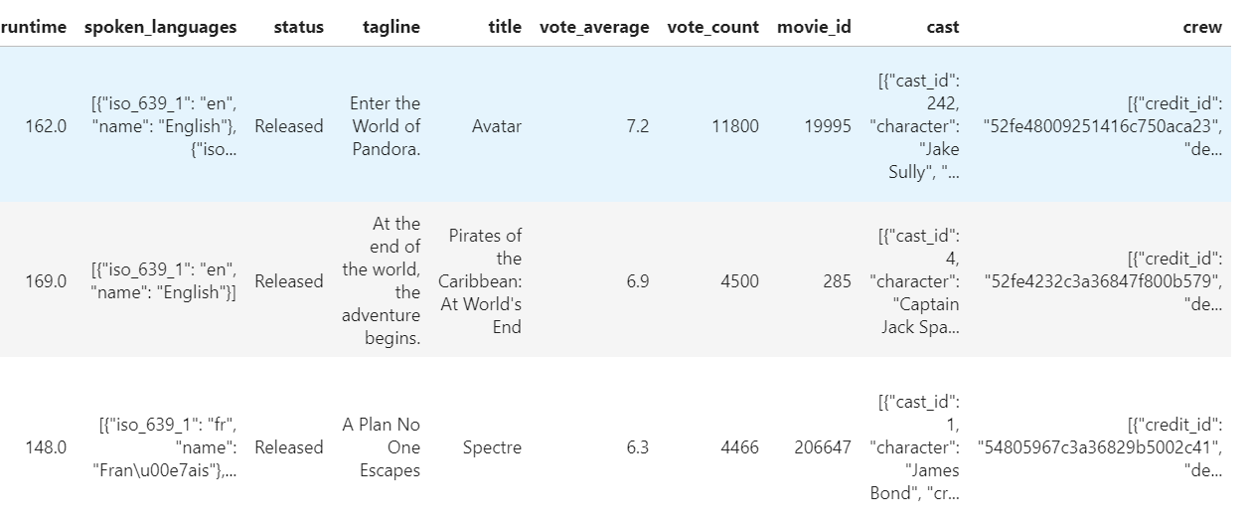
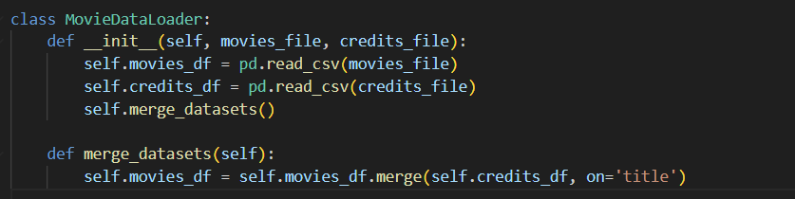
Class 1 - MovieDataLoader
Purpose: Manages the loading and merging of datasets to prepare a unified data structure.
Key Methods:
__init__: Initializes the loader with paths to datasets, loads them using pandas, and calls merge_datasets.
merge_datasets: Combines movies and credits data on the 'title' to enrich movie information with cast and crew details.
Output: Here we can see the columns of credits and movies have merged together:

Slide 5
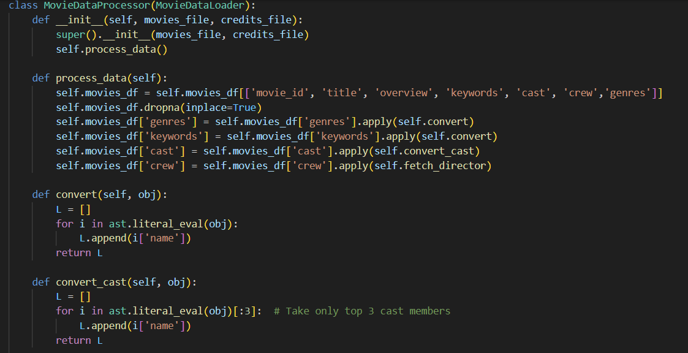
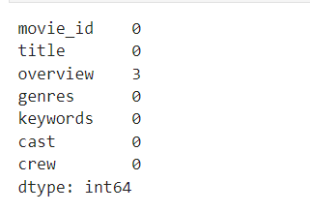
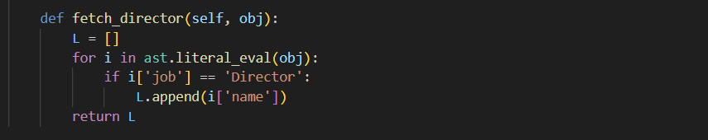
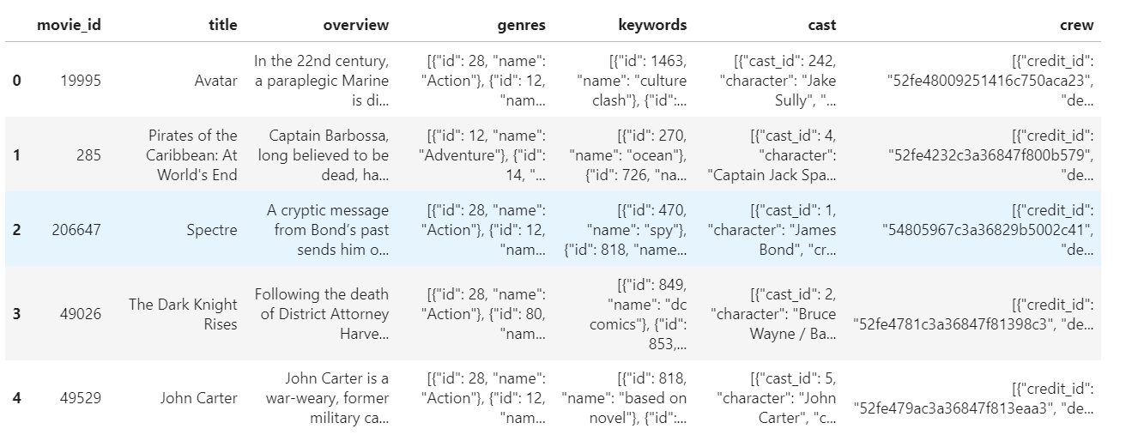
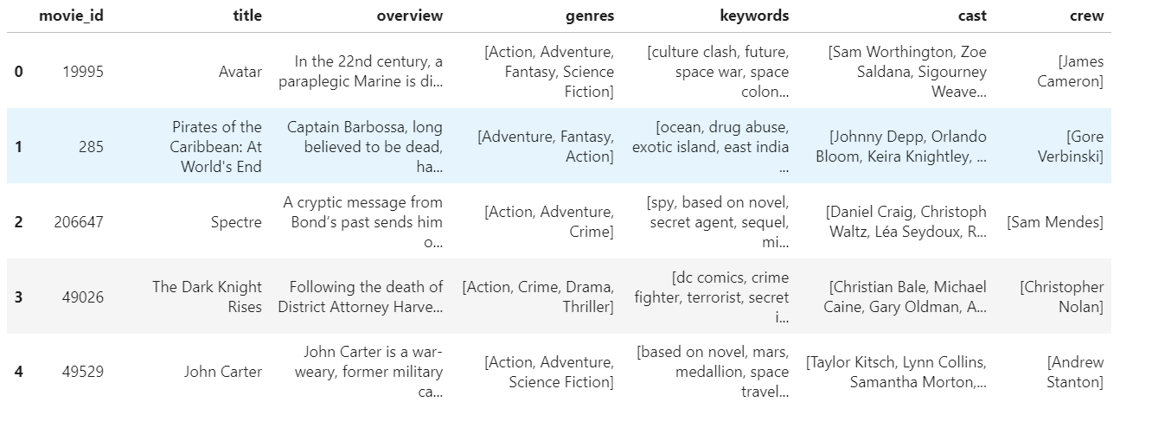
Class 2- MovieDataProcessor
Purpose: Discuss how this class processes the data to prepare it for recommendation.
Key Methods:
process_data: Filters and cleans the dataset.
convert, convert_cast, fetch_director: Transform JSON-like strings into clean lists.
Output: This diagram shows only the titles important for recommendation which we filtered earlier.
The first diagram shows title with all numbers and extra details, second image shows filtered and clean data

Slide 6
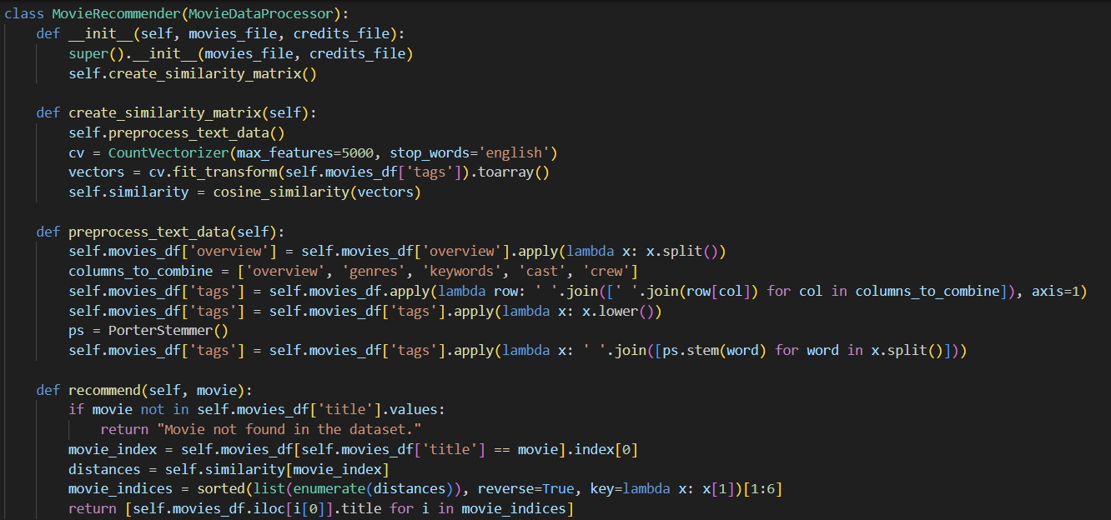
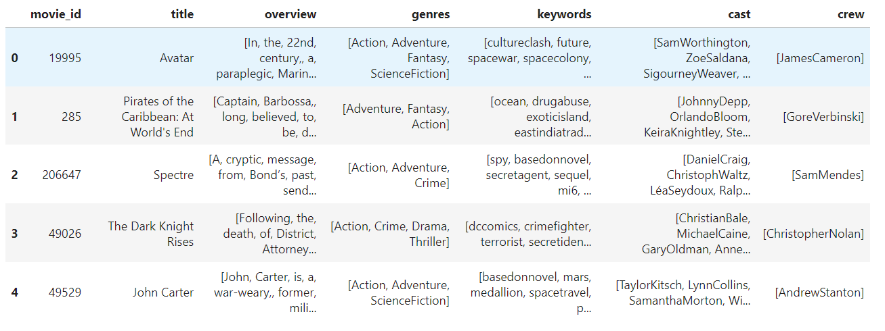
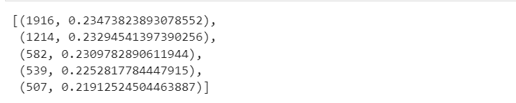
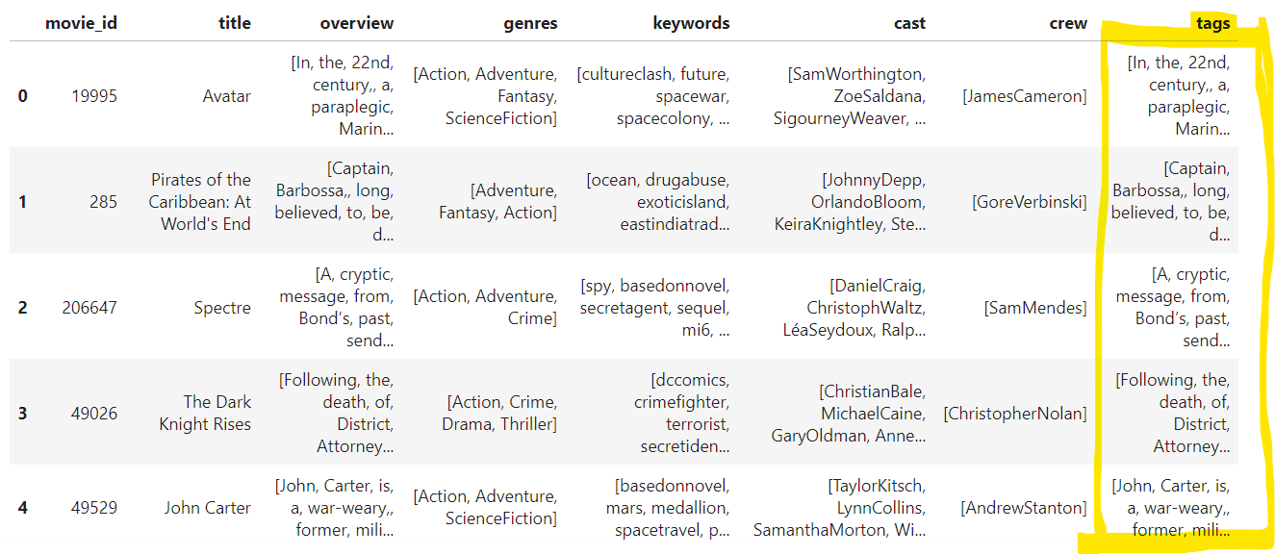
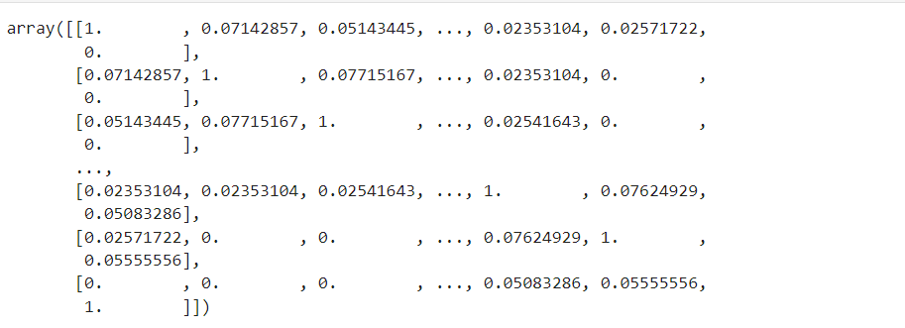
Class 3: MovieRecommender
Purpose: Implements the recommendation logic using machine learning techniques.
Key Methods:
create_similarity_matrix: Creates a matrix to measure content similarity between movies using vectorized tags.
preprocess_text_data: Processes textual data by combining columns, applying stemming, and vectorizing the content.
Output:
We remove any space between two values like Science Fiction and also we can see the data is separated into different words separated by comma to pick up words for recommendation.

Slide 7
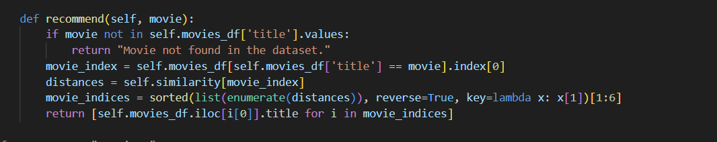
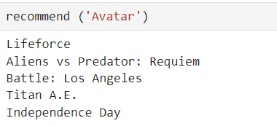
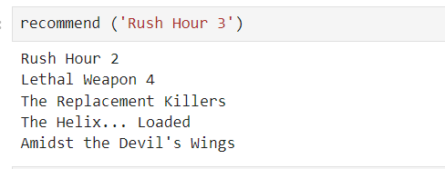
Recommending Movies
Functionality:
Uses cosine similarity to find movies most similar to a user-inputted title.
Example:
Let's find movies similar to 'Avatar'. The system will output the top 5 recommended movies based on content similarity."
Similarly, for a comedy movie eg. Rush Hour 3, we get:

Slide 8

Code Execution
How to Run the Code:
"To run this script, ensure you have Python and the required libraries installed. Run the script from a terminal or an IDE."
For example:
User Input:
"The script prompts the user to enter a movie title and then displays the top five recommendations.“ The movie titles are case sensitive eg: Batman Begins where the initial letters of the titles are capital.

Slide 9
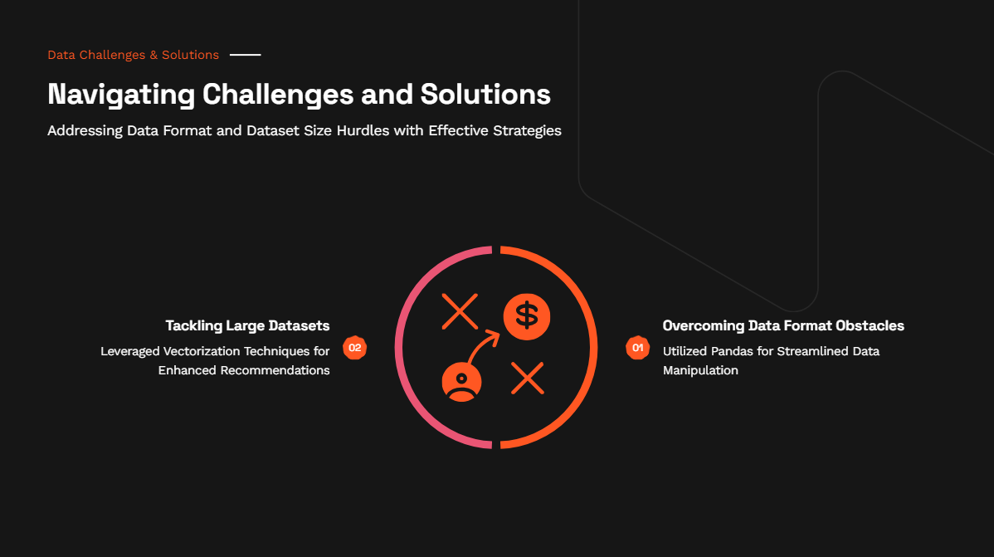

Slide 10
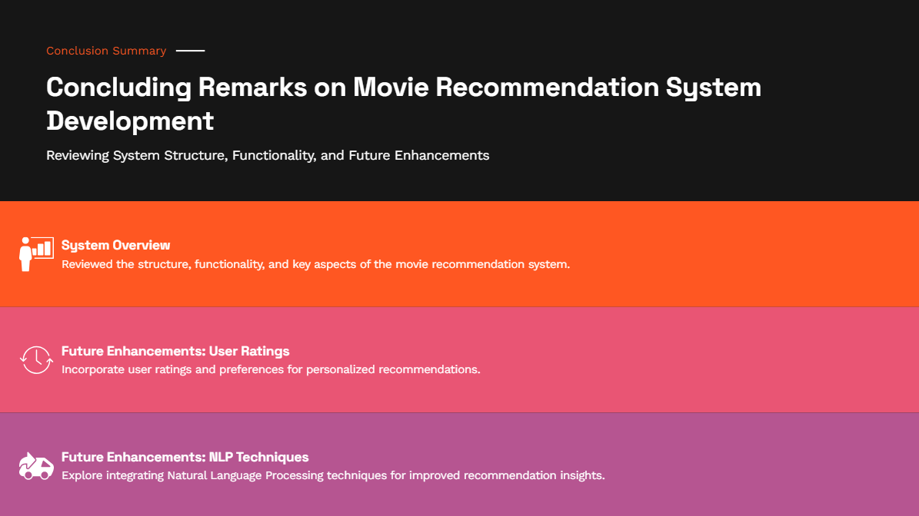

Slide 11


