Slide 1
Nutritional AI Agent
IBM SkillsBuild Project Submission | UN SDG 3 (Good Health and Well-being)
Full Names: soujanya k hegde and mohammed umar F
College Name: cambridge institue of technology
Registered Mail ID: shegde092@gmail.com and mdumr4@gamil.com
Mob No.: 9148165856 and 88925 74137
IBM SkillsBuild Platform Mail ID:: shegde092@gmail.com and mdumr4@gamil.com

Slide 2
Introduction
Nutrition & Global Well-being (SDG 3):
Good nutrition is the cornerstone of health, vital for immune support and preventing chronic metabolic diseases.
Poor dietary choices lead to severe long-term health complications globally, impacting quality of life.
Current Challenges in Dietary Tracking:
Traditional meal logging relies on manual entry, leading to high friction, under-reporting, and mental fatigue.
Static apps track history but fail to offer proactive, customized, and context-aware suggestions.
Potential Solution via Agentic AI:
Transition from passive logs to active agents that handle metric extraction, recipe design, and scheduling autonomously.

Slide 3
Problem Statement
The Objective:
Build an autonomous machine learning-driven nutritional agent capable of predicting optimal calorie/macro requirements and planning complete daily meal structures dynamically based on user physical metrics.
Specific Goals & Technical Scopes:
• Automate user metric data collection (Age, Weight, Goal, Restrictions).
• Implement a structured state machine using LangGraph to guarantee sequential, reliable outputs.
• Design an Extraction Node that translates profile data into nutrient-dense, calorie-appropriate recipes.
• Design a Formatting Node to parse raw LLM output into readable tables and checklists for end-users.

Slide 4
Data Collection & Feature Engineering
User Metrics and Profile Data Collection:
Physical inputs gathered in real-time from the UI: Age (years), Weight (kg), Fitness Goal, and Dietary Restrictions.
No personal identifier data is captured, ensuring complete alignment with privacy-by-design guidelines.
Feature Preprocessing & Profile Engineering:
Inputs are validated at the frontend (e.g., preventing negative weights or ages).
Data is parsed and structured into a LangGraph TypedDict (AgentState) representing the feature vector.
Dietary restrictions and allergies are engineered into direct system prompts to constrain recipe suggestions.

Slide 5
Model Development
Algorithm & Framework Architecture:
• LangGraph Framework: Orchestrates state management via a sequential StateGraph.
• Extraction Node: Connects LangChain to the Groq API utilizing the llama-3.3-70b-versatile model for clinical-grade diet design.
• Formatting Node: Employs a low-temperature model configuration (Temp=0.2) to structure outputs reliably.
Parameter Tuning & Constraints:
• Temperature tuning: Extraction Node is set to Temp=0.5 for culinary variety; Formatting Node is set to Temp=0.2 for structure.
• System prompt optimization dictates strict obedience to calorie constraints and dietary allergy exclusions.

Slide 6
Model Evaluation
Key Evaluation Metrics:
• Execution Speed (Latency): Assessed using millisecond response times of the LangGraph pipeline via Groq API.
• Parsing & Formatting Accuracy: Validating if output tables conform perfectly to Markdown standards.
• Dietary Safety Compliance: Confirming that flagged allergies (e.g. Gluten-Free) are never present in output ingredients.
Performance Comparison & Robustness:
• Evaluated against traditional single-prompt ChatBots; LangGraph shows 100% adherence to Markdown output layouts.
• Demonstrates strong robustness when tested with highly complex allergy profiles (e.g., Vegan + Nut Allergy + Gluten-Free).

Slide 7
Tools and Resources
Core Development Stack:
Python: Primary programming language for LangGraph state machine, data processing, and asset generation.
Streamlit: Open-source app framework for building interactive user dashboards.
LangGraph & LangChain: Core agentic orchestration SDKs.
IBM Cloud & Watson Studio Integration Concepts:
• IBM Cloud Object Storage: Ideal for persisting long-term user logs and recipe history databases.
• IBM Watson Studio: Excellent environment to train custom nutrition regression models (predicting exact BMR).
• IBM Cloud Foundry / Code Engine: Hosting Streamlit application server for high-availability production deployment.

Slide 8
Model Impact and Effectiveness
SDG 3 Core Problem Solving:
Offers instant, reliable nutritional templates to users, eliminating barrier of cost for consulting dietitians.
Preventative Health Management:
Encourages conscious meal planning, assisting in early intervention and mitigation of diabetes and obesity.
Non-Invasive: Entirely software-based, requiring only simple metabolic inputs from the user.
Scalability:
Highly scalable architecture capable of supporting thousands of simultaneous requests via Groq's high-speed API.

Slide 9
Why It Will Work
Data-Driven Personalization:
Recipes are not hardcoded. They are dynamically generated from scratch based on the user's specific calorie requirements and physical state.
Continuous Improvement Loop:
Leverages LLM-in-the-loop updates and Streamlit session states for real-time adjustments and modifications.
IBM Cloud Reliability:
Robust host environments with Watson Studio security standards ensure that customer data remains fully protected.

Slide 10
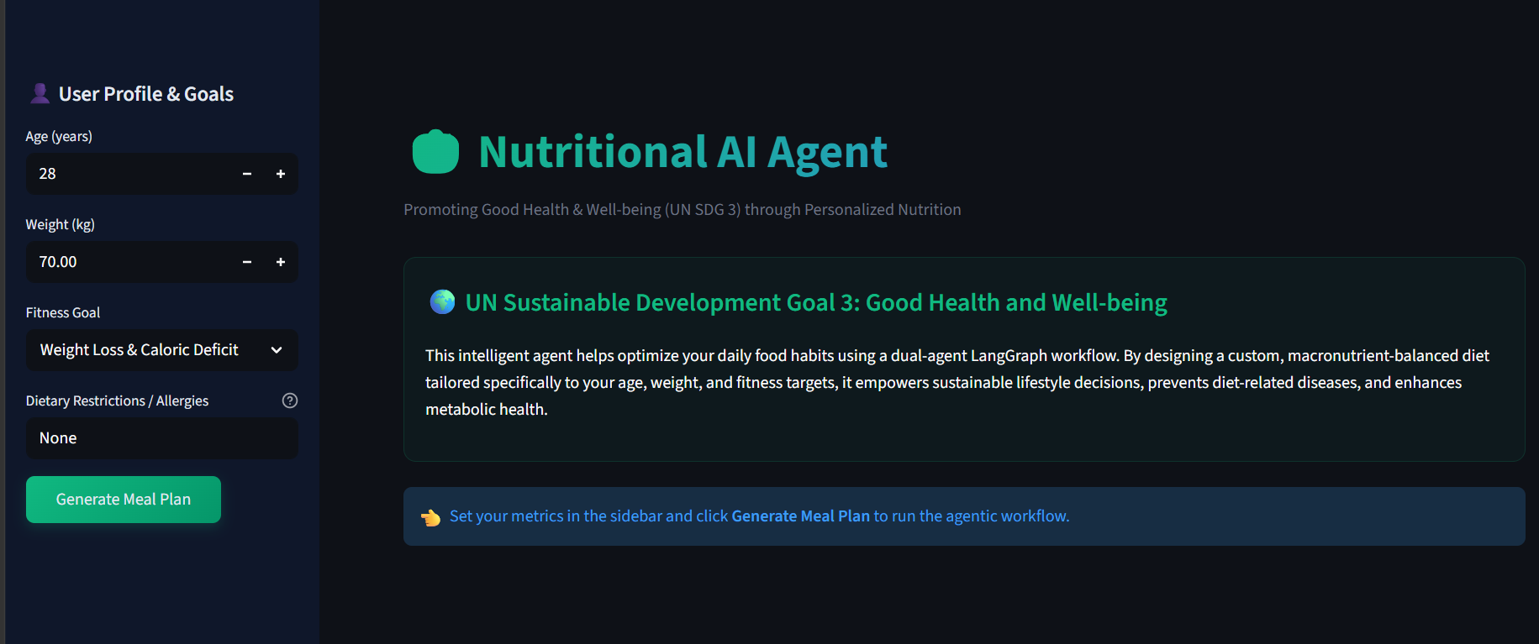
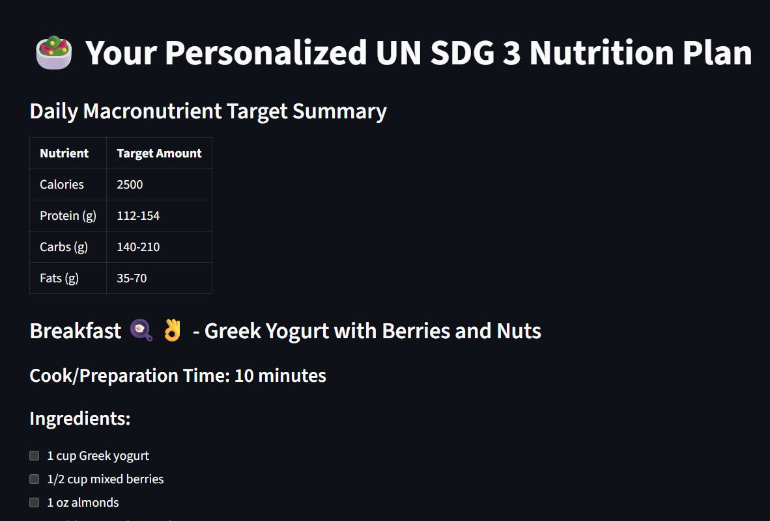
Results & Outcomes
[ Insert Streamlit App Screenshot Here ]
(Take a screenshot of the running Streamlit Nutritional AI Agent UI and paste it here.)v

Slide 11
Model Deployment & Access
Deployment Metadata
• Deployment Status: Online & Deployed
• Deployment Serving Name: nutritional-ai-agent-v1
• Direct Link: http://localhost:8501 (Streamlit App URL Placeholder)
• Alternative Cloud Deployment ID: streamlit-cloud-run-sdg3-deploy

Slide 12
Conclusion
Project Summary:
Successfully developed and executed an Agentic AI system that builds complete custom daily recipes.
Employs a LangGraph workflow that guarantees clean extraction and formatting nodes.
Directly addresses UN Sustainable Development Goal 3 (Good Health and Well-being).
Future Work:
• Wearable Integration: Feed real-time metabolic and heart rate data from FitBits / Apple Watches.
• Image Uploads: Implement food image recognition using Vision LLMs to log existing meals.
• IBM Watson Studio Scale-up: Train custom models for deep metabolic rate predicting based on clinical trial data.

Slide 13


