Slide 1
Linux Kernel Hacking 101
Kelley Nielsen
salticidoftheearth.com
github.com/shegeek/kernel-hacking-101

Slide 2


Slide 3

The process of kernel hacking is a
CYCLE

Slide 4
The Creative Cycle
Code your changes
Send in your patch
Gather feedback
Repeat

Slide 5
The Creative Cycle
Find a contribution to make
  Read stored communications
  Gain experience

Slide 6
The Creative Cycle
Find a contribution to make
  Read stored communications

Slide 7
The Creative Cycle
Find a contribution to make
  Read stored communications
  Gain experience

Slide 8
The Creative Cycle
Find a contribution to make
  Read stored communications
  Gain experience
  Ask

Slide 9
The Creative Cycle
Code your contribution
Prepare and send the patchset

Slide 10
The Creative Cycle
Gather feedback

Slide 11
The Creative Cycle
Gather feedback
  Testing results

Slide 12
The Creative Cycle
Gather feedback
  Testing results
  Mentoring and guidance

Slide 13
The Creative Cycle
Gather feedback
  Testing results
  Mentoring and guidance
  Discussion of strategies

Slide 14
The Creative Cycle
Gather feedback
  Testing results
  Mentoring and guidance
  Discussion of strategies
  General suggestions

Slide 15
The Creative Cycle
Incorporate changes
  Use feedback to improve
  If your contribution is rejected, find another
Regenerate and resend your patchset

Slide 16
Repeat the previous two slides until
Your patchset is accepted…
Then repeat with a new patchset…

Slide 17
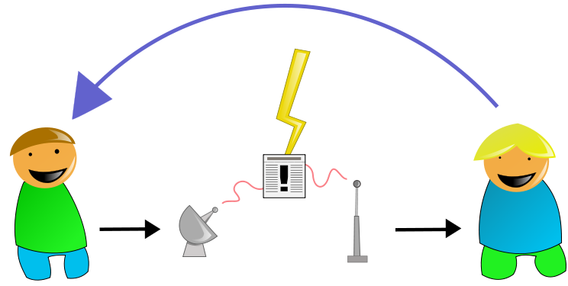
Communicating with team members
and community

Slide 18
Communicating
Mailing lists

Slide 19
Communicating
Mailing lists
Private email

Slide 20
Communicating
Mailing lists
Private email
Conferences

Slide 21
Communicating
Mailing lists
Private email
Conferences
Linux Weekly News

Slide 22
Communicating
Internet Relay Chat (IRC)
  Looks like multi-way text messaging
  Use a dedicated client (not a web client)
  Connect to a network
  Once on the network, join a channel

Slide 23
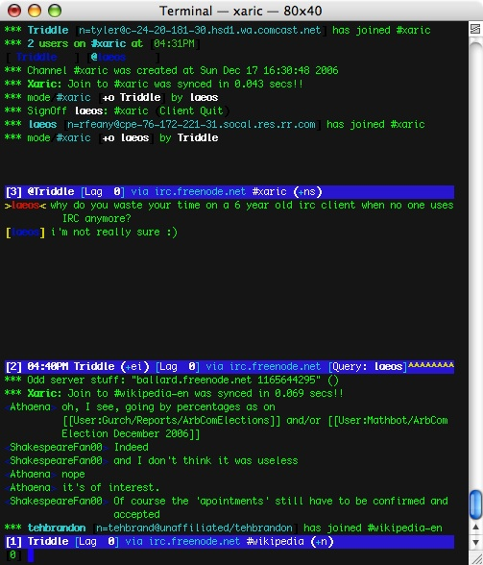

Slide 24
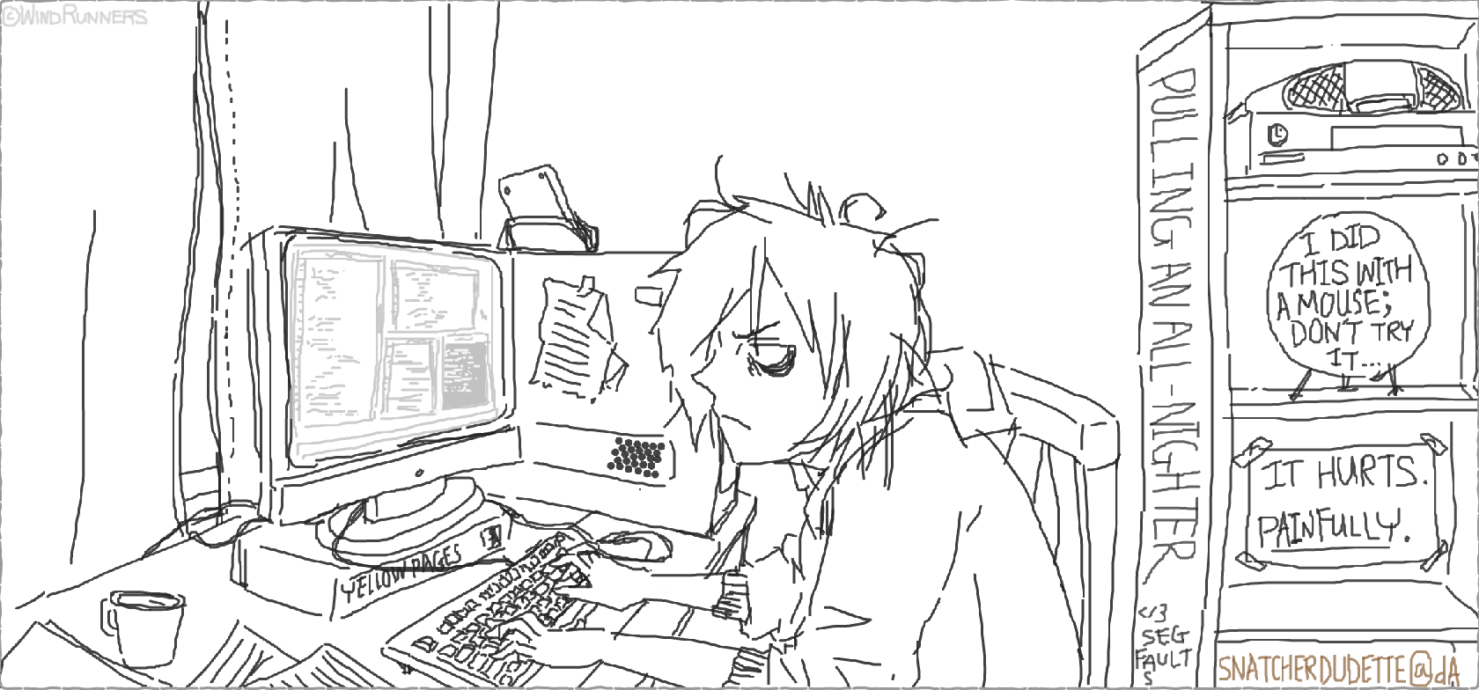
Coding your changes

Slide 25
Coding your changes
Plan
Code
Compile & run
Test & debug

Slide 26
Coding your changes
Plan
  Trace existing paths of execution
  Find examples similar to your goal

Slide 27
Coding your changes
Plan
  Trace existing paths of execution
  Find examples similar to your goal

Slide 28
Coding your changes
Plan
  Trace existing paths of execution
  Find examples similar to your goal
  Learn which lines are relevant

Slide 29
Coding your changes
Plan
  Trace existing paths of execution
  Find examples similar to your goal
  Learn which lines are relevant
  Your friends are grep and the lxr ident search

Slide 30
Coding your changes
Hack your code
  Language is C
  Follow kernel coding style
  Gain skill with your editor

Slide 31
Coding your changes
Compile and run
  This involves installation and rebooting!
  ne

Slide 32
Coding your changes
Compile and run
  This involves installation and rebooting!
  Use a virtual machine or dedicated machine

Slide 33
Coding your changes
Compile and run
  This involves installation and rebooting!
  Use a virtual machine or dedicated machine
  Maintain a known working and a test kernel

Slide 34
Coding your changes
Test and debug
  Your friend is printk()

Slide 35
Coding your changes
Test and debug
  Your friend is printk()
  Find messages in /var/log/kern.log

Slide 36
Coding your changes
Test and debug
  Your friend is printk()
  Find messages in /var/log/kern.log
  Create testing scenarios

Slide 37

Generating and Delivering Your Patch

Slide 38
Delivering Your Patch
Git commit strategy
Git branching strategy
Composing the commit message
The patch

Slide 39
Delivering Your Patch
Git commit strategy
  Make small incremental changes
  Make changes in logical order
  Each change should be encapsulated

Slide 40
Delivering Your Patch
Git commit strategy
  Make small incremental changes
  Make changes in logical order
  Each change should be encapsulated
  Be prepared to alter previous commits

Slide 41
Delivering Your Patch
Git commit strategy
  Make small incremental changes
  Make changes in logical order
  Each change should be encapsulated
  Be prepared to alter previous commits

Slide 42
Delivering Your Patch
Git commit strategy
  Make small incremental changes
  Make changes in logical order
  Each change should be encapsulated
  Be prepared to alter previous commits

Slide 43
Delivering Your Patch
Git commit strategy
  Make small incremental changes
  Make changes in logical order
  Each change should be encapsulated
  Be prepared to alter previous commits
  Be prepared for upstream changes as you update your sources

Slide 44
Delivering Your Patch
Git branching strategy
  Keep master branch unmodified
  Create a working branch

Slide 45
Delivering Your Patch
Git branching strategy
  Keep master branch unmodified
  Create a working branch

Slide 46
Delivering Your Patch
Git branching strategy
  Keep master branch unmodified
  Create a working branch
  Use a throwaway branch to squash commits

Slide 47
Delivering Your Patch
Git branching strategy
  Keep master branch unmodified
  Create a working branch
  Use a throwaway branch to squash commits
  If this method doesn’t work for you, try another

Slide 48
Delivering Your Patch
Composing the commit message
  Work as hard on this as you do on coding!

Slide 49
Delivering Your Patch
Composing the commit message
  Work as hard on this as you do on coding!
  Read existing examples

Slide 50
Delivering Your Patch
Composing the commit message
  Work as hard on this as you do on coding!
  Read existing examples
  Be concise, yet thorough

Slide 51
Delivering Your Patch
Composing the commit message
  Work as hard on this as you do on coding!
  Read existing examples
  Be concise, yet thorough
  Use imperative language

Slide 52
Delivering Your Patch
The patch itself
  Run checkpatch.pl on the files you change

Slide 53
Delivering Your Patch
The patch itself
  Run checkpatch.pl on the files you change
  Generate patch with a git command

Slide 54
Delivering Your Patch
The patch itself
  Run checkpatch.pl on the files you change
  Generate patch with a git command
  Cc everyone involved with the code

Slide 55
Delivering Your Patch
The patch itself
  Run checkpatch.pl on the files you change
  Generate patch with a git command
  Cc everyone involved with the code
  Send using plain text mail

Slide 56
Delivering Your Patch
Why plain text?
  Email formatting will break your code
  Team members will apply your patch as is
  Commit message will become subject line and content

Slide 57
Delivering Your Patch
Why plain text?
  Email formatting will break your code
  Team members will apply your patch as is
  t

Slide 58
Delivering Your Patch
Why plain text?
  Email formatting will break your code
  Team members will apply your patch as is
  Commit message will become subject line and content

Slide 59
Delivering Your Patch
Why plain text?
  Email formatting will break your code
  Team members will apply your patch as is
  Commit message will become subject line and content
  Use a specific mail client such as mutt
(no gmail!)

Slide 60
Now wait for your feedback,
And do it all again…

Slide 61


Happy Hacking!

Slide 62
Get the slides
Visit https://github.com/shegeek/kernel-hacking-101
$ git clone https://github.com/shegeek/kernel-hacking-101.git
Notes:
This is the last slide and must be included in the slide deck

Slide 63
Resources
Gnome Outreach Program for Women https://wiki.gnome.org/OutreachProgramForWomen
Kernel.org git repositories https://git.kernel.org/cgit/
Linux Kernel Newbies http://kernelnewbies.org/
Outreachy First Patch Tutorial http://kernelnewbies.org/Outreachyfirstpatch
The Eudyptula Challenge http://eudyptula-challenge.org/
KVM Installation https://help.ubuntu.com/community/KVM/Installation
Linux Kernel Mailing List https://lkml.org/
Various Linux related mailing lists at Gmane http://gmane.org/find.php?list=kernel
Linux Foundation events http://events.linuxfoundation.org/
Linux Weekly News http://lwn.net/
#irchelp http://www.irchelp.org/
Irssi – The Client of the Future http://www.irssi.org/
Wikipedia entry for the grep command http://en.wikipedia.org/wiki/Grep
Linux Cross Reference at Free Electrons http://lxr.free-electrons.com/
Linux Kernel Coding Style (pdf) https://computing.llnl.gov/linux/slurm/coding_style.pdf
Vim the editor http://www.vim.org/
Pro Git http://git-scm.com/book https://www.gitbook.io/book/gitbookio/progit
The Mutt E-Mail Client http://www.mutt.org/
Video of this talk from ScaLE 13x https://www.youtube.com/watch?v=WUU-gI3iYnY

Slide 64
Image Credits
Arrows Circle by Freepik CC BY 3.0
Communication shannon-weaver2 by Einar Faanes CC BY-SA 3.0
Xaric screen shot by Triddle BSD License http://commons.wikimedia.org/wiki/File:Xaric_screen_shot.jpg
Coding All Night Long by Snatcherdudette http://snatcherdudette.deviantart.com/art/Coding-all-night-long-183815498
Music present by Marta Crowe Creative Commons Attribution 2.0 Generic
Linux Foundation Logo is in the public domain
Linux “Tux” Logo is in the public domain

