Slide 1
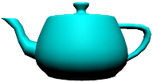
Teapots Can Fly
3D Graphics for Web Programmers
Presented by
Kelley Nielsen
Salticid Software, Codechix

Slide 2
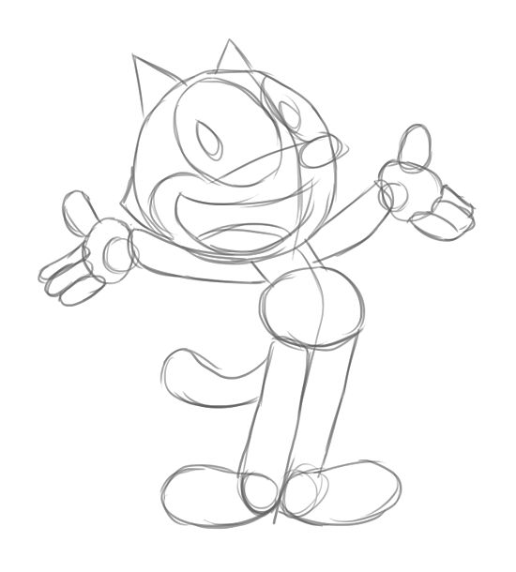
So,
how does
3D animation
work?

Slide 3
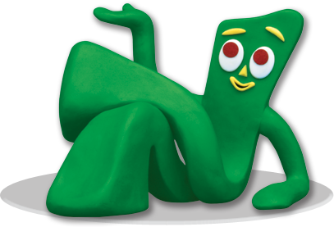
3D Animation is like Claymation

Slide 4
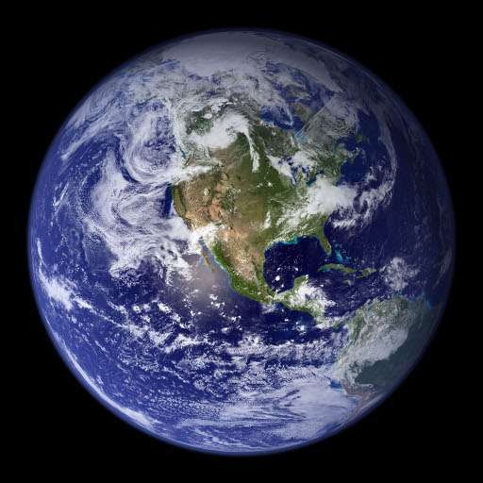
We're building
Our own little world

Slide 5
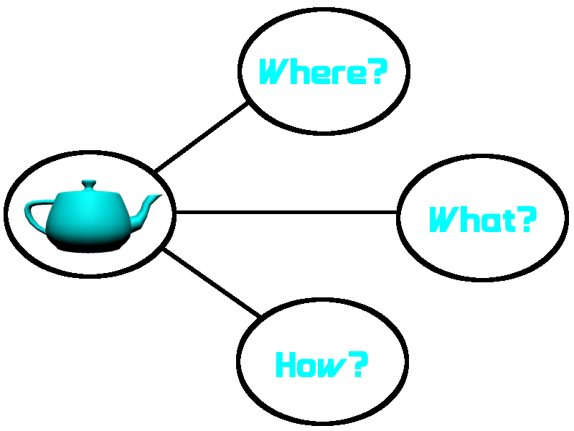

Slide 6
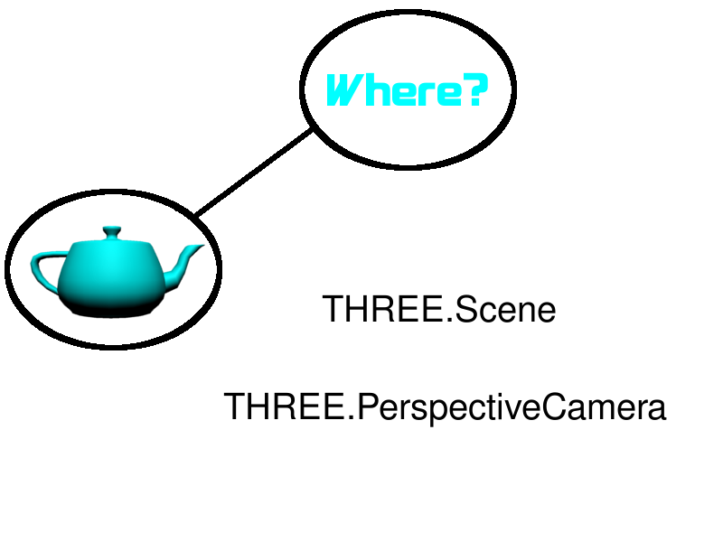

Slide 7
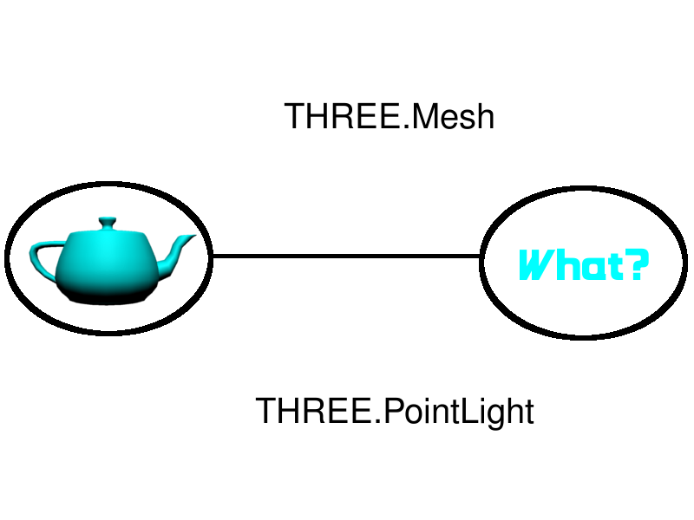

Slide 8
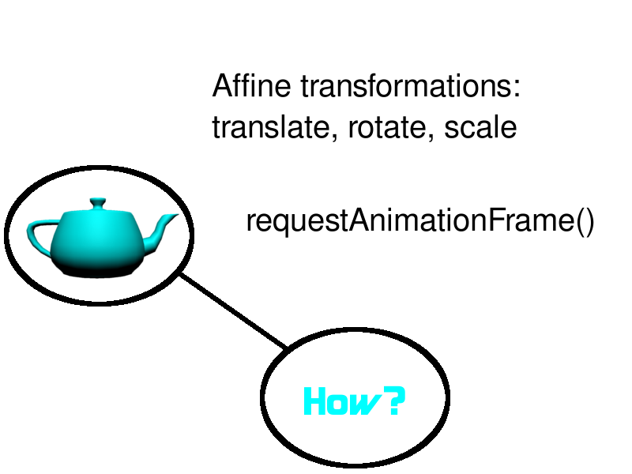

Slide 9
What do we need?
three.js
teapot.js
An html5 page

Slide 10
To get it all:
https://github.com/
teapots_can_fly
clone or download zip

Slide 11
The basic setup:
<head>
<title>Teapots can fly!<title>
<style>canvas { width: 100%;
Height: 100% }
</style>
</head>

Slide 12
The basic setup:
<body>
<script src="three.min.js">
</script>
<script>
** Our Stuff Goes Here! **
</script>
</body>

Slide 13
The last setup step:
<script>
var renderer = new THREE.WebGLRenderer();
renderer.setSize(window.innerWidth,
window.innerHeight);
document.body.appendChild
(renderer.domElement);
</script>

Slide 14
And now, the
3D code!

Slide 16
The Diorama
var scene = new THREE.Scene();

Slide 17
The Camera
var camera = new THREE.PerspectiveCamera(
35,
window.innerWidth/window.innerHeight,
0.1, 1000);
camera.position.z = 50;

Slide 18
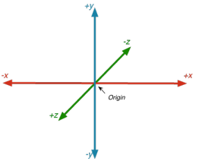
Right-handed coordinates
Positive X to the right
Positive Z coming out
of the screen

Slide 20
The Teapot
var teapot;
var jsonLoader = new THREE.JSONLoader();
jsonLoader.load( "teapot.js", createTeapot);

Slide 21
The Teapot's Callback
function createTeapot(tGeometry){
var tMaterial = new
THREE.MeshPhongMaterial({color: 0x00ffff});
var tMesh = new THREE.Mesh( tGeometry, tMaterial );
scene.add(tMesh);
teapot = tMesh;
}

Slide 22
A closer look...
new THREE.Mesh( tGeometry, tMaterial );
A mesh has two parts

Slide 23
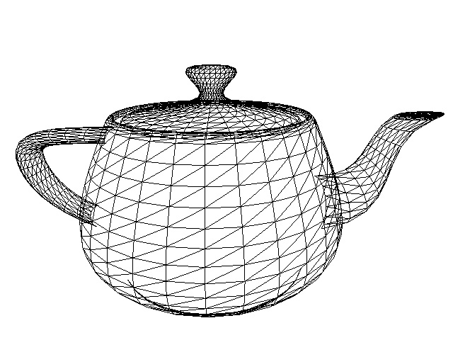
A Geometry
Is like
Bones...

Slide 24
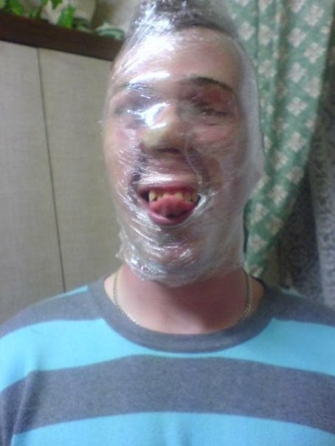
...A Material
Is like
Skin.

Slide 25
The Teapot's Callback
function createTeapot(tGeometry){
var tMaterial = new
THREE.MeshPhongMaterial({color: 0x00ffff});
var tMesh = new THREE.Mesh( tGeometry, tMaterial );
scene.add(tMesh);
teapot = tMesh;
}

Slide 26
Let there be light!
var light = new THREE.PointLight(0xffffff);
light.position.set(0,150,150);
scene.add(light);

Slide 28
Making the Teapot Move
teapot.position.x += 0.1;
if (teapot.position.x > halfScreenWidth)
teapot.position.x = -halfScreenWidth;

Slide 29
Rendering the Frame
renderer.render(scene, camera);

Slide 30
Setting Up the Next Frame
requestAnimationFrame(render);

Slide 31
The Complete Render Loop
var halfScreenWidth = 80;
var render = function () {
if (teapot) {
teapot.position.x += 0.1;
if (teapot.position.x > halfScreenWidth)
teapot.position.x = -halfScreenWidth;
renderer.render(scene, camera);
}
requestAnimationFrame(render);
};
render();

Slide 32
...And one again, the repo:
http://github.com/shegeek/
teapots_can_fly
Enjoy! Make cool stuff!
kelleynnn@gmail.com

Slide 33
Resources and links
three.js repo: https://github.com/mrdoob/three.js
three.js home page: http://threejs.org/
Stemkoski's examples: http://stemkoski.github.io/Three.js/index.html
WebGL Up and Running (by Tony Parisi):
http://shop.oreilly.com/product/0636920024729.do
Learning Three.js blog: http://learningthreejs.com/

Slide 34
Resources and links
three.js boilerplate builder:
http://jeromeetienne.github.io/threejsboilerplatebuilder/
An Introduction to Web GL: http://dev.opera.com/articles/view/an-introduction-to-webgl/
Tutorials on the LearningWebGL blog:
http://learningwebgl.com/blog/?page_id=1217
WebGL 1.0 spec: http://www.khronos.org/webgl/

Slide 35
Felix image courtesy of Wikihow
wikihow.com/Draw-Felix-the-Cat
Gumby image courtesy of
Art Clokey's Gumbyworld
gumbyworld.com
Earth image courtesy of NASA
visibleearth.nasa.gov
Coordinate axes image courtesy of
http://www.cocos2d-x.org/
Teapot wireframe image courtesy of
caig.cs.nctu.edu.tw/
Saran Wrap man image courtesy of
funnyordie.com

