Slide 1

Stroke Prediction Using Machine Learning
Shehani Wetthasinghe
12/07/2022

Slide 2
Project Overview

Slide 3
Project Data Source

Slide 4
Project Data Features
Feature | Description
1. Gender | Male / Female / Other
2. Age | Age of the patient in years
3. Hypertension | Yes (1) / No (0)
4. Heart Disease | Yes (1) / No (0)
5. Ever Married | Yes / No
6. Work Type | Children / Never worked / Government job / Private job / Self employed
7. Residence Type | Rural / Urban
8. Average Glucose Level | Average Glucose Level in Blood (mg/dL)
9. BMI | Body Mass Index (kgm⁻²)
10. Smoking Status | Formerly smoked/Never smoked/Smokes
11. Stroke | Yes (1) / No (0)

Slide 5
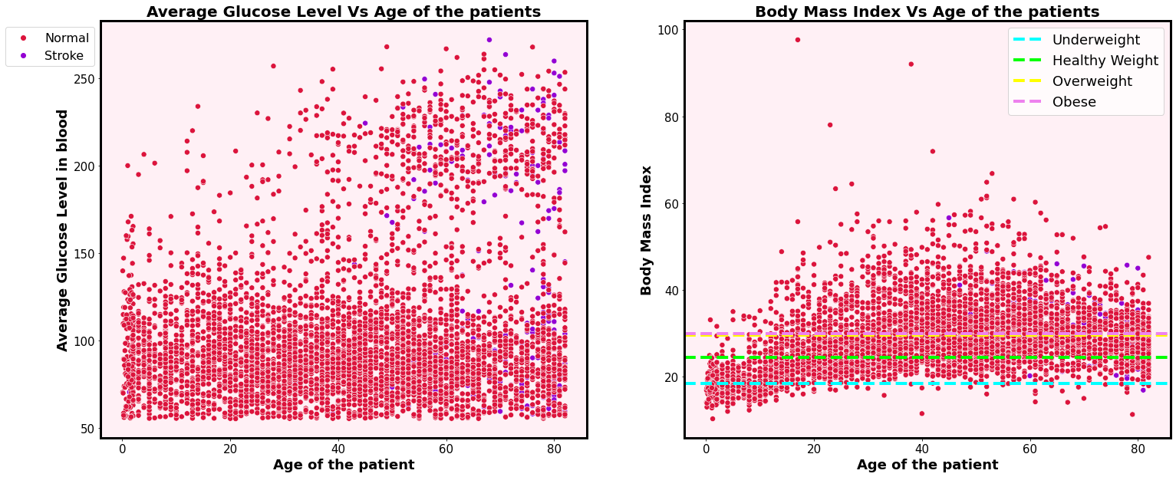
Model Selection and Evaluation

Slide 6
Recommendations

Slide 7
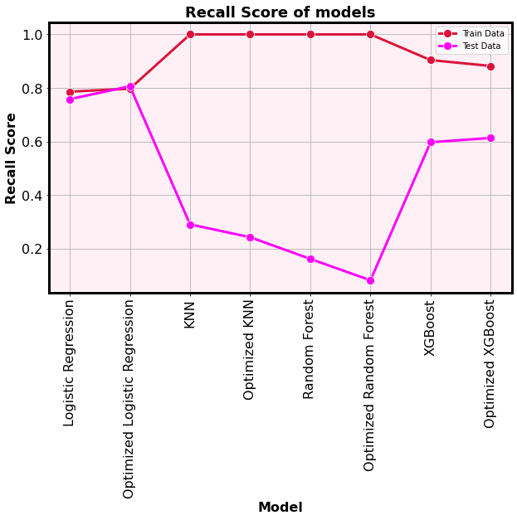
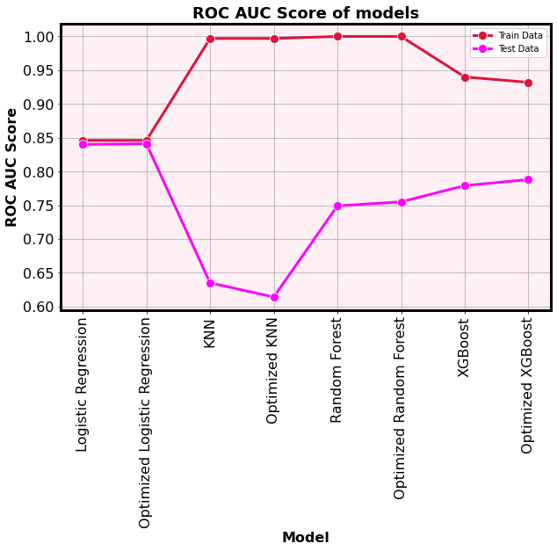
Model Selection and Evaluation

