Slide 1

Stroke Prediction Using Machine Learning
Shehani Wetthasinghe

Slide 2
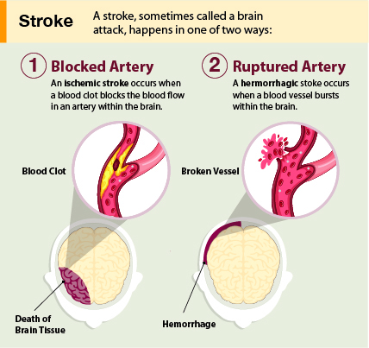
Project Overview
According to CDC;
“A stroke, sometimes called a brain attack, occurs when something blocks blood supply to part of the brain or when a blood vessel in the brain bursts. In either case, parts of the brain become damaged or die. A stroke can cause lasting brain damage, long-term disability, or even death.”
The goal of the project:
To predict the chance of having a stroke based on common risk factors using machine learning techniques.

Slide 3
Project Data Source
Source of Data: Kaggle Stroke Prediction Database
Author: FEDESORIANO
The original dataset ;
contains 5110 rows and 11 columns
12 columns = 10 input features + 1 target variable
From the total number of patients;
~95% detected as negative for brain stroke (normal)
~5% detected as positive for brain stroke (stroke)

Slide 4
Project Data Features
Feature | Description
1. Gender | Male / Female / Other
2. Age | Age of the patient in years
3. Hypertension | Yes (1) / No (0)
4. Heart Disease | Yes (1) / No (0)
5. Ever Married | Yes / No
6. Work Type | Children / Never worked / Government job / Private job / Self employed
7. Residence Type | Rural / Urban
8. Average Glucose Level | Average Glucose Level in Blood (mg/dL)
9. BMI | Body Mass Index (kgm⁻²)
10. Smoking Status | Formerly smoked/Never smoked/Smokes
11. Stroke | Yes (1) / No (0)

Slide 5
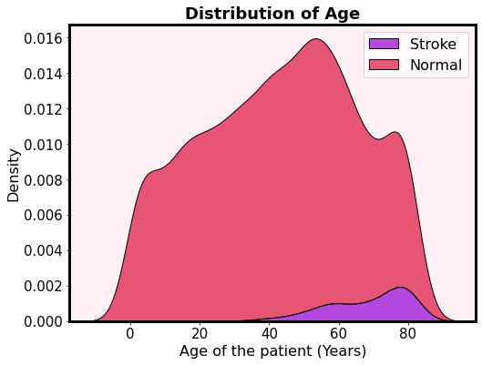
Distribution of Key Features
Patients who got positive for brain stroke is approximately above 30 years old
The risk of having a stroke is increasing with age

Slide 6
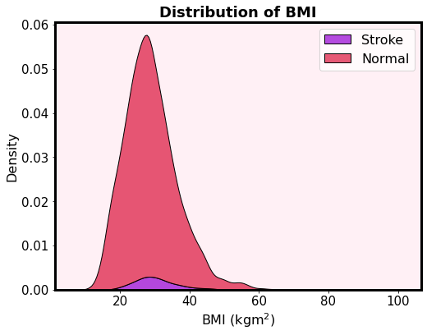
Distribution of Key Features
According to the CDC, patients can be categorized as;
BMI is less than 18.5: Underweight range
BMI is 18.5 to 24.9: Healthy Weight range
BMI is 25.0 to 29.9: Overweight range
BMI is 30.0 or higher: Obese range
There is a risk of having a stroke if the BMI beyond the overweight range
But there is also a chance of having a stroke even your BMI falls in healthy weight range

Slide 7
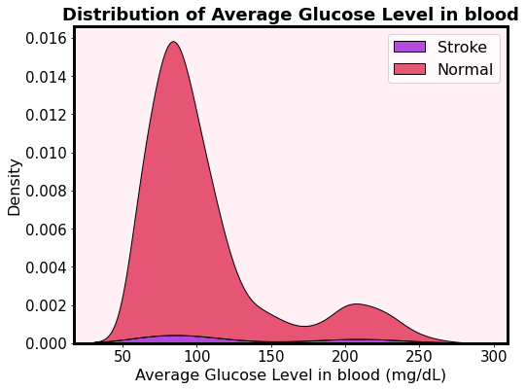
Distribution of Key Features
According to CDC;
Diabetes: above 126 mg/dL
Prediabetes: 100 – 125 mg/dL
Normal: Below 99 mg/dL
According this plot, the risk of having a stroke is not much dependent on the average glucose level in blood

Slide 8
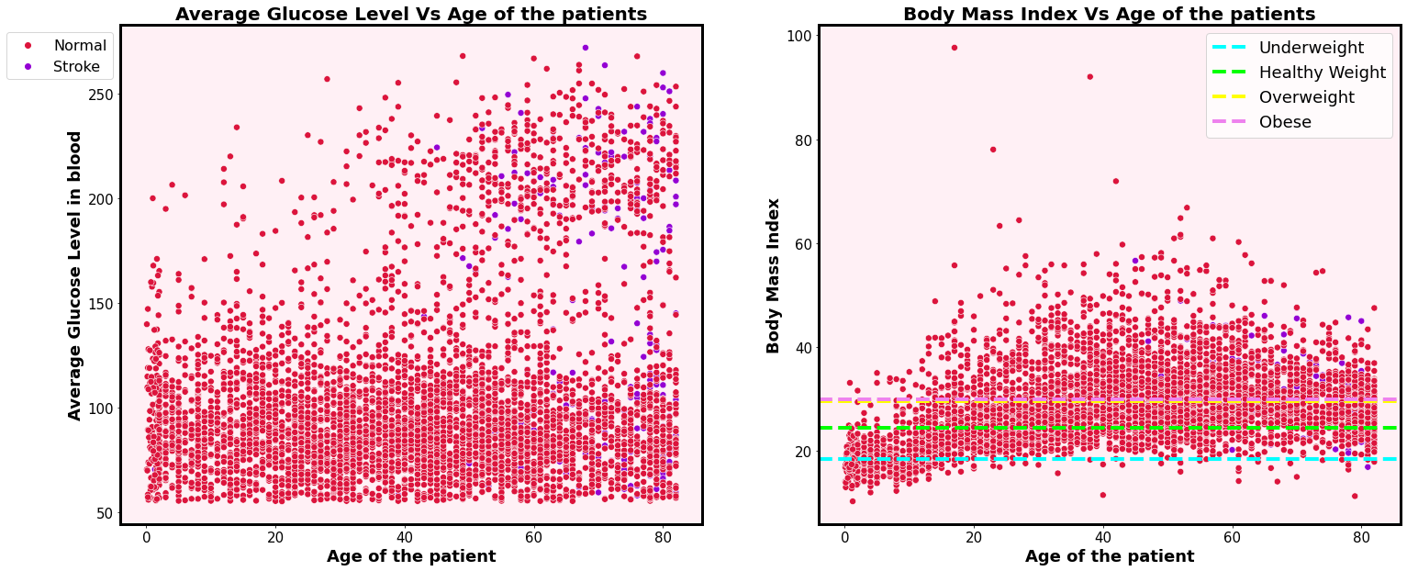
Correlation between average glucose level and age of patients
There is a high risk on the people above ~45 years who suffering from diabetes to have a brain stroke

Slide 9
Correlation between BMI and age of patients
There is a higher risk on the people above ~ 45 years who suffering from overweight to have a brain stroke

Slide 10
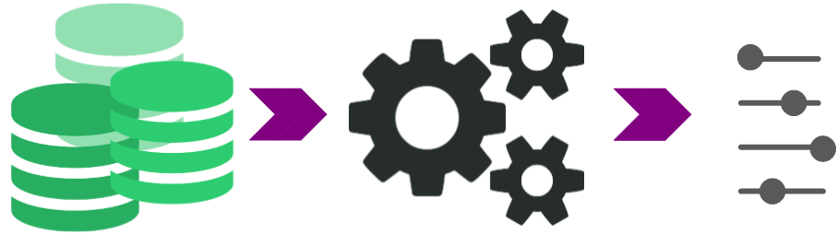
Machine Learning Models
Stroke Prediction : Classification Problem
Used Models :
Logistic Regression
K-Nearest Neighbor
Random Forest
XGBoost
Developments:
Reduce the number of features
Synthetically generated new data to balance the dataset
Optimize the default parameters

Slide 11
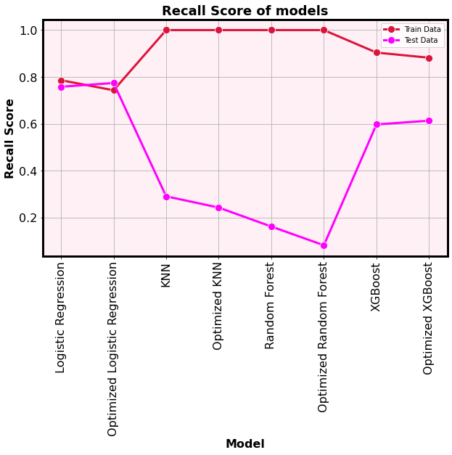
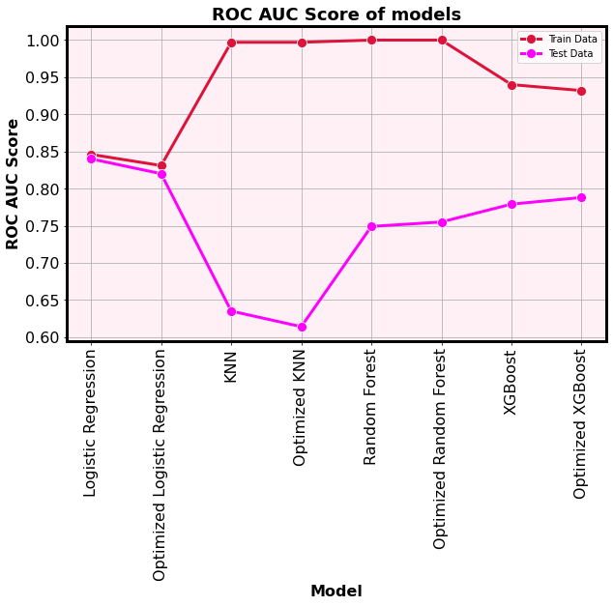
Model Selection and Evaluation
Optimized Logistic Regression Model was chosen as the best performing model to predict brain stroke
~77% of performance of making predictions for unseen data
The quality of the model is ~ 82% - 83%

Slide 12

Recommendations
As per the findings of this project, the optimized Logistic Regression Model can be used as an early detection of brain stroke and direct to the treatments
This model is developed to minimize the inaccurate predictions which may increase the severeness of the brain strokes
The risk of have a brain stroke is increasing with age, BMI and average glucose level in blood

Slide 13

Thank you

