Slide 1

FAKE NEWS DETECTION USING MACHINE LEARNING
Kaysarul Anas Apurba-1811257642
Rofiqul Alam Shehab- 1831185042
COURSE CODE-CSE 445
FALL 2021

Slide 2

Problem Statement
⧫ Develop a machine learning program to identify fake/unreliable news based on content acquired.

Slide 3
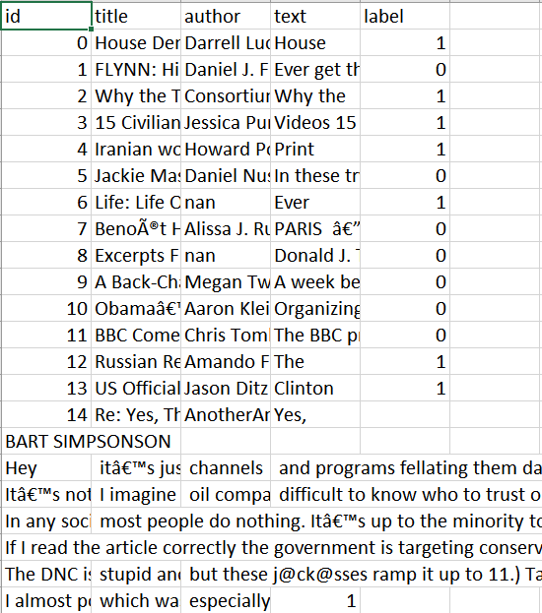
Data
⧫ Dataset source - Kagglehttps://www.kaggle.com/c/fake-news/data?select=train.csv
⧫ ID, Title, Author, Text, Label
⧫ Label 1 - Unreliable
⧫ Label 0 - Reliable

Slide 4


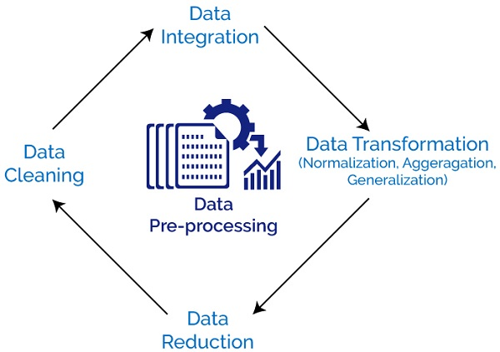
WORK FLOW DIAGRAM
Train
Test
Training ML Models With Train Data
News Data
Train Test Split
Feed Test Data To Our Trained Model
Real
or
Fake
Prediction

Slide 5
PRE-PROCESSING & DATA SPLITING
Train
Test
Remove Punctuations
Remove empty cells
DATA PREPROCESSING
Remove Stopwords
Converted into Lowercase
Train Test Split
Notes:
Preprocessing is done on a dataset before applying any algorithm to increase features of the dataset.

Slide 6



TRAINING ML MODELS
LOGISTIC REGRESSION
RANDOM FOREST
DECISION TREE

Slide 7
Comparison of Models
Model | Accuracy
LOGISTIC REGRESSION | 96.7%
RANDOM FOREST | 98.50%
DECISION TREE | 98.75%

Slide 8
Project Contribution
Kaysarul Anas Apurba | Logistic Regression, Random Forest
Rofiqul Alam Shehab | Random Forest, Decision Tree

Slide 9

Challenges Faced
⧫ Lack of clean data to directly work with might have slowed down our progress
⧫ The loss to value of information in a real scenario for news is very high
⧫Have to deal with existing null value which we filled with Boolean value True.

Slide 10

Future Work
⧫ Assemble the classifiers to achieve better performance - Adam Boost
⧫ Check the sources of the news
⧫ Search the news on the web to check the content of the news

Slide 11
THANK YOU

