Slide 1


Group Member’s
UNIFIEDQA: Crossing Format Boundaries with a Single QA System
Kaysarul anas- 1811257642
Md. Ahsanuzzaman 1813158642
Rofiqul Alam Shehab- 1831185042

Slide 2
Objective
By developing a format-agnostic QA system, we push for a unified vision of QA formats. Our research builds on previous advances in pre-trained neural networks for text-to-text conversion, with a particular focus on different QA formats. This paradigm allows numerous NLP models with task-specific architectures to be combined into a single text-to-text framework.

Slide 3
Motivation
Chatbot
80% of businesses plan having on a chatbot by 2020
Chatbot
63% of users would consider using a chatbot to obtain a customer service
Chatbot
By 2022, chatbot will have replaced 50% of the applications used in the workplace

Slide 4
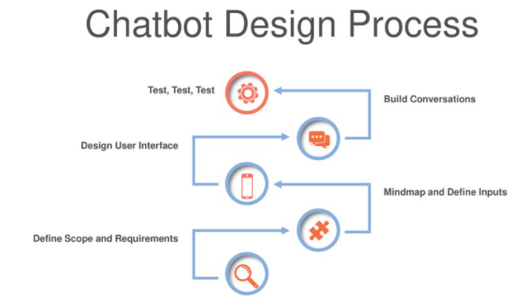

Slide 5
Publish the paper in a reputed journal

Slide 6


