Slide 1
Air Quality Index (AQI) Data Visualization Project
Understanding the Impact of Air Pollution and Solutions

Slide 2
Problem Statement
Air pollution is a major health and environmental concern. High AQI levels contribute to respiratory diseases, heart issues, and mortality.
Goal: Identify the most polluted areas, analyze pollutants, and propose solutions.

Slide 3
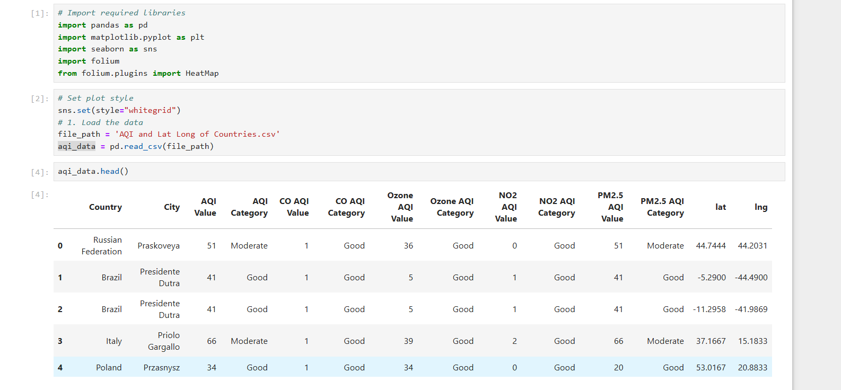
Data Description

Slide 4
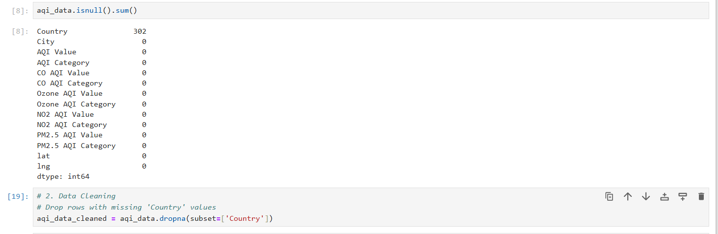
Data Cleaning:

Slide 5
Data Description
Dataset Overview:
Source: AQI monitoring stations worldwide.
Key Variables:
Country and City.
AQI Value and Pollutants (PM2.5, CO, NO2, Ozone).
Latitude and Longitude (for geospatial analysis).
Data Cleaning:
Removed rows with missing 'Country' values.
Ensured data integrity for accurate visualizations.

Slide 6
Visualizations
Geospatial Heatmap: Identifies global pollution hotspots.
Top 20 Countries: Highlights countries with the highest average AQI.
Pollutant Contribution: PM2.5 is the largest contributor to poor AQI.
AQI Categories Distribution: Shows the percentage of regions by AQI category.

Slide 7
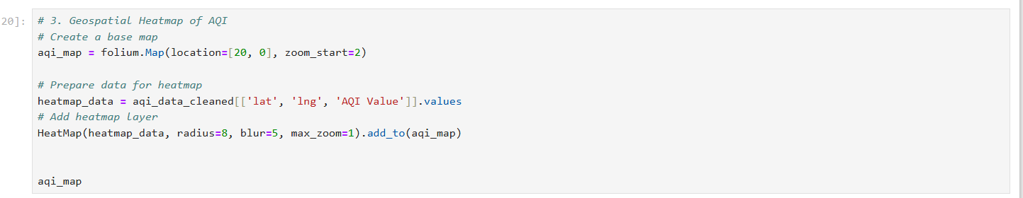
Visuals – Geospatial Heatmap

Slide 8
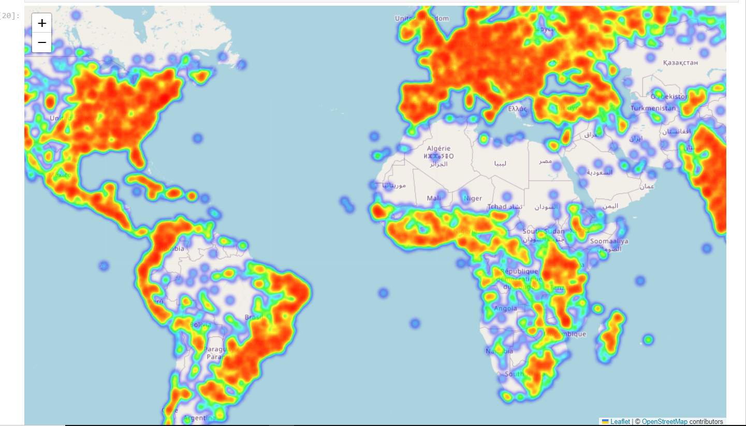
Visuals – Geospatial Heatmap

Slide 9
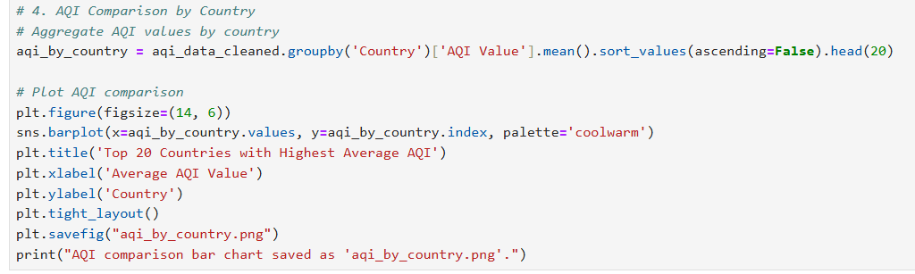
Visuals – Top 20 Countries

Slide 10
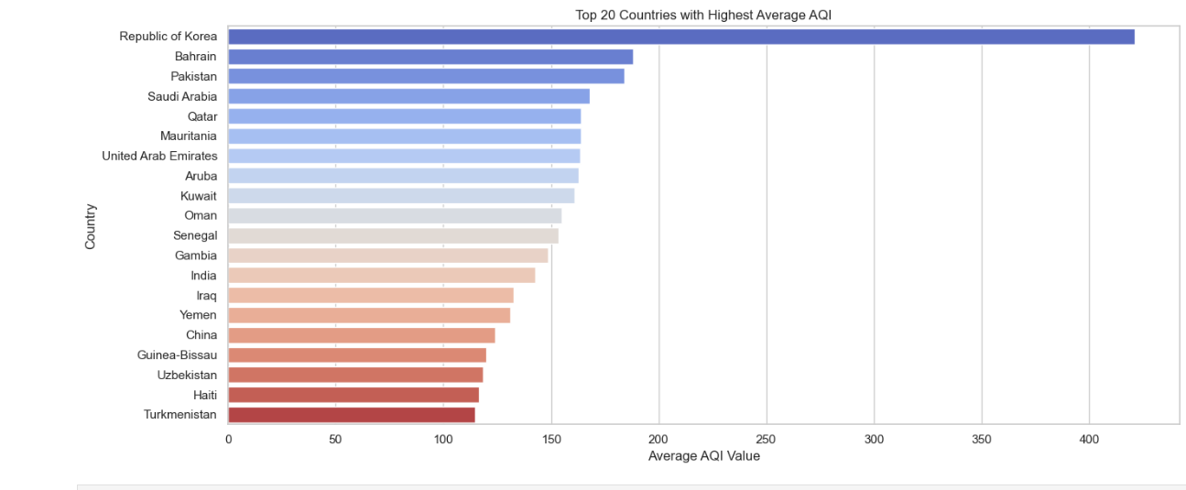
Visuals – Top 20 Countries
This chart shows the most polluted cities with their AQI scores.

Slide 11
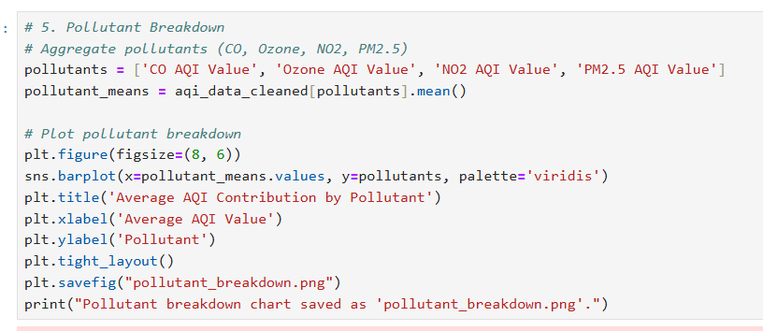
Visuals – Pollutant Contribution

Slide 12
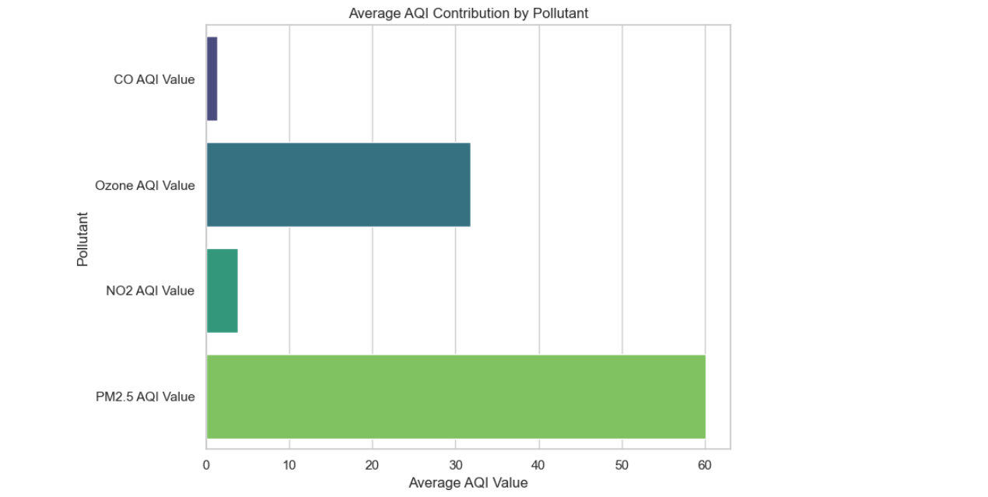
Visuals – Pollutant Contribution
PM2.5 and Ozone are the primary contributors to poor AQI.

Slide 13
Causes and Solutions for Increased Pollutants
PM2.5 (Particulate Matter):
Causes: Industrial emissions, vehicle exhaust, construction activities, and burning of biomass and fossil fuels.
Solutions:
Transition to cleaner energy sources like solar and wind.
Implement stricter vehicle emission standards.
Promote urban greenery to reduce dust particles.
Ozone (O3):
Causes: Reactions between volatile organic compounds (VOCs) and nitrogen oxides (NOx) in sunlight, often from industrial processes and vehicle emissions.
Solutions:
Reduce VOC and NOx emissions through industrial regulation.
Encourage use of electric or hybrid vehicles.
Support air quality monitoring systems for timely interventions.

Slide 14
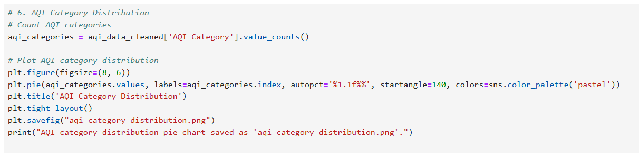
AQI Category Distribution

Slide 15
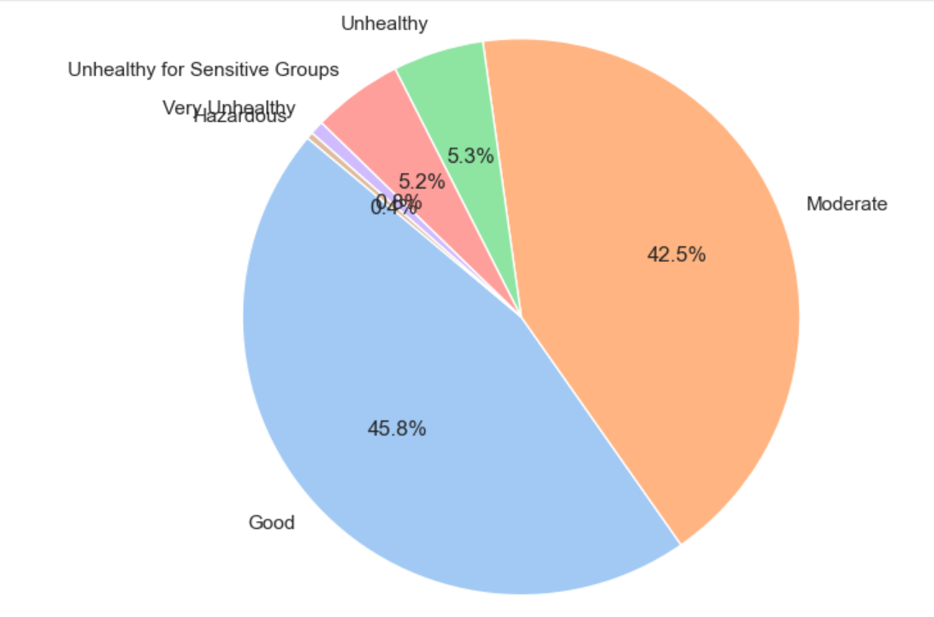
AQI Category Distribution

Slide 16
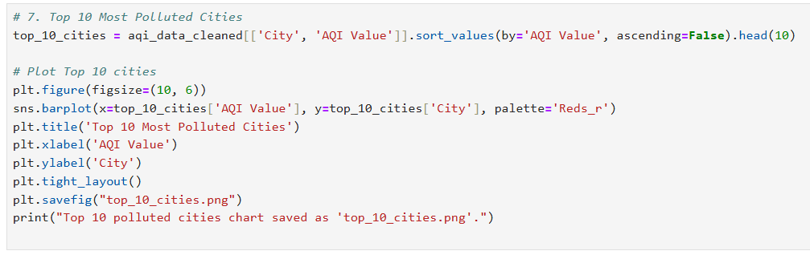
Visuals – Top 10 Polluted Cities

Slide 17
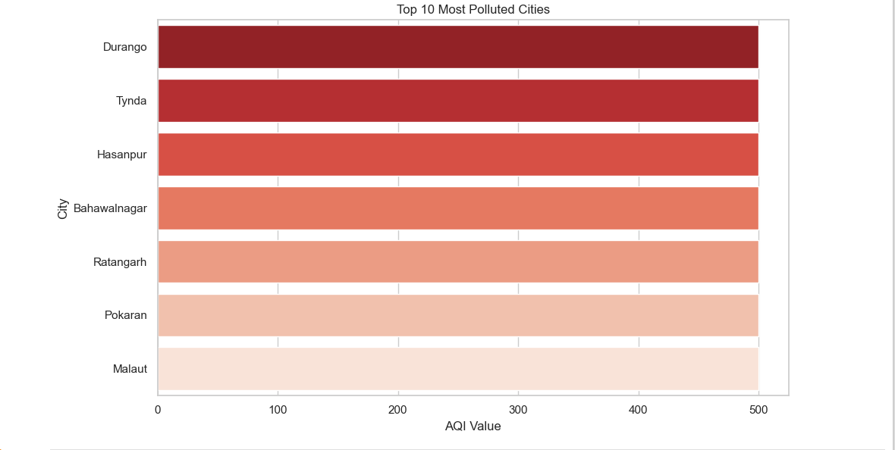
Visuals – Top 10 Polluted Cities
Countries with the most hazardous AQI values.

Slide 18
Data Insights
Geospatial analysis identified pollution hotspots.
PM2.5 is the most significant contributor to poor air quality.
Countries like Korea and Bahrain have the highest average AQI.
11.7% of regions fall under unhealthy or hazardous AQI categories.

Slide 19
Proposed Solutions
Promote Clean Energy: Solar, wind, and electric vehicles.
Enforce Emission Regulations: Stricter policies on industries and vehicles.
Raise Public Awareness: Educate communities about air pollution risks.
Real-Time Monitoring: Use IoT sensors for continuous AQI tracking.

Slide 20
Conclusion
This project highlights the importance of addressing air pollution through data-driven insights.
By identifying hotspots and key contributors, actionable strategies can be implemented to improve air quality.
Together, we can create a cleaner, healthier environment..

