Slide 1
Ontologies & the Semantic Web Project Sports Ontology
Team Members:
Ahmed Osama Ahmed – 18P6575
Shehab Mohamed Ibrahim – 18P7213
Yusuf Sameh Fawzi – 18P1399
Salma Ehab Mohamed – 18P6253
Maryam Mohamed Mohamed Mahmoud Abdelrahman – 18P8171

Slide 2
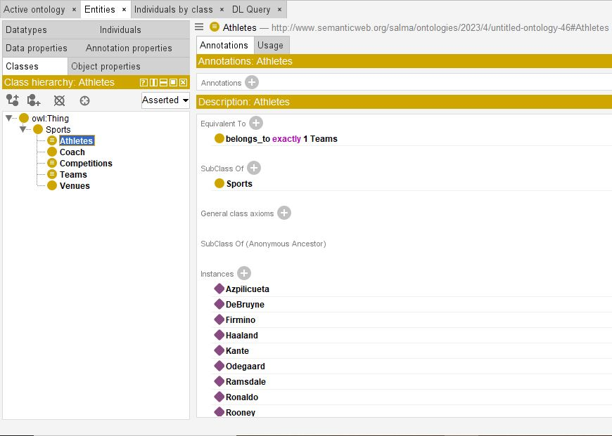
Classes
Sports (Main Class)
Athletes
Coaches
Teams
Venues
Competitions

Slide 3
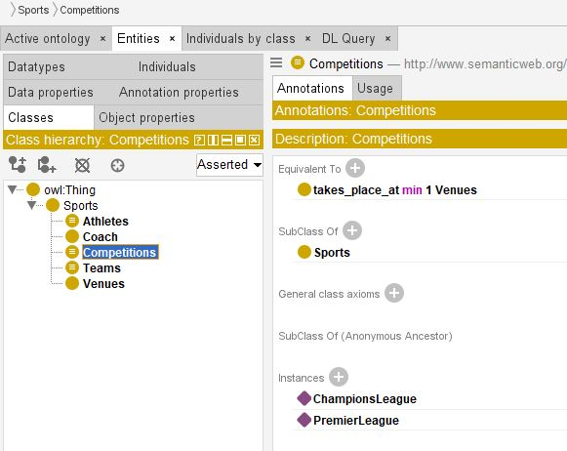
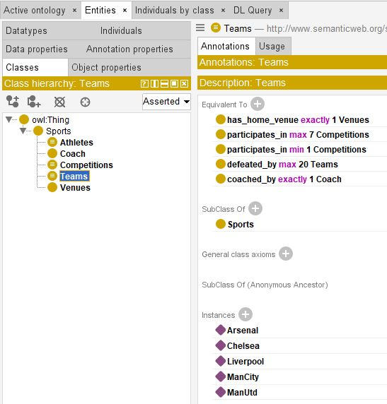
Classes (Cont.)

Slide 4
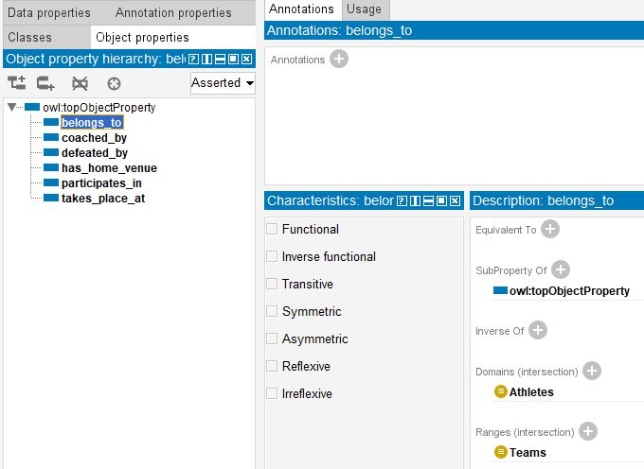
Object Properties
participates_in
belongs_to
takes_place_at
coached_by
defeated_by
has_home_venue

Slide 5
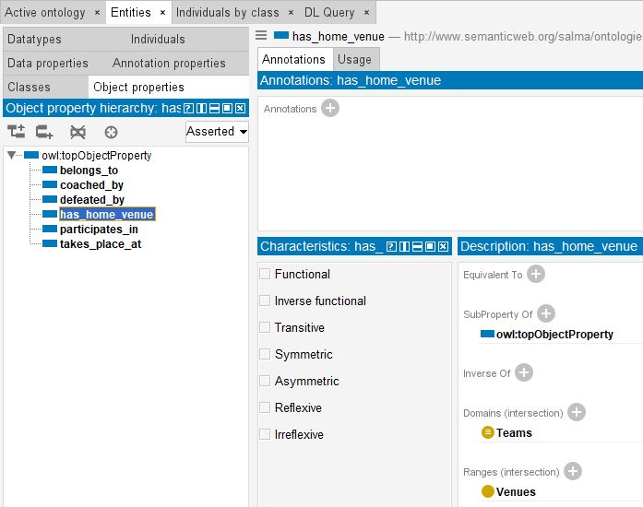
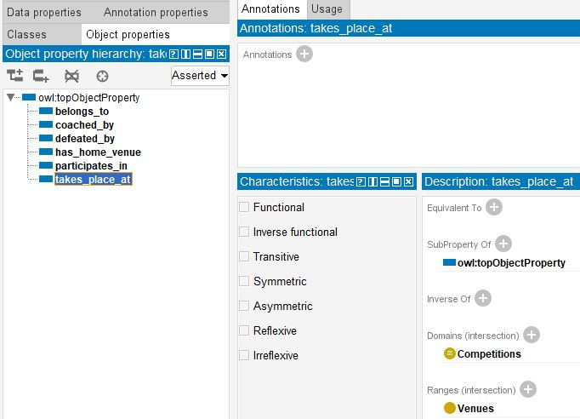
Object Properties (Cont.)

Slide 6
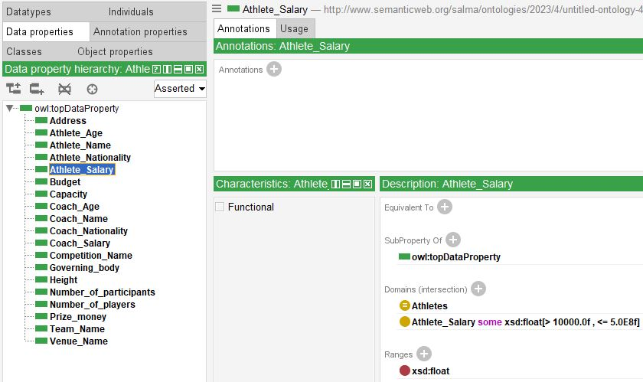
Data Properties
Address
Athlete_Age
Athlete_Name
Athlete_Nationality
Athlete_Salary
Budget
Capacity
Coach_Age
Coach_Name
Coach_Nationality
Coach_Salary
Competition_Name
Governing_body
Height
Number_of_participants
Number_of_players
Prize_money
Team_Name
Venue_Name

Slide 7
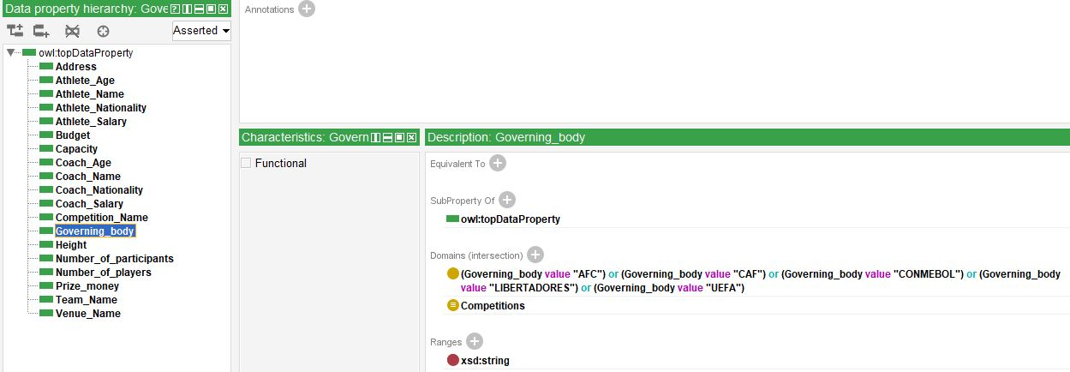
Data Properties (Cont.)

Slide 8
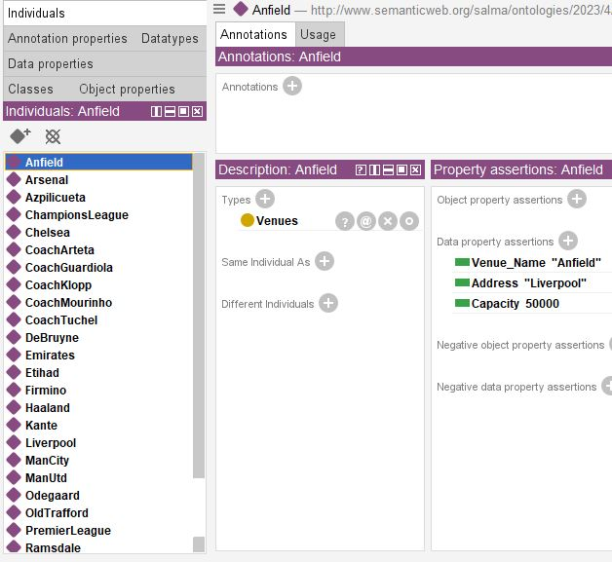
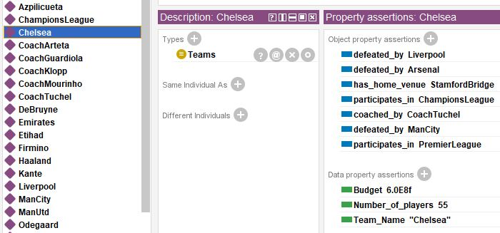
Individuals

Slide 9
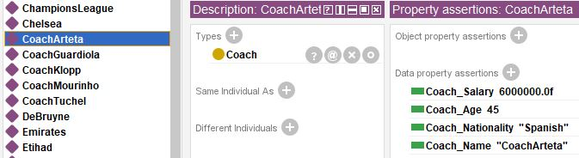
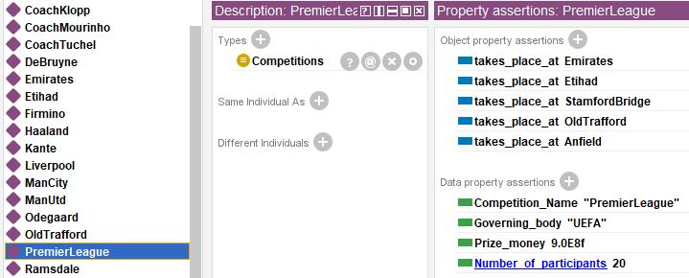
Individuals (Cont.)

Slide 10
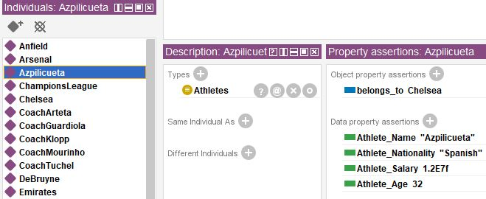
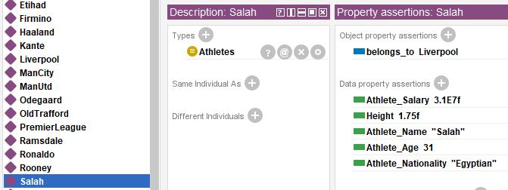
Individuals (Cont.)

Slide 11
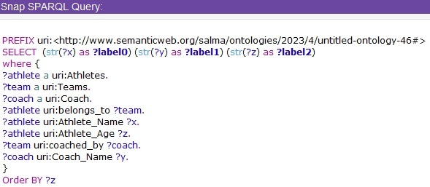
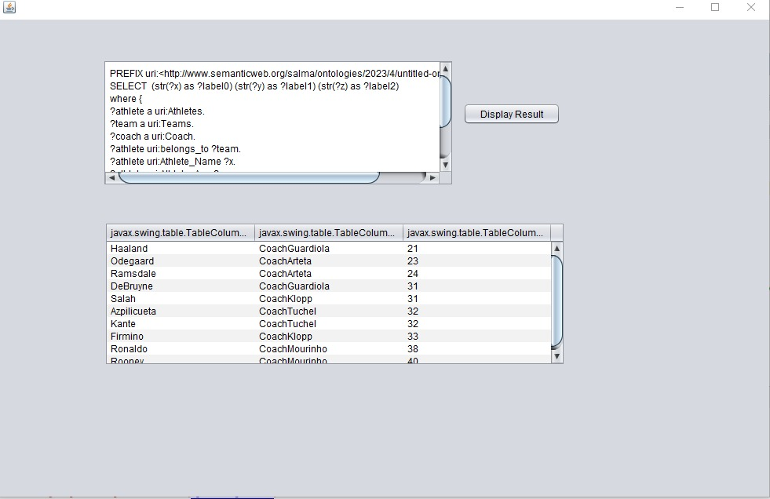
SPARQL Query 1
Returns athletes & their coaches & their ages, then orders results by age.

Slide 12
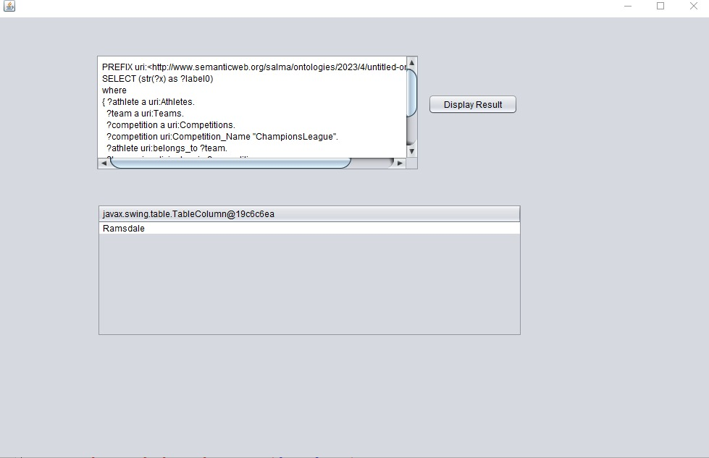
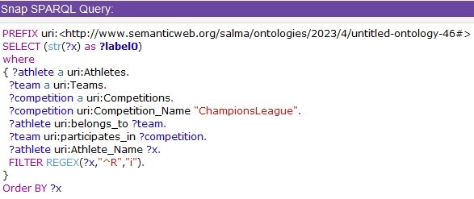
SPARQL Query 2
Returns athletes that play for a team participating in Champions League and has a name starting with the letter ‘R’.

Slide 13
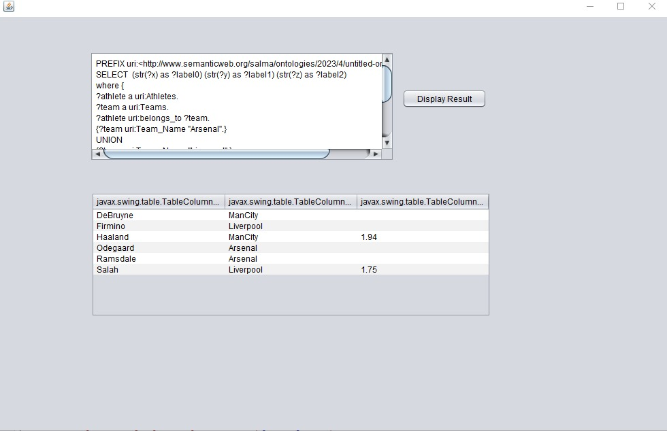
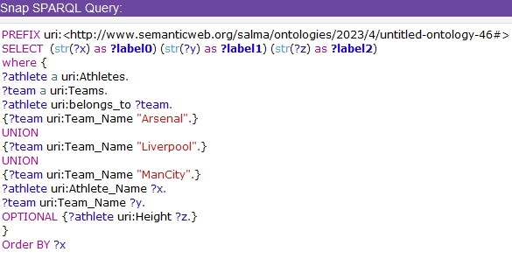
SPARQL Query 3
Returns athletes that play for Arsenal or Liverpool or Manchester City, and optionally returns each player’s height.

Slide 14
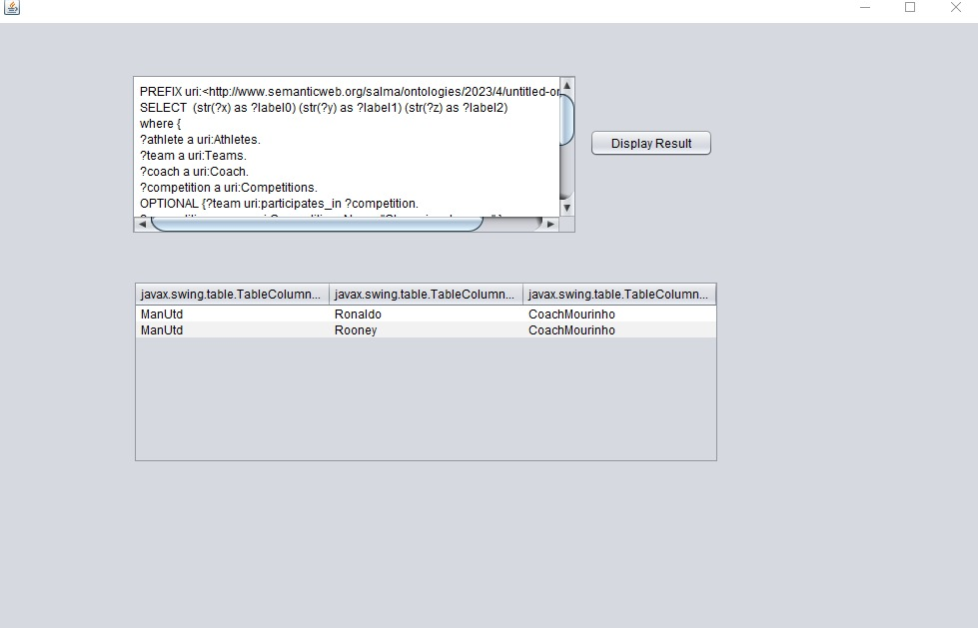
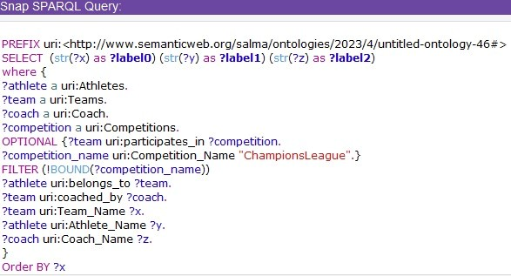
SPARQL Query 4
Returns teams & their athletes & their coach that does not participate in Champions League.

Slide 15
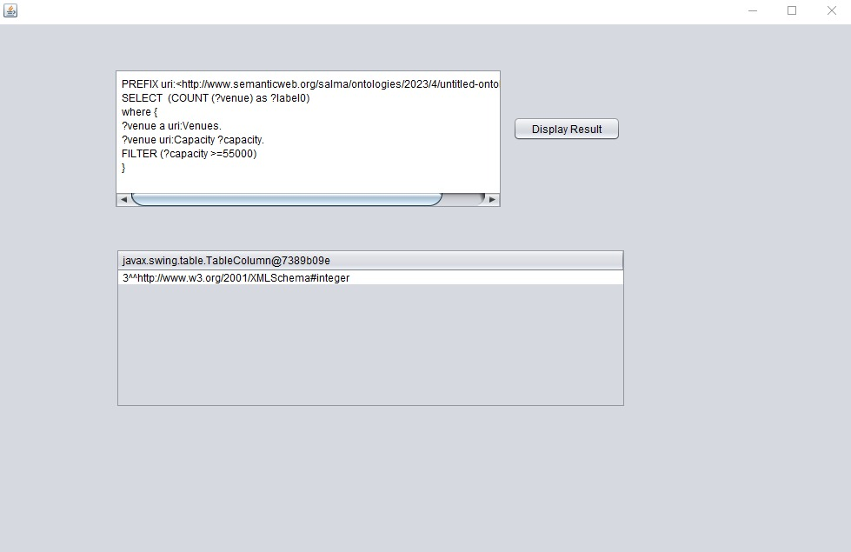
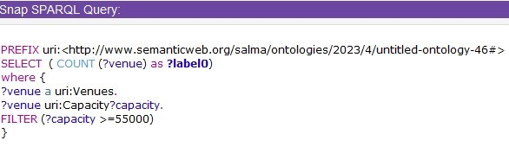
SPARQL Query 5
Returns the number of venues that has more than 55,000 seats or equal.

Slide 16
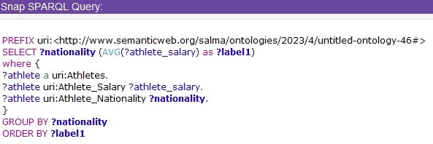
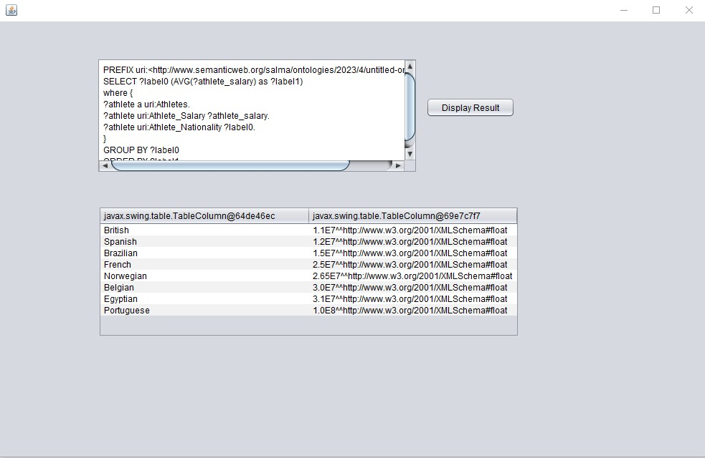
SPARQL Query 6
Returns the average salary per nationality, ordered in an ascending order.

Slide 17
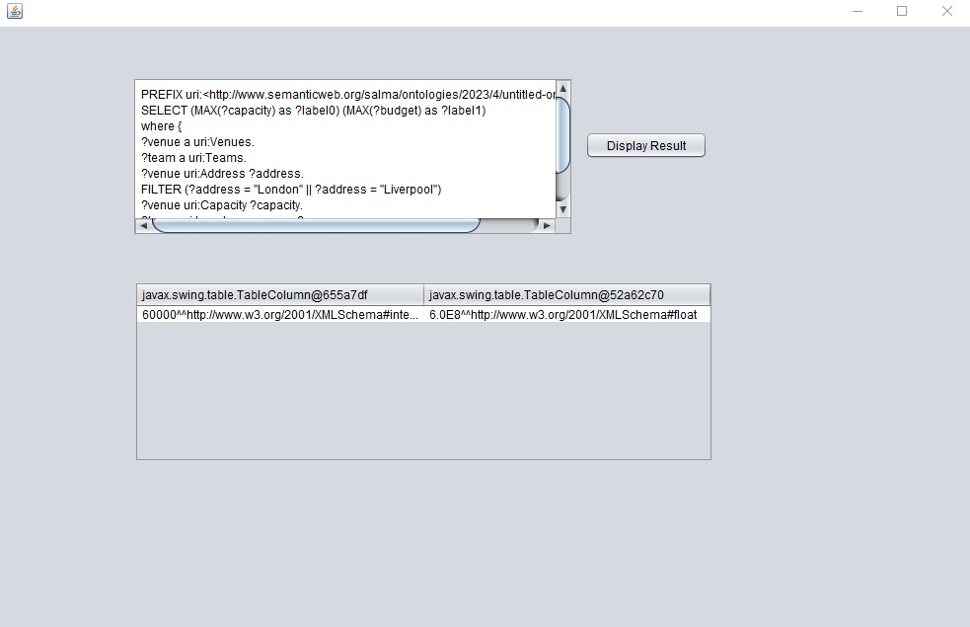
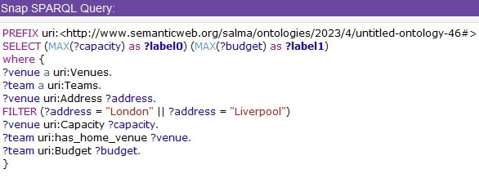
SPARQL Query 7
Returns the biggest stadium in the city of London or the city of Liverpool, and returns the highest budget found in the teams of the city of London or the city of Liverpool.

Slide 18
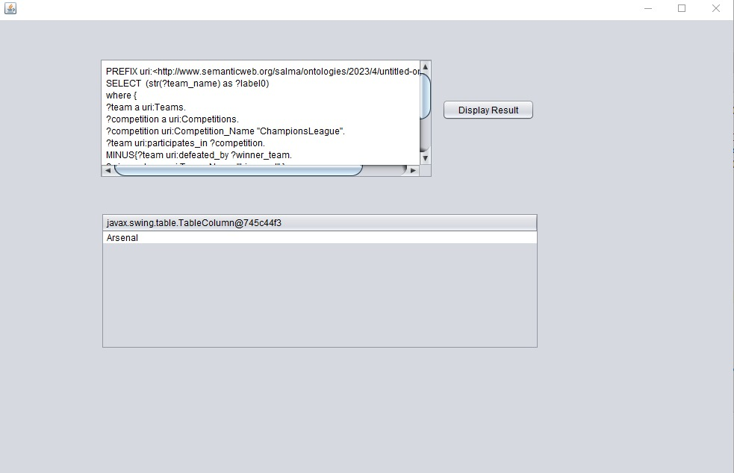
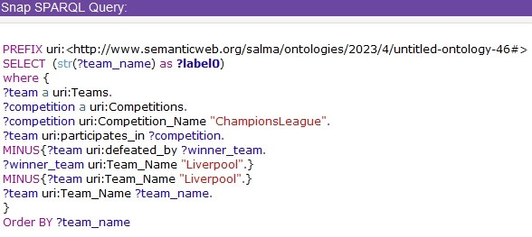
SPARQL Query 8
Returns teams that play in Champions League, that has not been defeated by Liverpool, other than Liverpool itself.

