Slide 1


Course Title: Operating Systems Course Code: CS321
Assiut University
كلية معتمدة من الهيئة القومية
لضمان جودة التعليم والاعتماد
Prof. Khaled F. Hussain

Slide 2
Reference
Silberschatz, Abraham, Peter B. Galvin, and Greg Gagne. Operating system concepts. John Wiley & Sons.

Slide 3
CPU Scheduling

Slide 4
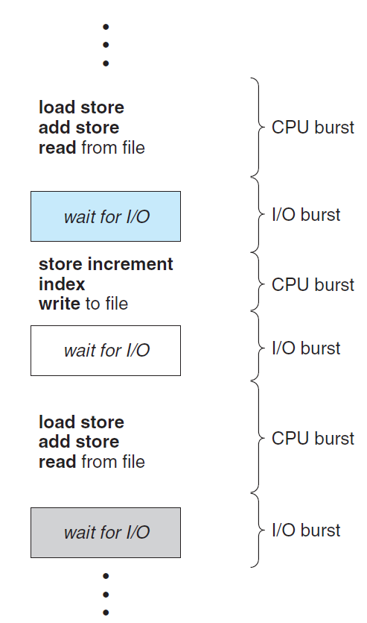
Alternating sequence of CPU and I/O bursts

Slide 5
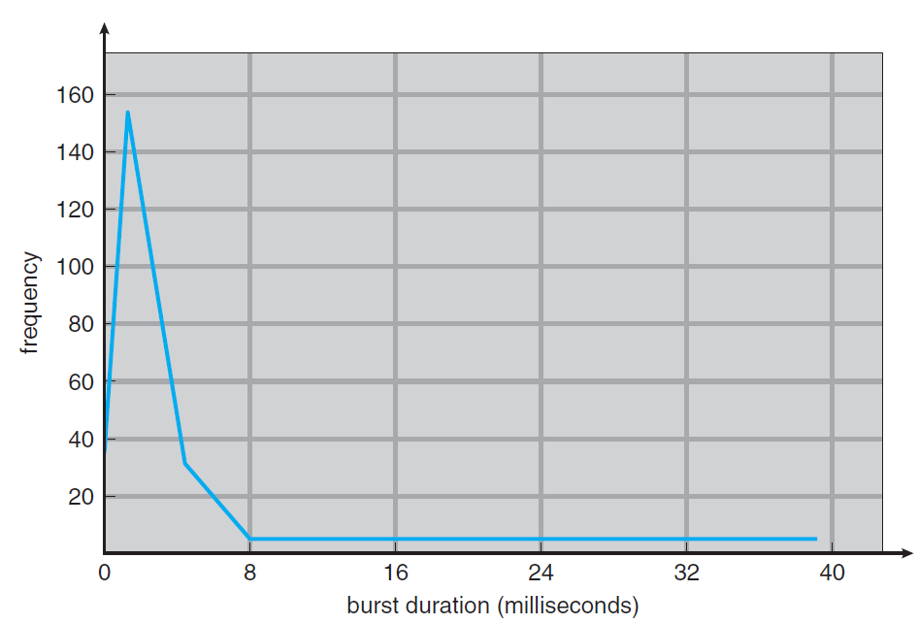
Histogram of CPU-burst durations

Slide 6
CPU scheduler (short-term scheduler)
The scheduler selects a process from the processes in memory that are ready to execute and allocates the CPU to that process.
Under nonpreemptive scheduling, once the CPU has been allocated to a process, the process keeps the CPU until it releases the CPU either by terminating or by switching to the waiting state.
Unfortunately, preemptive scheduling can result in race conditions when data are shared among several processes. Consider the case of two processes that share data. While one process is updating the data, it is preempted so that the second process can run. The second process then tries to read the data, which are in an inconsistent state.

Slide 7
Dispatcher
Another component involved in the CPU-scheduling function is the dispatcher.
The dispatcher is the module that gives control of the CPU to the process selected by the short-term scheduler. This function involves the following:
Switching context
Switching to user mode
Jumping to the proper location in the user program to restart that program

Slide 8
Scheduling Criteria
CPU utilization. We want to keep the CPU as busy as possible.
Throughput: the number of processes that are completed per time unit.
Turnaround time: the interval from the time of submission of a process to the time of completion.
Waiting time: the sum of the periods spent waiting in the ready queue.
Response time: the time from the submission of a request until the first response is produced, the time it takes to start responding.
It is desirable to maximize CPU utilization and throughput and to minimize turnaround time, waiting time, and response time.

Slide 9
Scheduling Algorithms
First-Come, First-Served Scheduling
Shortest-Job-First Scheduling
Priority Scheduling
Round-Robin Scheduling
Multilevel Queue Scheduling

Slide 10

First-Come, First-Served Scheduling (FCFS)
The implementation of the FCFS policy is easily managed with a FIFO queue. When the CPU is free, it is allocated to the process at the head of the queue. The running process is then removed from the queue.
Process Burst Time
P1 24
P2 3
P3 3
If the processes arrive in the order P1, P2, P3, and are served in FCFS order, we get the result shown in the following Gantt chart
The waiting time is 0 milliseconds for process P1, 24 milliseconds for process P2, and 27 milliseconds for process P3. Thus, the average waiting time is (0 + 24 + 27)/3 = 17 milliseconds.

Slide 11

First-Come, First-Served Scheduling (Cont.)
If the processes arrive in the order P2, P3, P1, however, the results will be as shown in the following Gantt chart:
The average waiting time is now (6 + 0 + 3)/3 = 3 milliseconds. This reduction is substantial.
Convoy effect: all the other processes wait for the one big process to get off the CPU.
Note that the FCFS scheduling algorithm is nonpreemptive.

Slide 12
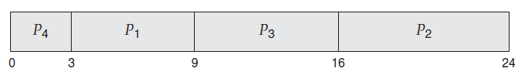
Shortest-Job-First Scheduling (SJF)
This algorithm associates with each process the length of the process’s next CPU burst. When the CPU is available, it is assigned to the process that has the smallest next CPU burst.
If the next CPU bursts of two processes are the same, FCFS scheduling is used to break the tie.
Process Burst Time
P1 6
P2 8
P3 7
P4 3
Using SJF scheduling, we would schedule these processes according to the following Gantt chart:

Slide 13
Shortest-Job-First Scheduling (SJF) (Cont.)
The waiting time is 3 milliseconds for process P1, 16milliseconds for process P2, 9milliseconds for process P3, and 0milliseconds for process P4. Thus, the average waiting time is (3 + 16 + 9 + 0)/4 = 7 milliseconds.
By comparison, if we were using the FCFS scheduling scheme, the average waiting time would be 10.25 milliseconds.
The SJF scheduling algorithm is provably optimal, in that it gives the minimum average waiting time for a given set of processes.
The real difficulty with the SJF algorithm is knowing the length of the next CPU request.
Although the SJF algorithm is optimal, it cannot be implemented at the level of short-term CPU scheduling. With short-term scheduling, there is no way to know the length of the next CPU burst. One approach to this problem is to try to approximate SJF scheduling. We may not know the length of the next CPU burst, but we may be able to predict its value.
By computing an approximation of the length of the next CPU burst, we can pick the process with the shortest predicted CPU burst.

Slide 14
Shortest-Job-First Scheduling (SJF) (Cont.)
The next CPU burst is generally predicted as an exponential average of the measured lengths of previous CPU bursts.
Let tn be the length of the nth CPU burst, and let τ_{n+1} be our predicted value for the next CPU burst. Then, for α, 0 ≤ α ≤ 1, define
τ_{n+1} = α t_{n} + (1 − α) τ _{n}.
The value of t_{n} contains the most recent information, while τ _{n} stores the past history.
The parameter α controls the relative weight of recent and past history in our prediction. If α =0, then τ_{n+1} = τ _{n}, and recent history has no effect (current conditions are assumed to be transient). If α =1, then τ_{n+1} = tn, and only the most recent CPU burst matters (history is assumed to be old and irrelevant).
More commonly, α = 1/2, so recent history and past history are equally weighted.
The SJF algorithm can be either preemptive or nonpreemptive. Preemptive SJF scheduling is sometimes called shortest-remaining-time-first scheduling.

Slide 15
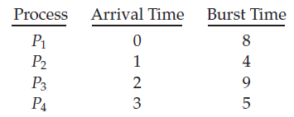
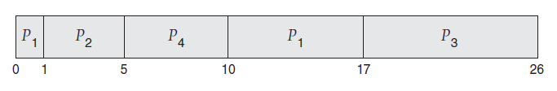
Example: preemptive SJF schedule
Process P1 is started at time 0, since it is the only process in the queue.
Process P2 arrives at time 1. The remaining time for process P1 (7 milliseconds) is larger than the time required by process P2 (4 milliseconds), so process P1 is preempted, and process P2 is scheduled.
The average waiting time for this example is [(10 − 1) + (1 − 1) + (17 − 2) + (5 − 3)]/4 = 26/4 = 6.5 milliseconds.
Nonpreemptive SJF scheduling would result in an average waiting time of 7.75 milliseconds.

Slide 16
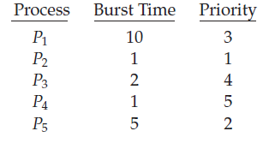
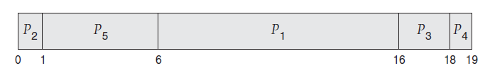
Priority Scheduling
The SJF algorithm is a special case of the general priority-scheduling algorithm. An SJF algorithm is simply a priority algorithm where the priority (p) is the inverse of the (predicted) next CPU burst.
A priority is associated with each process, and the CPU is allocated to the process with the highest priority.
Equal-priority processes are scheduled in FCFS order.
Priority scheduling can be either preemptive or nonpreemptive.
In this text, we assume that low numbers represent high priority.
The average waiting time is 8.2 milliseconds.

Slide 17
Priority Scheduling (Cont.)
A major problem with priority scheduling algorithms is indefinite blocking, or starvation. A process that is ready to run but waiting for the CPU can be considered blocked. A priority scheduling algorithm can leave some low priority processes waiting indefinitely, in a heavily loaded computer system.
(Rumor has it that when they shut down the IBM 7094 at MIT in 1973, they found a low-priority process that had been submitted in 1967 and had not yet been run.)
A solution to the problem of indefinite blockage of low-priority processes is aging. Aging involves gradually increasing the priority of processes that wait in the system for a long time.

Slide 18
Round-Robin Scheduling
The round-robin (RR) scheduling algorithm is designed especially for timesharing systems. It is similar to FCFS scheduling, but preemption is added to enable the system to switch between processes.
A small unit of time, called a time quantum or time slice, is defined. A time quantum is generally from 10 to 100 milliseconds in length.
The ready queue is treated as a circular queue. The CPU scheduler goes around the ready queue, allocating the CPU to each process for a time interval of up to 1 time quantum.
The average waiting time under the RR policy is often long.
The RR scheduling algorithm is thus preemptive.
If there are n processes in the ready queue and the time quantum is q, then each process gets 1/n of the CPU time in chunks of at most q time units.
Each process must wait no longer than (n − 1) × q time units until its next time quantum.
If the time quantum is extremely large, the RR policy is the same as the FCFS policy.
If the time quantum is extremely small (say, 1 millisecond), the RR approach can result in a large number of context switches.

Slide 19
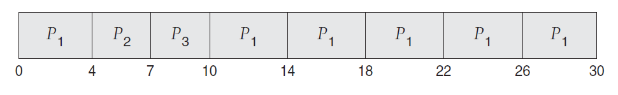
Round-Robin Scheduling (Cont.)
Process Burst Time
P1 24
P2 3
P3 3
Let’s calculate the average waiting time for this schedule. P1 waits for 6 milliseconds (10 - 4), P2 waits for 4 milliseconds, and P3 waits for 7 milliseconds. Thus, the average waiting time is 17/3 = 5.66 milliseconds.

Slide 20
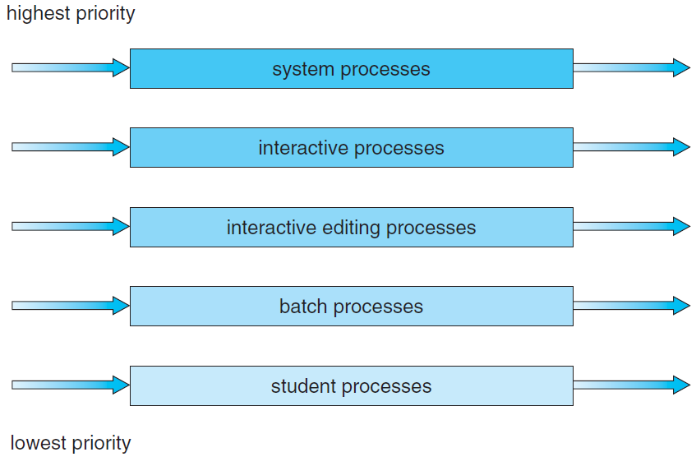
Multilevel Queue Scheduling
For example, a division is made between foreground (interactive) processes and background (batch) processes.
These two types of processes have different response-time requirements and so may have different scheduling needs. In addition, foreground processes may have priority (externally defined) over background processes.
A multilevel queue scheduling algorithm partitions the ready queue into several separate queues
Each queue has its own scheduling algorithm.

Slide 21
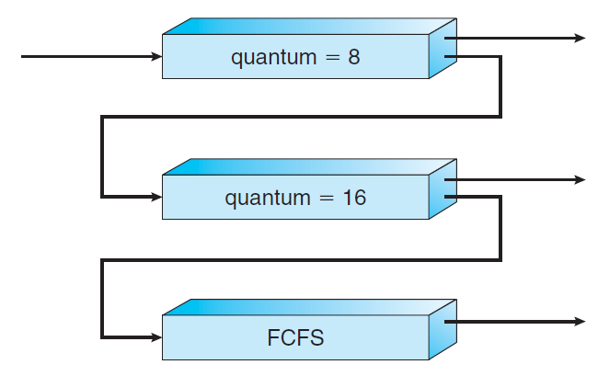
Multilevel Feedback Queue Scheduling
The multilevel feedback queue scheduling algorithm allows a process to move between queues.
The idea is to separate processes according to the characteristics of their CPU bursts. If a process uses too much CPU time, it will be moved to a lower-priority queue. This scheme leaves I/O-bound and interactive processes in the higher-priority queues. In addition, a process that waits too long in a lower-priority queue may be moved to a higher-priority queue. This form of aging prevents starvation.

Slide 22
Multilevel Feedback Queue Scheduling (Cont.)
In general, a multilevel feedback queue scheduler is defined by the following parameters:
The number of queues
The scheduling algorithm for each queue
The method used to determine when to upgrade a process to a higher priority queue
The method used to determine when to demote a process to a lower priority queue
The method used to determine which queue a process will enter when that process needs service

Slide 23
Real-Time CPU Scheduling
We can distinguish between soft real-time systems and hard real-time systems:
Soft real-time systems provide no guarantee as to when a critical real-time process will be scheduled. They guarantee only that the process will be given preference over noncritical processes.
Hard real-time systems have stricter requirements. A task must be serviced by its deadline; service after the deadline has expired is the same as no service at all.

