Slide 1
SLIDE 01 // CLOUDFUSION AWS ARCHITECTURE
Enterprise Cloud Modernisation & Architecture
CloudFusion Healthcare Analytics Ltd (CHA) | AWS Modernisation Strategy
99.999% Availability
Five-nines clinical reliability target with Multi-AZ redundancy.
100,000+ Users
Massive elastic auto-scaling via ECS Fargate and Aurora Serverless v2.
82.3% TCO Savings
Slashing $142k/mo on-premises run-rate to $25k/mo on AWS.

Slide 2
SLIDE 02 // CLOUDFUSION AWS ARCHITECTURE
The Legacy Infrastructure Crisis
On-Premises Single-Site Vulnerabilities & Monolithic Failure Modes
Single Point of Failure
220 VMware VMs in a single data center; power/cooling failure causes total regional blackout.
Monolithic Coupling
Billing, EHR, and patient vitals share memory; single memory leak halts intensive care monitoring.
Operational Drag
Manual deployments; no auto-scaling; legacy VPN bottlenecks to 22 branch hospitals.

Slide 3
SLIDE 03 // CLOUDFUSION AWS ARCHITECTURE
Business Drivers & The Five Nines Imperative
Contractual Mandate vs Clinical Life-Safety Realities
Telco-Grade 99.999%
99.99% permits 52.6 min/yr downtime; clinical life-safety demands 99.999% (<5.26 min/yr).
100,000 Concurrent Scale
Support morning clinic booking surges without database locking or server exhaustion.
FinOps Discipline
Reduce operational expenses by at least 40% using serverless and savings plans.

Slide 4
SLIDE 04 // CLOUDFUSION AWS ARCHITECTURE
Clinical Case for IoT: Discrete vs Continuous
Transforming Healthcare from Reactive Guesswork to Predictive Prevention
Discrete Nursing Polling
Nurses record vitals every 4-6 hours; patient cardiac arrests between visits are completely unmonitored.
Continuous IoT Streaming
Sensors stream SpO2 and ECG every 60s to AWS IoT Core; real-time dashboards track physiological drift.
AI Predictive Triage
Machine learning algorithms forecast sepsis and decompensation 24 to 48 hours in advance.

Slide 5
SLIDE 05 // CLOUDFUSION AWS ARCHITECTURE
Strategic Migration Framework (Well-Architected & 7 Rs)
Targeted Cloud Modernisation Aligned with the 6 Well-Architected Pillars
Replatform (Databases)
Migrate MS SQL Server and MySQL to Amazon Aurora PostgreSQL Serverless v2 via AWS SCT & DMS.
Refactor (Applications)
Decompose monolith into microservices on Amazon ECS on AWS Fargate; IoT to AWS IoT Core.
Terraform IaC Standard
Terraform selected over CloudFormation to ensure hybrid portability across AWS and on-prem VMware.

Slide 6
SLIDE 06 // CLOUDFUSION AWS ARCHITECTURE
Low-Downtime Data Migration Architecture
Continuous Change Data Capture (CDC) & Cryptographic Validation
AWS DMS Continuous CDC
Multi-AZ replication instance captures ongoing transaction logs with < 2 seconds latency.
15-Minute Cutover
Application downtime restricted to a 15-minute off-peak maintenance window.
AWS Glue PySpark Integrity
Converts 5+ years of archives to Parquet; verifies row-level SHA-256 integrity checksums.

Slide 7
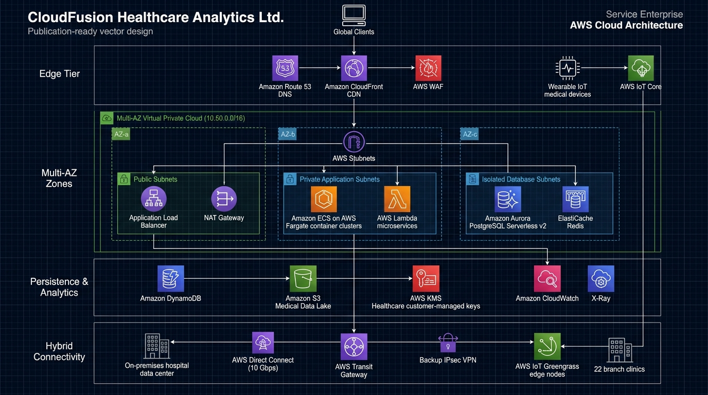
SLIDE 07 // CLOUDFUSION AWS ARCHITECTURE
Target AWS Multi-AZ Network Topology
VPC CIDR: 10.50.0.0/16 Spanning 3 Availability Zones in Singapore

Slide 8
SLIDE 08 // CLOUDFUSION AWS ARCHITECTURE
Patient Monitoring Platform (PMP): IoT Stream
Sub-Second Ingestion of Wearable Telemetry & Emergency Triage
Secure mTLS Ingestion
Medical wearables authenticate via mutual TLS (X.509 certs) publishing to AWS IoT Core.
Emergency Path (< 500ms)
Hypoxia rule (SpO2 < 90%) routes immediately to Amazon SNS & Lambda for doctor pager alerts.
Streaming Analytics Lake
Kinesis Data Streams writes hot records to DynamoDB and archival Parquet to Amazon S3.

Slide 9
SLIDE 09 // CLOUDFUSION AWS ARCHITECTURE
Telemedicine & Patient Portal (TPP): Web App
Distributed Microservices, WAF Edge Defense & Encrypted WebRTC
Edge Security & CDN
Route 53 + CloudFront CDN + AWS WAF protecting static React SPA hosted in S3 with OAC.
Elastic Fargate Microservices
Decoupled services (EHR, Appointments, Billing) auto-scaling from 6 to 60 containers.
Amazon Chime SDK Video
Peer-to-peer encrypted WebRTC video consultation sessions with zero backend compute load.

Slide 10
SLIDE 10 // CLOUDFUSION AWS ARCHITECTURE
Multi-Layered Zero-Trust Security Architecture
Defense-in-Depth Protecting Sensitive Electronic Health Records
Network & Perimeter
AWS WAF OWASP rules + strict Security Group chaining (ALB -> ECS -> Aurora DB).
Identity & Cryptography
Attribute-Based Access Control (ABAC), hardware MFA, and KMS Customer Managed Keys.
Continuous Auditing
AWS CloudTrail WORM object locking, AWS Config conformance packs, and GuardDuty threat detection.

Slide 11
SLIDE 11 // CLOUDFUSION AWS ARCHITECTURE
Healthcare Governance & Compliance Posture
Strict Adherence to GDPR Article 17, HIPAA, and ISO 27001
GDPR Right to Erasure
Pseudonymized patient identifiers via HMAC-SHA256; cryptographic erasure of individual salt keys.
HIPAA Compliance Mode
CloudTrail logs immutably locked using S3 Object Lock in Compliance Mode (cannot be deleted for 7 yrs).
Zero Patient Data Leaks
S3 Block Public Access enforced; mandatory TLS 1.3 encryption across all communication paths.

Slide 12
SLIDE 12 // CLOUDFUSION AWS ARCHITECTURE
Hybrid Connectivity & Hospital Edge Integration
10 Gbps Direct Connect Interconnect & AWS IoT Greengrass Ward Nodes
Direct Connect + IPsec VPN
10 Gbps dedicated link with automated BGP failover to Dual IPsec VPN in < 3 seconds via TGW.
Hybrid Route 53 DNS
Inbound endpoints resolve AWS services from clinics; outbound endpoints resolve hospital LDAP.
Greengrass Edge Nodes
Edge gateways in hospital wards filter vitals and buffer offline in SQLite during WAN outages.

Slide 13
SLIDE 13 // CLOUDFUSION AWS ARCHITECTURE
FinOps Cost Optimization (82.3% TCO Reduction)
Mathematical Proof of Slashing Operational Run-Rate Exceeding 40% Mandate
On-Premises: $142,400/mo
Baseline of 220 physical VMs, SAN storage arrays, VMware and SQL Server core licensing.
AWS On-Demand: $48,662/mo
Immediate 65.8% reduction through serverless container and database modernization.
AWS FinOps Target: $25,176/mo
82.3% Total TCO Savings via Fargate Spot (70% cut), 3-Yr Savings Plans, and S3 Glacier tiering.

Slide 14
SLIDE 14 // CLOUDFUSION AWS ARCHITECTURE
Disaster Recovery & Business Continuity Framework
Target Recovery Time Objective (RTO) and Recovery Point Objective (RPO)
Single AZ Outage
Aurora Multi-AZ storage failover in < 30 seconds with 0 seconds RPO (Zero Data Loss).
Database Corruption
Point-in-Time Recovery (PITR) restores database to any second within 15 minutes (< 5 min RPO).
Catastrophic Region Outage
Cross-region Pilot Light in Sydney (ap-southeast-2) with Route 53 automated DNS failover (< 45 min RTO).

Slide 15
SLIDE 15 // CLOUDFUSION AWS ARCHITECTURE
Conclusion & Strategic Implementation Roadmap
Turnkey Deliverables Ready for Immediate Staging and Production Cutover
Month 1: Foundation
Deploy Terraform stack in staging; configure DMS CDC replication; test Greengrass edge nodes.
Month 2: Load & Security Audit
Validate 100,000 user concurrency via Locust; execute penetration testing and compliance audit.
Month 3: Production Cutover
Execute 15-minute cutover window; repoint Route 53; decommission on-prem data center to save $1.4M/yr.

