Slide 1







PDF
ChatBot
Transforming PDFs into Intelligent Conversations through Advanced Embeddings

Slide 2



The team
Muhammad Sheharyar
Shayaan Malik

Slide 3





Contents
01
02
03
Introduction
DataSets Used
Pipeline
04
05
06
Model Selection
Results
Demo

Slide 4
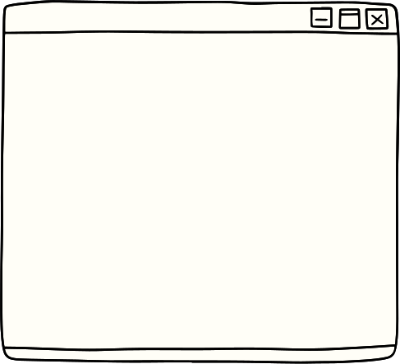


Introduction
Utilizing a fine-tuned Sentence Transformer model to revolutionize information retrieval, focusing on high-accuracy extraction of relevant information from extensive text data.
Integrating with the LangChain framework to enhance the system's capabilities in natural language understanding and processing, ensuring a seamless and efficient retrieval process.

Slide 5

Tasks | Muhammad Sheharyar | Muhammad Shayaan Malik
DataSet Acquisation
Training/ Fine Tuning
Testing/ Results
LangChain Integration
UI

Slide 6
Dataset Used
MNLI Dataset
SNLI Dataset
Size: Larger dataset with almost 400,000 sentence pairs.
Attributes: Three classification labels - "entailment," "contradiction," and "neutral."
Characteristics: Diverse in genres and aims to evaluate cross-genre and cross-domain NLI tasks.
SIZE: SMALLER DATASET WITH 550,152 SENTENCE PAIRS.
Attributes: Three classification labels - "entailment," "contradiction," and "neutral."
Characteristics: Focused on news articles and captions, providing a more specific domain for NLI evaluation.

Slide 7
tttttt
WHY??
t
Pretrained Knowledge: We chose Sentence BERT and Sentence Transformer models to leverage their extensive knowledge of natural language inference.
Cross-Domain Adaptability: These models excel in handling cross-domain and cross-genre NLI tasks due to their training on diverse sentence pairs from SNLI and MNLI.
Proven Performance: Sentence BERT and Sentence Transformer models have a strong track record of delivering state-of-the-art results in various NLP tasks, including sentence similarity and textual entailment.
Efficiency: Both models produce efficient fixed-length sentence embeddings, crucial for our real-time application.
Cost-Effective and Open-Source: These models are open-source and free, allowing us to integrate them into our project without incurring licensing fees, aligning with our cost-effectiveness goal.
MODEL SELECTION
01
SENTENCE BERT(SBERT)
02
SENTENCE TRANSFORMER

Slide 8
Comparison
SBERT
Sentence Transformer
WORD LEVEL EMBEDDING
MODEL & EPOCHS:
"BERT-BASE-UNCASED" MODEL
1 EPOCH
Tokenization & Pooling:
BERT tokenizer
mean-pooling
Loss Function:
CrossEntropyLoss
LEARNING RATE:
1E-5
WARMUP STRATEGY:
A WARMUP PHASE WITH 10% OF TRAINING STEPS.
DATASET USED:
MNLI AND SNLI
FAST-FORWARD NEURAL NETWORK
OPENAI EMBEDDINGS :
1536
SENTENCE LEVEL EMBEDDING
MODEL & EPOCHS:
"bert-base-uncased" model
10 Epoch
Tokenization & Pooling:
BERT tokenizer
mean-pooling
Loss Function:
MULTIPLENEGATIVESRANKINGLOSS (MNR)
DataSET Used:
MNLI and SNLI with only positive anchor pairs
OUR MODEL EMBEDDINGS :
768

Slide 9
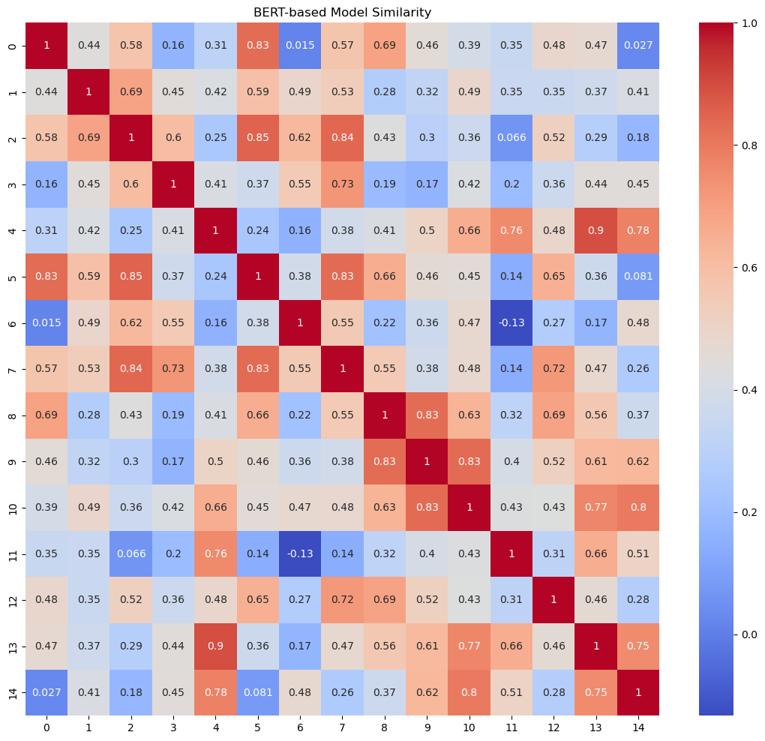
RESULTS
SBERT

Slide 10
"The marathon runners showed incredible endurance and speed."
"The author released a new novel that became a bestseller."
"The chef prepared a gourmet meal that delighted all the guests."
"Baking pastries requires precision and creativity in the kitchen."
"Artificial intelligence is shaping the future of technology."
"The orchestra delivered a breathtaking performance that captivated everyone."
"Reading fiction books is a great way to relax and unwind."
"The pianist played a beautiful melody that resonated throughout the hall."
"He has a passion for landscaping and outdoor design."
"Environmental conservation efforts are crucial to protect natural habitats."
"Healthcare professionals are dedicated to improving patient care."
"Climate change is impacting global weather patterns."
"The sun sets over the horizon, painting the sky in shades of orange and pink."
"The advancements in machine learning are transforming how we interact with data."
"Studying ancient civilizations helps us understand the past."

Slide 11
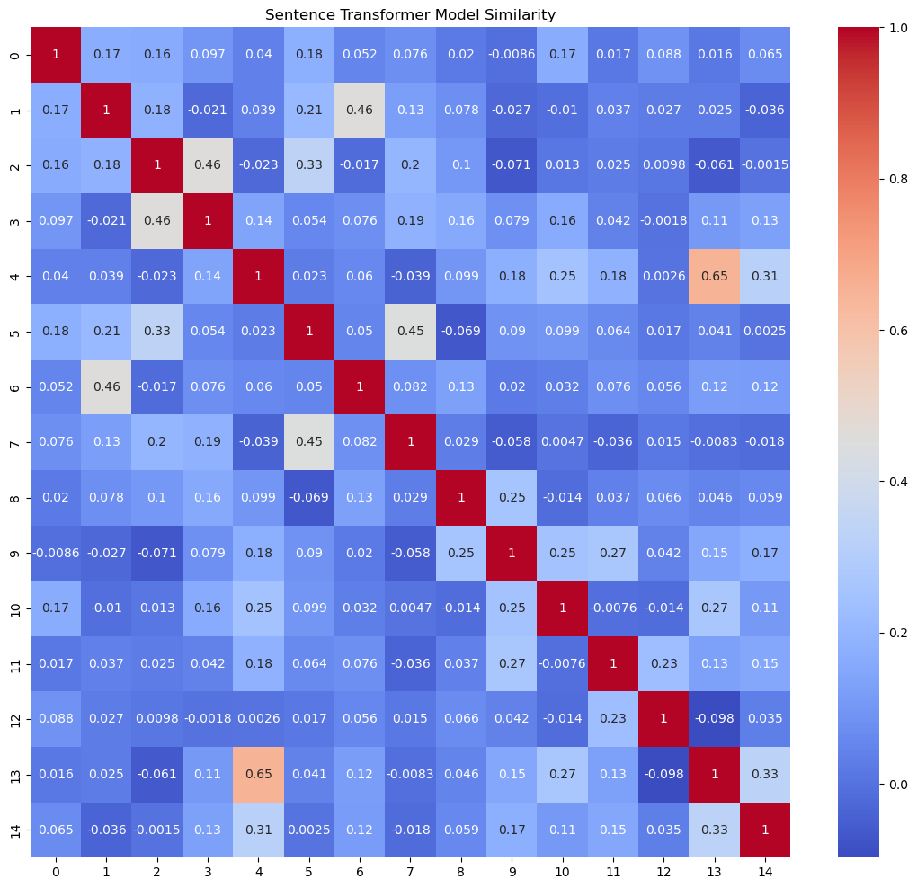
RESULTS
sentence transformer

Slide 12




EMBEDDINGS
VECTOR DB
QUERY CONVERT TO EMBEDDING
CHUNKING
INFORMATION RETRIEVAL FROM VECTOR DB
DISPLAYED ON STREAMLITT
OPEN AI API TO FORMULATE ANSWER
PDF FILE

Slide 13






Live Demo

Slide 14



Conclusion
Difficulty Faced:
Lack of computing resources
Model took almost 22 hrs to train.
Room for Improvement:
Chunking can be improved
Multiple Data sources can be used (CSV’s , PPT’s, CODE FILES)

Slide 15

Thank you

