Slide 1
Accessible Points for People on Wheelchair
Abdullah (BSCS - B316 G-I-C)

Slide 2
INTRODUCTION
Accessible Points for people on Wheelchair will be a mobile application designed for people who are on wheel chair and practically handicapped. This application provides solutions to them for which places are accessible by wheelchair and which are not.
This is a single platform for these people where they can access their desired places with complete information.

Slide 3
PROBLEM STATEMENT
Straightforward things like shopping and visiting food points become an extremely troublesome and complex task in all situations rapidly for people on wheelchair.
Uneven and unpleasant territory particularly with inclined ground makes wheelchairs to go practically impossible.
Getting to various dimensions of the travel framework particularly if there are no lifts or on the off chance that they are not working.

Slide 4
Proposed solution
Our application will let the people on wheelchairs roam accordingly and independently.
User will be given facility to search for a location where he/she wants to go and search the accessibility of ramps and elevators in that places, they are also given a facility to share their location with their family.
In case of any emergency they can generate alerts like messages and calls which will let their family and friends that if he/she is safe of not.

Slide 5
Objective
To design and develop an android application or a cross platform application for handicapped people.
Our application will let these people solve their problem and move around independently
To provide the user with a system that could show the places they should visit while they search.
User will be given facility to search for a location where he/she wants to go and search the accessibility of ramps and elevators in that places.

Slide 6
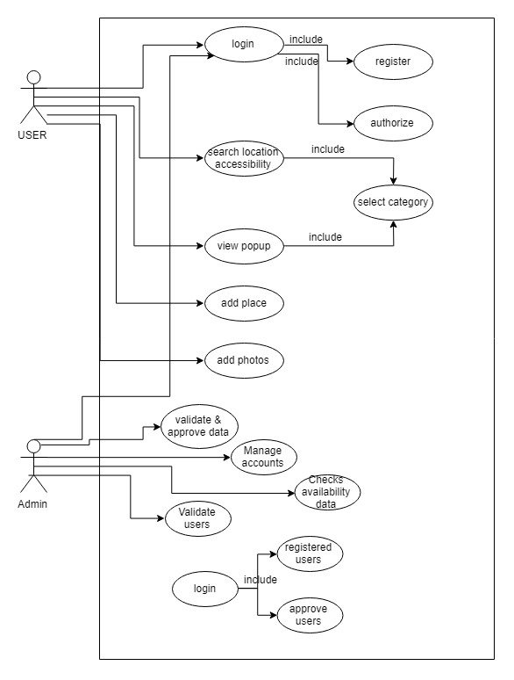
Use case:

Slide 7
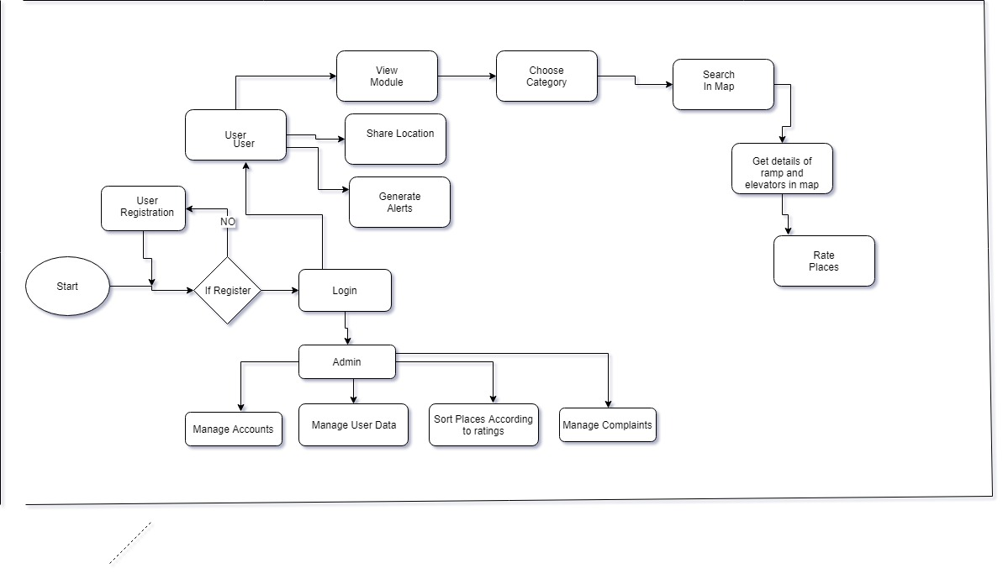
Activity Diagrams

Slide 8
Tools and Technology
Visual Studio Code (If it will be a cross platform application)
Android Studio (If its intends to target Android users)
Firebase/FireStore
JDK
SDK

Slide 9
Application programming Interface (APIs)
Google Maps Development
Firebase

Slide 10
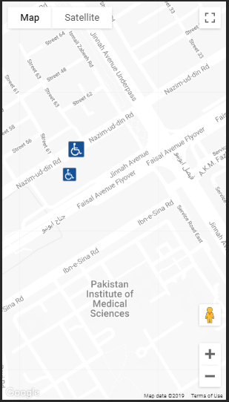
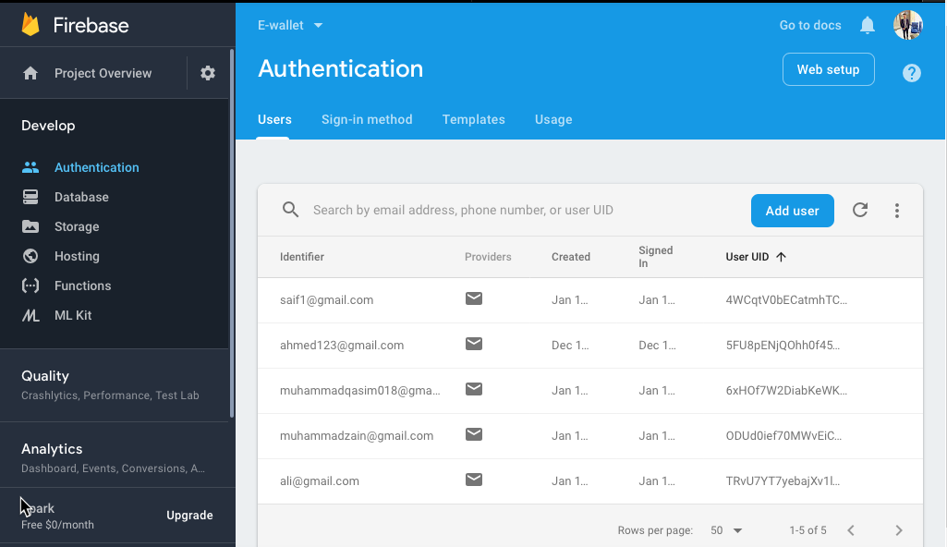
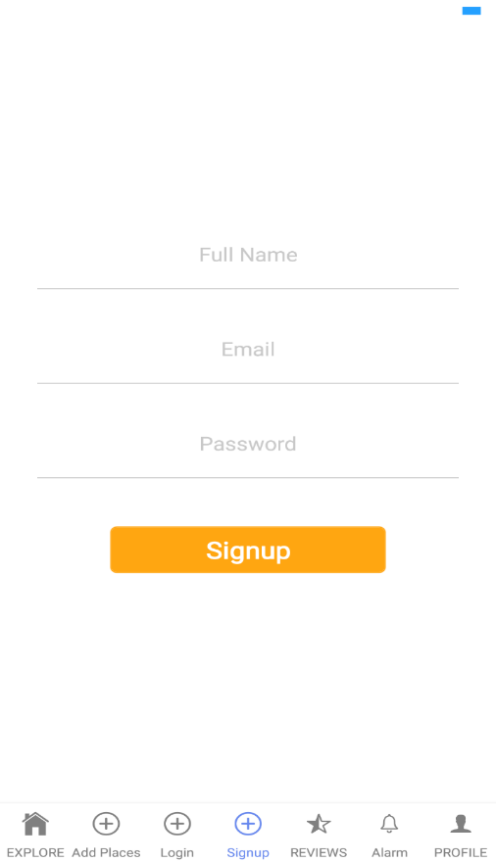
User interface and Database

Slide 11
Conclusion
I will develop an application which is capable of providing the handicapped people with places which are feasible for them or not. The basic idea is to provide ease to the handicapped people to get specific information about any place they are going to visit by providing them an engaging and interactive interface. The expected benefits of this project targets the welfare of the people with disabilities, as this application will be an excessive source for all the people with disabilities.
FOR A BETTER FUTURE

