Slide 1


IILM UNIVERSITY
INTERNSHIP PRESENTATION
DEPARTMENT OF COMPUTER SCIENCE & ENGINEERING
Academic Session 2025–2026
Modern Web Development & Front-End Engineering
Building Responsive Interfaces, Interactive Applications & UI Components
Student Name Shehbaz Mustafa
Enrollment Number 25SCS1003003654
Program & Semester B.Tech CSE / 3rd Sem (2CSE5)
Organization Name Cognifyz IT Solutions

Slide 2



Executive Summary
Internship Overview
Key Highlights
Completed a hands-on Web Development Internship at Cognifyz IT Solutions, applying modern front-end web development practices.
Role: Web Developer Intern
Host Organization: Cognifyz IT Solutions
Focused on creating semantic HTML structures, implementing responsive CSS styling, and developing client-side interactive logic with JavaScript.
Primary Focus: Front-End Development & Responsive UI
Code Repository: GitHub Version Controlled
Successfully submitted all assigned project levels to the official GitHub repository, validating code quality and version control.
Academic Integration: Applied 3rd Sem B.Tech CSE Coursework

Slide 3
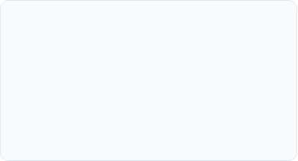
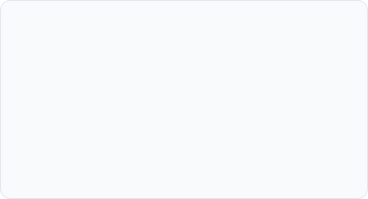
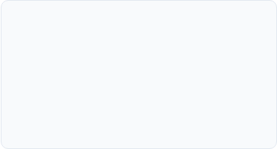



Objectives & Tech Stack
HTML5 & Markup
CSS3 & Layouts
JavaScript & DOM
Structuring semantic, accessible web pages using modern HTML elements, forms, and input elements.
Styling web elements using Flexbox, CSS Grid, media queries, custom properties, and smooth transitions.
Implementing client-side logic, form validation, event listeners, and dynamic DOM manipulation.

Slide 4

Project Tasks & Modules
Level & Task | Module Title | Core Responsibilities | Status
Level 1 - Task 1 | Basic Web Page Structure | Built semantic HTML markup with structured text, headers, and images. | Completed
Level 1 - Task 2 | Form Design & Inline Validation | Designed user forms with client-side input validation and feedback. | Completed
Level 2 - Task 3 | Responsive CSS & Grid Layout | Created multi-section responsive web page using Flexbox and Media Queries. | Completed
Level 2 - Task 4 | Dynamic DOM & Events | Integrated interactive JS buttons, event handlers, and real-time DOM updates. | Completed

Slide 5








Development Workflow
Phase 1
Phase 2
Phase 3
Phase 4
Markup Setup: Building clean semantic HTML5 layouts and forms.
Styling & Responsive: Applying custom CSS, media queries, and Flexbox.
Interactivity: Scripting JS handlers, form checks, and DOM manipulation.
Version Control: Pushing modular code to GitHub repository.

Slide 6

Technical Highlights
Front-End Architecture
JavaScript Execution
Semantic HTML: Utilized proper header, nav, main, section, and footer elements for SEO and accessibility.
Event Listeners: Implemented non-intrusive JavaScript handlers for dynamic user interaction.
Responsive Design: Tested across multiple device viewports (Desktop, Tablet, Mobile) using fluid breakpoints.
Input Validation: Regular expressions (Regex) for validating emails, passwords, and numbers.
Clean Code: Followed consistent naming conventions, indentation, and modular file organization.
State Management: Dynamically updating DOM elements without requiring full page reloads.

Slide 7
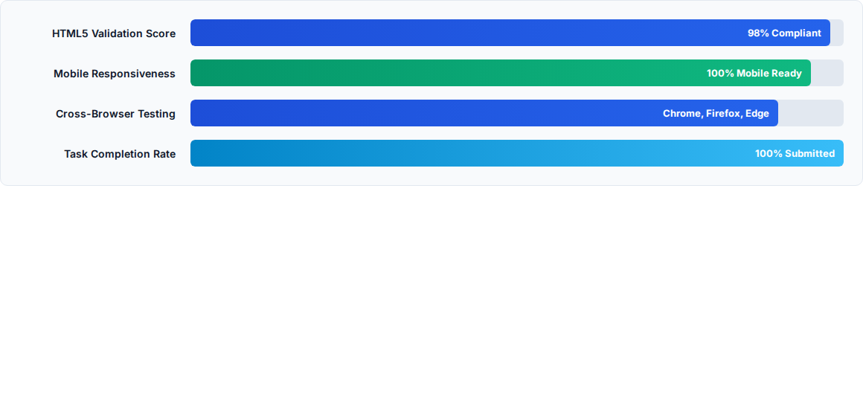
Performance Metrics
* Measured using Lighthouse browser audits and W3C markup validation tools.

Slide 8


Challenges & Solutions
Challenges Faced
Solutions Applied
CSS Alignment: Managing vertical alignment and flex wrap issues on smaller mobile screens.
Flexbox & Box-Sizing: Applied standard `box-sizing: border-box` and flexible media queries.
Form Edge Cases: Preventing invalid form submissions prior to client-side validation checks.
JS Event PreventDefault: Intercepted form submit events using `e.preventDefault()` for clean validation.
Git Workflow: Conflict-free commit organization across different task folders.
Structured Repo: Organized tasks into dedicated directories with clean commit messages.

Slide 9
Skills & Learnings
Technical Mastery
Git & Version Control
Debugging & Logic
Strengthened core understanding of HTML5 tags, CSS Flexbox/Grid, and vanilla JavaScript DOM operations.
Learned industry best practices for repository management, commits, and project hosting on GitHub.
Enhanced problem-solving abilities using Chrome Developer Tools for element inspection and JS console debugging.

Slide 10

Academic Integration
Connecting B.Tech CSE Coursework
The 3rd Semester curriculum at IILM University provided a strong theoretical base that directly accelerated internship performance.
Web Technologies: Applied foundational web design principles and DOM scripting concepts.
Data Structures & Logic: Utilized structured algorithms for client-side form validation routines.
Software Engineering: Followed modular development standards and version control practices.

Slide 11


Questions & Answers
Thank you for your guidance and attention!
IILM University Mentors
Cognifyz IT Solutions
Faculty Guide & Dept. of Computer Science & Engineering
Internship Mentor & Technical Evaluation Team
Shehbaz Mustafa | Enrollment No: 25SCS1003003654

