Slide 1
Analysis of Liquid Biopsy Brain Tumor Samples using Machine Learning
-Shehbeel Arif
PCLRU, D³B

Slide 2
Objectives
Visualize the data using UMAP
Build a machine learning model to predict whether
Brain tumor sample is LGG or HGG
Patient will have relapse or not
Get a list of miRNA gene biomarkers
Test the effectiveness of miRNA biomarker genes by clustering

Slide 3
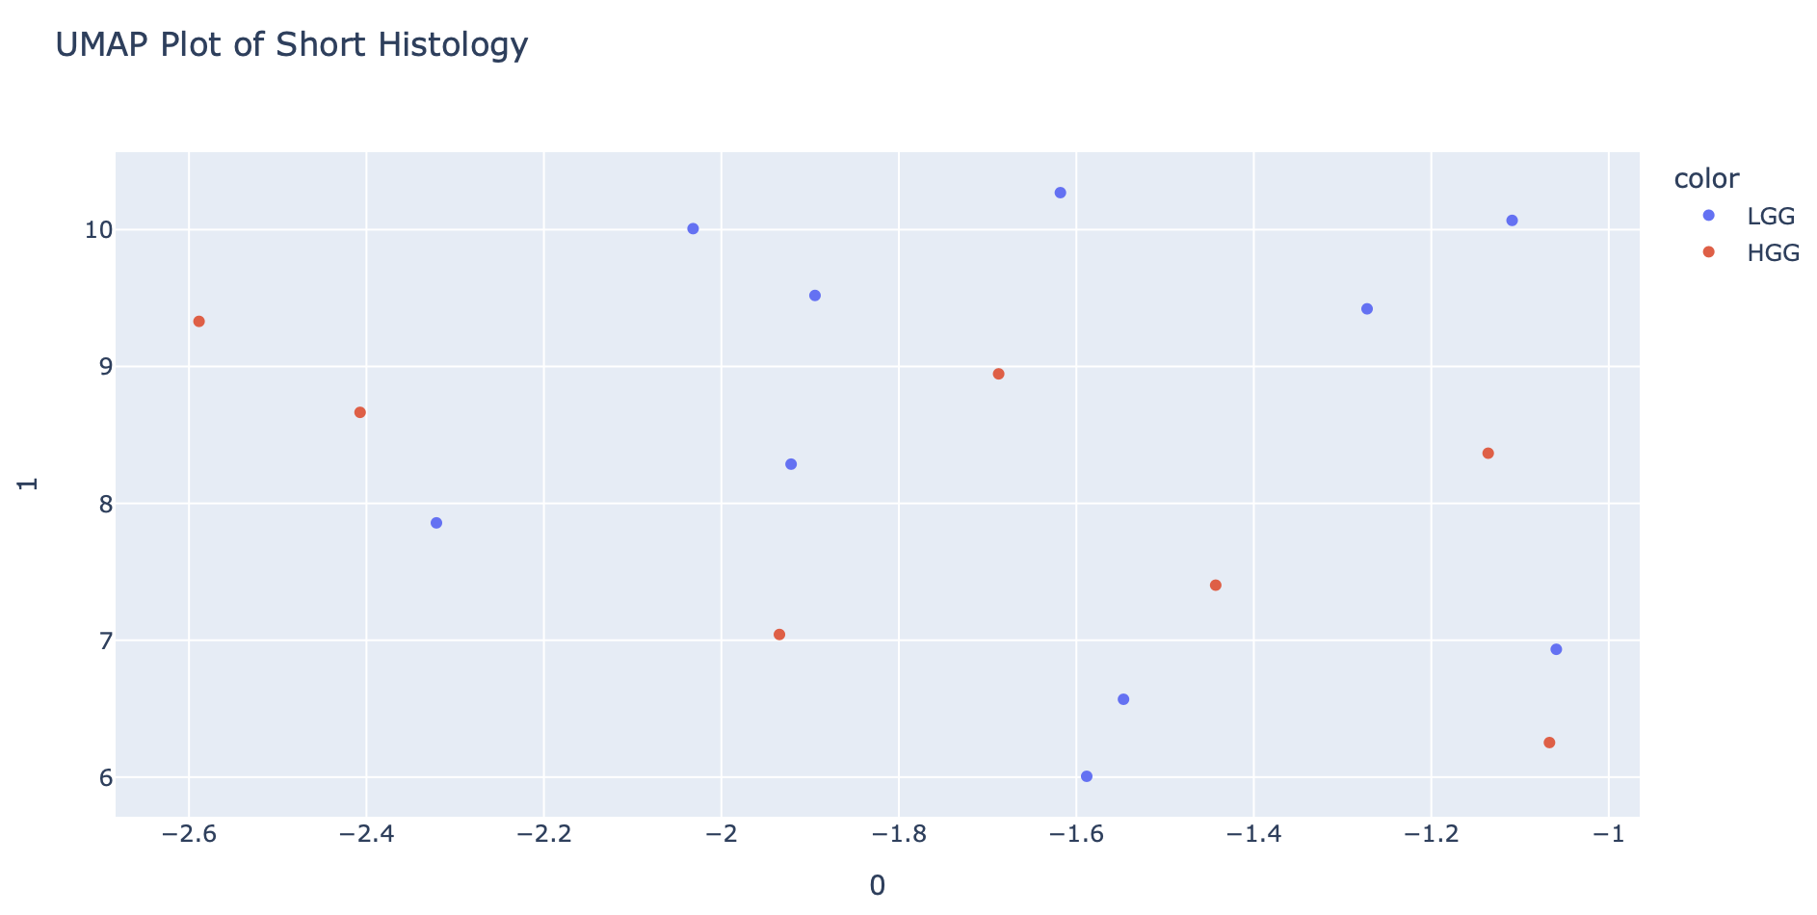
Plotting Liquid Biopsy Samples by Histology

Slide 4
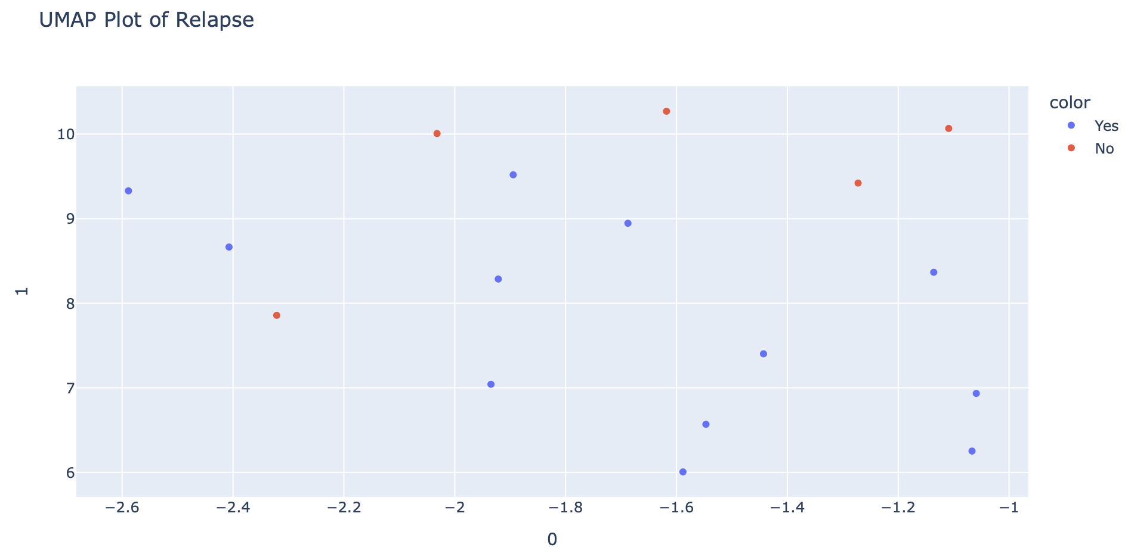
Plotting Liquid Biopsy Samples by Relapse

Slide 5
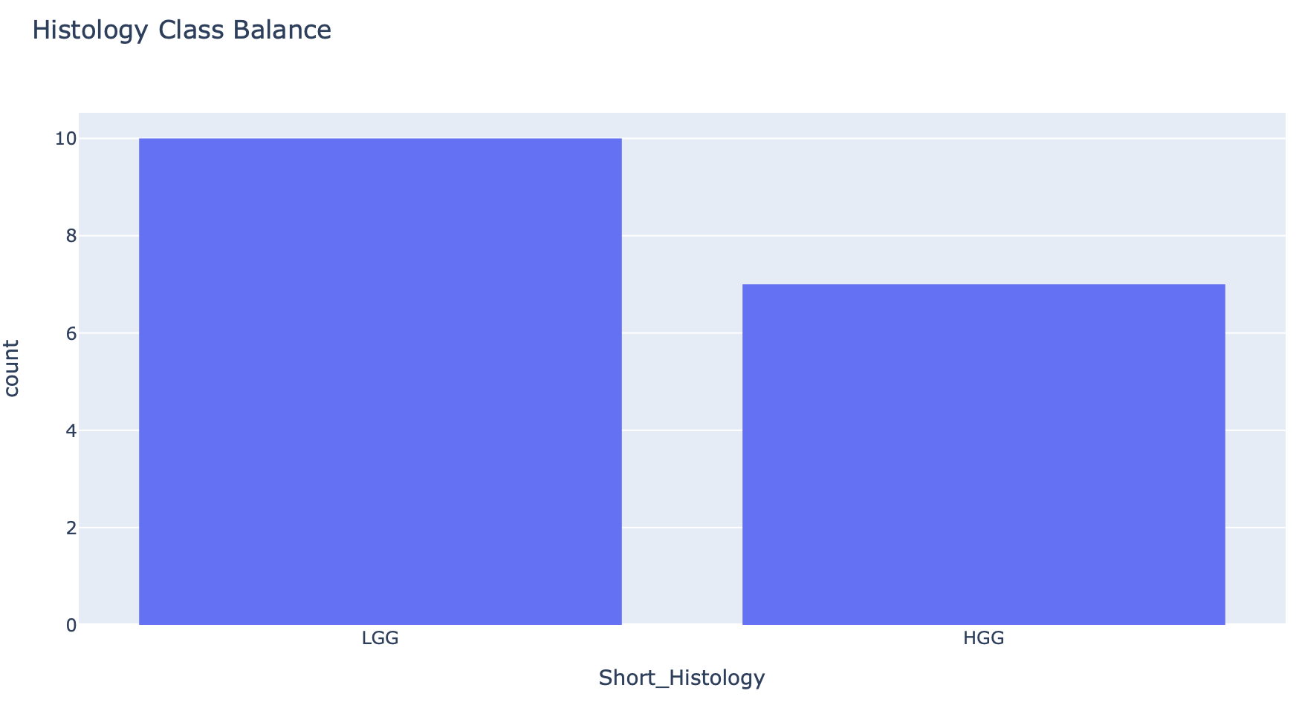
Preprocessing the Dataset
Total: 17 samples
Classifications: LGG/HGG; Yes/No (Relapse)
Training data size: 12 samples
Testing data size: 5 samples
Total genes: 2102

Slide 6
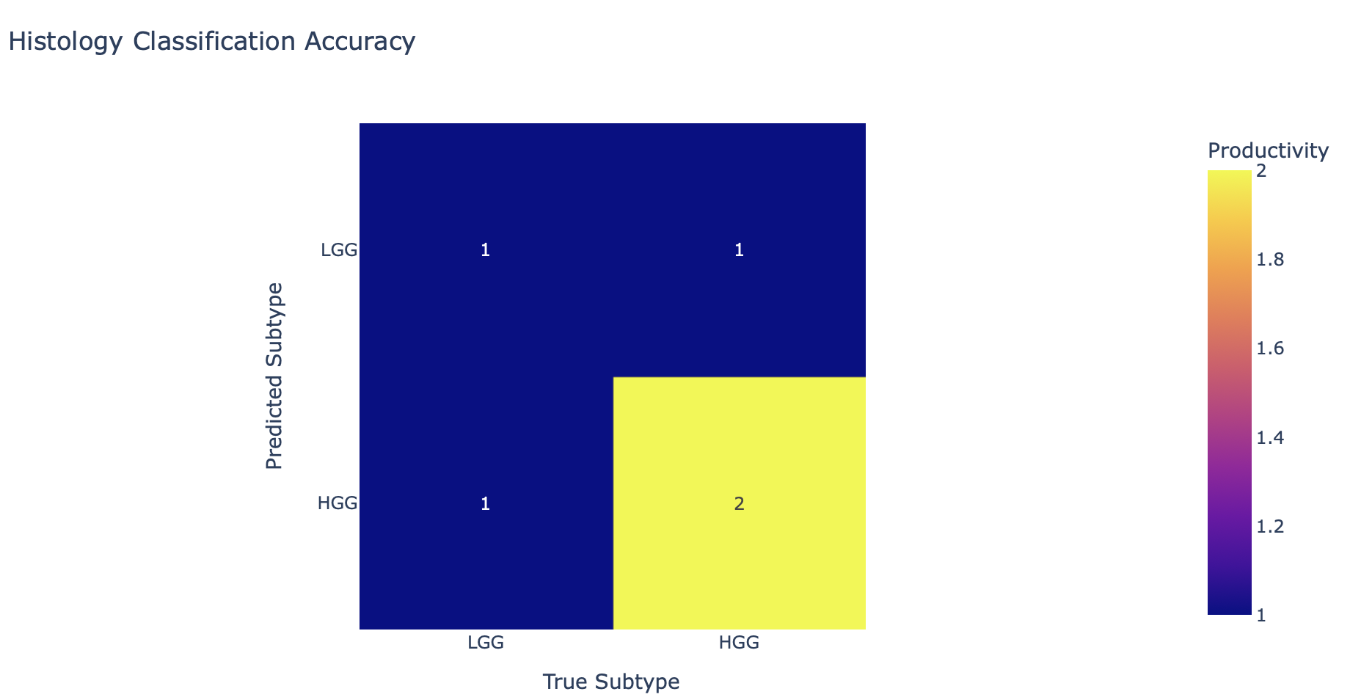
Random Forest Algorithm for Histology
# of decision trees: 100
Depth of trees: 2
Accuracy: 60%

Slide 7
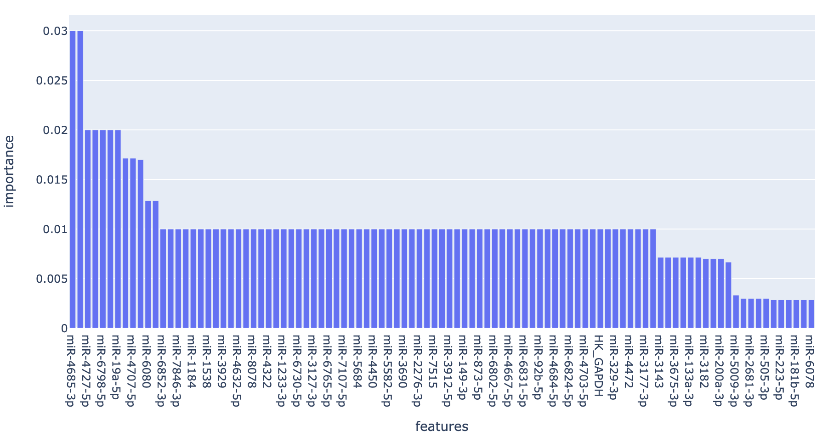
Significant Genes found by Algorithm

Slide 8
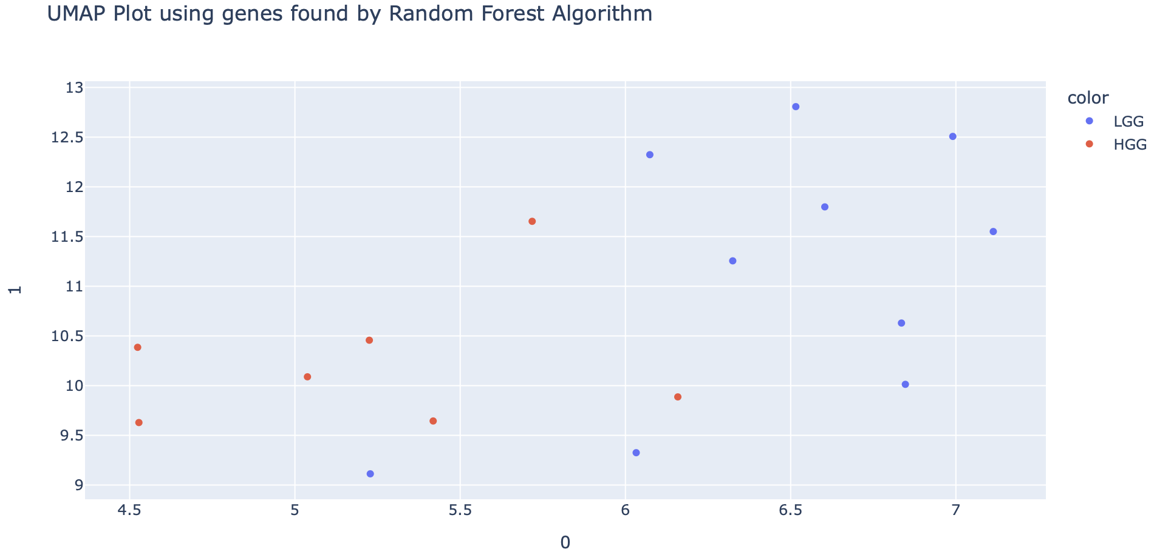
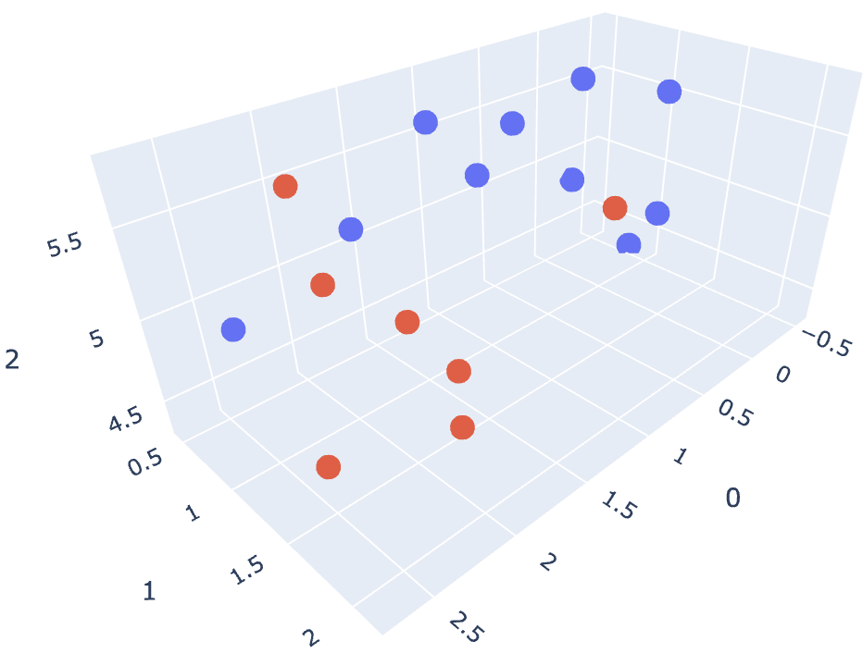
How good are these genes for histology classification?

Slide 9
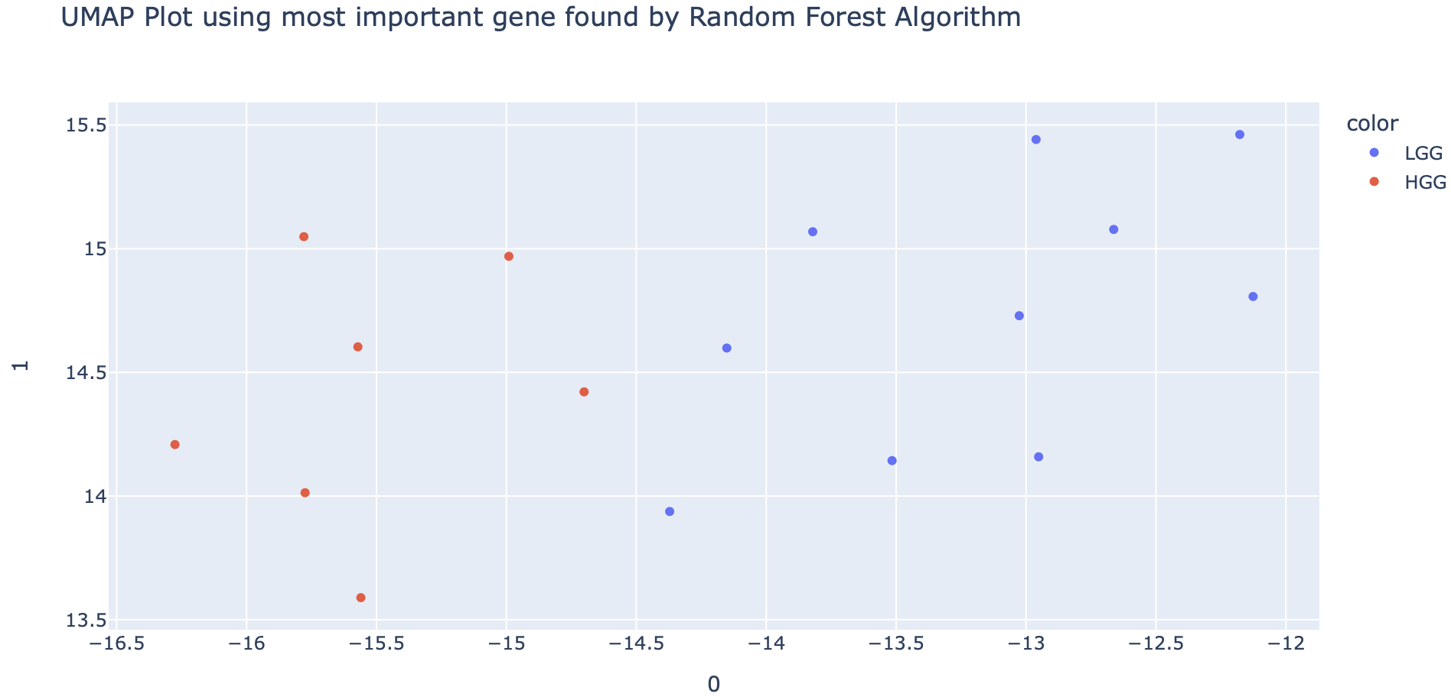
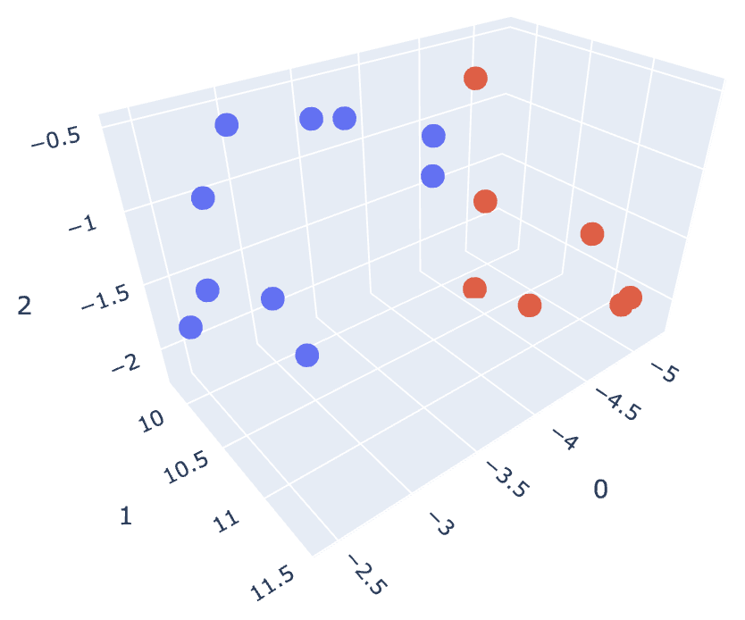
Clustering Using a Single Gene

Slide 10
What is this single miRNA?
miR-4685-3p

Slide 11
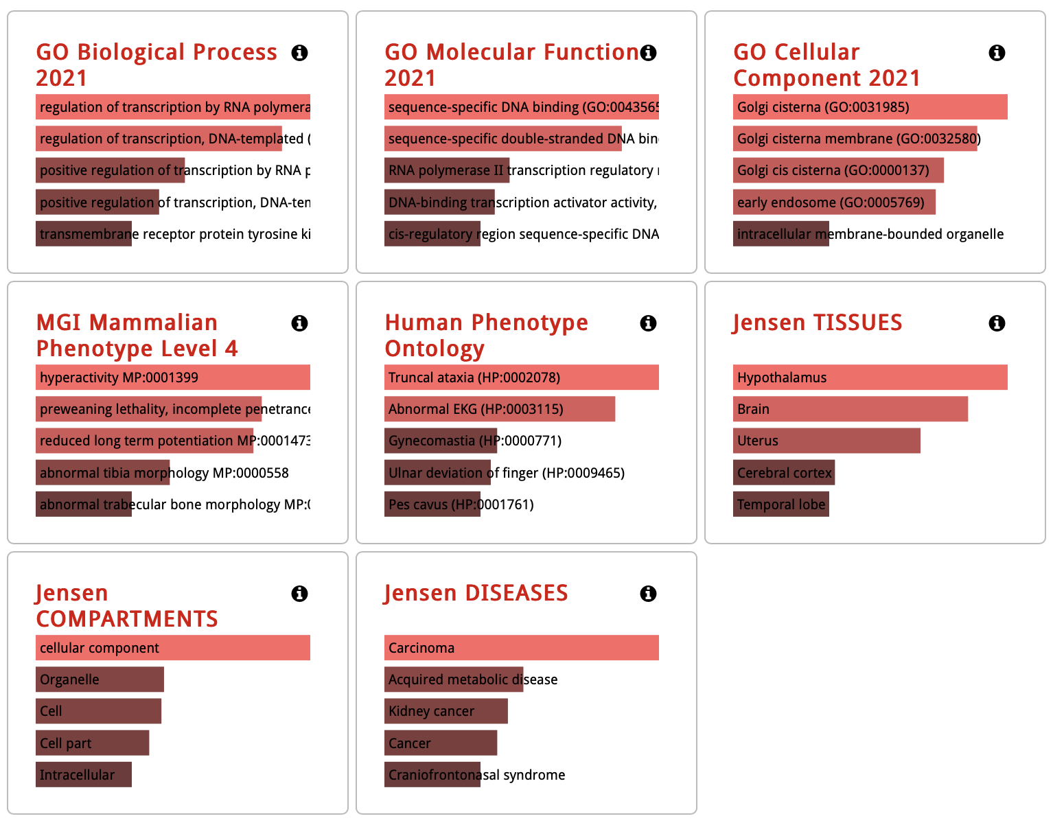
miR-4685-3p Gene Ontology
5075 downstream target genes found using TargetScan, which…
Play key role in regulating gene transcription by regulating transcriptional machinery
Found in cytoplasm
Found predominantly in the brain (hypothalamus)
Has carcinoma disease signature

Slide 12
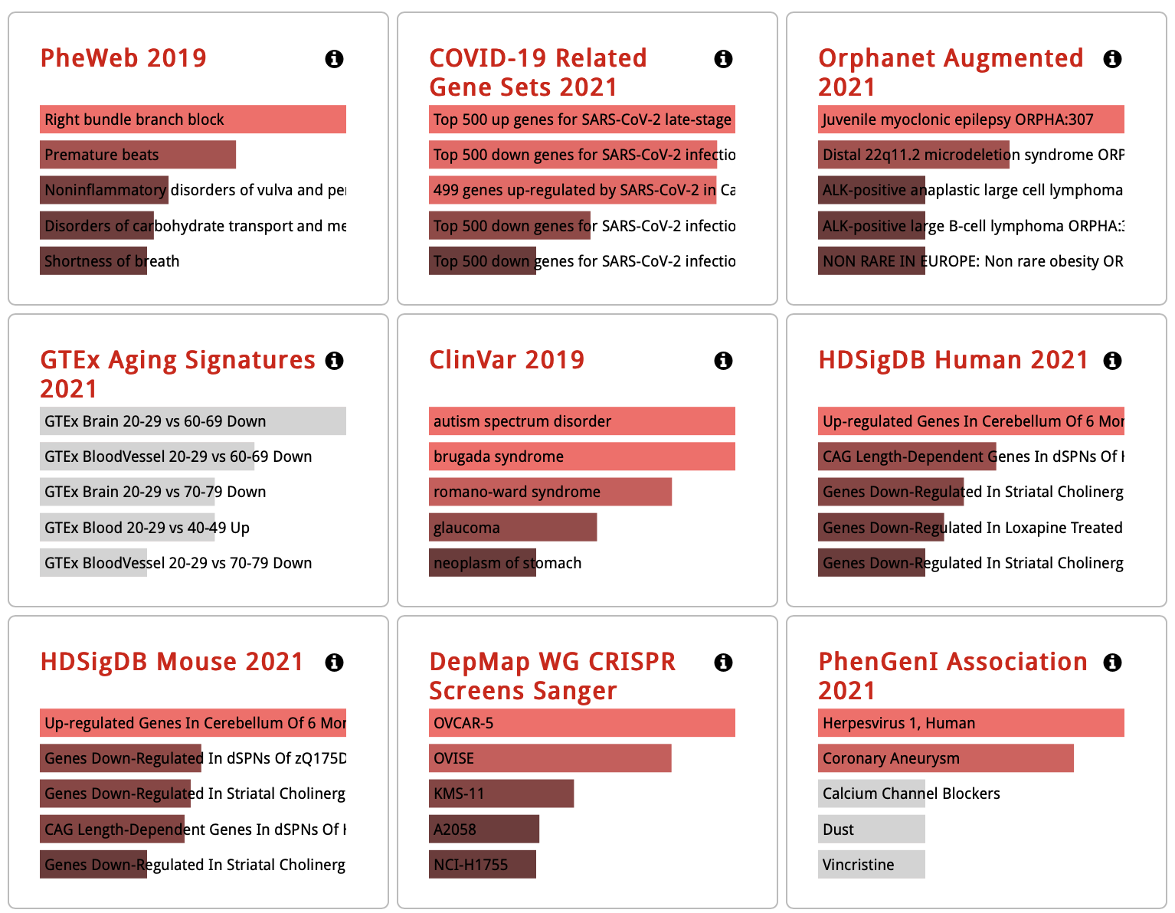
Enrichr (Disease/Drugs)

Slide 13
RELAPSE PREDICTION ALGORTHM

Slide 14
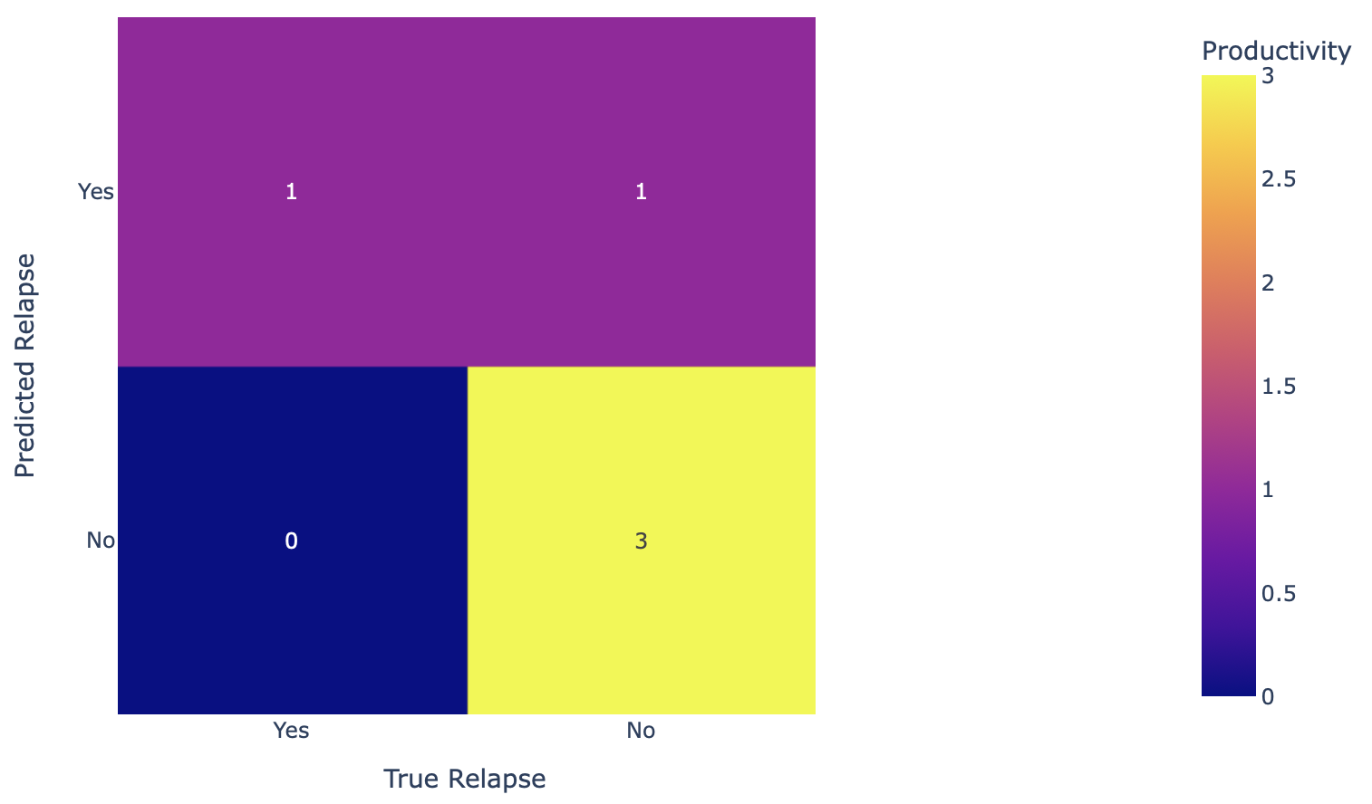
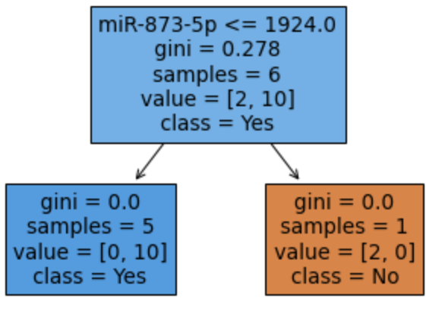
Random Forest Algorithm for Relapse
# of decision trees: 100
Depth of trees: 2
Accuracy: 80%
How the first decision tree is making a decision

Slide 15
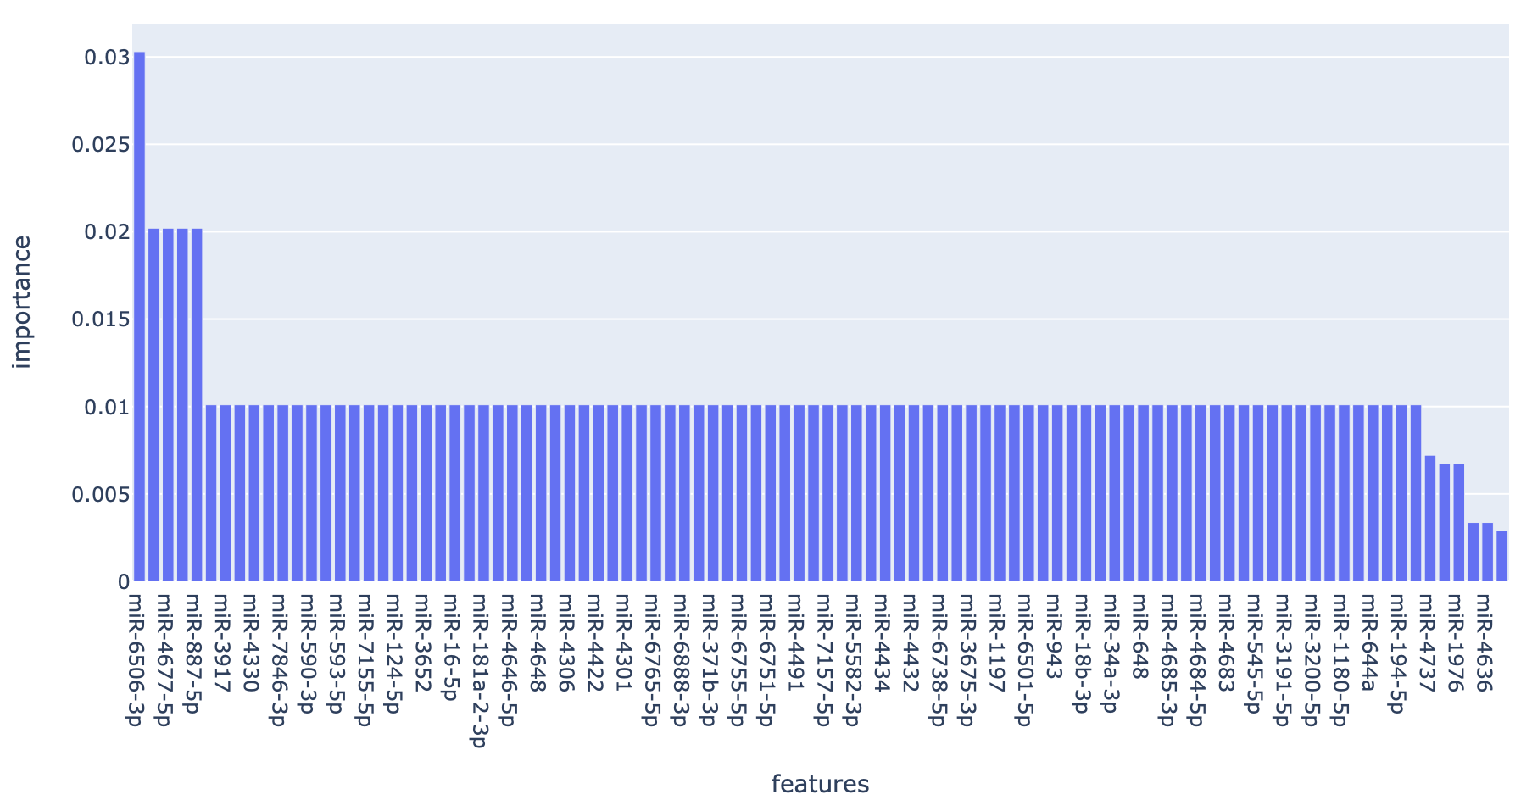
Significant Genes found by Algorithm

Slide 16
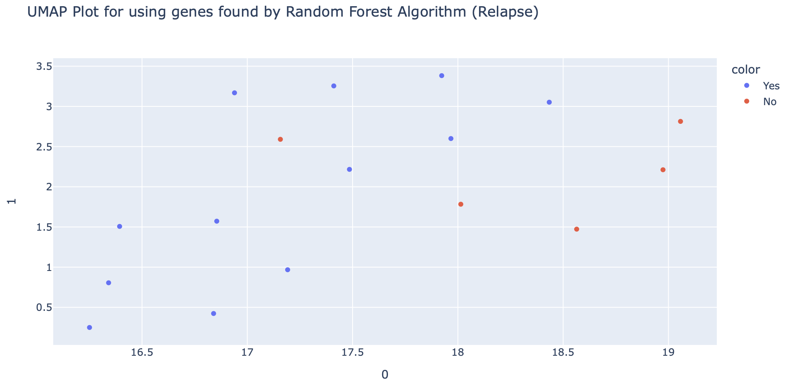
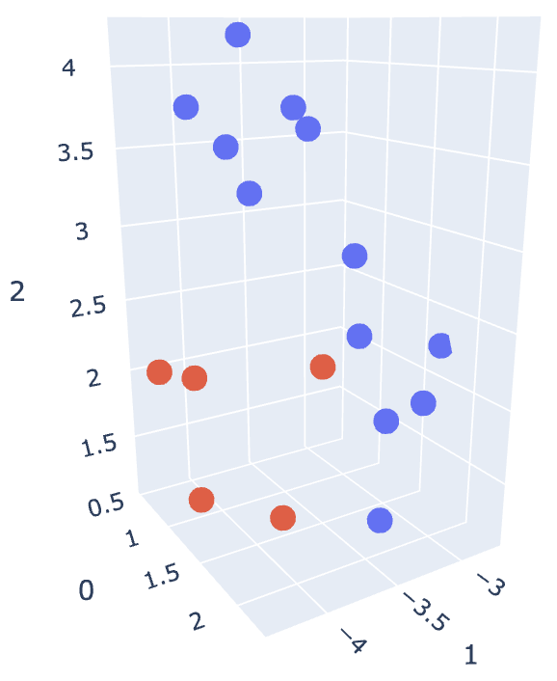
How good are these genes for relapse classification?

Slide 17
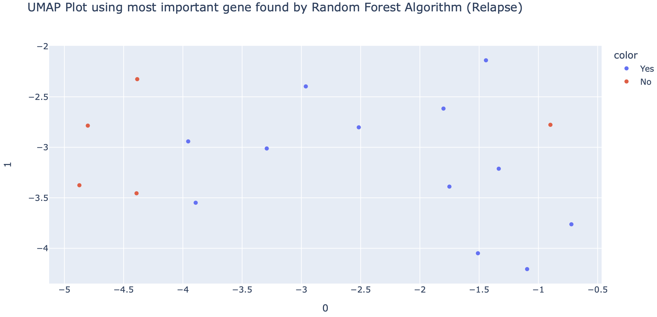
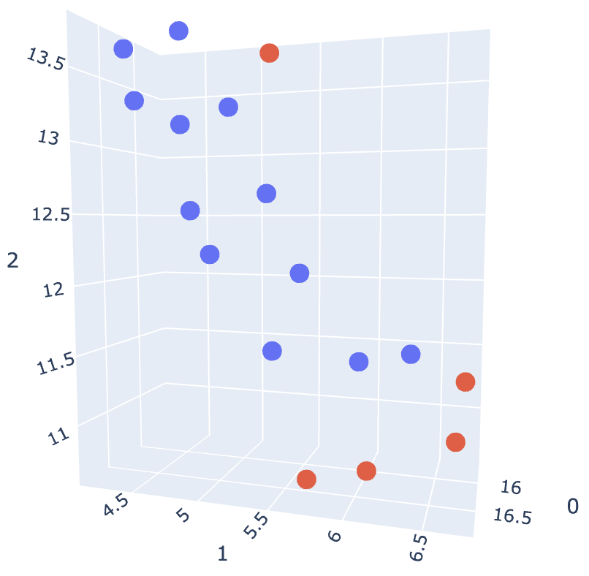
Clustering Using a Single Gene

Slide 18
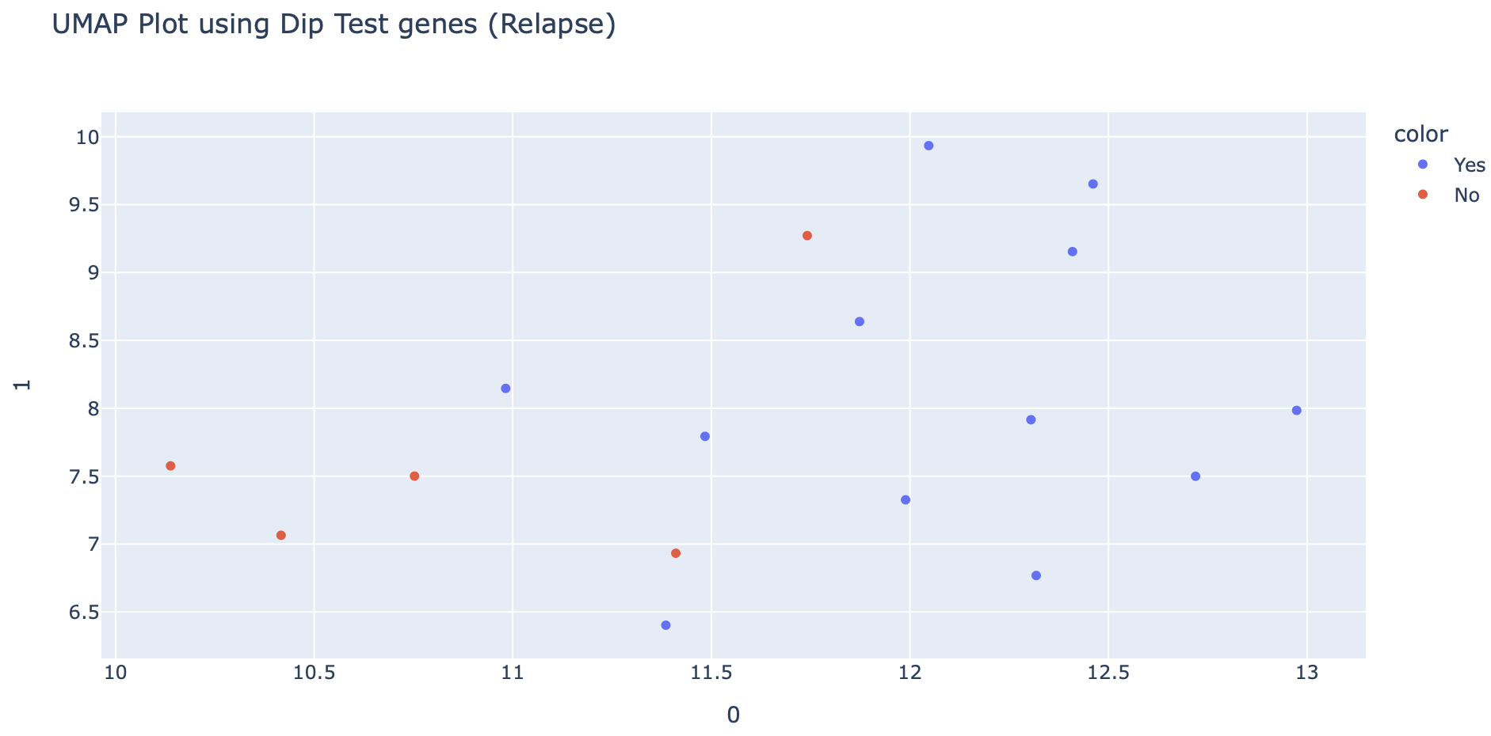
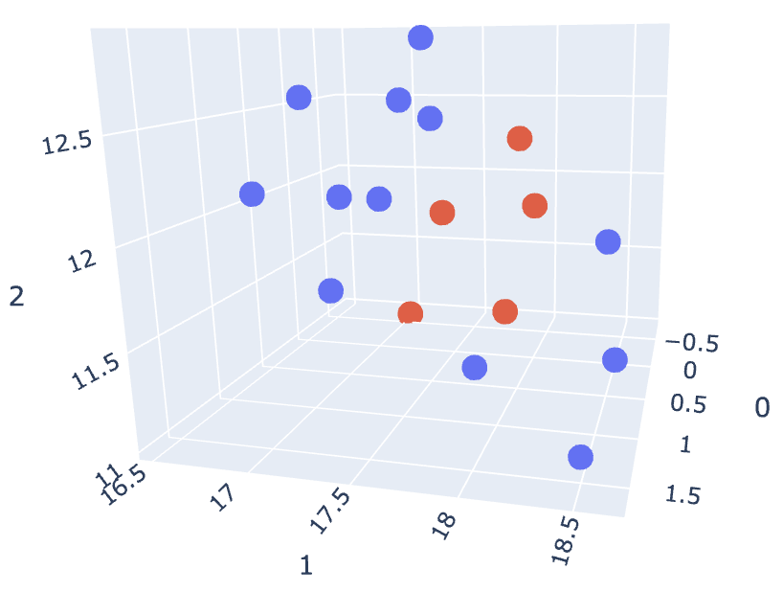
Relapse Clustering Using Dip Test Genes from Shiny App

Slide 19
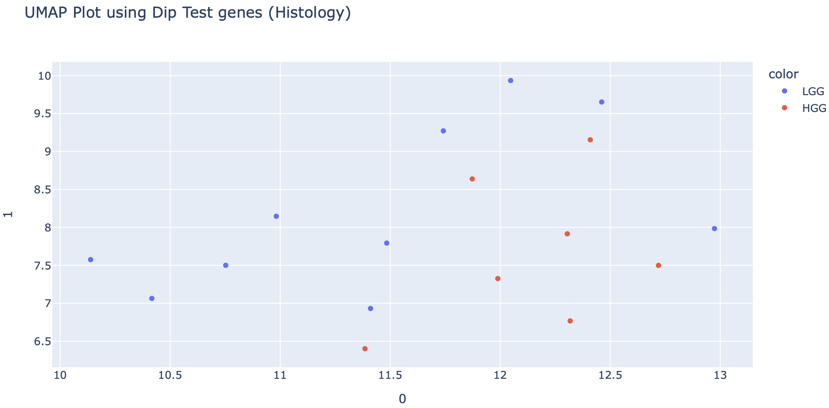
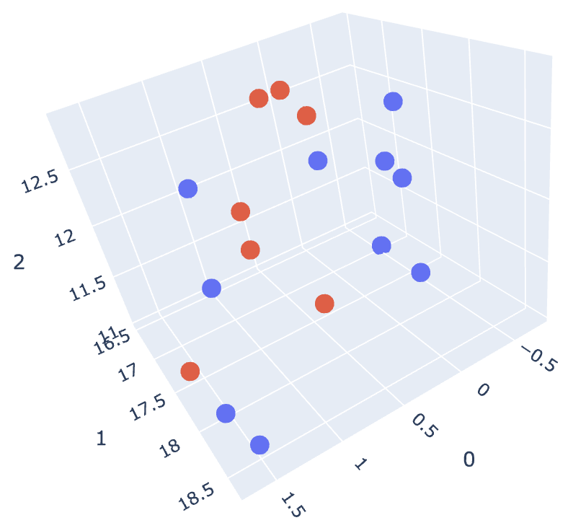
Histology Clustering Using Dip Test Genes from Shiny App

Slide 20
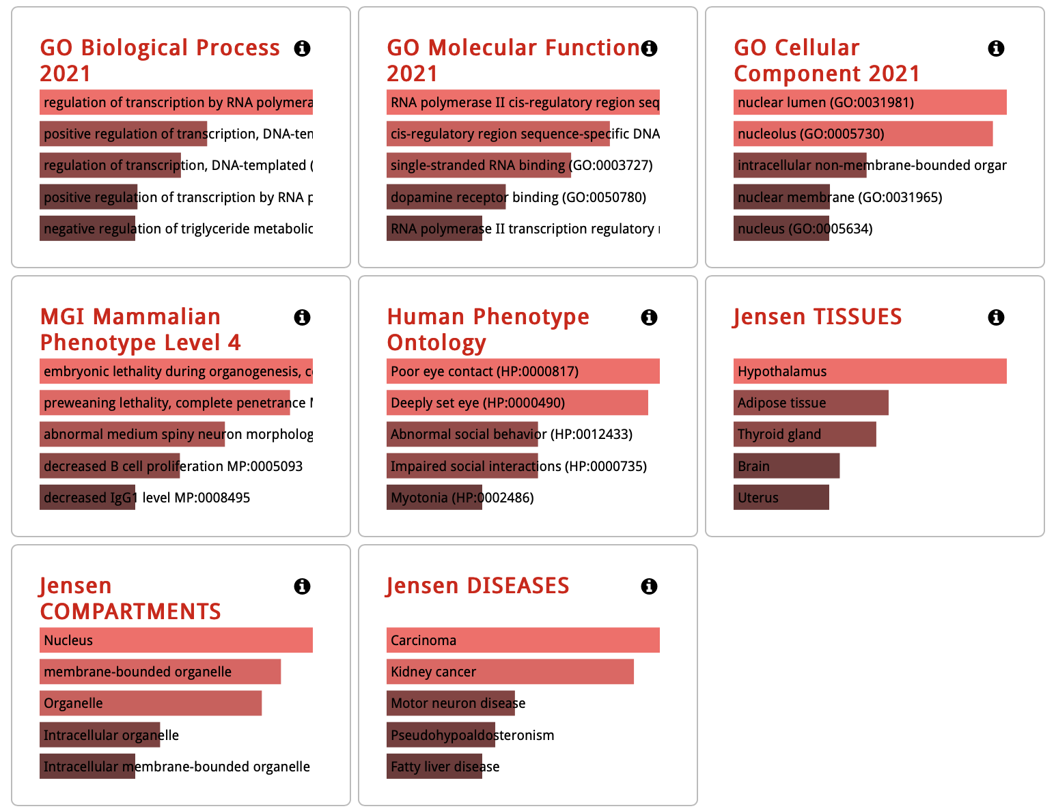
miR-6506-3p Gene Ontology
508 downstream target genes found using TargetScan, which…
Play key role in regulating gene transcription by regulating transcriptional machinery
Found in nucleus
Found predominantly in the brain (hypothalamus)
Has carcinoma disease signature

Slide 21
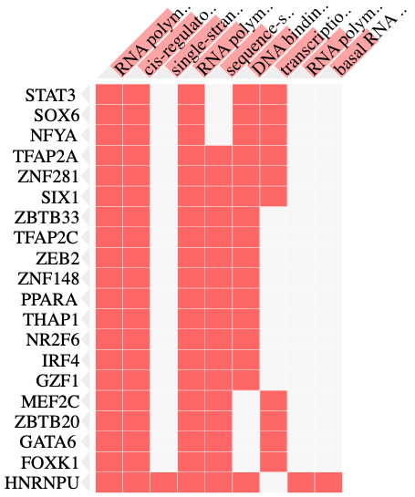
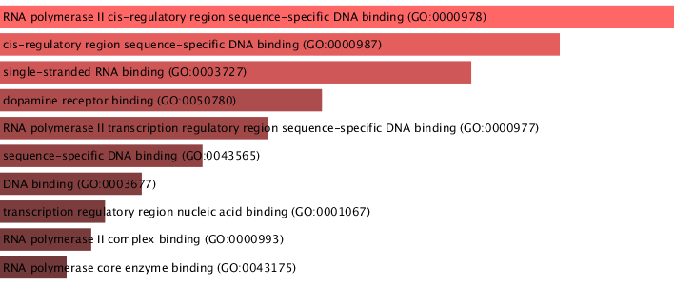
miR-6506-3p Gene Ontology in Detail

Slide 22
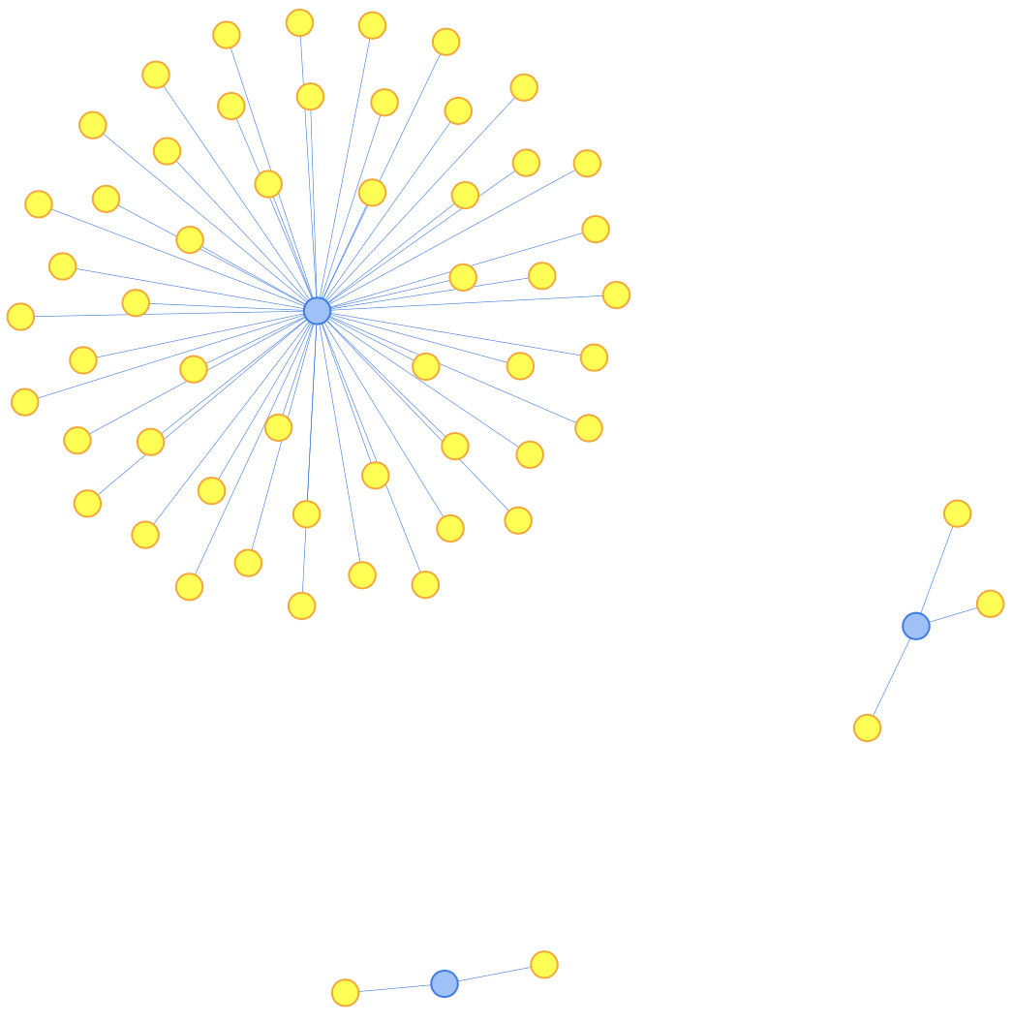
Network Analysis – miR-16-5p, miR-194-5p, miR-33b-5p

Slide 23
Conclusion
Developed and trained a Random Forest algorithm to predict whether a brain tumor sample is LGG or HGG with 60% accuracy
Developed and trained another Random Forest algorithm to predict whether a patient will have relapse with 80% accuracy
Found miR-4685-3p as a possible regulator that leads to low-grade glioma becoming high-grade
Found miR-6506-3p as a prognostic biomarker for predicting relapse in low-grade and high-grade glioma patients

