Slide 1
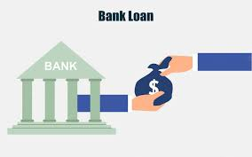
Financial Loan Performance & Risk Analysis
Presented by:
Shehnaz Fatima

Slide 2
Objective
Analyze loan performance
Identify high-risk customers
Understand repayment trends
Support data-driven lending decisions

Slide 3
Tools Used
Excel → KPI & Dashboard
SQL → Data extraction & transformation
Power BI → Interactive visualization
Tableau → Advanced analytics

Slide 4
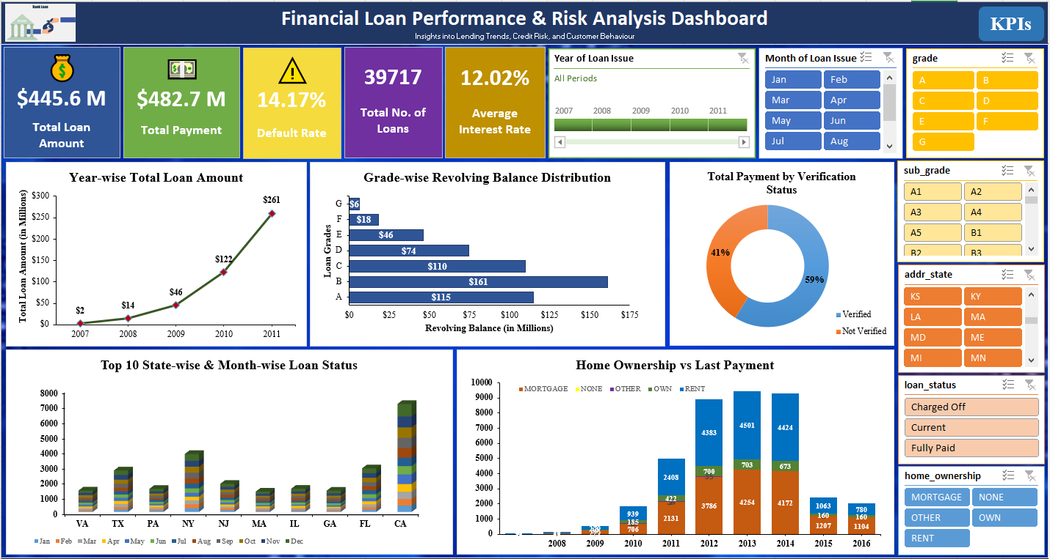
Excel Dashboard

Slide 5
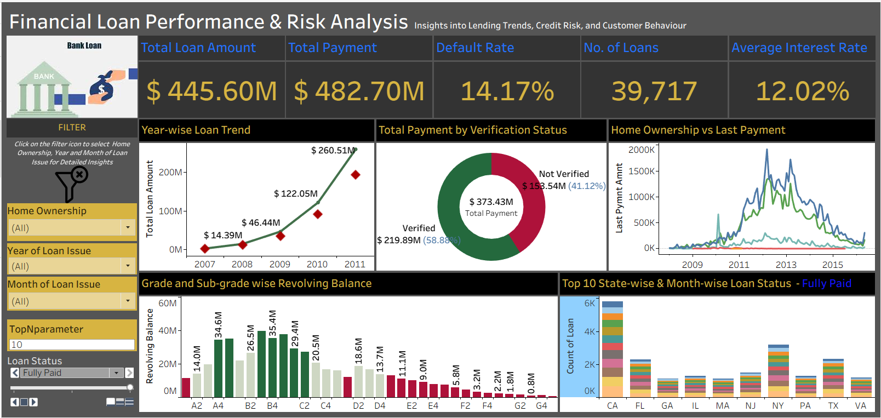
Tableau Dashboard

Slide 6
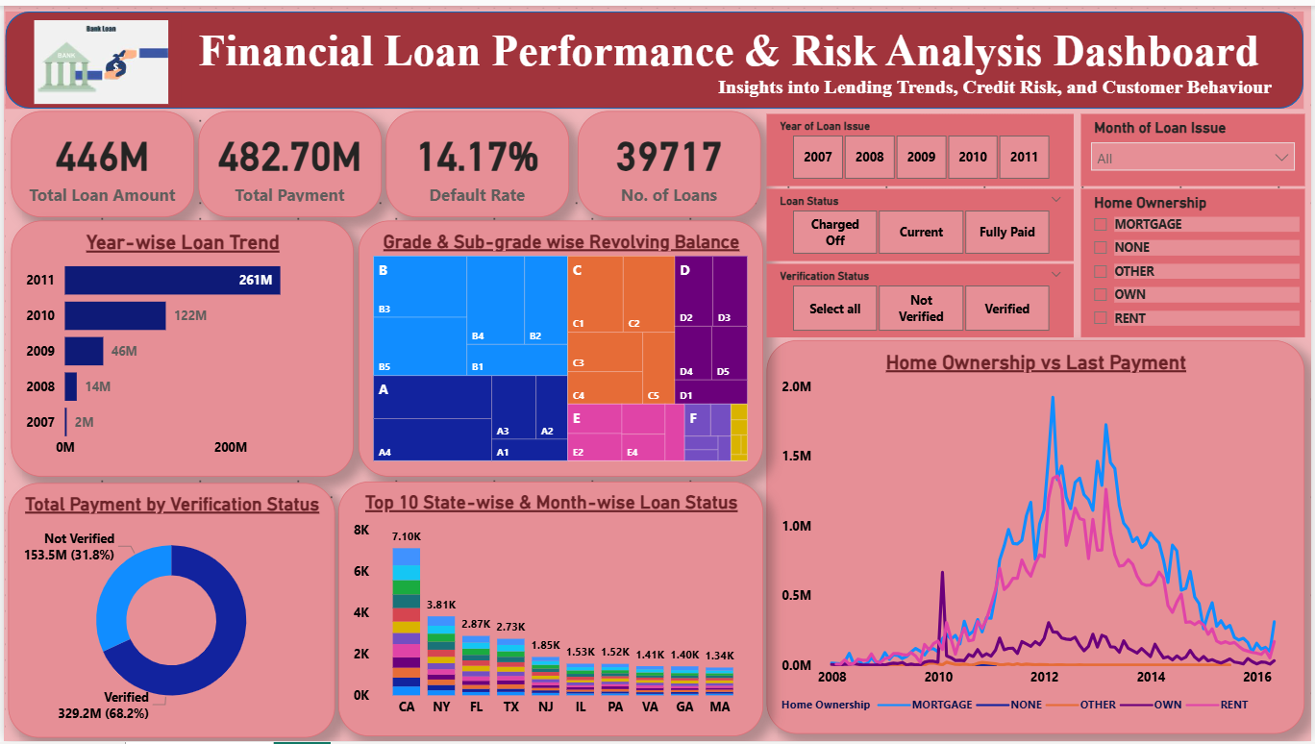
Power BI Dashboard

Slide 7
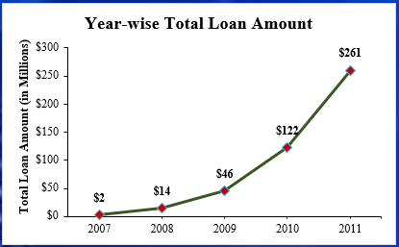
KPI 1: Year-wise Loan Amount Stats
Observation:
Continuous growth (2007–2011)
Sharp rise in later years
Increasing loan demand
Business Suggestion:
Sustain growth with risk checks
Expand in high-demand segments
Balance growth with credit control

Slide 8
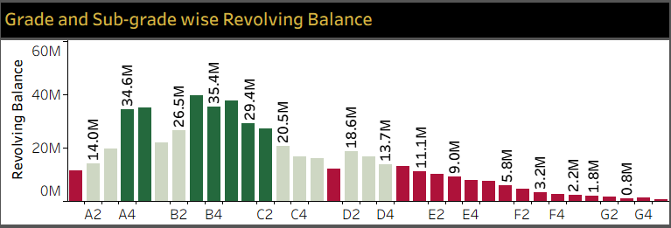
KPI 2: Grade & Sub-grade wise Revolving Balance
Observation:
A & B grades → higher balance
Lower grades → higher risk
Clear risk segmentation
Business Suggestion:
Focus on low-risk customers
Tight approval for risky grades
Apply risk-based pricing

Slide 9
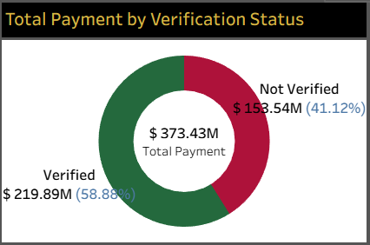
KPI 3: Total Payment: Verified vs Non-Verified
Observation:
Verified → higher payments (~59%)
Non-verified → lower contribution
Strong link: verification & repayment
Business Suggestion:
Strengthen verification process
Encourage customer verification
Limit exposure to non-verified

Slide 10
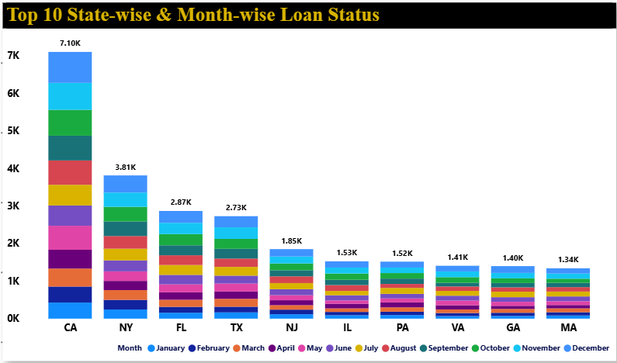
KPI 4: State-wise & Month-wise Loan Status
Observation:
CA, NY → high loan activity
Monthly variation present
Regional performance differs
Business Suggestion:
Target high-performing states
Monitor risky regions
Plan seasonal strategies

Slide 11
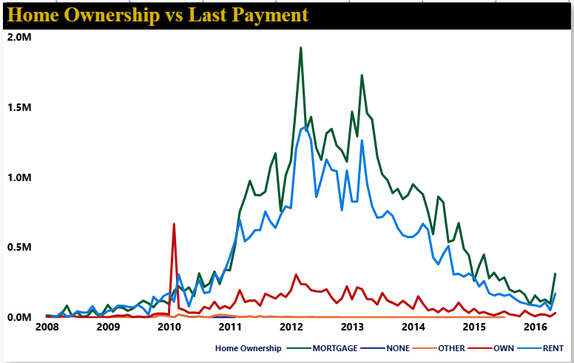
KPI 5: Home Ownership vs Last Payment
Observation:
Mortgage → highest payments
Peak around 2012–2013
Rent → moderate & stable
Own/Other → lower contribution
Decline after 2013
Business Suggestion:
Focus on mortgage segment
Target renters with control
Monitor declining trends
Use ownership in credit checks
Improve retention strategies

Slide 12
Key Insights
Business is growing steadily
Balanced risk segmentation
Verified customers are more reliable
Key states & seasonal trends identified
Financial stability improves repayment

Slide 13
Thank You

