Slide 1
Zomato Restaurant Analytics
Presented by:
Shehnaz Fatima

Slide 2
OBJECTIVE
The objective of this project is to analyze Zomato restaurant data and generate business insights by studying:
Restaurant distribution
Customer ratings
Pricing patterns
Cuisine preferences
Online delivery
Table booking
Restaurant opening trends

Slide 3
Tools Used
Excel:
Data Cleaning, Power Pivot Dashboard
Tableau:
Interactive Dashboard
Power BI:
Business Intelligence Dashboard
MySQL:
Database Design & SQL Analysis

Slide 4
Dataset Overview
Dataset contains:
Restaurant Information
Ratings
Average Cost
Cuisines
Delivery Status
Table Booking
Opening Dates
Dataset size:
9,551 Restaurants
15 Countries
141 Cities
$ 5.05 Average Cost USD
2.9 Average Rating
Country, Currency and Calendar tables were created to build a proper data model.

Slide 5
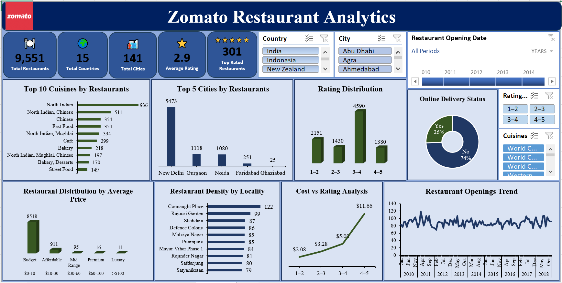
Excel Dashboard

Slide 6
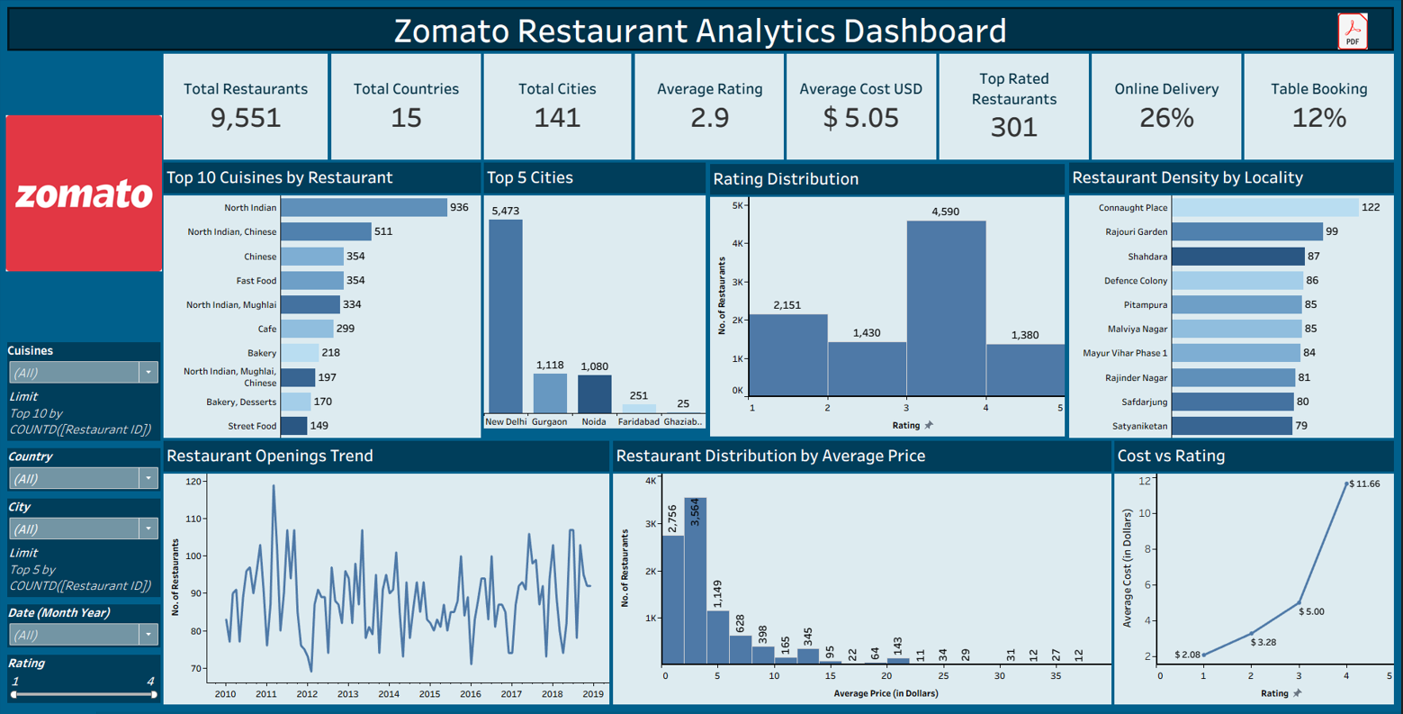
Tableau Dashboard

Slide 7
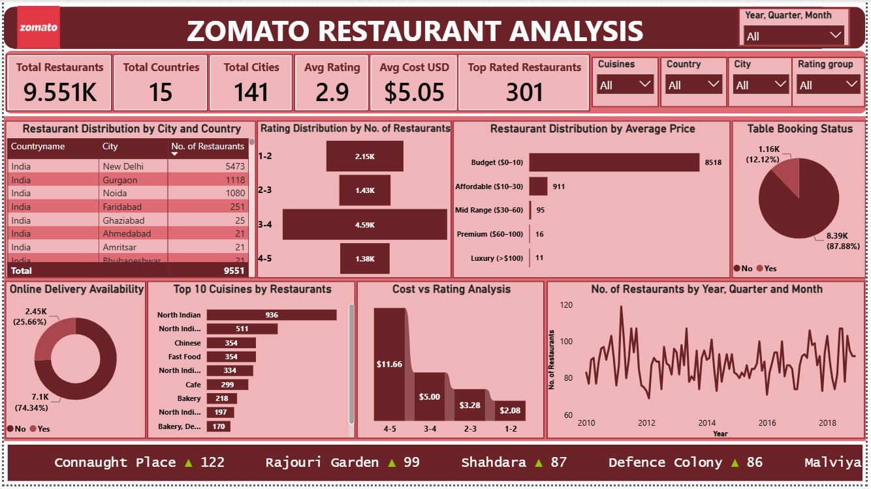
Power BI Dashboard

Slide 8
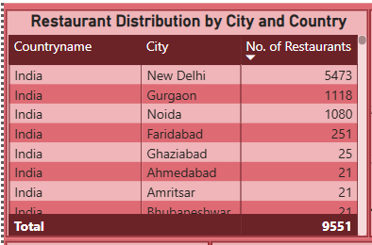
Restaurant Distribution Analysis
Observation:
New Delhi has the highest restaurant concentration.
Restaurant business is concentrated in metro cities.
Suggestion:
Expand into under-served cities.
Identify high-demand locations with fewer competitors.
Conclusion:
Metro cities dominate restaurant presence, but smaller cities offer growth opportunities.

Slide 9
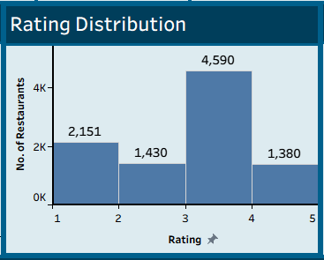
Customer Rating Analysis
Observation:
Most restaurants fall into the 3-4 rating category.
Only 1,380 restaurants have ratings >=4.
Suggestion:
Improve food quality & customer service.
Encourage customer reviews.
Conclusion:
Customer satisfaction is moderate and there is significant scope for quality improvement.

Slide 10
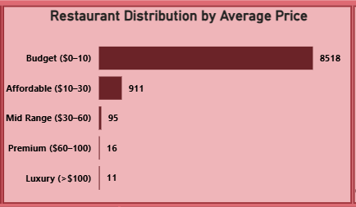
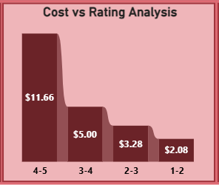
Pricing Analysis
Observation:
Budget restaurants dominate.
Higher-rated restaurants generally charge higher prices.
Suggestion:
Promote affordable restaurants.
Premium restaurants should emphasize quality and experience.
Conclusion:
Customers prefer affordable dining,
but premium pricing is justified by higher ratings.

Slide 11
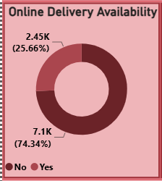
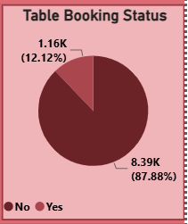
Customer Services Analysis
Observation:
Only 26% offer online delivery.
Only 12% offer table booking.
Suggestion:
Increase delivery partnerships.
Encourage restaurants to enable reservations.
Conclusion:
Digital services remain underutilized and
present significant growth opportunities.

Slide 12
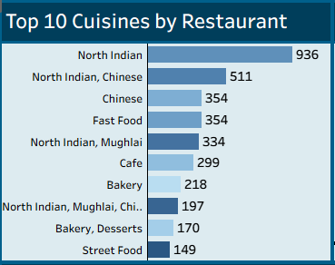
Cuisine Analysis
Observation:
North Indian cuisine has the highest restaurant count.
Indian and Chinese cuisines dominate the top cuisine.
Suggestion:
Strengthen partnerships with popular cuisine categories.
Promote multi-cuisine restaurants to attract more customers.
Expand high-demand cuisines into cities with lower restaurant presence.
Conclusion:
Customer demand is highest for North Indian and fusion cuisines, making them key focus areas for business growth.

Slide 13
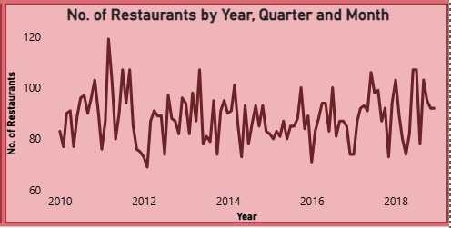
Restaurant Opening Trend Analysis
Observation:
Restaurant openings remain stable over the years.
Occasional spikes indicate periods of higher growth.
Suggestion:
Identify factors behind peak growth periods.
Plan future expansions based on demand trends.
Conclusion:
The restaurant market shows consistent growth with periodic expansion opportunities.

Slide 14
KPI Summary
KPI | Value
Restaurants | 9,551
Countries | 15
Cities | 141
Average Rating | 2.9
Average Cost | $ 5.05
Top Rated Restaurants | 301
Online Delivery | 26%
Table Booking | 12%

Slide 15
Overall Business Recommendations
Expand into under-served cities
Increase online delivery adoption
Encourage table booking
Improve restaurant ratings
Promote top-performing cuisines
Focus on affordable pricing
Use customer feedback for service improvement

Slide 16
Conclusion
End-to-end analytics using MySQL, Excel, Tableau & Power BI.
Transformed raw data into meaningful business insights.
Analyzed ratings, pricing, cuisines, restaurant distribution, and services.
Enabled data-driven decision-making and identified growth opportunities.

Slide 17
Thank You

