Slide 1

OLIST STORE ANALYSIS E-Commerce Sales & Customer Insights Analysis
Presented by:
Shehnaz Fatima
Group 3

Slide 2
OBJECTIVE
Analyze customer purchasing behavior
Study payment trends and customer preferences
Evaluate delivery performance
Understand customer satisfaction through review scores
Generate business insights using data analytics tools

Slide 3
Tools Used
Excel:
Pivot tables
KPI dashboard creation
Basic visual analysis
MySQL:
Data Cleaning
Data Querying
KPI Calculations
Tableau:
Interactive visualizations
Trend Analysis
Power BI:
Dynamic dashboard
Advanced Business Insights
Interactive filtering

Slide 4
Dataset Overview
Brazilian E-Commerce Dataset by Olist
Dataset Information contains:
Orders
Customers
Products
Payments
Reviews
Sellers
Delivery Details
Dataset size:
~ 112K Orders
Approximately 16M Brazilian Real Revenue
Around 99K Customers
Nearly 33K Products
More than 3K Sellers
4.09 Average Customer Rating

Slide 5
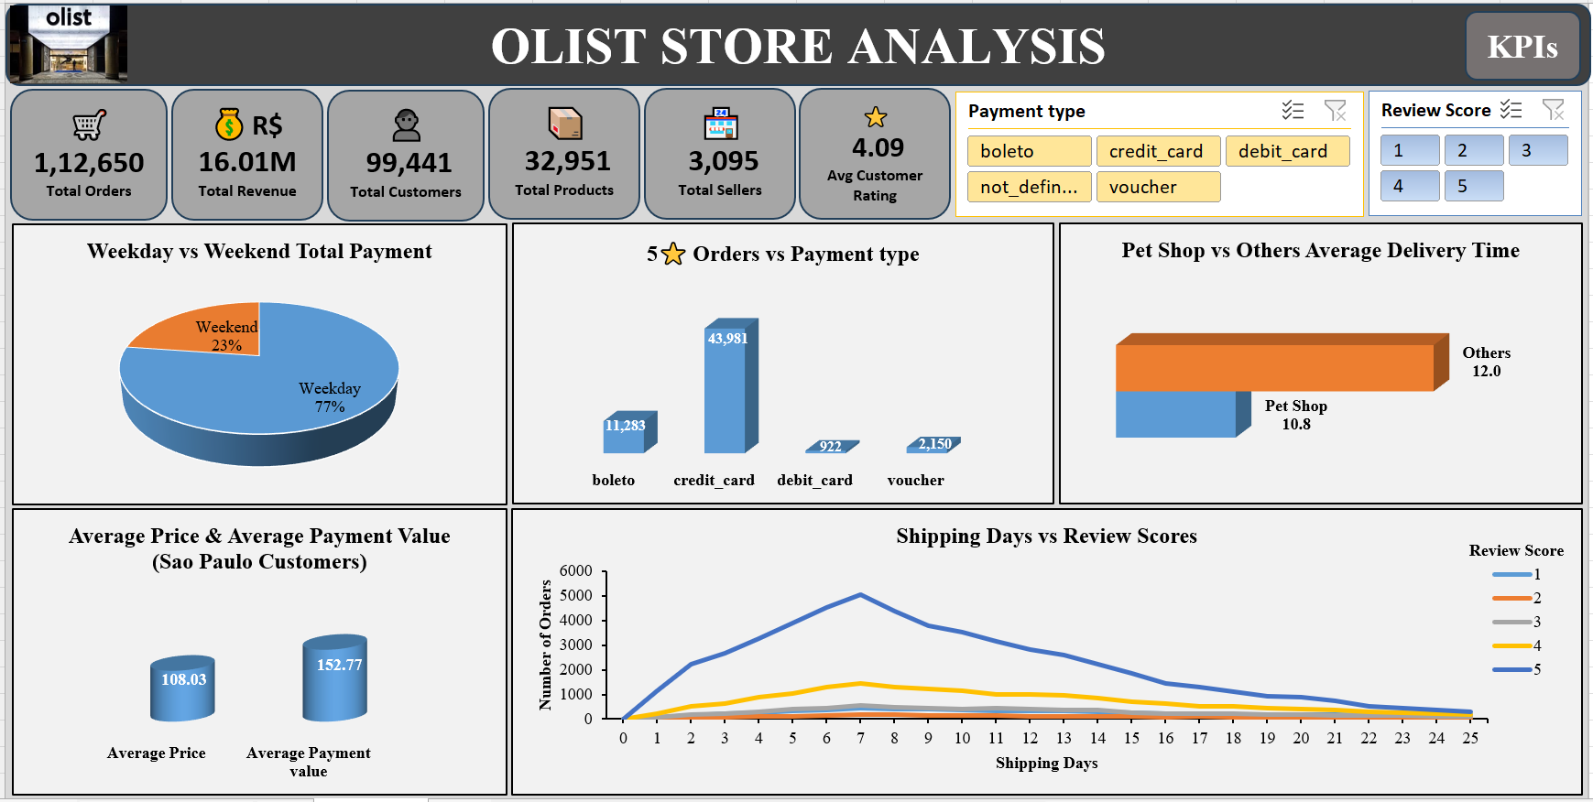
Excel Dashboard

Slide 6
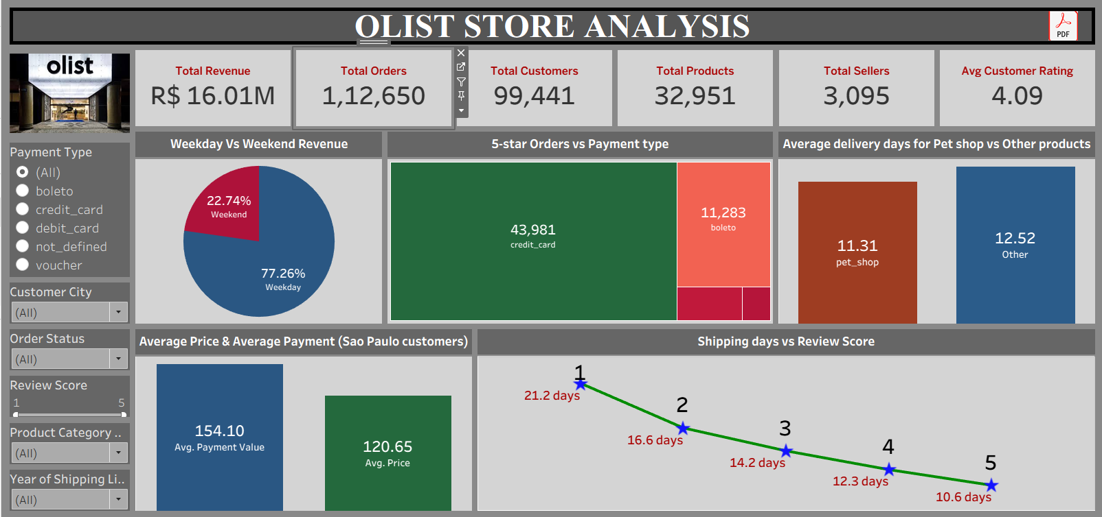
Tableau Dashboard

Slide 7
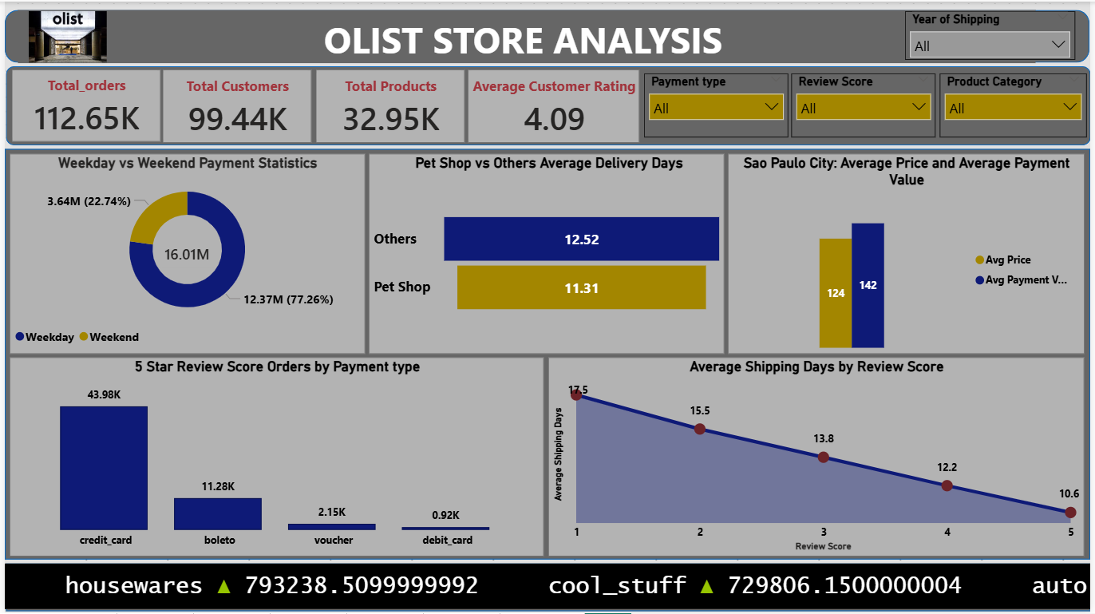
Power BI Dashboard

Slide 8
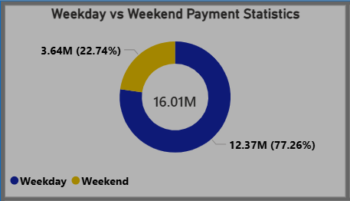
KPI 1: Weekday vs Weekend Payment Statistics
Observation:
Weekdays contributed ~77% of total payments
Weekend sales contribution was lower
Business Suggestion:
Introduce weekend discounts and offers
Increase weekend marketing campaigns
Improve weekend customer engagement

Slide 9
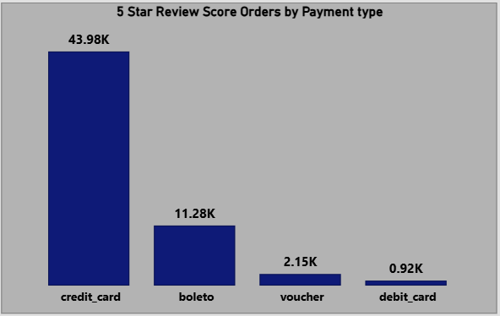
KPI 2: 5-Star Review Orders by Payment Type
Observation:
Credit card payments had the highest number of 5-star reviews
Debit card and voucher had lower order counts
Business Suggestion:
Promote digital payment methods
Improve payment experience for other payments
Offer cashback or rewards on preferred modes

Slide 10
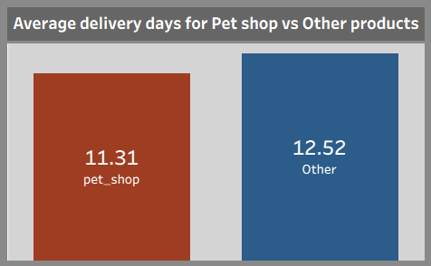
KPI 3: Pet Shop vs Others Average Delivery Days
Observation:
Pet shop products had slightly faster delivery times
Other categories took more delivery days
Business Suggestion:
Apply efficient logistics strategies to slower categories
Optimize warehouse and shipping operations
Improve delivery tracking systems

Slide 11
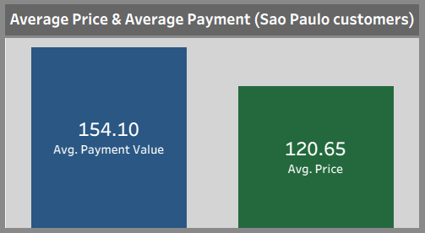
KPI 4: Sao Paulo Customer Analysis
Observation:
Average payment value was higher than average product price
Indicates freight charges and multi-item purchases
Business Suggestion:
Introduce loyalty programs for Sao Paulo customers
Provide bundled product offers
Improve customer retention strategies

Slide 12
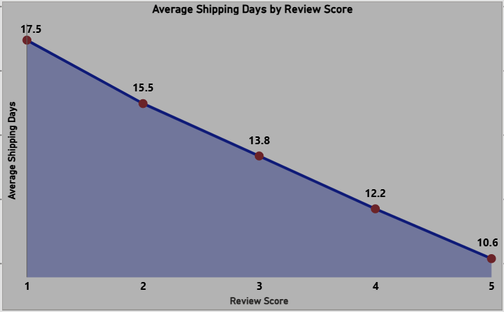
KPI 5: Shipping Days vs Review Scores
Observation:
Faster deliveries received higher review scores
Delayed deliveries resulted in lower ratings
Business Suggestion:
Improve delivery efficiency
Reduce shipping delays
Focus on customer satisfaction through faster logistics

Slide 13
Key Insights
Delivery performance impacts customer satisfaction
Credit card is the most preferred payment method
Weekday sales are significantly higher than weekend sales
Faster delivery improves customer ratings

Slide 14
Conclusion
Data analytics helps identify customer behavior and sales trends
Interactive dashboards improve business decision-making
Logistics and payment optimization can increase customer satisfaction

Slide 15
Thank You

