Slide 1

NORTHERN UNIVERSITY
NOWSHERA
Personal Budget Management System(PBMS)
Shehryar Kamran
SUPERVISED BY: Syed Atif Ali Shah
NORTHEN UNIVERSITY, NOWSHERA
1

Slide 2

Outline
Introduction
Objectives
Development Tools
Network Hierarchy
Preliminary Design
NORTHEN UNIVERSITY, NOWSHERA
2

Slide 3
Introduction
PBMS is an android based mobile application.
Keep record of every income/expense easily at any location.
This app also helps user to have analyze his spending trend through the month.
Quick and easy to use.
Quick overview with info such as last transactions , balance , savings etc.
7 currencies.
4 themes.
You will be always informed about all your latest transactions and instantly know where your money goes as well as which are your main income sources.
NORTHEN UNIVERSITY, NOWSHERA
3

Slide 4
Objectives
Create personal budget.
Record expense transactions.
Record income transactions.
Income can be updated or deleted in future.
Remove any expense.
Expense can be updated in future.
Details of income can be seen.
Expense which was created before with its information can be viewed later on.
Filters for advanced transactions search.
Data can be backup for future use.
NORTHEN UNIVERSITY, NOWSHERA
4

Slide 5
Tools
Language: Java, Xml
Platform: Android
Database: SqLite
IDE: Android Studio
NORTHEN UNIVERSITY, NOWSHERA
5

Slide 6
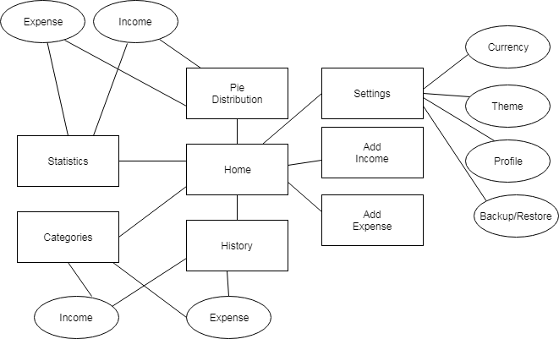
Network Hierarchy
Figure : 1
NORTHEN UNIVERSITY, NOWSHERA
6

Slide 7
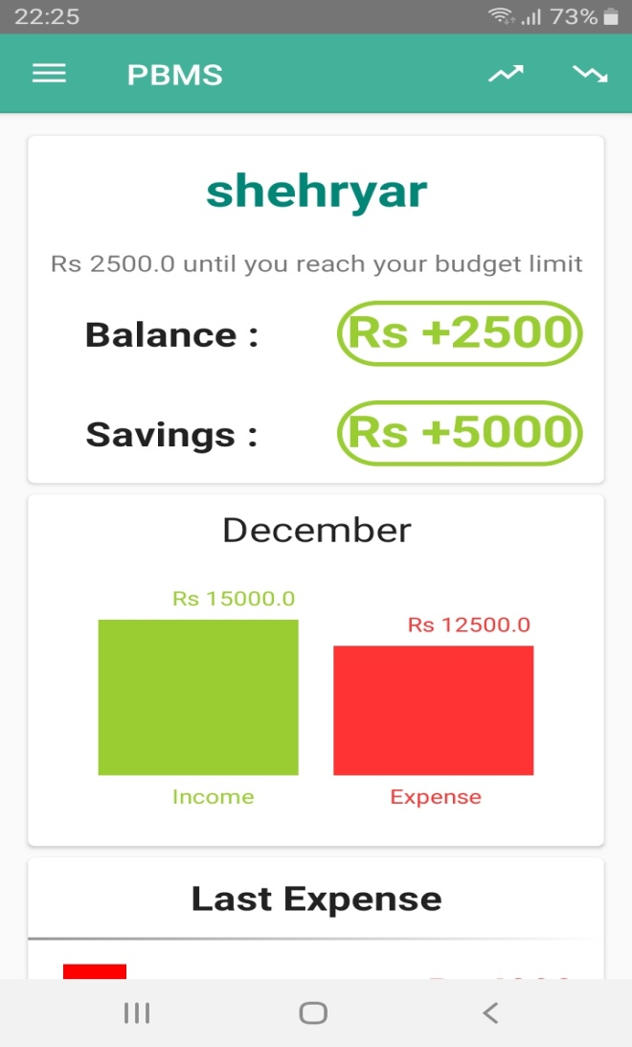
Home
Figure : 2
NORTHEN UNIVERSITY, NOWSHERA
7

Slide 8
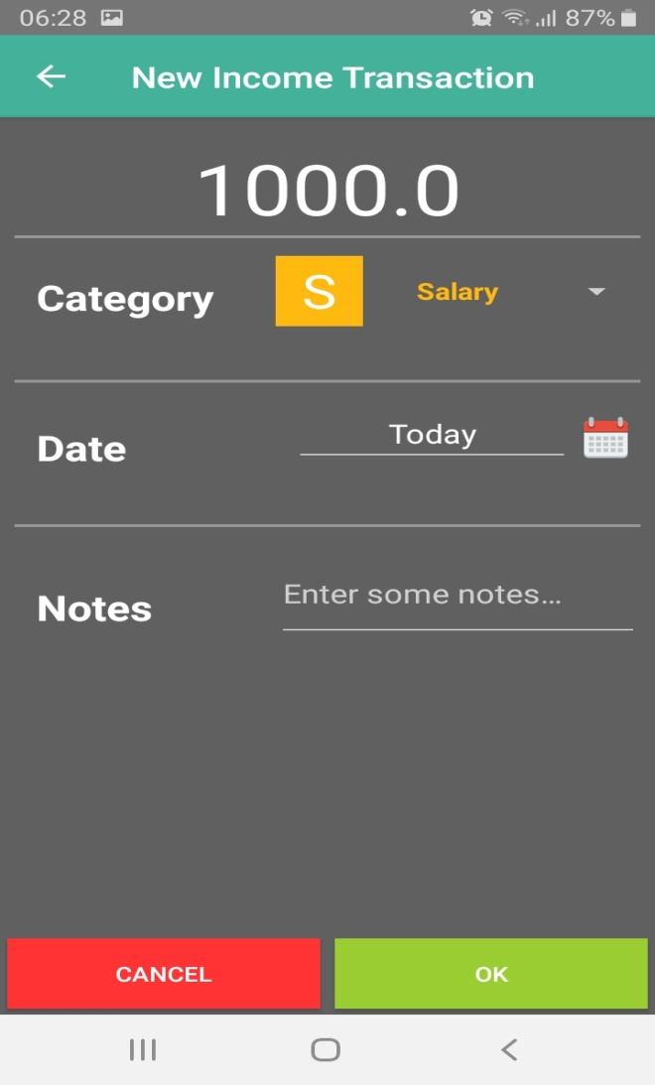
Add Income
Figure : 3
NORTHEN UNIVERSITY, NOWSHERA
8
9

Slide 9
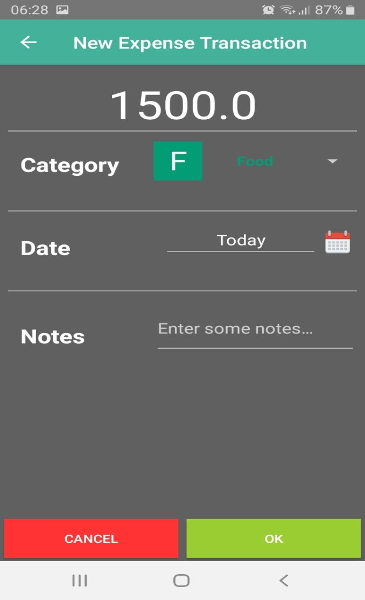
Add Expense
Figure : 4
NORTHEN UNIVERSITY, NOWSHERA
9
12

Slide 10
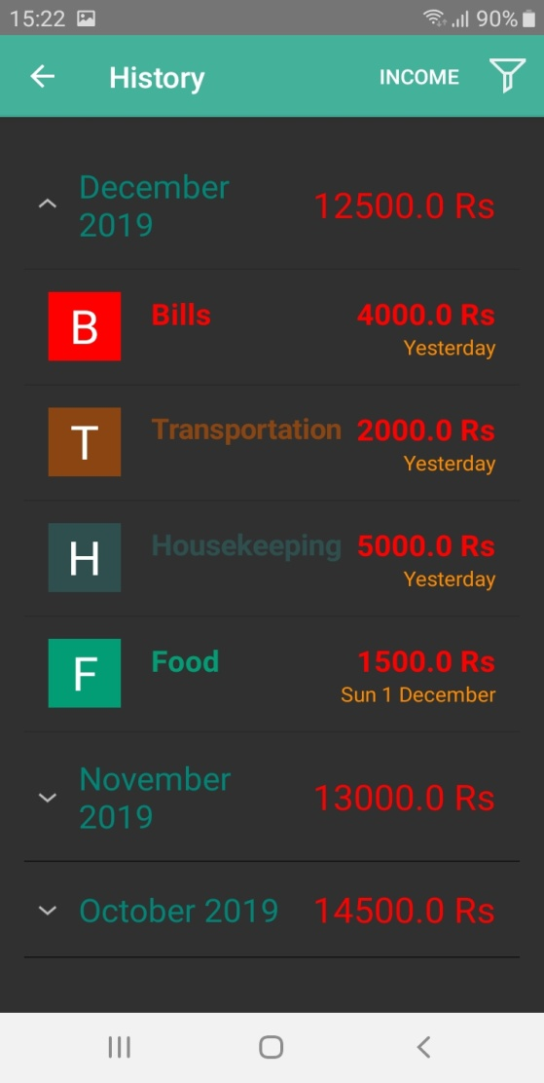
History
Figure : 5
NORTHEN UNIVERSITY, NOWSHERA
10
10

Slide 11
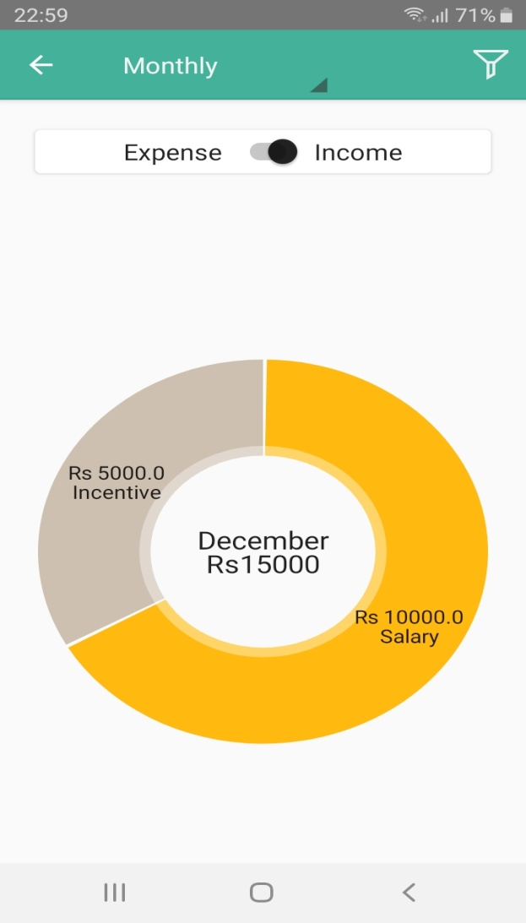
Pie Distribution
Figure : 6
NORTHEN UNIVERSITY, NOWSHERA
10
10

Slide 12
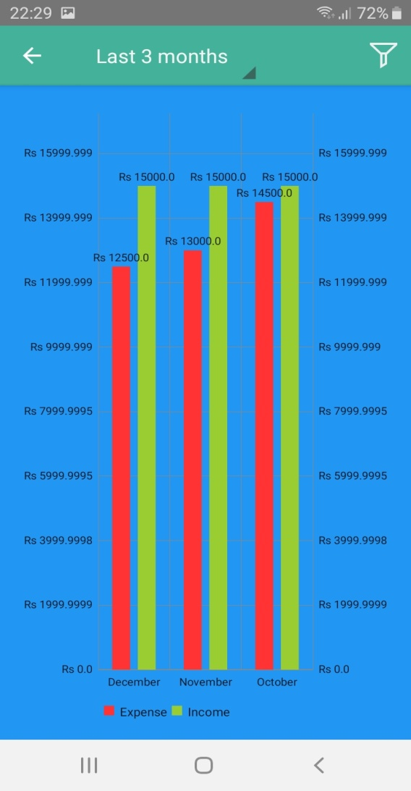
Statistics
Figure : 7
NORTHEN UNIVERSITY, NOWSHERA
10
10

Slide 13
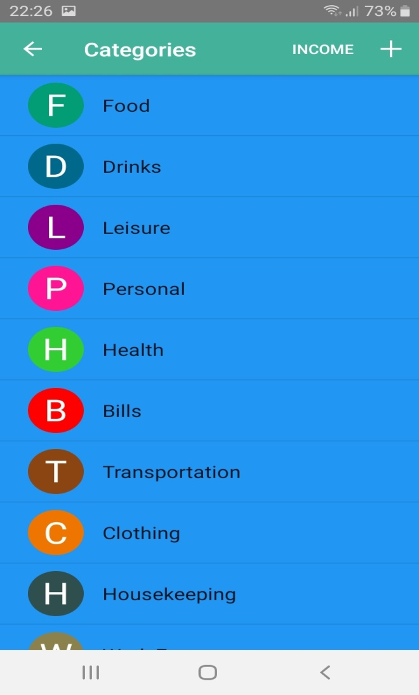
Categories
Figure : 8
NORTHEN UNIVERSITY, NOWSHERA
10
10

Slide 14
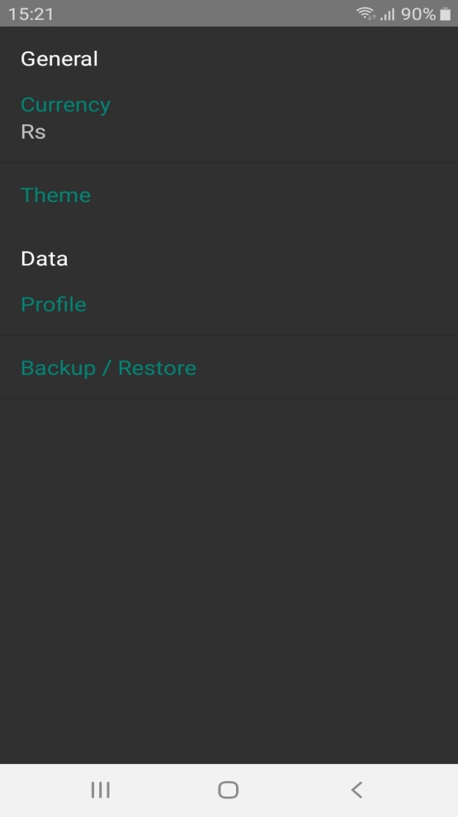
Settings
Figure : 9
NORTHEN UNIVERSITY, NOWSHERA
10
10

Slide 15
Q/A
?
NORTHEN UNIVERSITY, NOWSHERA
11

Slide 16
Thank You
Thank You
NORTHEN UNIVERSITY, NOWSHERA
12

