Slide 1
Finding orientation angle for object
180
0
The degree in this presentation refers from right as 0 and left as 180. To show the angle of the object

Slide 2
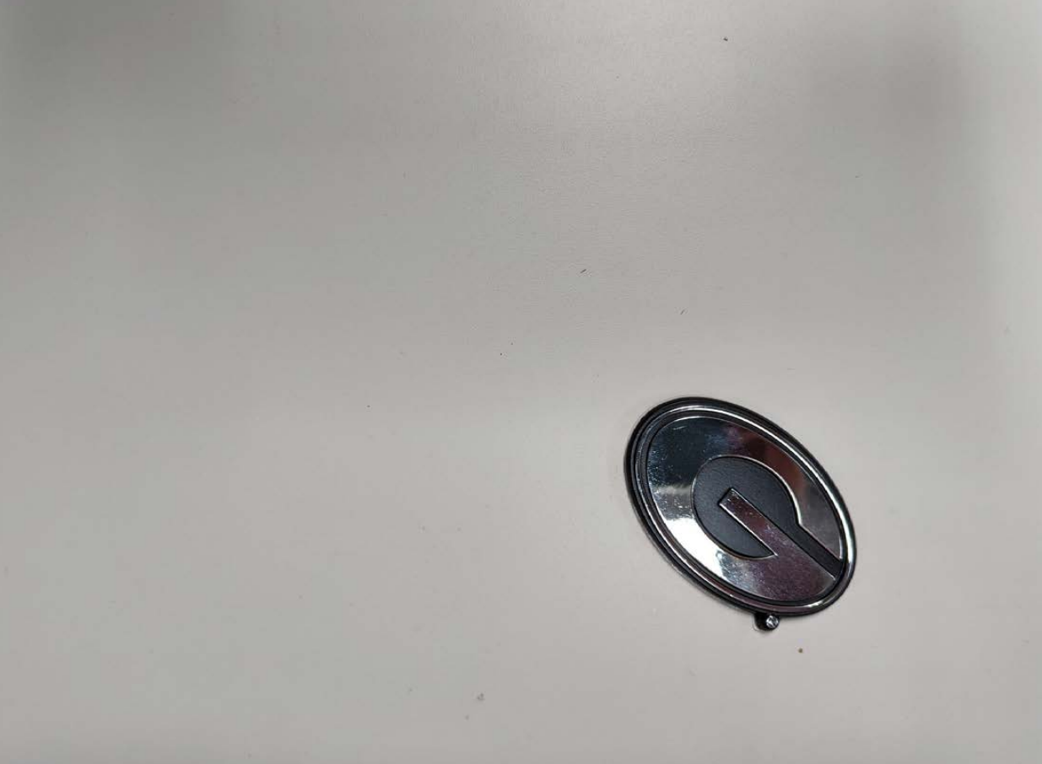
Input image
Size of the image is ﻿(1235, 906)(width height)

Slide 3
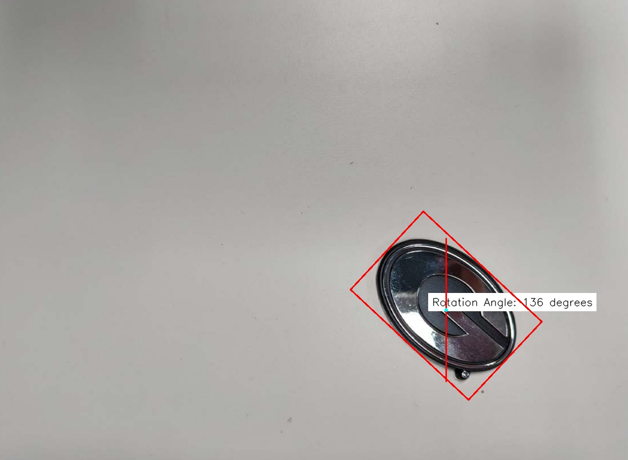
From the above image the object is 136 degree rotated and the center of the object which is the blue dot
Is located at the axis ﻿(877, 610) (x,y) in the image

