Slide 1




Predicting Restaurant Inspections
DAT 7 Shehzad Bashir
Aug 12th, 2015

Slide 2

Problem
48M+ Americans per year become sick from food
~75% of the outbreaks come from food prepared by restaurants and caterers
Current solution is random inspections
Time wasted at clean restaurants
Missed opportunities at restaurants with safety issues

Slide 3
Question
Can Yelp reviews be used to make the process of sending health inspectors to restaurants more efficient?
More specifically: How accurately can we predict the total number of violations a restaurant is likely to get based on Yelp reviews and historic inspection data?

Slide 4
Scope Limitation
Competition Prediction: Predict the number of health violations, by severity, a restaurant is likely to receive
My Prediction: Total number of health violations, regardless of severity, a restaurant is likely to receive (Regression)
Prediction

Slide 5
Data Gathered
 | Format
Business | JSON
Review | JSON
Check-in | JSON
Tips | JSON
User | JSON
ID Mapping File
 | Format
Training Data | CSV
Submission Data | CSV
Unique Business IDs | CSV
Yelp ID to Business ID (CSV)

Slide 6
Pre-processing & Cleaning
Joined Yelp business data with Boston city data based on mapping file
Filtered to one record for each restaurant
Combined reviews for each restaurant into one field
Averaged the number of violations for restaurant with multiple inspections, and summed for total violations
Lost some features such as date of inspections & reviews
Dropped unnecessary columns
i.e. Hours, State, Review ID

Slide 7
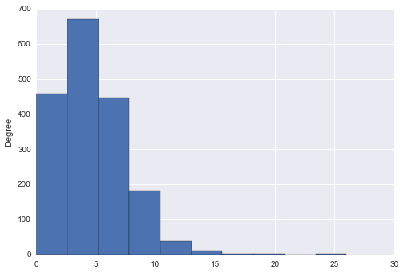
Total Number of Health Violations
Number of Health Violations

Slide 8
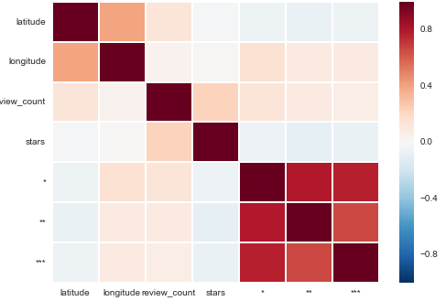
Correlation

Slide 9
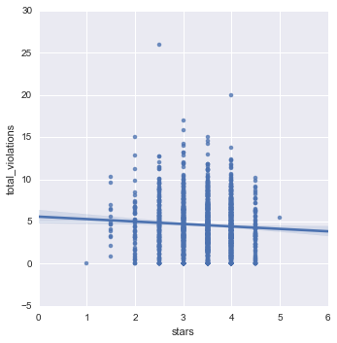
Average Rating (Stars) and Number of Violations

Slide 10
Baseline Model
Model: Linear Regression
Model Features:
Number of reviews
Text length
Ratings
Evaluation Metric:
Root Mean Squared Error (RMSE)
RMSE Cross Validation Score: 2.85

Slide 11
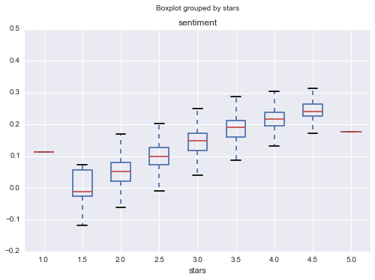
Sentiment Analysis
Polarity

Slide 12
Reviews by Sentiment Polarity
Most Positive Reviews (Polarity: ~ 0.32) | Most Negative Reviews (Polarity: ~- 0.12)
"This was an excellent dinner, from start to finish..." | "The place is dirty.."
"Outstanding wine list, phenomenal food" | "The service here is incredibly slow"
"The Faculty Club is a very clean and open space…" | "We will never go back there to get scammed on cheap soda"
"My favorite cheap eatery in the area for sure" | "Please, just close or put proper management/staffing in place"
"Would highly recommend stopping by after work.." | "Some employees seemed to be friendly and helpful, but most of them were rude, and seemed like they hated their jobs"

Slide 13
Linear Regression
Model: Linear Regression
Model Features:
Number of reviews
Text length
Ratings
Sentiment Polarity Score
Evaluation Metric:
Root Mean Squared Error (RMSE)
RMSE Cross Validation Score: 2.82 (.05)

Slide 14
Random Forests
Model: Random Forests
Model Features:
Number of reviews
Text length
Ratings
Sentiment Polarity Score
Evaluation Metric:
Root Mean Squared Error (RMSE)
RMSE Cross Validation Score: 2.61 (.24)

Slide 15
Model (with Reviews)
Model: Random Forests (n_estimators = 40, max_features = 1500)
Model Features:
Number of reviews
Text length
Ratings
Polarity
TF-IDF Vectorizer
- Stop words = English
- Min_df = 6 (reduced from 85k to 23k features)
Evaluation Metric:
Root Mean Squared Error (RMSE)
RMSE Score: 2.51 (.10)

Slide 16
Model Summary
 | Model Type | Number of Features | RMSE
1 | Linear Regression (Baseline) | 3 | 2.85
2 | Linear Regression | 4 | 2.82
3 | Random Forests | 4 | 2.61
4 | Random Forests | 1500 | 2.51

Slide 17
Next Steps
Predict number of health violations by severity, as required for competition
Account for features such as date and user profile data
Try different n_grams & other tuning parameters
Build new features from Naïve Bayes

Slide 18

Questions

