Slide 1




Predicting Restaurant Inspections
DAT 7 Shehzad Bashir
Aug 12th, 2015

Slide 2


Problem
48M+ Americans per year become sick from food
~75% of the outbreaks come from food prepared by restaurants and caterers
Current solution is random inspections
Time wasted at clean restaurants
Missed opportunities at restaurants with safety issues

Slide 3
Question
Can Yelp reviews be used to make the process of sending health inspectors to restaurants more efficient?
More specifically: Can we predict the total number of violations a restaurant is likely to get based on Yelp reviews and historic inspection data?

Slide 4
Prediction
Competition: Predict the number of health violations, by severity, a restaurant is likely to receive
My Prediction: Total number of health violations, regardless of severity, a restaurant is likely to receive (Regression)
Prediction

Slide 5
Data Gathered
 | Format
Business | JSON
Review | JSON
Check-in | JSON
Tips | JSON
User | JSON
ID Mapping File
 | Format
Training Data | CSV
Submission Data | CSV
Unique Business IDs | CSV
Yelp ID to Business ID (CSV)

Slide 6
Pre-processing & Cleaning
Joined Yelp business data with Boston city data based on mapping file
Split data into two sets by date:
Training: October 2007 – March 2014
Test/Validation: April 2014 – March 2015
Filtered to one record for each restaurant
Combined reviews for each restaurant into one field
Averaged the number of violations for restaurant with multiple inspections, and summed for total violations
Lost some features such as date of reviews
Dropped unnecessary columns
i.e. Hours, State, Review ID

Slide 7
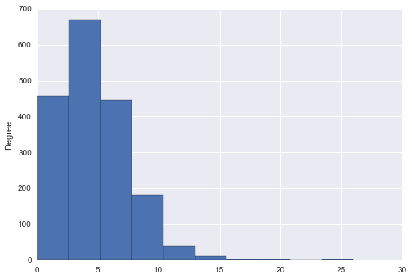
Total Number of Health Violations
Number of Health Violations

Slide 8
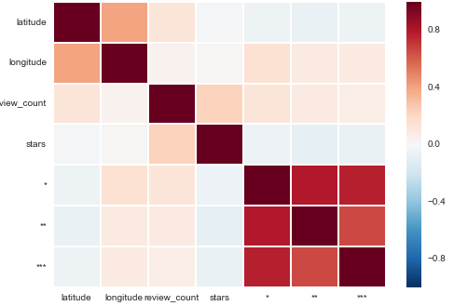
Data Exploration
Correlation Heatmap

Slide 9
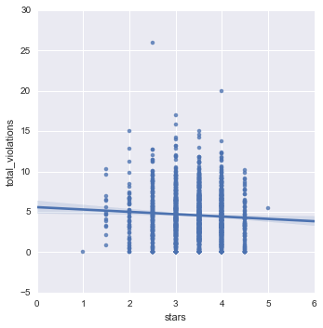
Data Exploration
Average Rating (Stars) and Number of Violations

Slide 10
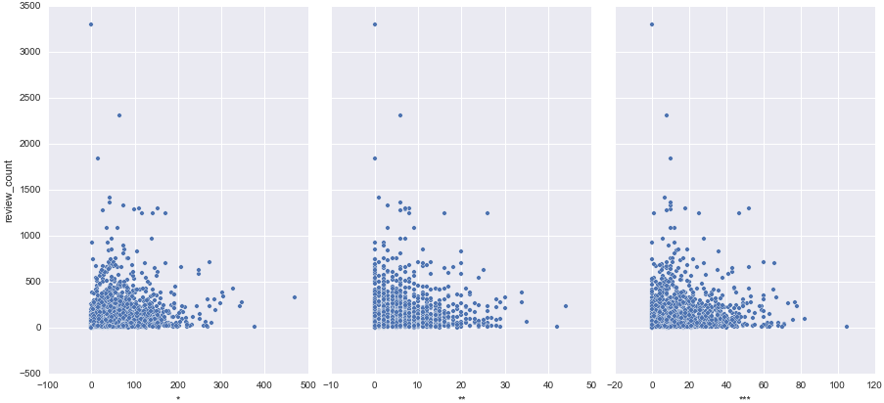
Data Exploration
Number of reviews and severity of violation

Slide 11
Baseline Model
Model: Linear Regression
Model Features:
Number of reviews
Text length
Ratings
Evaluation Metric:
Root Mean Squared Error (RMSE)
RMSE Cross Validation Score: 2.85

Slide 12
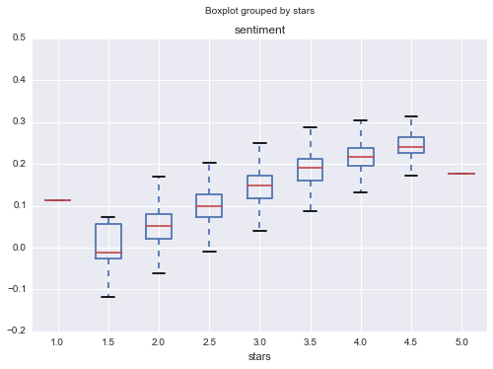
Sentiment Analysis
Polarity

Slide 13
Model (with Sentiment)
Model: Linear Regression
Model Features:
Number of reviews
Text length
Ratings
Sentiment Polarity Score
Evaluation Metric:
Root Mean Squared Error (RMSE)
RMSE Cross Validation Score: 2.82 (-.05)

Slide 14
Model (with Sentiment)
Model: Random Forests (n_estimators = 40, max_features = 1500)
Model Features:
Number of reviews
Text length
Ratings
Sentiment Polarity Score
Evaluation Metric:
Root Mean Squared Error (RMSE)
RMSE Cross Validation Score: 2.61 (-.24)

Slide 15
Keywords
List of keywords
Or
Feature Importance (may not work): pd.DataFrame({'feature':feature_cols,'importance':treereg.feature_importances_}).sort('importance')

Slide 16
(Notes slide)
Try different n_grams
# includes 1 gram and 2 gram words
vect = CountVectorizer(ngram_range=(1, 2)) train_dtm = vect.fit_transform(X_train) train_dtm.shape

Slide 17
Model (with Sentiment)
Model: Random Forests (n_estimators = 40, max_features = 1500)
Model Features:
Number of reviews
Text length
Ratings
Polarity
TF-IDF Vectorizer
- Stop words = English
- Min_df = 6 (reduced from 85k to 23k features)
Evaluation Metric:
Root Mean Squared Error (RMSE)
RMSE Score: 2.51 (-.10)

Slide 18
Next Steps
Work backward and making prediction for level of severity that would allow me access to a lot more features (actually woudn’t be too hard to do) – original thought it would be

Slide 19

Questions

