Slide 1



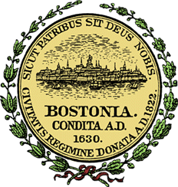

Predicting Restaurant Inspections
DAT 7 Shehzad Bashir
July 13th, 2015

Slide 2


Problem
48M+ Americans per year become sick from food
~75% of the outbreaks come from food prepared by restaurants and caterers
Current solution is random inspections
Time wasted at clean restaurants
Missed opportunities at restaurants with safety issues

Slide 3

Question
Can Yelp reviews and Boston’s historic health inspection data be used to make the process of sending health inspectors to restaurants more efficient?
?

Slide 4
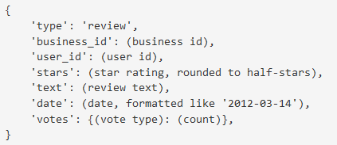
Data Gathered
 | Format
Business | JSON
Review | JSON
Check-in | JSON
Tips | JSON
User | JSON
ID Mapping File
 | Format
Training Data | CSV
Submission Data | CSV
Unique Business IDs | CSV
Yelp ID to Business ID (CSV)

Slide 5
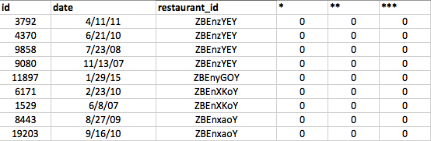
Submission Data
Predict the number of health violations, by severity, a restaurant is likely to receive
Minor Violation = *
Major Violation = **
Severe Violation = ***

Slide 6
Data Cleaned
Converted JSON files to CSV
Joined Yelp business data with Boston city data based on mapping file
Dropped unnecessary columns
i.e. Hours, State, Review ID
Next Steps:
Merge reviews
Merge user data

Slide 7
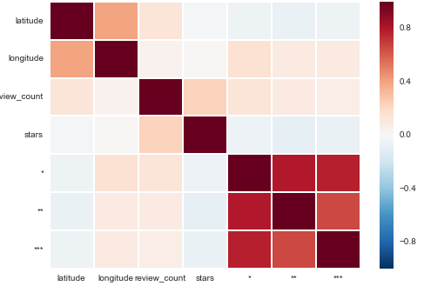
Data Exploration
Correlation Heatmap

Slide 8
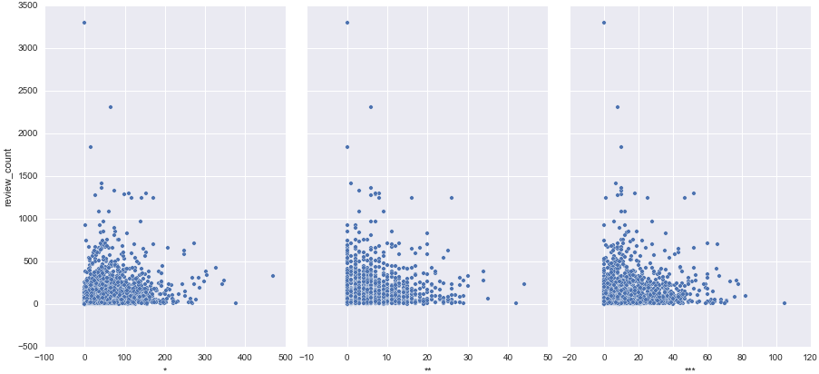
Data Exploration
Number of reviews and severity of violation

Slide 9




Next Steps
Sentiment Analysis
Location Analysis
Yelp User Profile Analysis
Filter/Drop Unnecessary Fields

Slide 10




Modeling & Scope
Regression or Classification Problem?
Classification: Based on likelihood of whether a restaurant will receive a violation, what will the severity of the violation be?
Regression: Based on total violations, what is the likelihood of a restaurant’s violations to increase?
Potential Model Features:
Number of reviews
Keywords from reviews
Ratings
Date
Location
Review length
Response:
Health Violations (violation indicator or # of violations)

Slide 11

Questions

