Slide 1


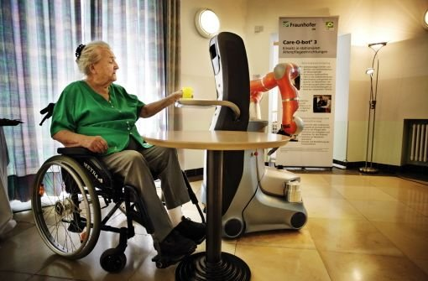
AMR foundation Course
Robot Operating System(ROS)
Basic concepts and their usage
to prepare softwares
for your robots
Shehzad Ahmed
Master of Autonomous Systems
Hochschule Bonn-Rhein-Sieg
Sep. 12, 2014

Slide 2
ROS-Introduction

Slide 3
First, lets see some cool videos and demos

Slide 4
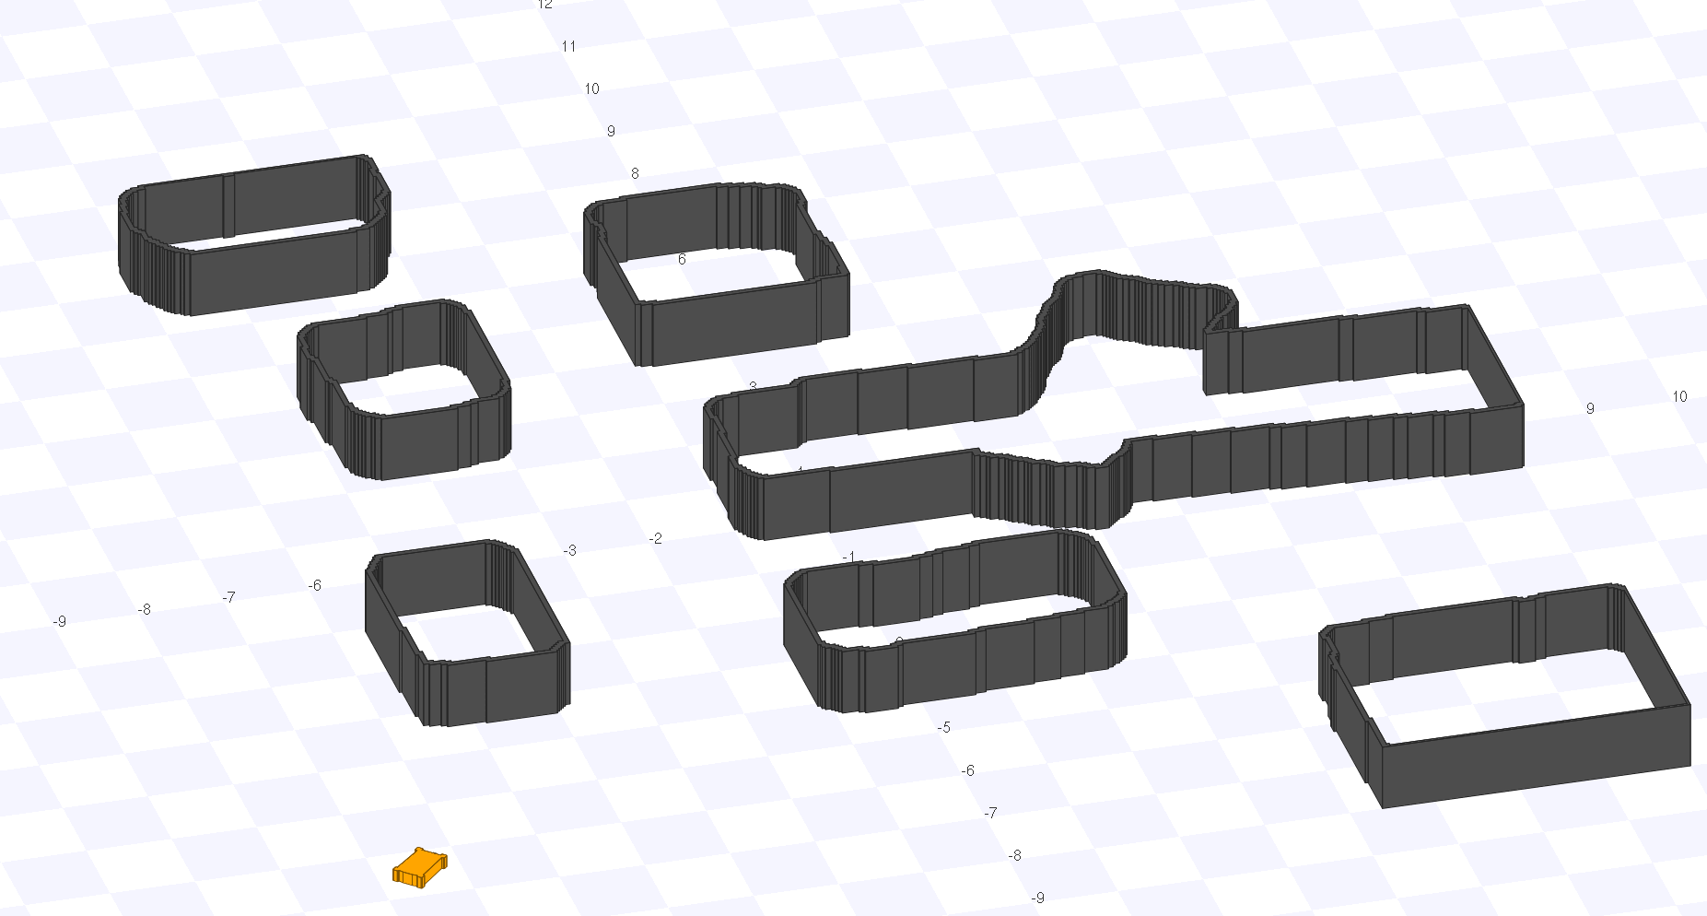
AMR-Stage

Slide 5
ROS-Introduction
It is like an operating system.
Services of an operating system:
  hardware abstraction
  low-level device control,
  implementation of commonly-used functionality,
  message-passing between processes,
  and process management.
Similarly, ROS provides a 'communication infrastructure' to create a 'peer-peer network' of process.

Slide 6
ROS-Introduction
Peer-Peer network of process?
Let's understand this using a simple graph
  Process/Processes? What is it?
  Server? Why do we need this?
  Data sharing/Message passing? But how?
    Asynchronous
    Synchronous
  Process might also need configuration
  parameters.

Slide 7
ROS-Terminologies
Process/Processes → Node/Nodes
Server → ROS Master
Message Passing:
  Asynchronous → Topics
  Synchronous → Services
Config. Parameters → ROS parameter server

Slide 8
ROS-CONCEPTS
ROS concepts are divided into three levels.
ROS Computation Graph level(CGL)
  Network of ROS processes that are performing data processing make a Computation graph.
  Nodes,master, messages, topics services, parameters come under this level.

Slide 9
ROS CGL→ROS Master
Two main responsibilities of ROS Master
  Act as a nameserver therefore it provides name registration and lookup.
  Acts as a parameter server.
Nodes communicate with the master to:
  Report their registration information.
  Get registration information about other nodes.

Slide 10
ROS CGL → Nodes
Nodes are processes that perform computation.
Node-2-Node communication:
  Server provides lookup information to all nodes.
  Then Nodes directly create connection among them.
    Using ROSTCP or ROSUDP protocols.
Lookup information?
  Names: They have a very important role in ROS.

Slide 11
ROS CGL → Messages
Nodes communicate with each other by passing messages.

Slide 12
ROS CGL → Topics
Topics acts as a message bus to transport them using publisher and subscriber model.
Publisher and subscriber model uses only one type of message.
Many-to-Many, one-way transport.

Slide 13
ROS CGL → Services
Request and Response model is used by services.
Services uses two types of messages: one for request and other for response.
Its one-to-one two way communication.
Client side operation: Request-Wait-Response pipeline.

Slide 14
ROS Concepts
ROS Filesystem Level
  This level more related to software organization of the ROS resources.
  The concepts involved in this level are:
    Packages: Organize ROS Software
    MetaPackages: Combine Multiple Packages
    Package Manifest: Provides package meta information and dependencies.
    Repositories: Packages are stored and shared by using Version Control System(VCS).
ROS Community Level

Slide 15
ROS-Practical Implementation
ROS Computation Graph level concepts are implemented in ros_comm repository.
  Provides communications-related packages
  Stable supported core client libraries are roscpp and rospy.
  Graph introspection tools (rostopic, rosnode, rosservice, rosparam).
  Provide implementations and tools for CGL.

Slide 16
Navigating the ROS Filesystem
Filesystem cmd Tools:
  rospack
  roscd
  rosls

Slide 17
Packages
  Creating catkin packages
  What makes up a catkin Package?
  Catkin packages in a catkin Workspace.
  Package dependencies
    First-order dependencies
    Indirect dependencies
  Customizing the package.
  Customizing the CmakeLists.txt.

Slide 18
ROS graph concepts
ROS Nodes:
  Nodes are written using ROS client libraries.
  Creation of nodes CPP and Python.
cmd tools:
  Roscore: master+ rosout+parameter server
  rosnode
  Rosrun

Slide 19
Initialization and Shutdown
  Two levels of initialization.
    Initializing the node through a call to one of the ros::init() functions.
    Starting the node is most often done through creation of a ros::NodeHandle.
  Node handle:
    Automatic Startup and Shutdown of the node.
    NodeHandles allows to specify a namespace.

Slide 20
Callbacks and Spinning
  Single-threaded Spinning:spin and spinOnce
  Multi-threaded Spinning: MultiThreadedSpinner and ros::AsyncSpinner
ROS Time and Duration
  ROS has builtin time and duration primitive types.
  ros::Time::now() and ros::Duration d(0.5)

Slide 21
ROS Logging:
  DEBUG,INFO,WARN,ERROR,FATAL

Slide 22
ROS graph concepts
ROS Messages
  ROS primitive types of messages
    std_msgs
    common_msgs
    Custom type messages
  Cmd tools
    rosmsg …...
  ROS message utilization.

Slide 23
ROS graph concepts
ROS topics
  nodes publish and subscribe desired topics.
  topics transport messages.
  topics publisher and subscriber node.
  Cmd tools:
    rostopic …..
    rqt_graph
    rqt_plot

Slide 24
roslaunch tool:
  Provides easiness to remap topic names.
  Launch group of nodes to manage large network of nodes.
  Roslaunch example.

Slide 25
ROS graph concepts
ROS Services
  Creating services.
  Using services.
  Service-Client pipeline.
  CPP and python examples.

Slide 26
Tommorrow:Next to Come.......
ROS parameter
ros action server
ROBOT description files ros transformation

