Slide 1
Exploratory Data Analysis On Movie Dataset by Sheifali Agarwal

Slide 2
Data Description Dataset contains plenty of information about the movies ranging from basic info to metrics that can help us evaluating the success of movie. It can be categorized into following :- Features for Evaluating the Success of Movies - Revenue - Popularity, - Vote Average Score Potential Key/Features to Affect the Success of a Movie - Budget - Actors - Director - Runtime - Genres - Release Year - Vote Average

Slide 3
Problem Statement What is the recipe to make a blockbuster movie ?? Factors which makes a movie profitable ☺

Slide 4
Investigation Of Data Had a glance on data to develop the gist of what my data looked like Found out the potential unreasonable data value, null data or duplicates Features interesting to pursue and what probably isn’t worth following up on Made a data clearing decision Summarized preprocessed data to see if gives more useful insights Hypothesis building using the relationships between variables. Used effective visualizations to communicate my results

Slide 5
Research Questions Since the dataset contains the movie released year, so the general exploration of the movie metrics over period of years can be investigated first i.e.; > Number of movies released year by year > Popularity of movies over years > Genres trend over years We always define a success of movie based on it’s revenue, reviews/rating, popularity and the potential properties associated with high popularity/rating movies can be runtime, budget, cast, director, genres etc. , so the answers to these questions can lead us to the conclusion . > Properties associated with movies that have high popularity in recent years - Is revenue associated with movies popularity? - Is budget associated with movies that have high popularity? - Is runtime associated with movies that have high popularity on average? - What casts, directors, genres associated with high popularity?

Slide 6
> Properties associated with movies that have high voting score in recent years - Is revenue affecting the score rating of the movie - Is budget associated with movies that have high score? - Is runtime associated with movies that have high score? - What casts, directors, genres associated with high score?

Slide 7
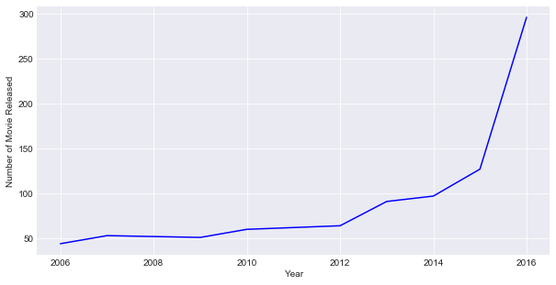
Number Of Movie Released
Number of movie released are increasing by years since the curve is concave upward.

Slide 8
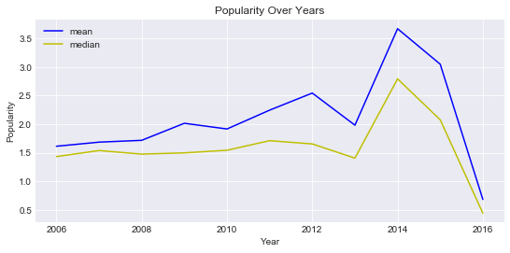
Popularity Over Years
On an average, popularity over years is going up in recent years.
Trend is reasonable due to easier access of movie information nowadays.
Moreover, in the internet age , people can easily watch the content through different sources.

Slide 9
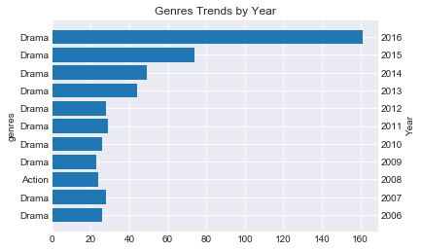
Genres Trend By Year
Genre `drama` are the most filmed in all the years, most popular in movie industry

Slide 10
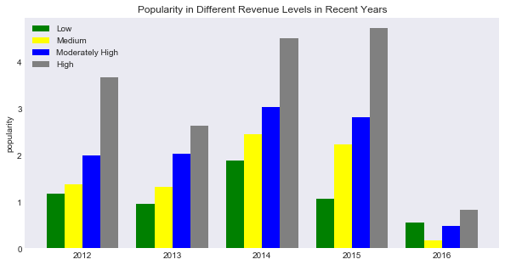
Properties associated with movies that have high popularity
Is revenue associated with movies popularity ??
High revenue movie is always with a higher popularity than movies with lower revenue levels and this is reasonable

Slide 11
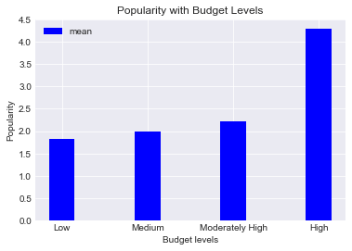
Is budget associated with movies that have high popularity ??
Movies with higher popularity are with higher budget level and that is obvious since the movies with higher popularity may have a higher promoting advertising cost.

Slide 12
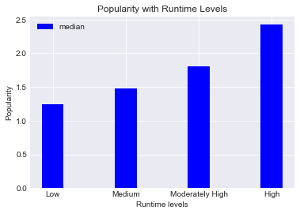
Is runtime associated with movies that have high popularity on average
Higher popularity movies has longer run time.

Slide 13


What casts, directors, genres associated with high popularity ??
Actors Mark Wahlberg , Christian Bale appeared in both popular and unpopular movies, I think they have huge popularity .
Director Ridley Scott and David Yates have been awarded for their popular work
Genres Drama, Comedy, Action are most common in movie industry

Slide 14
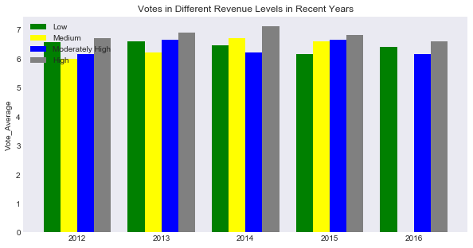
Properties associated with movies that have high voting score in recent years
Is revenue associated to the voting score of the movie
No big difference of movie rating between each revenue level.

Slide 15
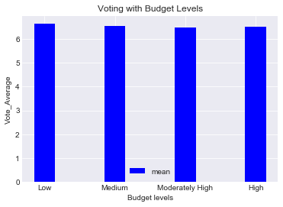
Is budget associated with movies that have high score ??
No big difference in rating at different budget levels

Slide 16
Is runtime associated with movies that have high score on average
No big difference in average voting score in different runtime levels

Slide 17


What casts, directors, genres associated with high score??
Actors Mark Wahlberg , Christian Bale appeared in both highly and low rated movies
Director Ridley Scott and David Yates have made top quality movies on an average
Genres Drama, Comedy, Action are most common in movie industry

Slide 18
Conclusion
This was a very interesting data analysis. I came out with the following interesting facts for a movie to be blockbuster, profitable
- Initially explored few of the general questions. The result turned out to be:-
The number of movie released are increasing. It is accelerated growth trend.
Movie popularity trend is growing on an average.
Genre Drama are the most filmed in almost all years.
- Moreover, I focused on properties that are associated with high popularity movies and found movies with higher revenue level are with higher popularity in recent years on average and also with high budget levels and longer run time.

Slide 19
Cast associated with high popularity movies are `Mark Wahlberg`, `Christian Bale`; Director associated are `Ridley Scott` and `David Yates` - Next I focused on what are the properties that are associated with high voting score and found movies with higher revenue level don't have the significant high score rating in recent years, resulted me to know more about the properties that are affects the rating of the movie. Runtime and budget don't have obvious significance on high rating. In other words, low budget may still have a high rating. Director `Martin Scorsese` and `Clint Eastwood` have made top quality movies on average over the past few years ; Actors `Mark Wahlberg` and `Christian Bale`, they have a huge popularity for their good work.

Slide 20
Thank You

