Slide 2


IEEE 802.11 Physical Layer Fuzzing Using OpenWifi
department of information technology
internet technology and data science lab
Steven Heijse (2/9/2021)

Slide 3
INTRODUCTION

Slide 4

introduction
Hackers are problem that will continue to grow
August 2021:
A cyberattack on the government of Belarus has compromised dozens of police and interior ministry databases.
A cyber-espionage group linked to one of Russia’s intelligence forces targeted the Slovak government.
T-Mobile suffered a data breach that led the hacker to access the personal details of over 50 million people.
In one of the largest cryptocurrency heists, a hacker stole around $600 million from Blockchain site Poly Network.
A hacking group targeted a high-profile Iranian prison, uncovering documents, videos, and images that displayed the violent treatment of its prisoners.
A cyberattack on the Covid-19 vaccine-scheduling website for the Italian region of Lazio forced the website to temporarily shut down.
July 2021:
Russian hackers exploited a vulnerability in Kaseya’s virtual systems/server administrator (VSA) software allowing them to deploy a ransomware attack on the network. The hack affected around 1,500 small and midsized businesses, with attackers asking for $70 million in payment.
Iran’s transport and urbanization ministry was the victim of a cyber attack that impacted display boards at stations throughout the country. The attack caused delays and cancellations of hundreds of trains across Iran.
The Japan 2020 Olympics was subject to data breach exposing the personal credentials of volunteers and ticket holders. The information included usernames, passwords, addresses, and bank account numbers.

Slide 5
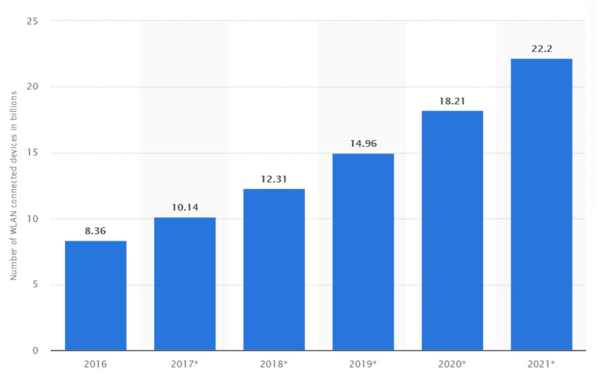
introduction
Projected number of WLAN connected devices worldwide:
Notes:
WLAN connected devices worldwide 2016-2021 | Statista
Wlan currently the most used wireless protocol

Slide 6
IEEE 802.11

Slide 7
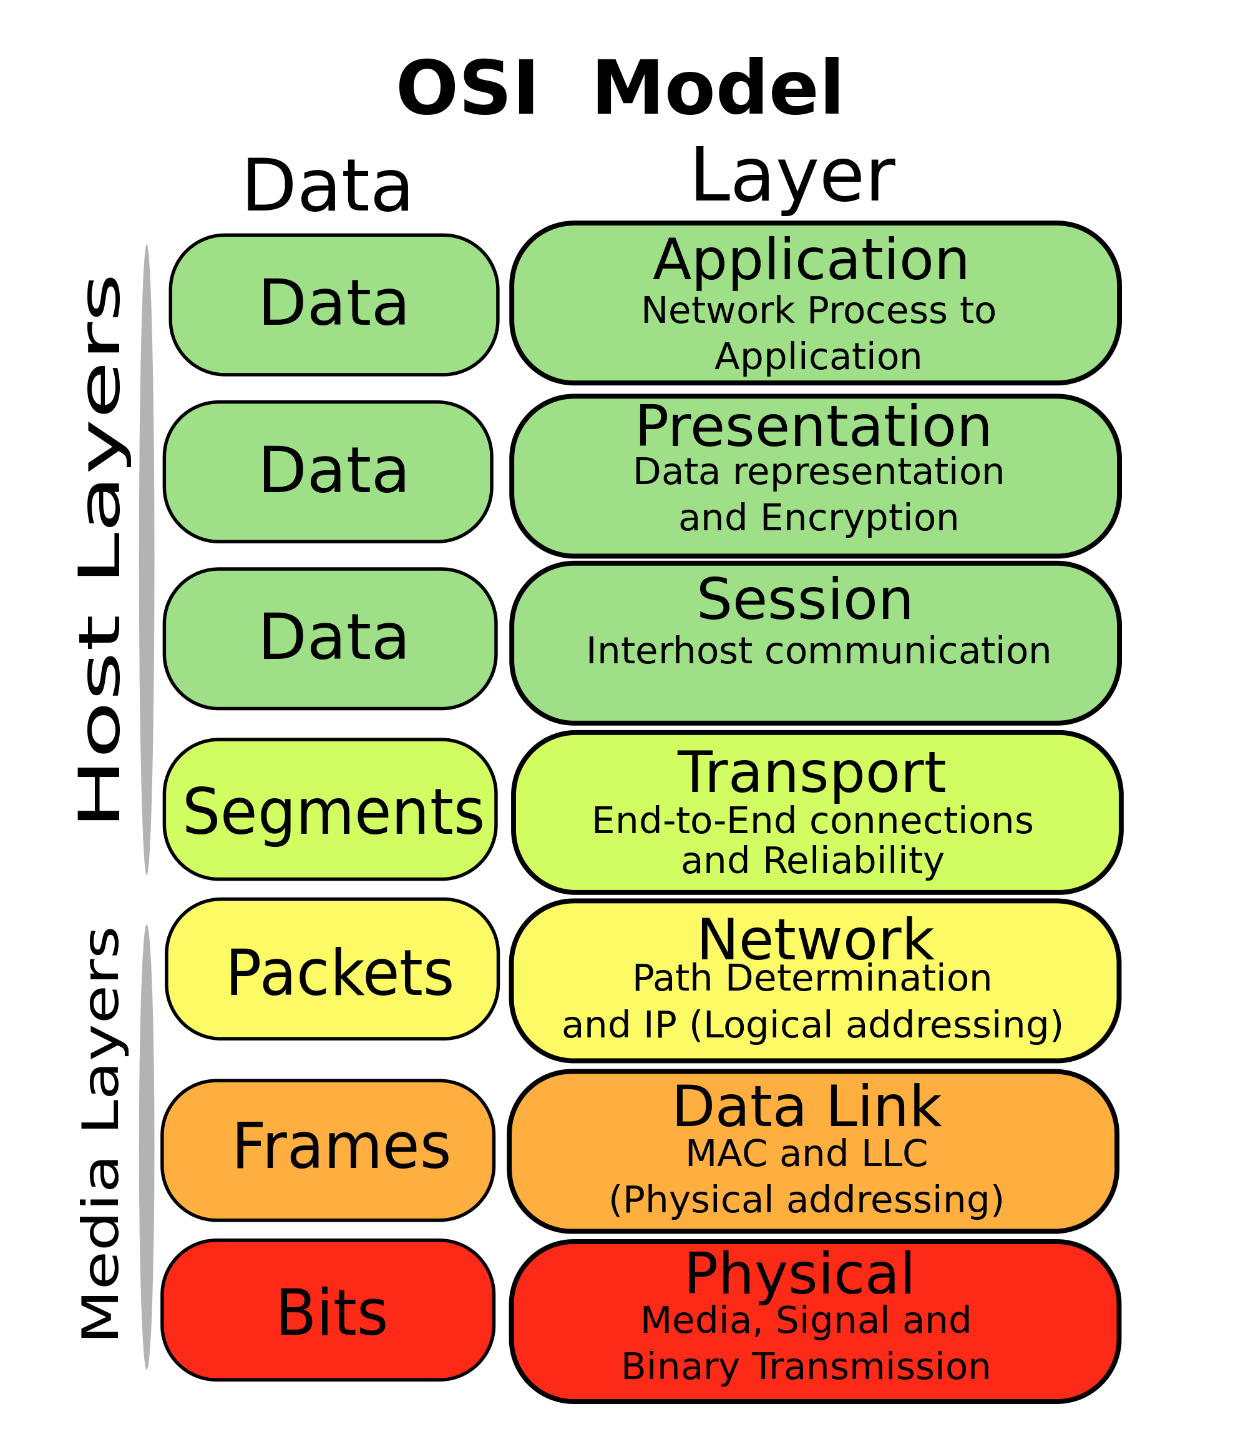
OSI model
Physical
Data link
➔ Media Access Control (MAC)
Notes:
https://www.computerworld.com/article/3594283/hoe-werkt-het-osi-model-precies.html
The Open Systems Interconnection model (OSI model) is a conceptual model that characterises and standardises the communication functions of a telecommunication or computing system without regard to its underlying internal structure and technology. Its goal is the interoperability of diverse communication systems with standard communication protocols.
IEEE 802.11 is part of the IEEE 802 set of local area network (LAN) technical standards, and specifies the set of media access control (MAC) and physical layer (PHY) protocols for implementing wireless local area network (WLAN) computer communication. The standard and amendments provide the basis for wireless network products using the Wi-Fi brand and are the world's most widely used wireless computer networking standards. IEEE 802.11 is used in most home and office networks to allow laptops, printers, smartphones, and other devices to communicate with each other and access the Internet without connecting wires.
Commercial wifi chips -> black box
=> openwifi

Slide 8

Openwifi
Open source
WIFI chip implementation
FPGA
Driver
Linux
802.11n (fosdem.sh)
802.11a/g (fosdem-11ag.sh)
Orthogonal Frequency-Division Multiplexing (OFDM)
Notes:
orthogonal frequency-division multiplexing (OFDM) is a type of digital transmission and a method of encoding digital data on multiple carrier frequencies

Slide 9
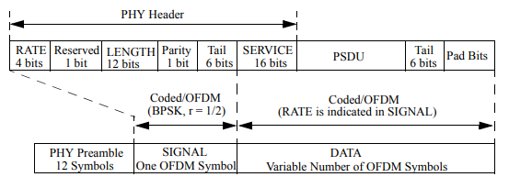
Physical Layer Convergence Protocol (PLCP)
Notes:
Physical Layer Convergence Protocol is the physical layer protocol of several data transmission networks. It is used in the 802.11 standard.
The basic idea of OFDM was the reduction of the symbol rate by distributing bits over numerous subcarriers. IEEE 802.11a uses a fixed symbol rate of 250 000 symbols per second independent of the data rate (0.8 μs guard interval for Inter Symbol Interference (ISI) mitigation plus 3.2 μs used for data results in a symbol duration of 4 μs).
This is an important table to understand the relations between data rate, modulation & coding, number of data/coded bits per subcarrier and per OFDM symbol.
Example BPSK 1/2: BPSK for modulation delivers 1 coded bit per carrier. For all 48 data subcarriers this totals to 48 coded bits per OFDM symbol, which gives 24 data bits with 1/2 coding. These 24 data bits per OFDM symbol then result in: 24 bits/OFDM-symbol or 24 bit / 4 μs = 6 x 10⁶ bps = 6 Mbps.
BPSK:
Phase shift keying (PSK) is een modulatietechniek voor het versturen en ontvangen van digitale signalen, waarbij de fase van het te verzenden signaal verandert om de bits weer te geven.
Er zijn verschillende methodes van PSK. De eenvoudigste methode maakt gebruik van twee fasen: 0° en 180°. Het digitale signaal wordt in de tijd opgedeeld in individuele bits. Deze methode wordt ook wel binaire PSK genoemd (BPSK).
The PLCP preamble consists of 12 symbols and is used for frequency acquisition, channel estimation, and synchronization.
The duration of the preamble is 16 μs. (While a normal symbol lasts 4 μs, the preamble contains 10 short symbols of only 0.8 µs and 2 normal symbols of 4 µs, explaining the duration of only 16 µs).
The following OFDM symbol, called signal, contains the following fields and is BPSK-modulated:
The 4 bit ‘rate’ field determines the data rate and the modulation of the rest of the packet (examples are 0x3 for 54 Mbps, 0x9 for 24 Mbps, or 0xF for 9 Mbps).
The ‘length’ field indicates the number of bytes in the payload field.
The ‘parity’ bit shall be an even parity for the first 17 bits of the signal field (rate, length and the reserved bit).
Finally, the six ‘tail’ bits are set to zero. (enable decoding of rate and length fields after reception)
The data field is sent with the rate determined in the rate field. It consists of:
a ‘service’ field is used to synchronize the descrambler of the receiver (the data stream is scrambled using the polynomial x⁷ + x⁴ + 1) and contains also bits for future use.
the PSDU (PLCP Service Data Unit) containing the MAC frame (1- 4095 bytes).
the ‘tail’ bits used to reset the encoder.
the ‘pad’ field ensuring that the number of bits in the PDU maps to an integer number of OFDM symbols.

Slide 10

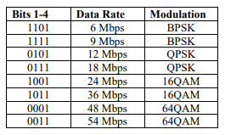
PLCP Protocol Data Unit (PPDU)
calc_phy_header()
Rate: 4 bits
Reserved: 1 bit
Length: 12 bits
Parity: 1 bit
Signal tail: 6 bits
Notes:
PPDU: header added to the mac frame (PSDU)
Rate: odd rate values have meaning
The following OFDM symbol, called signal, contains the following fields and is BPSK-modulated:
The 4 bit ‘rate’ field determines the data rate and the modulation of the rest of the packet (examples are 0x3 for 54 Mbps, 0x9 for 24 Mbps, or 0xF for 9 Mbps).
The ‘length’ field indicates the number of bytes in the payload field.
The ‘parity’ bit shall be an even parity for the first 17 bits of the signal field (rate, length and the reserved bit).
Finally, the six ‘tail’ bits are set to zero.

Slide 11
fuzzing

Slide 12
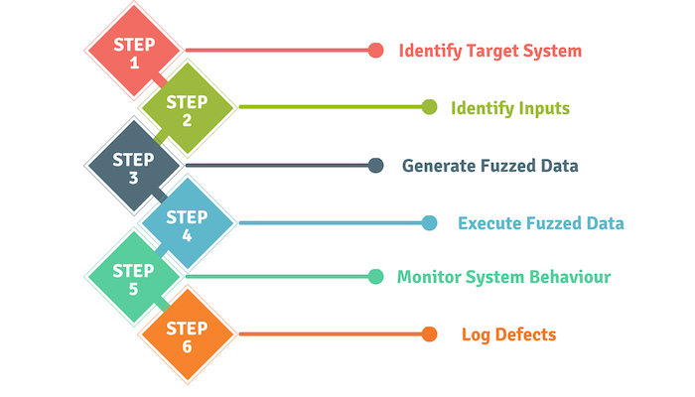
fuzzing
Notes:
What is fuzzing
Static human programmers: prone to human error
Advantages
Automated
during design

Slide 13
fuzzing
Generation vs mutation based
White box vs black box
Gray box
➔ mutation based gray box fuzzer

Slide 14
setup

Slide 15
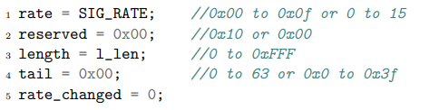
DRIVER
Driver files generated with Linux bash script
Values changed with Python script
Drivers manually transferred between computers
➔ Surface level testing
Notes:
not every permutation is tested because that would take 32 years in the current setup
Surface level testing
Why 2 computers?

Slide 16
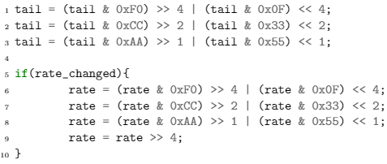
DRIVER
Little endian architecture (ARM)
➔ Bytes mirrored

Slide 17
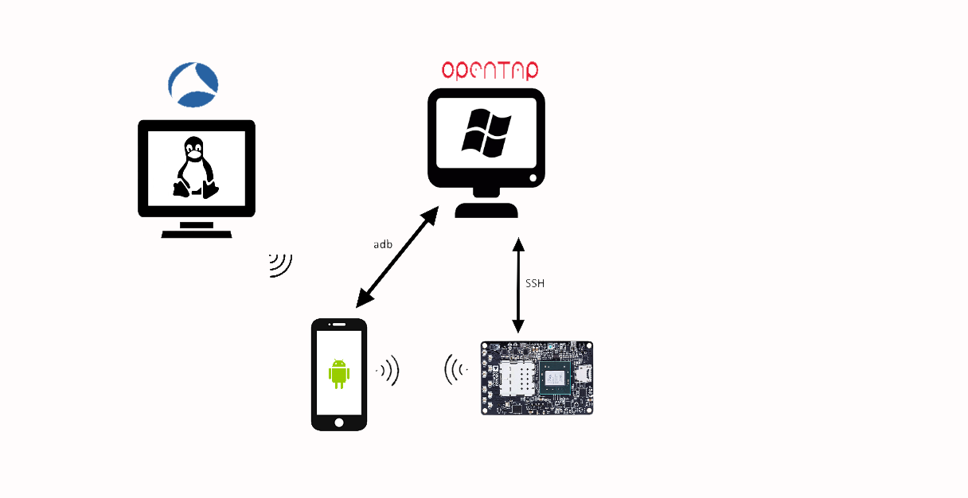
Automated SETUP
SSH : secure shell
adb : android debug bridge
Notes:
Phone: USB
Board: ethernet
Automatically connect to openwifi
Monitor mode linux

Slide 18
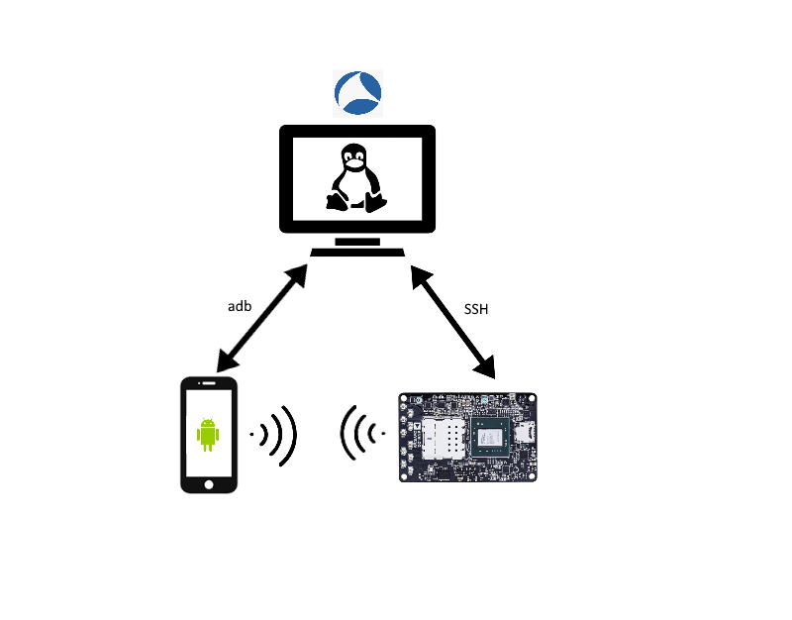
Manual SETUP

Slide 19
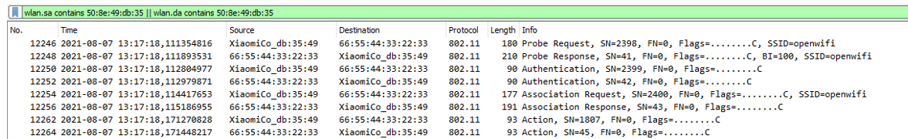
Wireshark

Slide 20
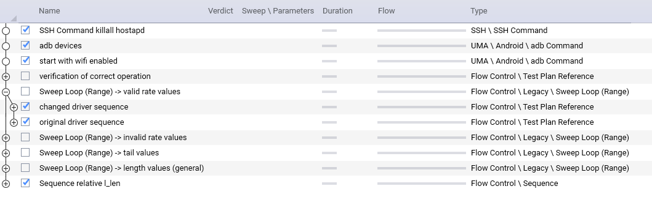
OPENTAP

Slide 21
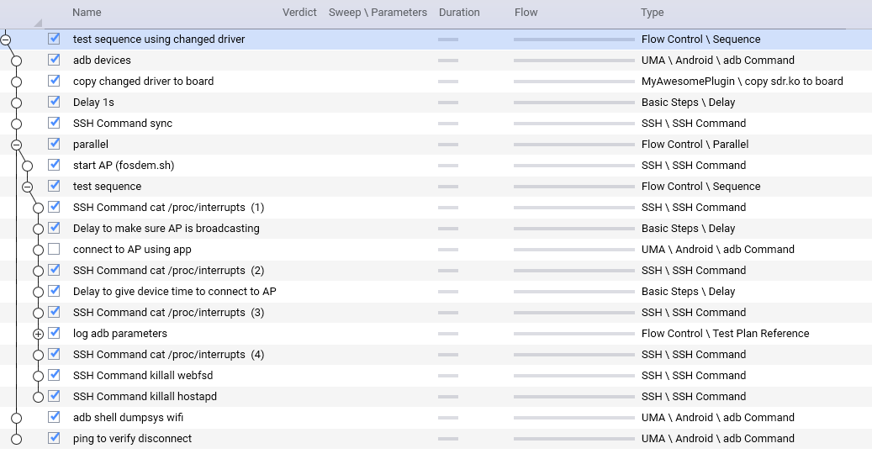
OPENTAP

Slide 22
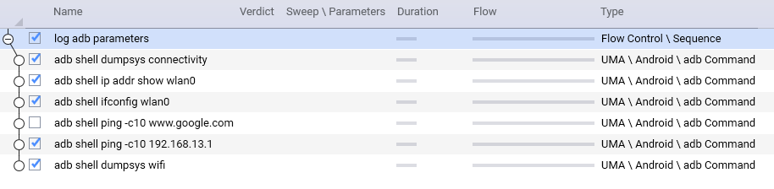
OPENTAP

Slide 23
results

Slide 24
Results
Reserved value made no difference
Both automated and manual tests
Manual analysis

Slide 25
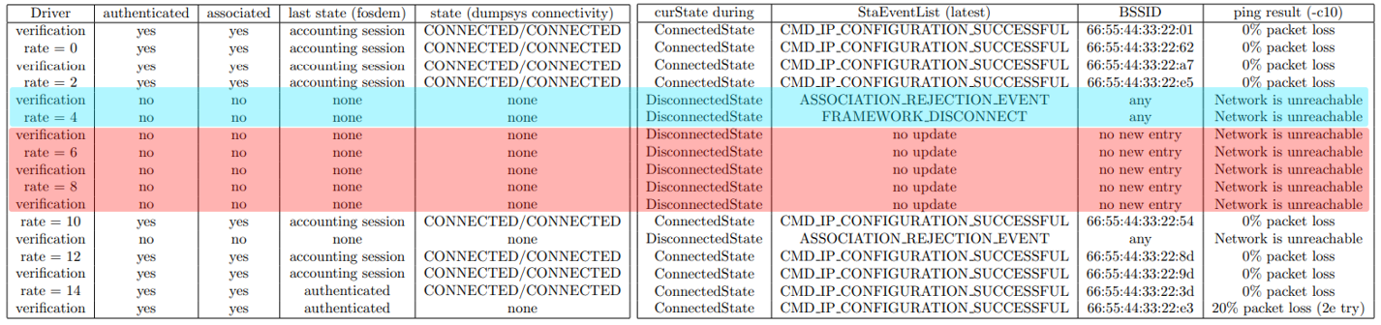
Results automated tests
Automated tests:
➔ In general every driver worked with 1 exception
Notes:
After disconnect no visible updates in the wifi logs

Slide 26
Results automated tests
Presumed problem:
➔ Missing or misused quotes in the string that copies the driver file ‘sdr.ko’ to the board
"/C pscp -scp -pw openwifi \"" + path + "/rate" + rate + " reserved" + reserved + " length" + length + " tail" + tail + "/sdr.ko\" root@192.168.10.122:openwifi/"
Notes:
sdr.ko compiled version of the driver sdr.c

Slide 27
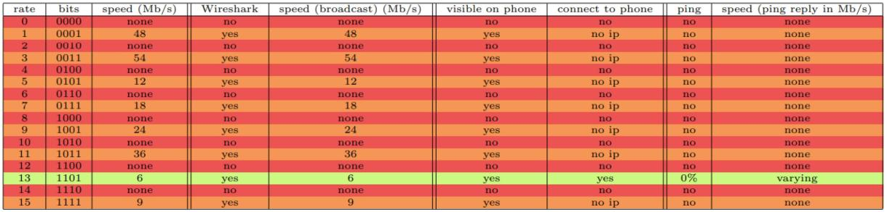
Results manual tests: rate
fosdem.sh (802.11n)
Notes:
Build in safety (fpga): 6 Mb/s

Slide 28
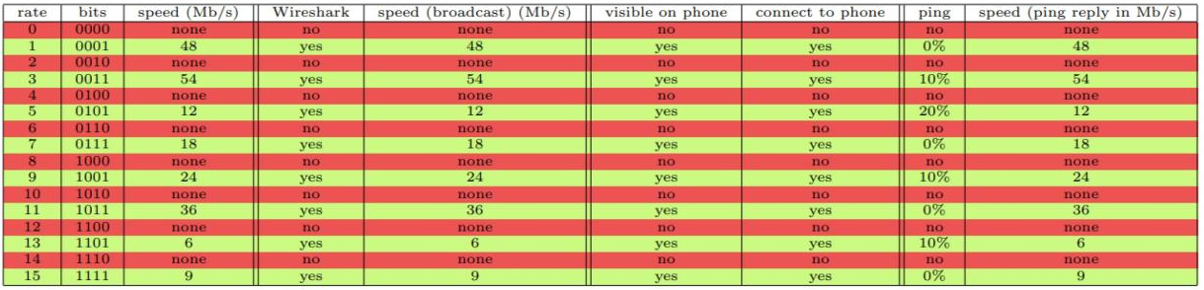
Results manual tests: rate
fosdem-11ag.sh (802.11a)
Notes:
Build in safety (fpga): 6 Mb/s

Slide 29
Results manual tests: length
fosdem.sh
➔ increments up to 5
… decrements worked for neither
fosdem-11ag.sh
increments up to 11
excluding 9 & 10
Error shown (Wireshark):
➔ Length of contained item exceeds length of containing item
Notes:
Relative value: original + or – value
Instead of specific values
All packet were reported malformed by wireshark

Slide 30
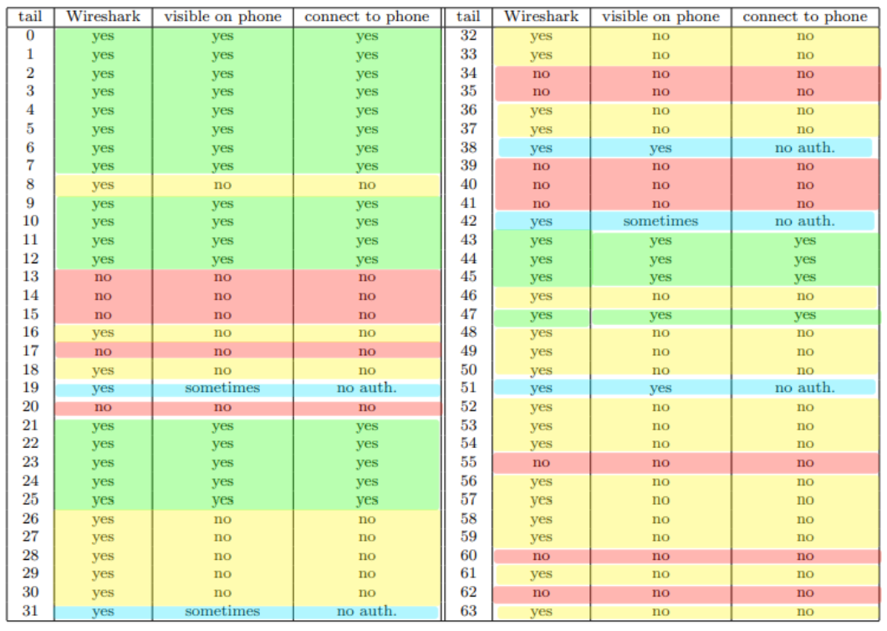
Results manual tests: tail
4 cases:
Connect to phone (green)
Visible on phone (yellow)
Not visible at all (red)
Varying (blue)
For the green case:
Varying delays between visibility and connecting, preceded by a connection that was not authenticated
Notes:
Varying degree of time needed between visibility and connections (no inpact on connections with different ssid’s)
1 attempt whitout auth. before actually connecting

Slide 31
conclusion

Slide 32
conclusion
Surface level testing
Full automation impossible (current setup)
➔ Transfer of files between computers
Opentap automation is close
Manual tests show varying degree of decoding
Notes:
Terugkoppelen naar inleiding

Slide 33



Steven Heijse Student Department of Information technology E steven.heijse@ugent.be T +32 55 30 94 90 M +32 471 26 76 20 www.ugent.be
Universiteit Gent @ugent
@ugent Ghent University

