Slide 1
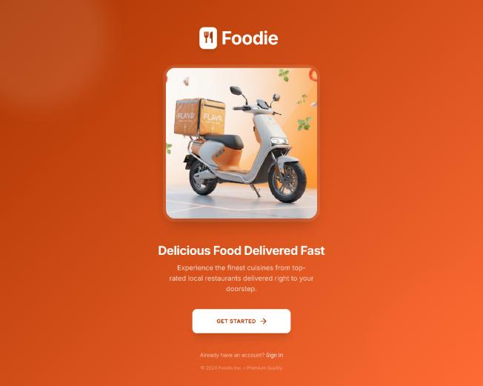
Foodie – Food Delivery Web Application
INTERNSHIP REVIEW | IT3711
UI/UX Design Internship at Media Wave Technology, Tiruchirappalli
A Sheik Abdullah · 810023205306
B.Tech Information Technology, 7th Semester
Notes:
Good morning. I am Sheik Abdullah, 7th semester IT, UCE BIT Campus. I did my UI/UX internship at Media Wave Technology, Trichy, and designed a food delivery web app called Foodie.

Slide 2
Company and my role
Media Wave Technology
My role and responsibilities
Software company in Tiruchirappalli serving businesses, institutions and startups.
Services: web & mobile apps, UI/UX design, digital marketing, testing & QA, cloud solutions.
My domain: UI/UX Design (15 Jun – 15 Jul 2026)
• User research & competitor study
• Personas, journey map, user flow
• Wireframes and design system
• High-fidelity screens in Figma
• Interactive prototype
• Usability testing & documentation
Notes:
Media Wave is a Trichy based software company. I worked in the UI/UX domain for 30 days and handled the full design cycle.

Slide 3
Problem and our solution
Problem in existing apps
Foodie solution
• Complicated navigation
• Long, unclear checkout
• Poor search and filters
• Unclear order tracking
• Discover: search, categories, offers
• Choose: image-led food cards
• Pay: UPI, card, net banking, COD
• Track: status and ETA
• Wishlist, reorder, support
Notes:
Research and competitor analysis showed four main pain points. Foodie answers each with a clear stage: discover, choose, pay, track.

Slide 4
Design Thinking and user research
1
2
3
4
5
6
7
Empathize
Define
Ideate
Wireframe
Visual Design
Prototype
Test
Research methods
Personas
• Online survey and interviews
• Observation of existing apps
• Competitor analysis
• College student: quick, simple ordering
• Working professional: speed, tracking
Notes:
I followed the 7 stage Design Thinking process. Research covered students, professionals and families.

Slide 5
User flow: login to delivery
Login / Register
Home
Search / Categories
Restaurant
Food Details
Cart
Payment
Track Order
Support layer: Research → Persona → Journey → Wireframe → Design System → Hi-Fi UI → Prototype → Testing
Notes:
Primary ordering journey. Order confirmation comes after payment, then tracking until delivery.

Slide 6
Tools and design system
Tools used
• Figma: design, components, prototype
• Stitch AI: initial layout ideas
• HTML5, CSS3, JavaScript: understanding structure and behavior
• Google Fonts, Material Icons
Primary orange
White
Deep orange
Dark text
Poppins
Rounded cards and buttons, reusable components, consistent spacing, responsive layouts
Notes:
Figma was the main tool. One design system kept all screens consistent.

Slide 7
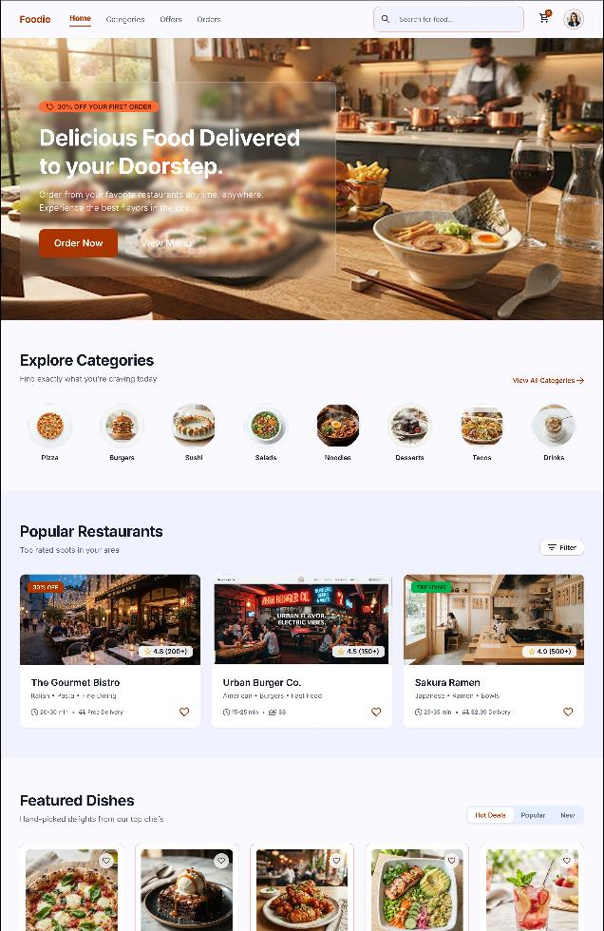
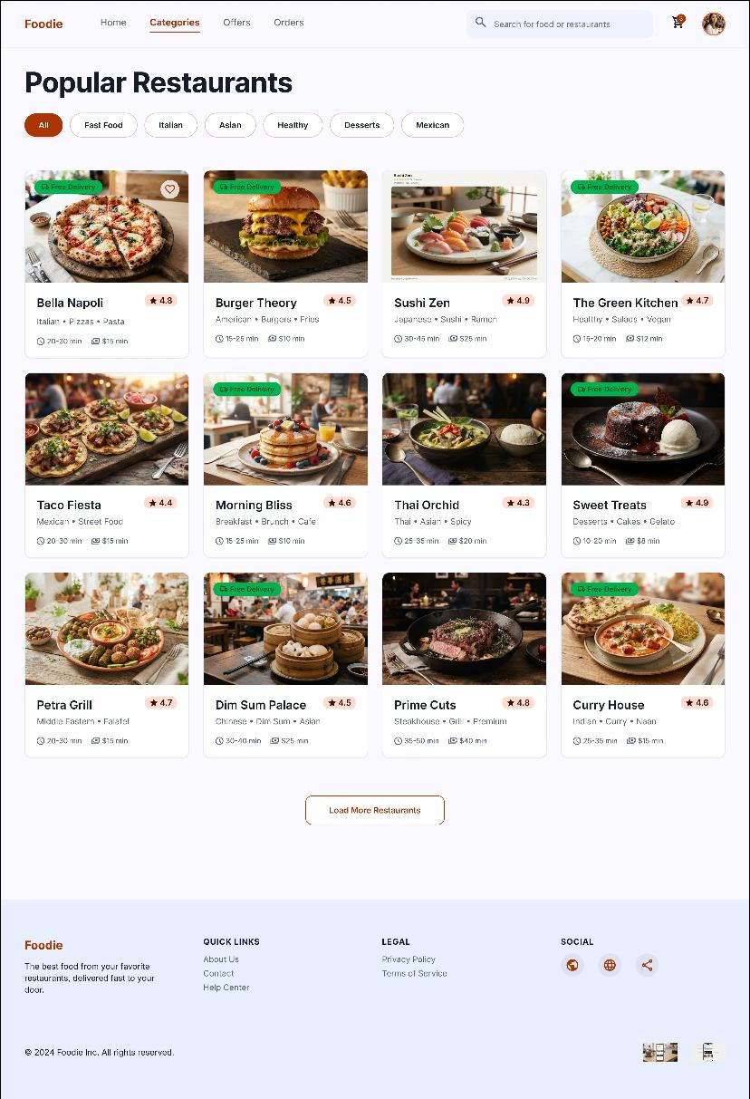
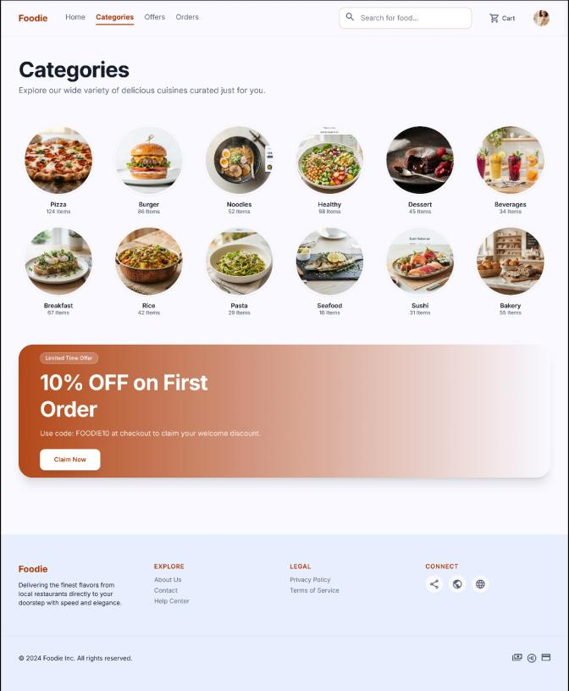
Final screens: discovery
Landing
Home
Categories
Popular restaurants
Notes:
Landing, home dashboard, categories and restaurant listing. Search and categories are at the top for quick discovery.

Slide 8
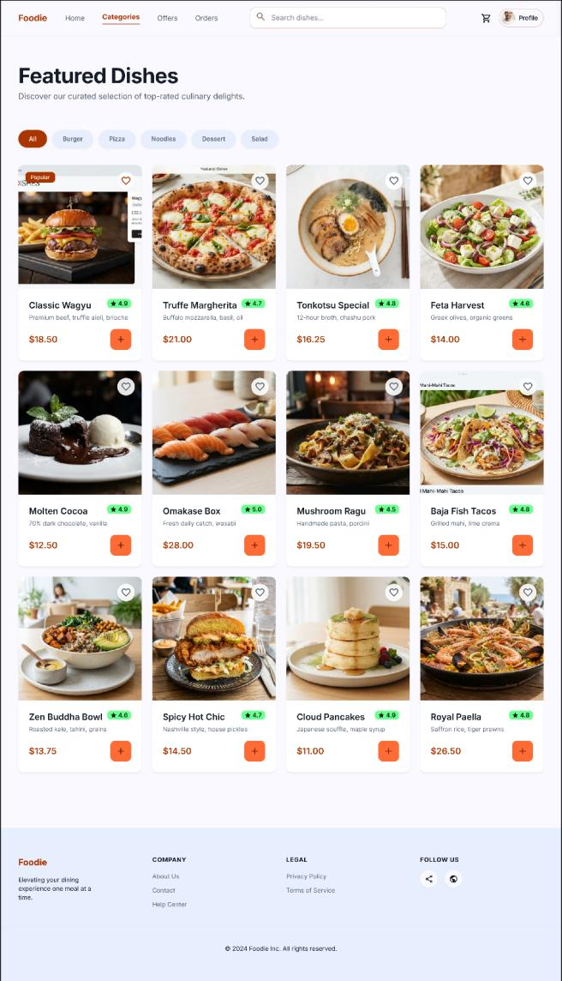
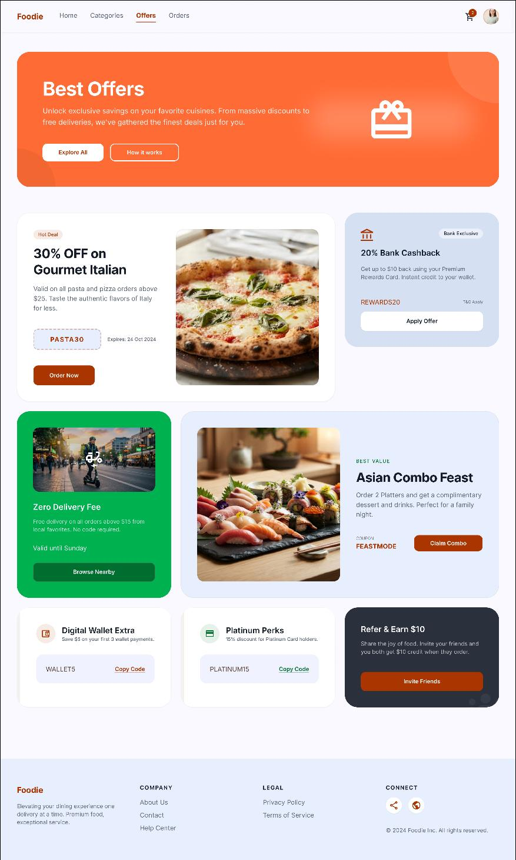
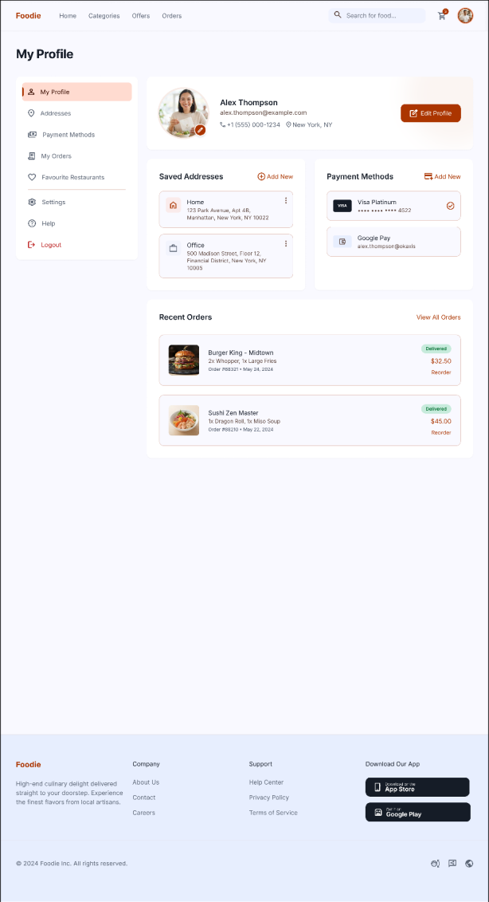
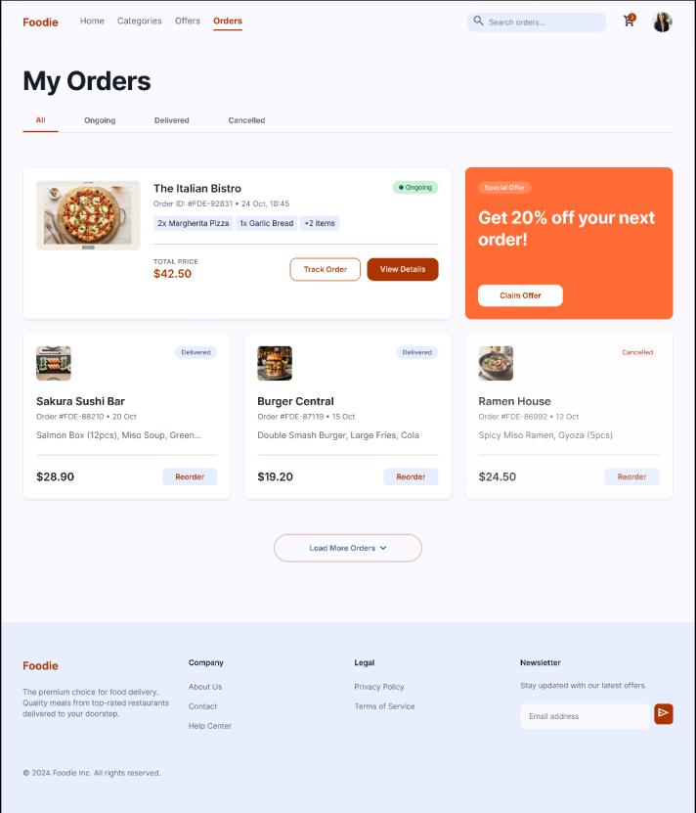
Final screens: offers, orders, profile
Best offers
Featured dishes
My orders
Profile
Notes:
Offers, featured dishes with quick add, orders with reorder and tracking, and profile with addresses and payment methods.

Slide 9
Testing, conclusion and future work
Test case | Result
User login | Pass
Restaurant search | Pass
Add to cart | Pass
Online payment flow | Pass
Order tracking | Pass
Profile update | Pass
Conclusion and future work
Completed the full UI/UX cycle from research to a tested prototype. Navigation, discovery, checkout and tracking are simpler and clearer.
Future: backend integration, live GPS tracking, AI recommendations, Android / iOS apps.
Notes:
All six core test cases passed. The design simplified the ordering journey. Future scope covers backend, live tracking, recommendations and mobile apps.

Slide 10
Thank you
Questions?
A Sheik Abdullah · Foodie – UI/UX Internship

