Slide 1


WhatsApp
Softweare Engineering Project

Slide 2
Introduction
WhatsApp is a free and cross-platform messaging app that allows you to make voice and video calls, send text messages, and share photos and documents with others. It is available on iOS, Android, Windows phone, and web. WhatsApp is one of the most popular messaging apps in the world, with over 2 billion active users.

Slide 3
problem and Proposed solution
Expensive SMS fees
Slow transmission
WhatsApp offers unlimited messaging and calls over an internet connection.
Ifeatures allow for faster sending of the message.
Device incompatibility
group chat
Davailable on wibe range of devices such as iOS,Android,Windows,web.
feature allows users to chat with multiple people at the sem time

Slide 4
Background
The WhatsApp application was launched in 2009 and was purchased from Facebook for 19 billion.

Slide 5
Work plan
Iwaterfall model for WhatsApp analysis, design, implementation, testing, and then publishing application to users.

Slide 6
project Requirements: functional requirements
1.Chat backups and restore.
2.Chat archiving and muting.
3.Search for the contact list the number or registered with it.
4.Login usingn phone umber.
5.Group message of 256 people.
6.Show a flag when the message arrives and another flag to.
7.Sending the message to the addressee at the same time.
8.The ability to delete the message.

Slide 7
project Requirement: Non-Functional requirement
1.Scalable architecture.
2.Secur authentication.
3.Test program before delivery.
4.Provides all languages.

Slide 8
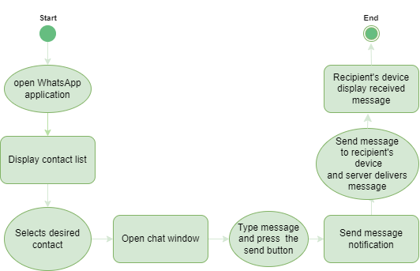
Activity diagram

Slide 9
Actor
Roles | Actor
Create/edit/save/update/hide/ browse profile – add/ delete/find user - create group - find chat - find/view/send/ forward media -send/view/forward message - send/view/find/ forward document - send/view/ forward location - find/update/view status - send complain - set welcome message- set option bot message- set action bot message | User
Send welcome message – Process bot message – listen to bot message | bot
suspend user - recieve complain - suspend group | Admin

Slide 10
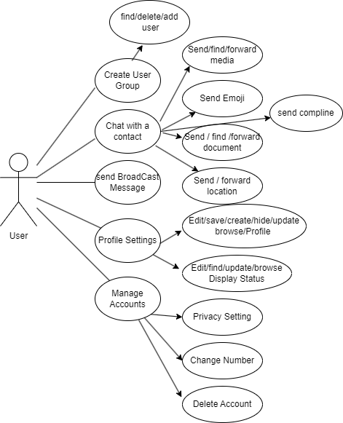
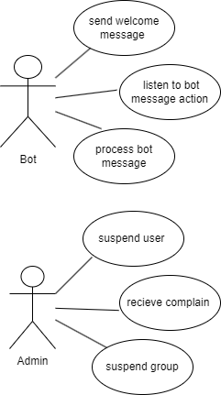
Actor

Slide 11

Table 1
Send Complain
Actors | User, Admin
Description | The user sends a message to the admin to send a related complaint to another user to suspend his account
Data | Usre information, the complaint
Stimulus | User command to suspend Account
Response | Account suspension
Comments | The account will be suspended if the reports are real or numerous

Slide 12

Table 2
Send Complain
Actors | A user conversation with another user.
Description | A user sends conversations, media, files, location, and stickers to the other user.
Data | Pictures, videos, voice notes (media), and documents.
Stimulus | He wants to talk and have a conversation with the user.
Response | Sharing daily events and trending news

Slide 13
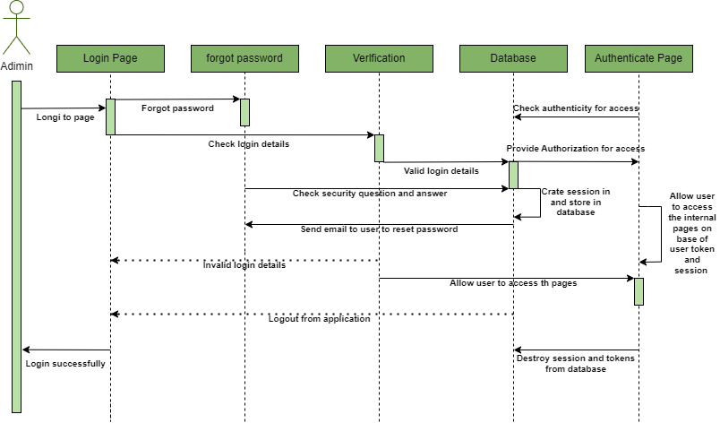
Sequence diagram

Slide 14
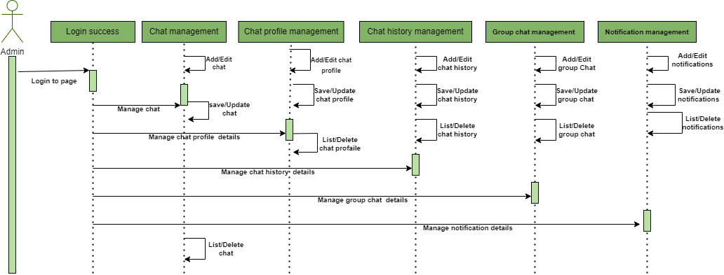
Sequence diagram

Slide 15
شيخة سعود القاسم | 442850112 – 277
شهد مبارك الزعير | 443850367 – 277
روان مهدي الكبيري | 442850245 – 277
وله سعود القاسم | 443850333 - 743

