Slide 1
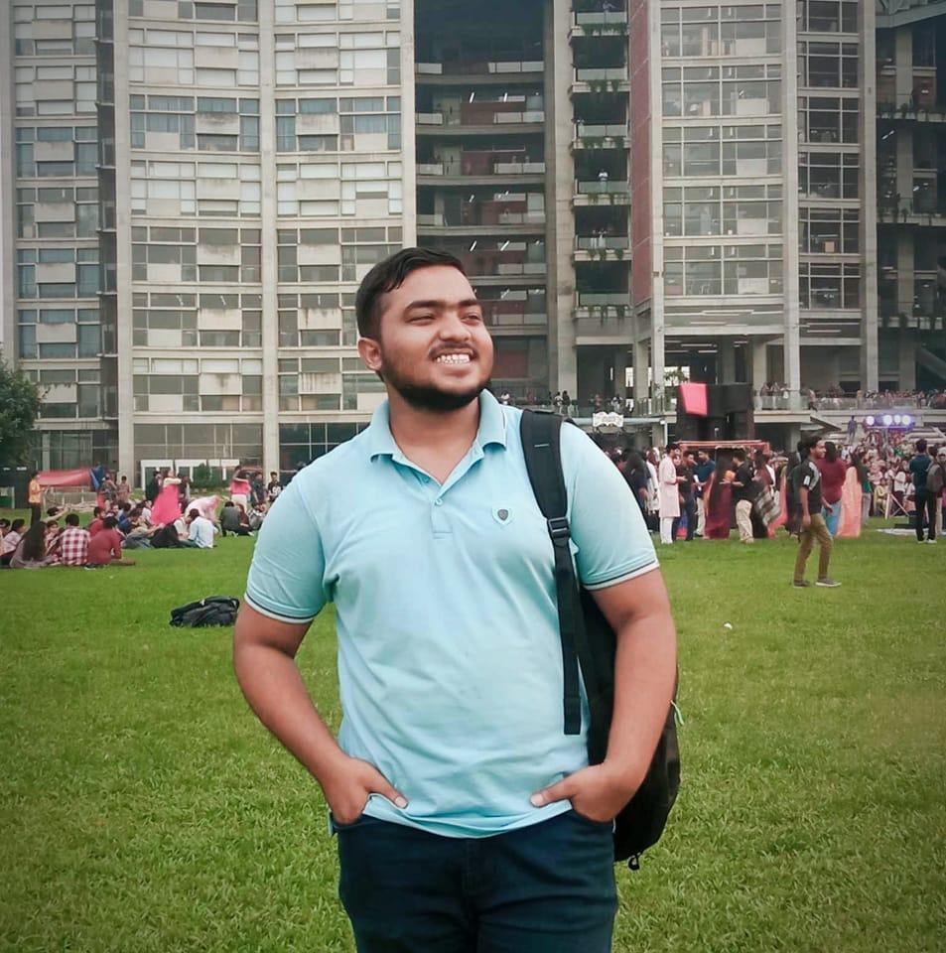
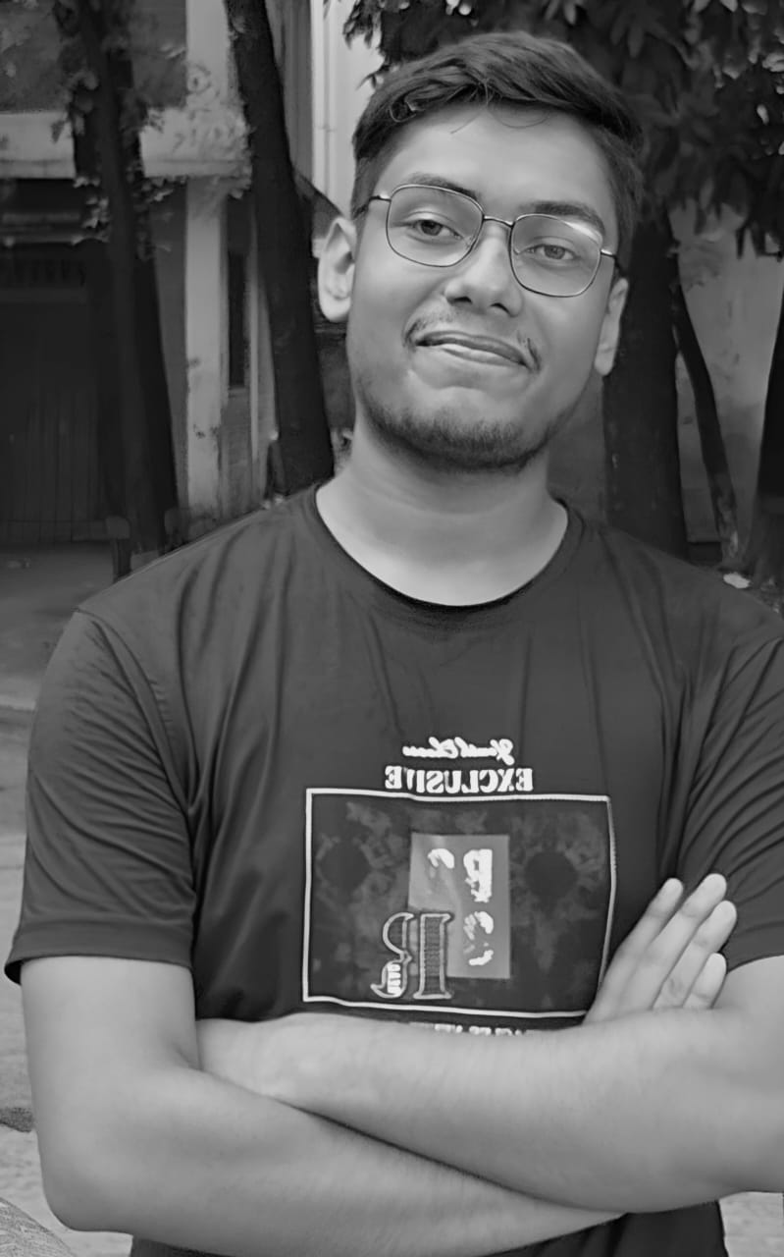
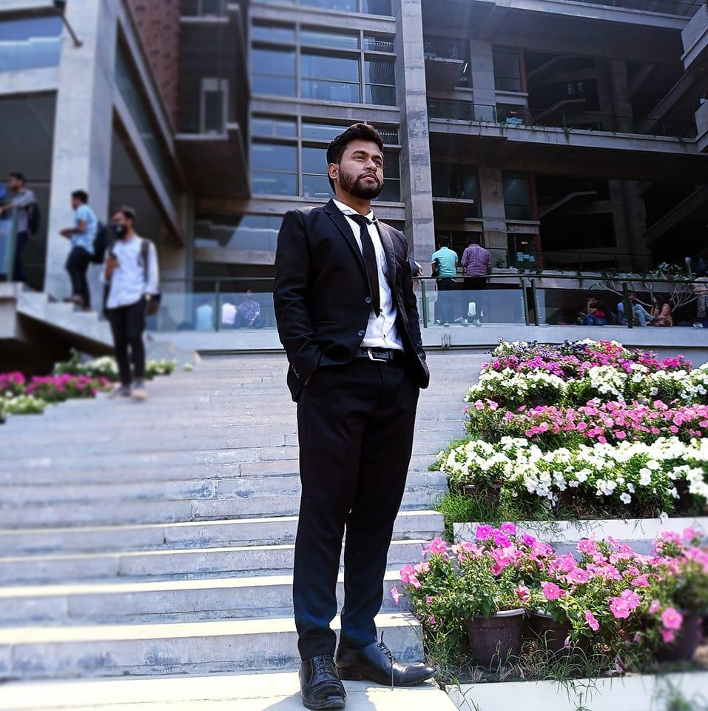
Project Name: Student Tracking System
Team Brainiac
Md Rafi
Md Shihub Uddin
Md Mainul Hossen
0112230083
0112230084
0112230085

Slide 2
INTRODUCTION
The student tracking system is an easy tool for tracking your students’ progress. By using the simple overviews, you can quickly see who is using the course and in which manner.

Slide 3
features
Set Your Goal
Your Courses
Personal Folder
Global Chat
Find Q&S

Slide 4




Set Your Goal
Set Your Goals
Set Time Hour Limits
View Graph by user’s daily or weekly activity
Set Prayer Time
Set Class Time

Slide 5
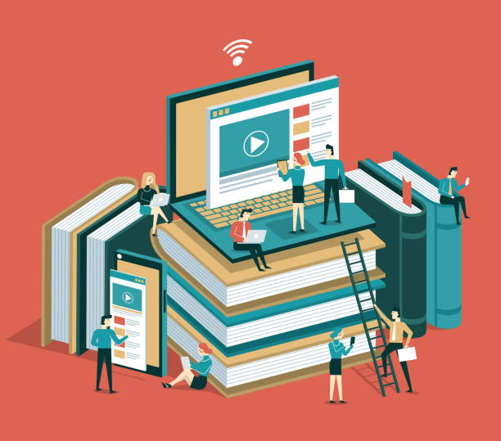
Your Courses
Add Your Course
See Your Courses
Course Material:
Video
Notes (pdf)
Books (pdf)
Add Question And Solution

Slide 6
TYPES OF Course Material
Video
Notes
Books
Questions
Solutions
Used to complete transactions anywhere crypto is accepted
These tokens have a specific use within a blockchain
Tokens backed by securities
Authenticates ownership of specific assets
Used as in-game currency and traded with real world value

Slide 7

Personal Folder
A personal folder is a private space, either physical or digital, where you store your important documents, files, and information.

Slide 8

Global Chat
Global chat refers to a communication platform or feature that allows individuals from around the world to connect and converse in real time.

Slide 9

FIND Q&s
Anyone who logged in this site will be available to find the previous question and solution.

Slide 10
SUMMARY

Slide 11
THANK YOU

