Slide 1
Artificial Intelligence in Healthcare
Muhammad Hashir
26K-0057
More than an Idea in 2026

Slide 2
AI Assisted Problem Solving
AI/ML Algorithms work best in identifying Patterns.
Pattern identification is 1st step in Problem solving
Most Medical Issues are solved by Pattern Recognition
Fast Recognition of Medical Issue leads to Better Treatment

Slide 3
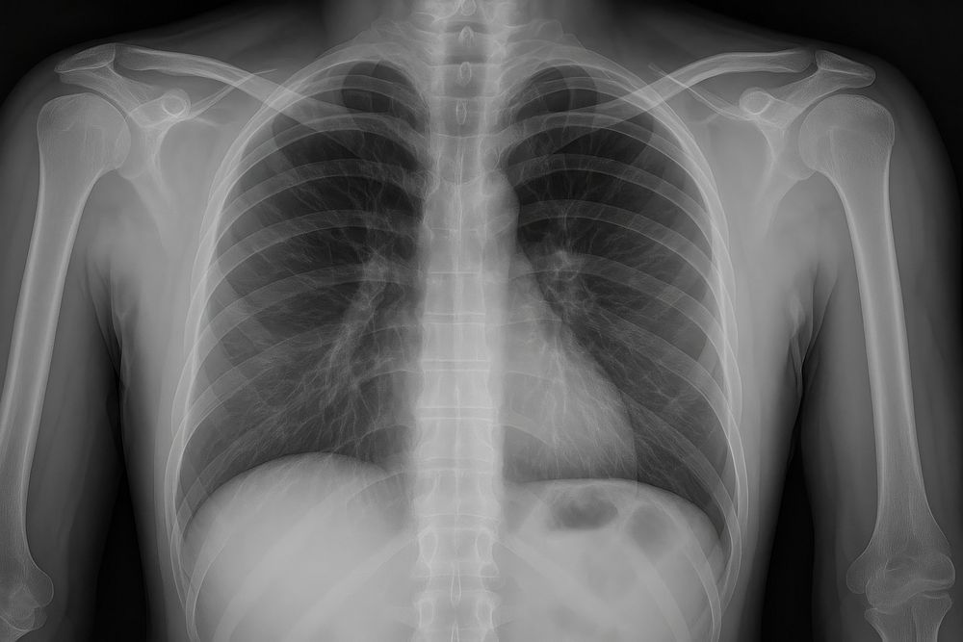
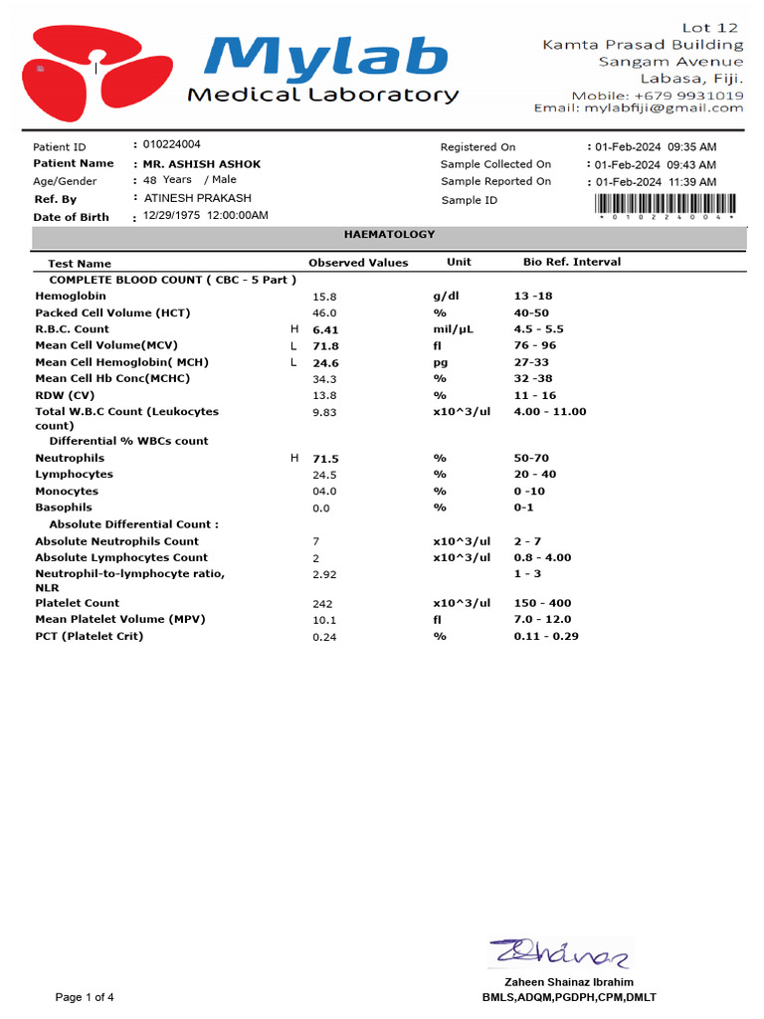


Requirements for AI Diagnostics
Medical Imaging
Lab & Test Reports
Patient Vitals / EHR
Genomic Data

Slide 4
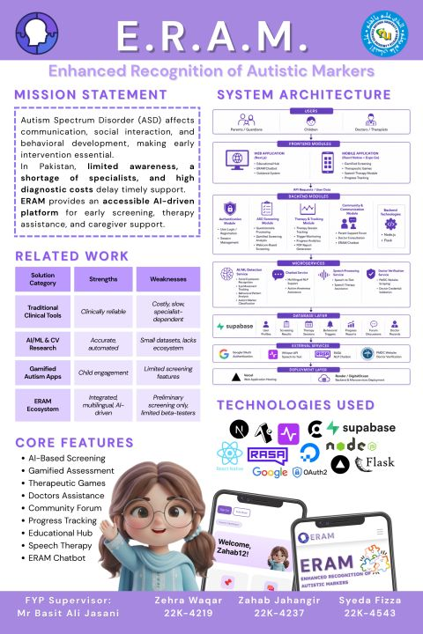
Case Study: ERAM
Named after Erum Zafar, whose personal journey with autism inspired the project.
AI Based Screening and Recognition of Autistic People
Use of Therapeutic games, speech assistance, progress tracking, & multilingual Chatbot
Bridges the gap caused by limited awareness, high diagnostic costs, and shortage of specialists
Reference: eramapp.tech (Created by FAST Batch 22 Students)

Slide 5
Conclusion
AI will never replace Medical Judgment It simply Speeds up connecting the links making Treatment Faster and More Effective.
Tools like ERAM show that AI support can be extended Beyond the Everyday Software Developer’s Office and Into every walk of Life, Including but not limited to Medicine

