Slide 1
Forecasting energy availability from renewable sources

Slide 2
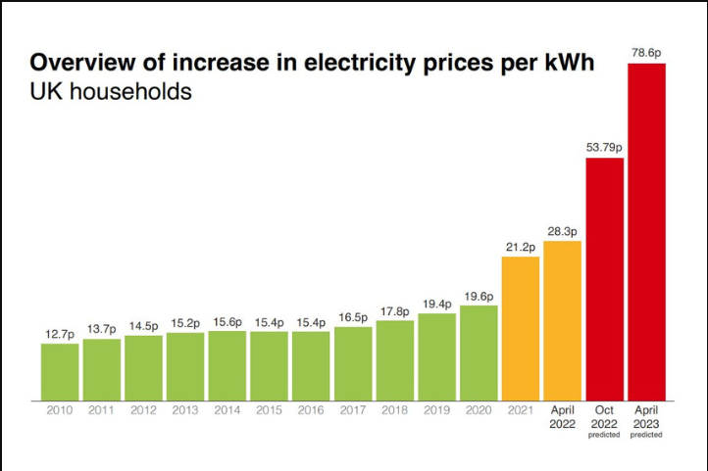
Introduction
In light of rising energy costs, the company seeks to introduce a service providing free energy to local clients near renewable sources during surplus energy periods. With a pilot project slated for May 2024, our immediate focus is on developing a predictive system to forecast surplus energy at least 24 hours in advance. This introduction outlines our goal to assess feasibility, minimize false positives, and pave the way for successful implementation, leveraging historic energy data at our disposal.

Slide 3
Objective
Analyze historical energy records to identify patterns and trends related to excess renewable energy.
Develop a predictive model to forecast excess renewable energy conditions with a minimum lead time of 24 hours.
Validation and Testing: Validate the model on unseen data to ensure its generalizability and robustness. Conduct thorough testing to confirm that the model performs reliably across different scenarios and time periods.
Determine appropriate threshold points for excess energy through external studies and research.
Analyze if the model is ready for deployment in May 2024

Slide 4
Methodology
Historical weather data of Brighton from 2010-2024
Data cleaning and Preprocessing to address missing values, outliers, and inconsistencies.
Split the dataset
Train Set: 2010 – 2019
Validation Set: 2020 - 2021
Test Set: 2022 - 2024
Design and train two Recurrent Neural Network (RNN) models with Long Short-Term Memory (LSTM) layers:
Model 1: Forecast solar energy production 24 hours in advance.
Model 2: Forecast wind energy production 24 hours in advance.

Slide 5
Assumptions and Research
Wind energy calculation
Air density: 1.225kgm⁻³
The windmill's dimensions, i.e., turbine radius, and swept area of the turbine are assumed to be 12m and 452.4 m² respectively.
The assumed number of windmills is 116 in Brighton
Solar energy calculation
Solar Panel efficiency is assumed to be 20%
Panel surface area: 20m²
The assumed number of solar panels is 369 in Brighton

Slide 6
Assumptions and Research
Energy Surplus Threshold
No of households in Brighton: 121,401
Average hourly energy usage per household: 0.38kWh
Average hourly energy consumption all over Brighton households: 46.13 MWh
Consumer behavior factor: 2
Assumed Threshold: 95 mW
Model selection
Extensive research and testing is done to find the best model for the defined problem – RNN with LSTM architecture
Electricity cost per 1 Megawatt: £50

Slide 7
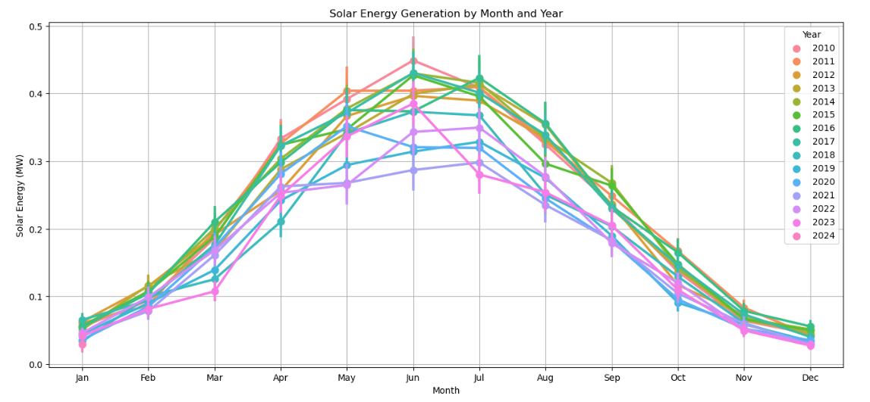
Results
Solar Energy data showing clear seasonal trends.

Slide 8
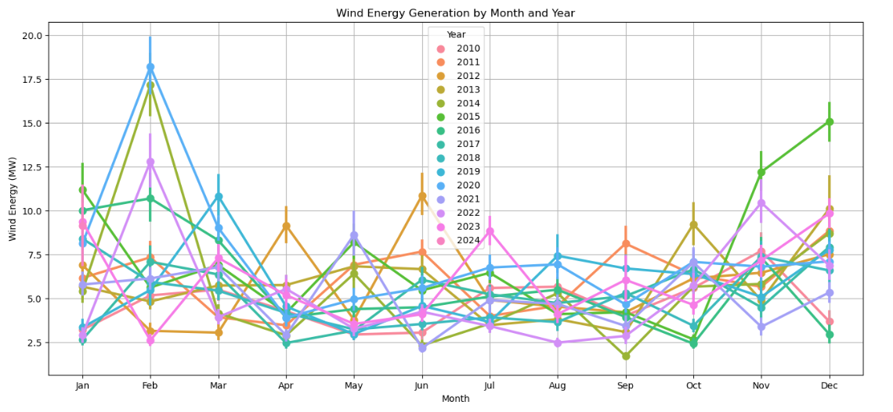
Results
Wind Energy data does not show us a clear seasonal trend.

Slide 9
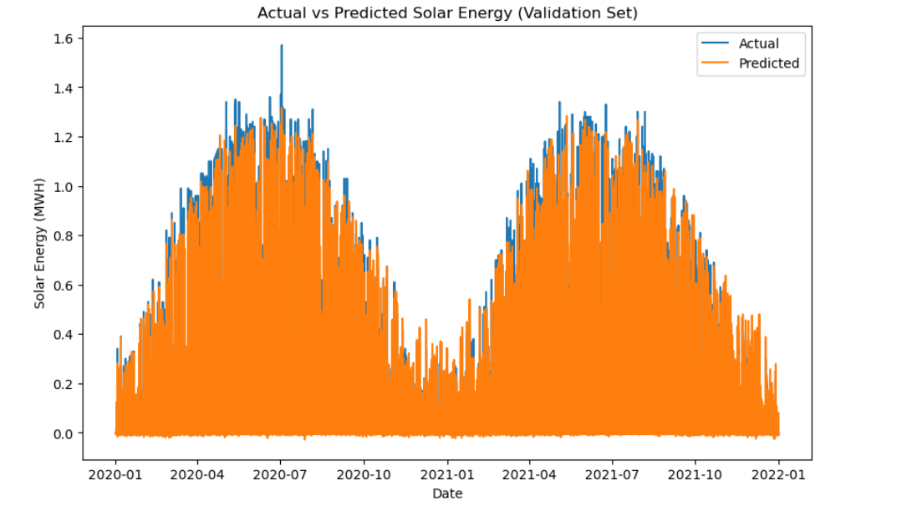
Solar energy forecasting model performance on the validation set
The average squared difference between the predicted values and the true values (Mean Squared Error) : 0.0077
R-Squared: 0.912 indicates our model fits the data very well.

Slide 10
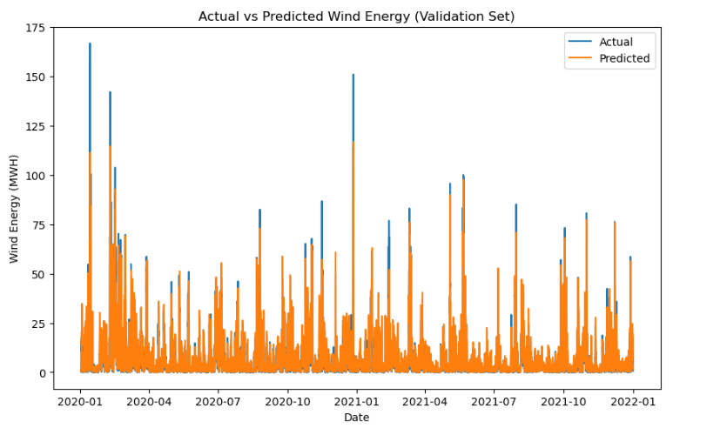
Wind energy forecasting model performance on the validation set
The average squared difference between the predicted values and the true values (Mean Squared Error): 20.665
R-Squared: 0.822 indicates our model fits the data well but not as well as it fits for solar energy.

Slide 11
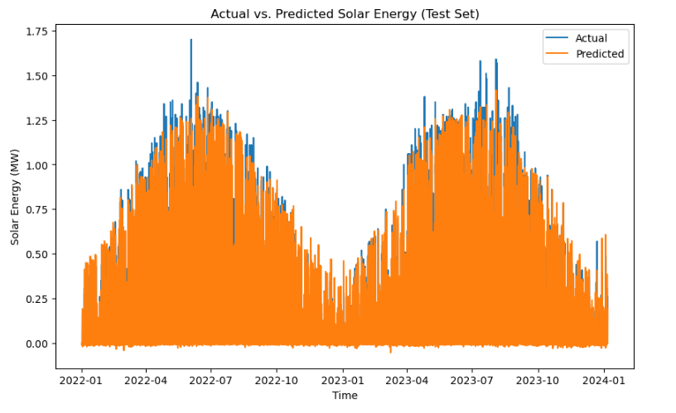
Solar energy forecasting model performance on the test set
The average squared difference between the predicted values and the true values (Mean Squared Error) : 0.01
R-Squared: 0.886 indicates our model fits the data very well.

Slide 12
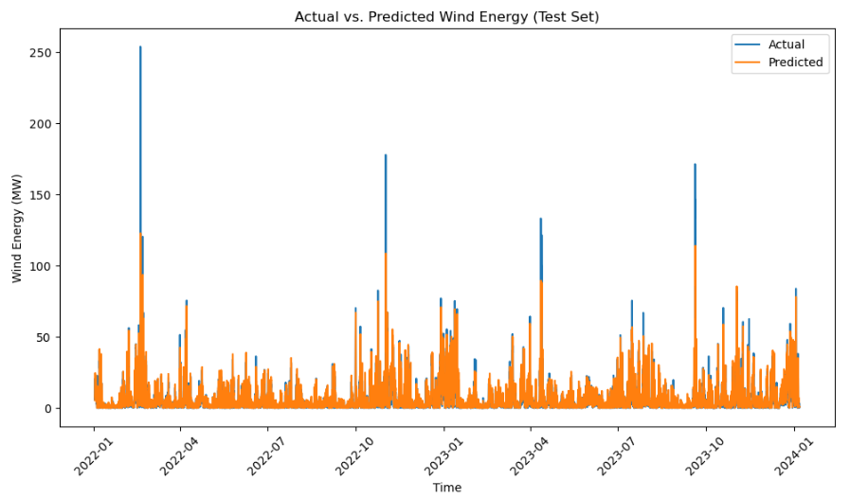
Wind energy forecasting model performance on the test set
The average squared difference between the predicted values and the true values (Mean Squared Error): 22.42
R-Squared: 0.79 indicates our model is comparatively not performing well for wind energy.

Slide 13
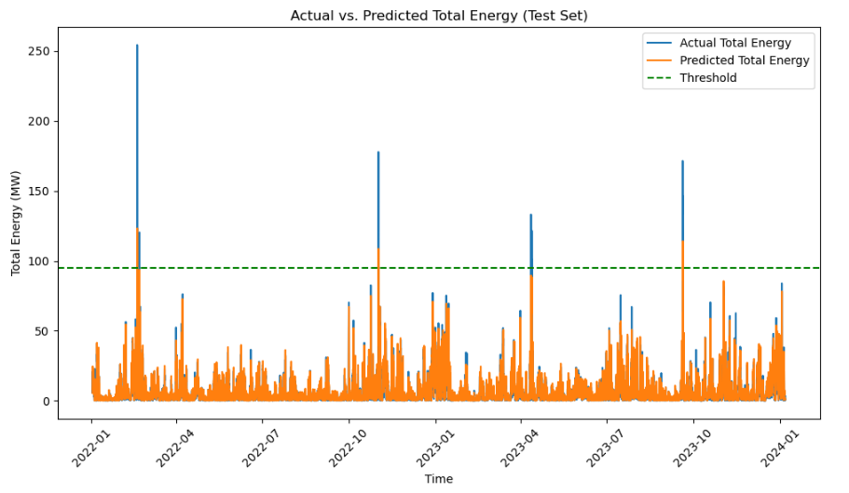
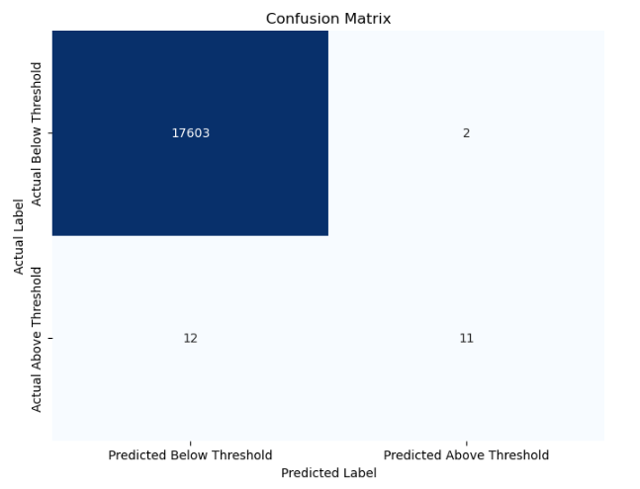
Total Energy Analysis
Threshold: 95 mW
False Positives: 2

Slide 14
False Positives Analysis
Cost: £50 for 1mW
Datetime | Total Energy | Total Energy - Predicted | Difference | Cost in GBP
2022-02-18 16:00:00 | 60.18 | 106.30 | 46.12 | 2306.392
2022-11-01 03:00:00 | 68.25 | 108.64 | 40.39 | 2019.522
Total estimated cost to the company £4325.91

Slide 15
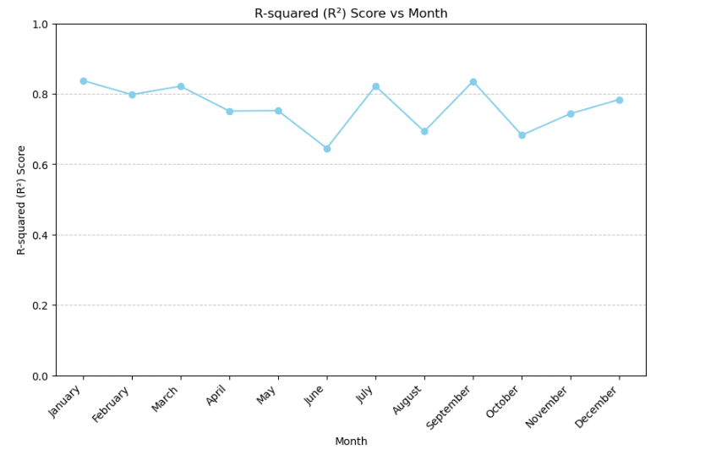
Monthly Model Performance on Test Set

Slide 16
Conclusions and Recommendations
Conclusions:
Model predicted 2 false positives which will incur a £4325.91 loss for the company
Model performance in May is 75%, indicating its effectiveness in capturing the variability in energy production during that month.
We can conclude that the model is feasible and ready to be deployed in May 2024
Recommendations and future work:
Look for better alternatives to predict wind energy.
Continuously monitor and evaluate the model's performance post-deployment.
Conduct a thorough cost-benefit analysis to evaluate the economic impact of deploying the model.

Slide 17
References
https://www.rampionoffshore.com/#:~:text=The%20wind%20farm%20comprises%20116,coast%20in%20the%20English% 20Channel
https://www.e-education.psu.edu/emsc297/node/649#:~:text=Thus%2C%20the%20power%20available%20to,variable%20input%20is%20wind%20speed
https://www.brighton-hove.gov.uk/news/2023/hundreds-council-homes-switch-solar-power
https://www.saurenergy.com/solar-energy-blog/here-is-how-you-can-calculate-the-annual-solar-energy-output-of-a-photovoltaic-system
https://lginform.local.gov.uk/reports/lgastandard?mod-metric=3801&mod-area=E06000043&mod-group=AllUnitaryLaInCountry_England&mod-type=namedComparisonGroup
https://www.utilitybidder.co.uk/compare-business-energy/what-is-the-average-household-energy-usage/#:~:text=What%20is%20the%20average%20electricity,factors%20that%20affect%20this%20figure
https://www.brighton-hove.gov.uk/sites/default/files/2024-03/census-2021-briefing-city-profile_Muna%20Mohamed.pdf
https://businessenergycomparison.com/business-electricity/price-of-1-mwh-of-electricity-in-2023/#:~:text=Price%20Of%201%20MWh%20Electricity,focus%20on%20wholesale%20electricity%20prices
https://www.greenbuildingrenewables.co.uk/guide-to-solar-energy-as-electricity-prices-increase/

Slide 18
Thank You🙂

