Slide 1
Gotham City Hall Open House 06 / 01 / 20
²

Slide 2
Presentation of changes
²
Security
Incident reporting Application
GPS trucks
Drones
Connected Trash

Slide 3

Security
²
the security of all changes has been subcontracted by the city of Minneapolis.
A surveillance team was set up
Only a small group of people can have access to personal data

Slide 4
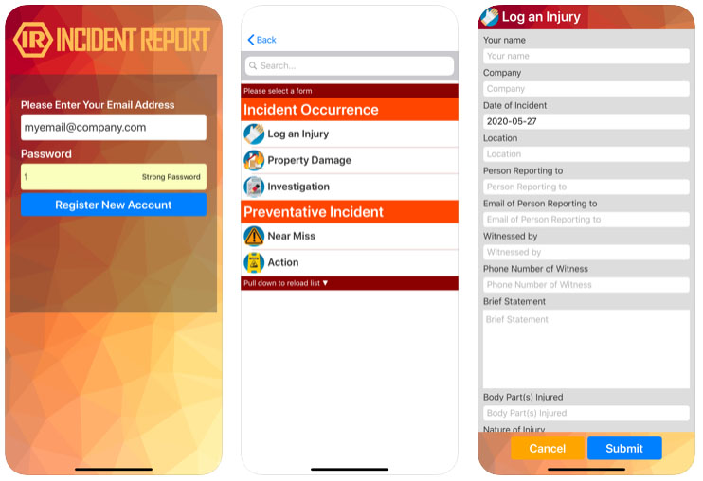
Incident reporting application
²
An application for report incidents and ask for sanitation services.
Free, secure and respect privacy
Available on all system

Slide 5

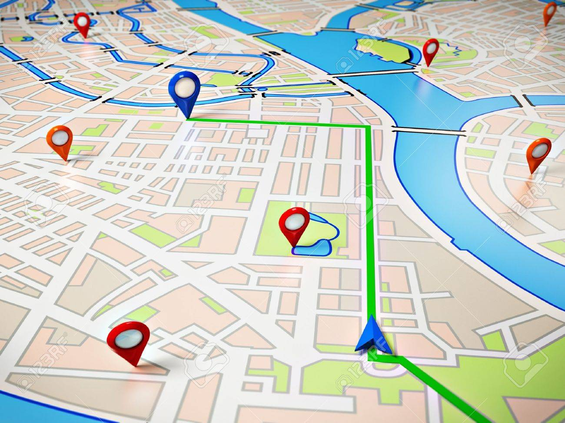
GPS truck
²
The trucks will be equipped with GPS tracers, in order to be able to live-map their presence on the city map
Send the adequate team when there is an emergency

Slide 6
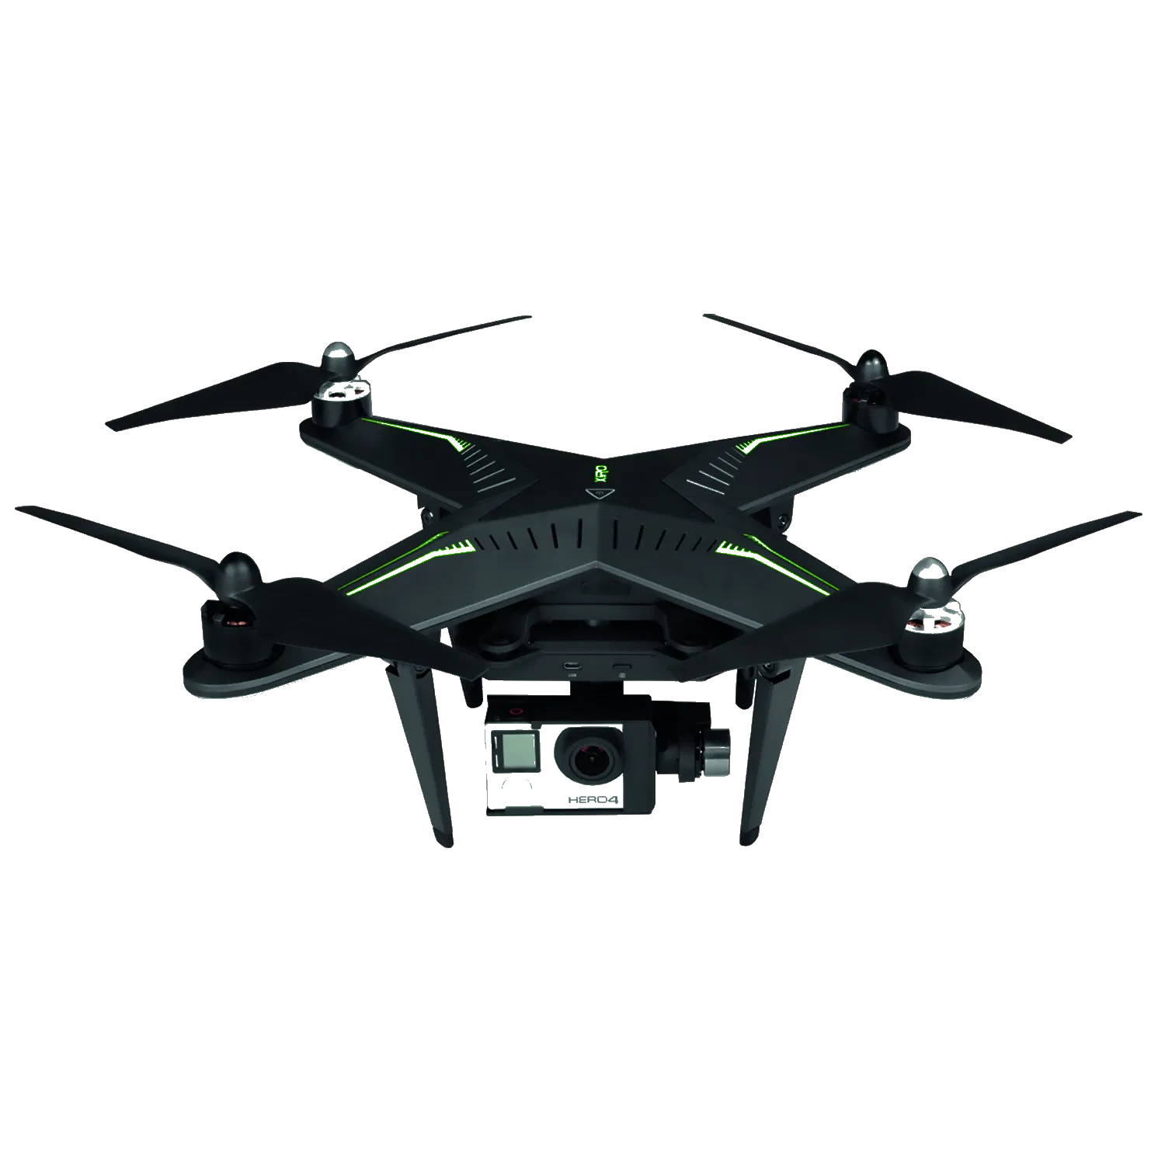
Drone
²
Used to make surveillance in the various neighborhoods
Check up on the state of garbage collection and cleanness of the streets

Slide 7
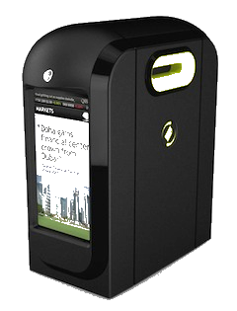
Connected Trash
²
The trash will be smaller, but equipped with captors that will send a signal to SWAG when full.
This should let SWAG offer a more customized service to citizens.

Slide 8
Questions
²
?

