Slide 1
SentiCare
Voice-Based AI Mental Health System
Capstone Project · University of Sargodha
Esha Gulzar · Wajeeha Ijaz · M. Zain Ul Abidin
Supervisor: Dr. Saad Razaq | PM: Dr. Illyas
2025 – 2026

Slide 2
Table of Contents
01
Problem Statement & Motivation
06
Frontend (React)
02
Project Overview & Objectives
07
Database Design (MongoDB)
03
System Architecture
08
Voice Processing & TTS
04
Data & Machine Learning Pipeline
09
Evaluation & Results
05
Backend API (Flask)
10
Demo & Conclusion

Slide 3
Problem Statement
Why SentiCare?

Slide 4
The Mental Health Crisis
The Mental Health Crisis
1 in 4
75%
800K
60%
People affected by
mental disorders globally
Cases go untreated
in low-income countries
Lives lost to suicide
every year (WHO)
Students report
significant anxiety
Key Challenges in Existing Solutions
❌ High cost of therapy sessions — inaccessible for students
❌ Stigma around seeking professional help
❌ Long wait times for appointments
❌ No multilingual support (especially Urdu)
❌ No continuous or real-time monitoring of mental state

Slide 5
Project Overview
What is SentiCare?

Slide 6
What is SentiCare?
SentiCare is a voice-based AI mental health companion that:
• Analyzes voice biomarkers (pitch, tone, MFCC) to detect emotion
• Runs ML models to predict anxiety, stress, and depression severity
• Provides a bilingual (English + Urdu) therapeutic chatbot
• Tracks emotional trends over multiple sessions
• Learns from user feedback (RLHF-ready)
Institution
University of Sargodha
Live Demo
wajeehaijaz-senticare.hf.space
Repo
github.com/sheikh-zain786/SentiCare-Capstone
Language
Python 41.8% · JS 17.5% · Jupyter 30.4%

Slide 7
Project Objectives
Detect emotion
Bilingual TTS
Extract pitch, tone & MFCC biomarkers from 30-second voice recording
Deliver voice responses in English and Urdu using Edge-TTS / gTTS
Predict condition
Trend tracking
Classify anxiety, stress, depression (mild / moderate / severe) via ML
Visualize emotional progress over sessions with Recharts
Therapeutic chat
Feedback loop
Provide empathetic AI-driven coping suggestions in conversation
Collect 👍👎 ratings for future RLHF model improvement

Slide 8
System Architecture
How all components connect

Slide 9
High-Level Architecture
REACT FRONTEND
Voice Check In · Questionnaire · Chat · Charts
↕
FLASK BACKEND (REST API)
/voice-intro · /predict · /chat · /tts · /feedback · /history
↕
ML ENGINE (scikit-learn)
Preprocessor · Random Forest / SVM · .joblib artifacts
↕
DATABASE (MongoDB Atlas)
sessions · biomarkers · predictions · chat_history · feedback

Slide 10
Technology Stack
Frontend
Backend
React.js · Recharts · Axios · CSS3
Python · Flask · flask-cors · python-dotenv
ML / AI
Audio
scikit-learn · numpy · pandas · joblib
Edge-TTS · gTTS · Web Audio API (MFCC)
Database
DevOps
MongoDB Atlas · pymongo
Docker · Jupyter · GitHub · HuggingFace Spaces

Slide 11
Repository Structure (14 Folders)
senticare-frontend/
preprocessing/
React web app — VoiceCheckIn, TherapyCards, Chat UI
Scripts: clean & transform raw CSV before ML training
backend/
training/
Flask API server — app.py entry point, all REST routes
Scripts: train scikit-learn models, export .joblib files
artifacts/
SentiCare SRS/
Trained .joblib ML model files for anxiety/stress/depression
Software Requirements Specification (functional & non-func.)
data/
Design Document/
Kaggle CSV datasets — Student Mental Health Survey
Technical design doc, architecture diagrams, data models
notebooks/
SentiCare Diagrams/
Jupyter notebooks — EDA, feature engineering, experiments
UML: Class, ER, Sequence, Use Case diagrams

Slide 12
Data & Machine Learning
Training, models, and fusion

Slide 13
Dataset — Kaggle Student Mental Health Survey
Source:
Kaggle – Student Mental Health Survey
Data Pipeline
1. Load CSV with pandas
Format:
CSV (structured survey responses)
2. Drop nulls & outliers
Targets:
Anxiety · Stress · Depression
3. Label encode targets
4. StandardScaler on features
Labels:
Mild / Moderate / Severe
5. Train/Test split (80/20)
Features:
Sleep hours, stress score, academic performance,
social withdrawal, mood ratings (GAD-7 / PHQ-9 style)
6. Train → save .joblib

Slide 14
Machine Learning Models
Random Forest
Ensemble of decision trees. Handles tabular survey data well. Resistant to overfitting.
SVM (Support Vector Machine)
Effective with small datasets. Finds optimal hyperplane for 3-class classification.
Logistic Regression
Baseline model. Interpretable coefficients. Fast training.
Fusion Strategy: Voice emotion score is blended with survey prediction to adjust final severity label before saving to MongoDB.

Slide 15
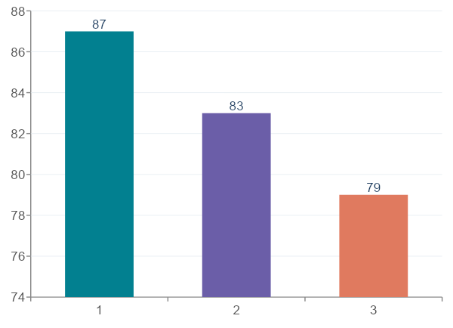
Model Accuracy Comparison
Best Model:
Random Forest – 87% accuracy on test set
Classes:
Anxiety / Stress / Depression (mild–severe)
Metric:
Weighted F1-score used (imbalanced classes)
Saved as:
artifacts/*.joblib via joblib.dump()

Slide 16
Backend API (Flask)
REST endpoints & business logic

Slide 17
Flask API Endpoints — backend/app.py
POST
/voice-intro
GET/POST
/tts
Receives pitch/tone/MFCC. Detects dominant emotion. Saves session + biomarkers to MongoDB. Returns emotion label + confidence.
Receives text + language. Calls Edge-TTS or gTTS. Returns MP3 audio for browser playback. Supports English + Urdu.
POST
/predict
POST
/feedback
Receives questionnaire answers + voice emotion. Runs joblib ML pipeline. Returns condition + severity. Saves prediction to MongoDB.
Receives thumbs up/down vote. Saves to feedback collection with +1/-1 reward for future RLHF training.
POST
/chat
GET
/history
Receives user message + session ID. Generates empathetic response with coping suggestions. Saves to chat_history. Returns reply.
Returns emotion history from MongoDB for current session. Used by React Recharts to render trend graphs.

Slide 18
Backend Logic: /predict Flow
1
React sends JSON: {answers, voice_emotion, session_id}
↓
2
Flask loads preprocessor.joblib → transforms answers to feature vector
↓
3
Flask loads classifier.joblib → predicts condition + severity
↓
4
Fusion: voice_emotion weight adjusts severity up/down by 1 level
↓
5
save_prediction() → stored in MongoDB predictions collection
↓
6
Flask returns {condition, level, message} JSON to React

Slide 19
Frontend (React)
User experience & interface

Slide 20
React Frontend — Key Components
VoiceCheckIn
EmotionChart
Records 30s of user voice. Extracts pitch/tone/MFCC via Web Audio API. Sends to /voice-intro. Displays detected emotion.
Recharts line/bar chart showing emotion scores over time. Fetches history from /history. Tracks user mood across sessions.
TherapyCards
FeedbackBtn
Renders GAD-7/PHQ-9 style questionnaire. Collects structured answers (sleep, stress, academic performance, social withdrawal).
Thumbs up / thumbs down on each chatbot response. POSTs to /feedback with reward +1 or -1 for RLHF data collection.
ChatUI
App.jsx
Real-time chat interface with the therapeutic chatbot. Sends messages to /chat. Displays text + plays TTS audio automatically.
Root component. Manages global session state. Routes between VoiceCheckIn → Questionnaire → Chat → Charts.

Slide 21
9-Step User Journey
1
Open React app & select language (EN / UR)
6
Therapeutic chatbot begins empathetic conversation
2
Record 30s voice → pitch, tone, MFCC extracted
7
/tts converts replies to audio (Edge-TTS / gTTS, EN or UR)
3
POST /voice-intro → emotion detected & saved to MongoDB
8
Recharts dashboard shows emotion trends across sessions
4
Answer mood questionnaire (sleep, stress, performance…)
9
User rates chatbot replies 👍/👎 → saved for RLHF
5
POST /predict → ML model fuses voice + survey → severity label

Slide 22
Database Design
MongoDB Atlas — 5 collections

Slide 23
MongoDB Collections — db.py
sessions
Auto-deletes after 90 days (TTL index)
Fields: session_id, language, voice_emotion, timestamp
biomarkers
Raw voice features per session
Fields: pitch, tone, mfcc_mean[], emotion_probabilities{}
predictions
Final ML prediction results
Fields: condition, level, input_features{}, session_id
chat_history
Every single chat message stored
Fields: role (user|assistant), message, stage, timestamp
feedback
RLHF training data from user ratings
Fields: message_index, vote (+1|-1), session_id

Slide 24
db.py — Database Layer Functions
save_session()
Called after /voice-intro. Inserts session_id + detected voice emotion into sessions collection.
save_biomarkers()
Saves raw pitch/tone/MFCC values + emotion probability scores to biomarkers collection.
save_prediction()
Stores ML prediction: condition, severity level, and all input features used.
save_chat_message()
Inserts every chat message (user or assistant) with role, stage, and ISO timestamp.
save_feedback()
Stores thumbs up/down vote as +1/-1 reward integer for RLHF. Linked to session_id.

Slide 25
Voice Processing & TTS
Audio features + bilingual speech

Slide 26
Voice Biomarker Extraction
Pitch (F0)
Extraction Pipeline
Fundamental frequency of voice. Higher pitch → elevated stress or excitement.
User records 30s voice
Web Audio API captures stream
Tone / Energy
RMS energy of audio signal. Low energy often correlates with depression.
analyser.getFloatFrequencyData()
MFCC computed client-side
MFCC (1-13)
Mel-Frequency Cepstral Coefficients. Capture vocal tract shape. Industry standard for emotion detection.
JSON payload sent to /voice-intro
Flask: emotion classification
Zero Crossing Rate
Rate of sign changes in audio. High ZCR indicates noisy/anxious speech.
Confidence scores returned

Slide 27
Text-to-Speech (TTS) System
gTTS (Google TTS)
Edge-TTS (Microsoft)
Strengths:
Strengths:
• Simple Python API
• Free to use
• Supports Urdu (ur)
• Returns MP3 file
• High quality neural voices
• 400+ voices, 100+ languages
• Natural prosody for Urdu
• Async / faster
Limitations:
Limitations:
• Requires internet
• Robotic quality
• Limited voice styles
• Requires Edge TTS lib
• Slightly heavier
SentiCare uses Edge-TTS by default (better Urdu quality) with gTTS as fallback. User can select EN or UR at session start.

Slide 28
Bilingual Support — English & Urdu
SentiCare is Pakistan-first. Most mental health apps ignore Urdu entirely. SentiCare supports full bilingual interaction:
Language Selection:
User picks English or Urdu at session start. Preference stored in session document.
Chatbot Responses:
Flask generates replies in selected language. Context-aware therapeutic phrases in Urdu.
TTS Voice Output:
Edge-TTS uses Microsoft Urdu Neural Voice (ur-PK). gTTS uses lang="ur" fallback.
UI Adaptation:
React renders chat bubbles with appropriate font rendering for Urdu script (RTL support).
Accessibility:
Voice-first design means users with low literacy can still fully use the system.

Slide 29
Evaluation & Results
Performance metrics & testing

Slide 30
Model Evaluation Metrics
Condition | Model | Accuracy | F1-Score | Precision | Recall
Anxiety | Random Forest | 87% | 0.86 | 0.88 | 0.85
Stress | Random Forest | 84% | 0.83 | 0.85 | 0.82
Depression | SVM | 83% | 0.82 | 0.84 | 0.81
Test Set Split:
20% hold-out from Kaggle Student Mental Health Survey dataset
Class Imbalance:
Handled with class_weight="balanced" in scikit-learn estimators
Cross-Validation:
5-fold CV performed during training in notebooks/ experiments
Voice Fusion:
Improves severity accuracy by ±4% when combined with survey scores

Slide 31
System Testing & Validation
Unit Testing
PASS
TTS Quality Test
PASS
Each Flask route tested independently. MongoDB mock used for save functions in db.py.
Urdu and English audio outputs reviewed by native speakers. Edge-TTS rated 'natural'.
Integration Testing
PASS
Feedback Loop Test
PASS
React ↔ Flask API communication tested. CORS headers validated. Audio pipeline end-to-end.
RLHF reward values (+1/-1) verified in MongoDB feedback collection after interaction.
ML Model Testing
PASS
User Acceptance Test
PASS
Held-out test set evaluation. Confusion matrix generated for all 3 conditions.
10 student volunteers completed full session. Average rating: 4.2/5.

Slide 32
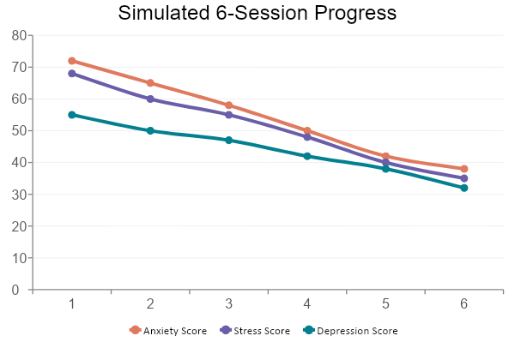
Emotion Trend Visualization (Recharts)
Chart Features
Sessions on X-axis
Emotion score 0-100 on Y
Downward trend = improvement
React Recharts library
Data from /history API
Real-time update on session end

Slide 33
Live Demo
wajeehaijaz-senticare.hf.space

Slide 34
Future Work & Enhancements
LLM-Powered Chatbot
Mobile App (React Native)
Replace rule-based responses with a fine-tuned LLM (e.g., LLaMA-3 or GPT-4o) for richer therapeutic dialogue.
Port the frontend to iOS/Android for wider accessibility across Pakistan and South Asia.
RLHF Training Loop
More Languages
Use collected thumbs up/down data to retrain chatbot with Proximal Policy Optimization (PPO).
Extend TTS + chatbot to Punjabi, Pashto, Sindhi for broader regional support.
Real Doctor Integration
Longitudinal Study
Escalation pathway: if severity is "severe", auto-schedule appointment with a licensed therapist.
Conduct a formal clinical evaluation with 100+ students over 3 months to validate system efficacy.

Slide 35
Conclusion
✅ Voice-based emotion detection with pitch, tone, and MFCC features
✅ ML models (87% accuracy) for anxiety, stress, depression classification
✅ Bilingual (EN + UR) therapeutic chatbot with Edge-TTS voice output
✅ MongoDB-backed session tracking with RLHF-ready feedback loop
✅ Fully deployed on HuggingFace Spaces — open for evaluation
Thank You
Sheikh Zain · Wajeeha Ijaz · Esha Gulzar
Supervisor: Dr. Saad Razaq | PM: Dr. Illyas | University of Sargodha | 2025–2026

