Slide 1
Dhoa
HACK FOR HUMANITY BANGLADESH 2026
Satellite-based screening to help inspectors prioritize brick kiln inspections in Bangladesh
TEAM ASTRAL
Sheikh Mosheul Akbar · Sohom Sattyam
Climate Resilience & Environmental Sustainability Track
Notes:
[0:00–0:20] "Bangladesh has over 7,000 brick kilns. Most are illegal. None are being monitored at scale. Dhoa changes that." Open dashboard — point to stats bar: 2,135 kilns · 430 high-risk · 1,767 violations. "These numbers come from real satellite imagery analyzed by our AI model — not surveys, not guesswork."

Slide 2




Brick kilns put millions of people at risk
THE PROBLEM
Thousands of kilns, mostly informal. The exact number is unknown.
AT RISK
18M+
Over 75% of kilns sit within 1 km of a school.
Nearly 10% of kilns sit within 1 km of a health facility.
people live within 1 km of a brick kiln in Bangladesh
No scalable way for regulators to find and prioritize kilns.
Source: Lee et al., “Scalable deep learning to identify brick kilns and aid regulatory capacity,” PNAS, 2021.
Notes:
Anchor on the 18 million figure (Lee et al., PNAS 2021, Stanford and icddr,b). Then the siting picture: most kilns are close to schools, some to health facilities. The gap is not awareness; it is that regulators cannot find and prioritize kilns at scale.

Slide 3






From satellite imagery to a ranked review queue
THE APPROACH
01
Advisory by design. Every output is a screening candidate for human review, not a legal determination.
Notes:
Walk left to right: free imagery, detection, rule-signal screening, prioritization. Close on the advisory framing: Dhoa never decides legal status; it tells a human reviewer where to look first.

Slide 4
A working prototype across five districts
THE EVIDENCE
Detection model
Pilot coverage
Held-out SentinelKilnDB test chips
2,150 candidate rows across five districts
0.752
0.699
0.734
mAP50
Precision
Recall
AP50 by kiln type
Metrics describe held-out dataset chips, not field accuracy. Counts are candidate rows, not a census of kilns. Dataset: SentinelKilnDB, Mondal et al., NeurIPS 2025 (CC BY-NC 4.0).
Notes:
Left: detector results on held-out SentinelKilnDB chips. Be explicit that this is dataset performance, not field accuracy. Right: candidate rows in the processed output for the five pilot districts. These are candidates for review, not a census.

Slide 5
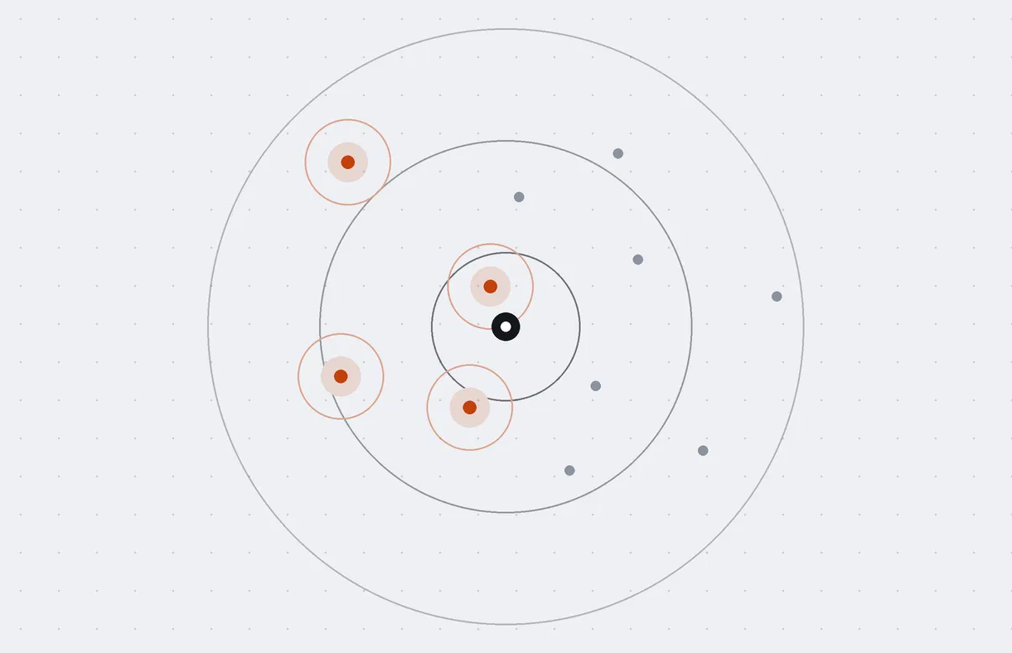




Siting-rule signals for every candidate
SCREENING
Each candidate is compared with mapped sensitive features, informed by the Brick Manufacturing and Kiln Establishment (Control) Act, 2013.
Schools
Hospitals
Settlements
Railways
Wetlands
Government forests
Sensitive site (school, hospital…)
Buffer distance around a site
Kiln candidate
A separate technology signal flags FCBK kilns. Signals are screening proxies; mapped distances may differ from legally controlling boundaries.
Illustrative diagram, not to scale.
Notes:
Each candidate is checked against mapped features such as schools and hospitals. The diagram is illustrative: a sensitive site, a buffer around it, and kiln candidates inside and outside. Mention that distances are to mapped features and may differ from legally controlling boundaries.

Slide 6

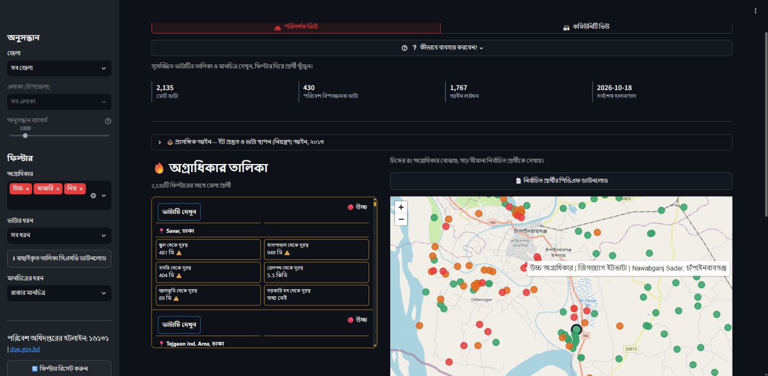
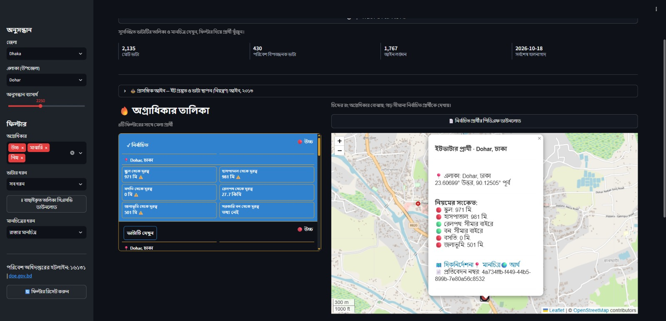


Select District & Upazila
Instantly filtered to that upazila — every kiln ranked by violations.
Rule signal breakdown
Red = violation, yellow = borderline, green = clear. One tap to navigate.
Field-ready PDF
Coordinates, violation list, reference number — no paperwork needed.
Notes:
[0:20–1:10] Select District: Chapainawabganj → Upazila: Shibganj. Point to ranked list: filtered instantly, worst offenders first. Click ভাটা দেখুন on top High-priority kiln — show rule signal breakdown (red/yellow/green). Click দিকনির্দেশনা for Google Maps navigation. Click PDF download — field-ready report with coordinates and violation list.

Slide 7

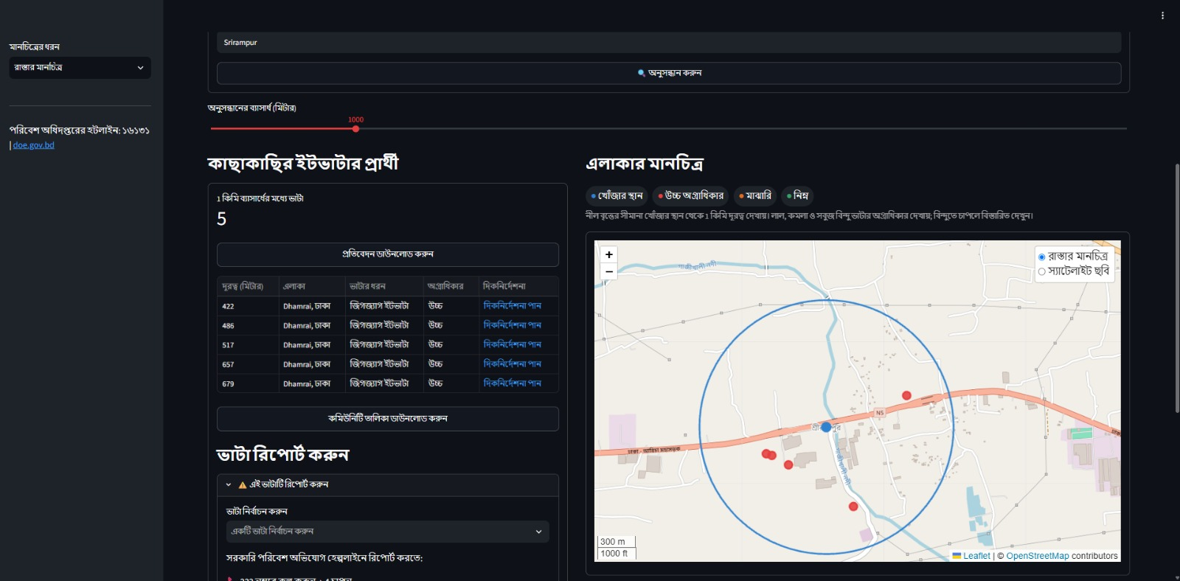
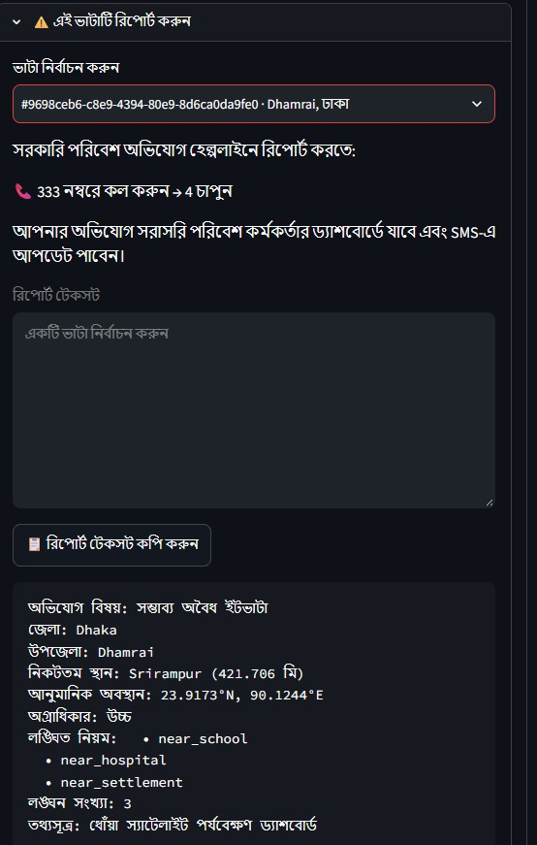

Any citizen. Any phone with a browser. In Bengali.
COMMUNITY VIEW
Search your neighborhood
Type Savar — kilns within 2 km, color-coded by priority.
Dhoa · Community search
Pre-filled complaint
Location, violations, reference — ready to read to the DoE hotline 16131.
No app store needed
Works on any browser. No account, no English required.
Notes:
[1:10–1:50] Switch to কমিউনিটি ভিউ tab. Type Savar, hit search. Point to map: kilns within 2km, color-coded by priority. Scroll to report section — pre-filled complaint: kiln location, violation details, ready to read to the DoE hotline. Point to hotline 16131: the real Department of Environment complaint line. No app store, no account, no English required.

Slide 8

Thank you
Because every breath counts.
TEAM ASTRAL
Sheikh Mosheul Akbar
Sohom Sattyam
LIVE DEMO
hack-for-humanity-dhtqzvofebzbjrsyunlnmz.streamlit.app
Scan to open the live demo
SOURCE CODE
github.com/sheikh2583/Hack-For-Humanity
Notes:
Close with the demo and repository. Offer to walk through the dashboard live.

