Slide 1
DealFinder
CSE 326 : Information System Design
Presented By
1705004, 1705005, 1705010,
1705014, 1705016, 1705020

Slide 2
Motivation

Slide 3
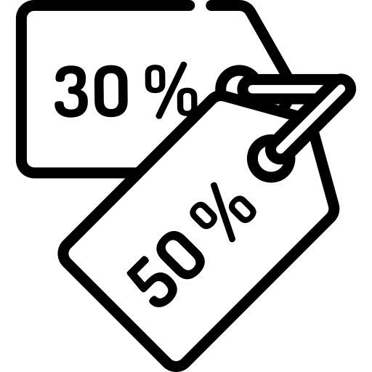


DISCOUNTS
GOOD REVIEWS
OFFERS
VERY TIME CONSUMING

Slide 4
Modules

Slide 5
Modules
Reward Points
Registration
User
DealFinder
Web Scraping
Advertisement
Searching & Filtering
Partner online stores

Slide 6
User Types
Unregistered User
Registered User
Premium User
Browse through the deals
Get special discounts and promo codes
Special privileges.

Slide 7
Features

Slide 8
Categories
PRODUCT
TRAVEL

Slide 9
Categories
PRODUCT
TRAVEL
Clothes
Electronics
Beauty products
Groceries
Vacation Packages
Flight Deals
Rental Car

Slide 10
SEARCHING & FILTERING
Top Deals
Editors’ Pick
Cheapest Deals
Stores
Product & Deal Query
Filter
Brands
User
Deal Finder
Special Offers
Free Shipping
Best Reviewed
Latest Deals
Flash Sale

Slide 11
Earn & Redeem points
Points added after order is reported
Get points and become a Premium User
Redeem points to get gift cards and discounts

Slide 12
Related Examples

Slide 13
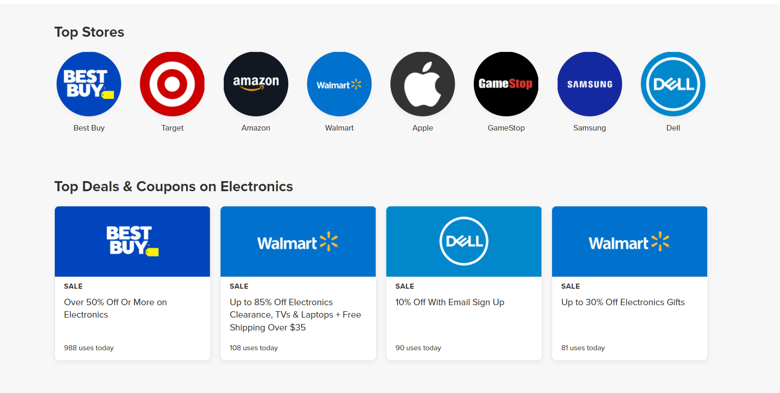
retailmenot.com

Slide 14
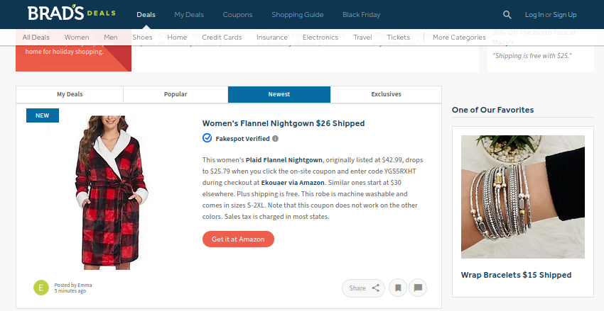
bradsdeal.com

Slide 15
Data Collection
Web Scraping tools
(using tools like BeautifulSoup)

Slide 16
Distribution of Presentations
1705014
1705004
1705020
Scope Fixation
Requirement Analysis
Class Diagram
Interaction Diagram
Mock UI
Demo
1705005
1705016
1705010

Slide 17
Thank You

