Slide 1

Innovation Management in Healthcare for Developing Countries
Sheikh Abdul Majid

Slide 2
The Introduction
Innovation: To capture value in a different way
Innovation has been a key driver for the evolution of health industry
Helps improve and enhance existing processes of product/service delivery
Innovation management: Handling processes involved in introduction of an innovation

Slide 3
The Problem
Improper management of innovation in healthcare sector
Poor allocation of resources makes it difficult for some social groups to access basic health care
Issue is more prevalent in developing countries such as Pakistan

Slide 4
100,000,000
50% of Pakistani population lacks access to basic health services
¹
¹
Zaidi, S., Idrees, N. & Riaz, A., 2017. Primary Care Systems Profile and Performance: Pakistan Case Study, s.l.: World Health Organization.

Slide 5
10,000,000
5% of Pakistani population experience catastrophic health expenditures
²
²
Zaidi, S., Idrees, N. & Riaz, A., 2017. Primary Care Systems Profile and Performance: Pakistan Case Study, s.l.: World Health Organization.

Slide 6
The Solution
Identify various innovation management approaches
Subject these approaches to several constraints
Apply multi-criteria decision making techniques
Select the best approach to implement in health sector in a developing country

Slide 7
Criteria
Alternatives
Consumer Demand
Overall Budget
Patient Satisfaction
Government Policies
Training Facilities
Top-Down Approach
Bottom-Up Approach
User-Centric Approach
Open Innovation Approach

Slide 8
Methodology
Data Collection
Primary Source – Questionnaire
Criteria Assessment
Alternatives Assessment
Experts

Slide 9
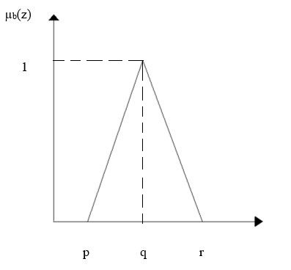
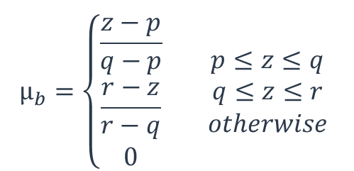
Methodology
Data Analysis – Criteria Weights
³
Fig 2: Triangular Fuzzy numbers
Fuzzy FUCOM (Full Consistency Method)
Triangular Fuzzy Numbers
$$µ_{b}=\left\{\begin{aligned}\frac{z−p}{q−p} \\ \frac{r−z}{r−q} \\ 0\end{aligned}\right. \begin{matrix}p≤z≤q \\ q≤z≤r \\ otherwise\end{matrix}$$
(1)
³
Anand, M. C. J. & Bharatraj, J., 2017. Theory of Triangular Fuzzy Number. Chennai-603103, Tamil Nadu, S. India, Department of Mathematics, Hindustan University

Slide 10
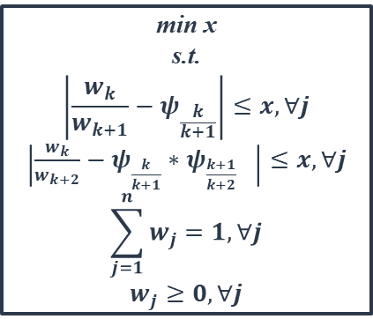
Methodology
⁴
Table 2
Data Analysis – Criteria Weights
Likert Scale
Very High | 7 | 9 | 9
High | 5 | 7 | 9
Medium | 3 | 5 | 7
Low | 1 | 3 | 5
Very Low | 1 | 1 | 3
Linguistic variables converted in to triangular Fuzzy numbers
Ranking based on significance
Formation of criteria weights matrix through LINGO
min x
s.t.
$$\left|\frac{w_{k}}{w_{k+1}}−ψ_{\frac{k}{k+1}}\right|≤x, ∀j$$
$\left|\frac{w_{k}}{w_{k+2}}−ψ_{\frac{k}{k+1}}∗ψ_{\frac{k+1}{k+2}} \right|≤x,∀j$
$$\sum_{j=1}^{n}{w_{j}}=1, ∀j$$
$$w_{j}≥0, ∀j$$
(2)
Table 1
W1 | W2 | W3 | W4 | W5
0.23 | 0.24 | 0.18 | 0.17 | 0.19
2 | 1 | 4 | 5 | 3
⁴
Kusumawardani, R. P. & Agintiara, M., 2015. Application of Fuzzy AHP-TOPSIS Method for Decision Making in Human Resource Manager Selection Process. Procedia Computer Science, Volume 72, pp. 638-646

Slide 11


Methodology
Data Analysis – Alternative Ranking
Fuzzy TOPSIS
Linguistic variables converted in to triangular fuzzy numbers
Formation of weighted normalized fuzzy decision matrix
$A ={[N}_{ab}]_{mxn}$* ${[W}_{q}]_{nx1}$
$$N_{ab}=\left(\frac{p_{ab}}{{c^{∗}}_{ab}},\frac{q_{ab}}{{c^{∗}}_{ab}},\frac{r_{ab}}{{c^{∗}}_{ab}}\right), \text{and} {c_{ab}}^{∗}=max\left(c_{ab}\right)$$
(3)
(4)

Slide 12

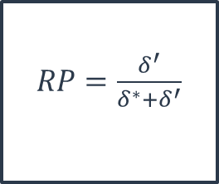
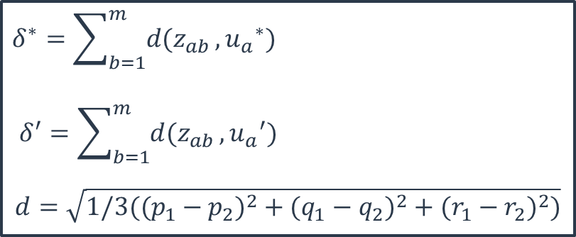

Methodology
Data Analysis – Alternative Ranking
Determination of Fuzzy positive ideal solution and Fuzzy negative ideal solution
Calculation of closeness factors of the alternatives
Ranking of the alternatives
$$F^{∗}={u_{1}}^{∗},{u_{2}}^{∗},…,{u_{n}}^{∗}$$
(6)
$$F^{′}={u_{1}}^{′},{u_{2}}^{′},…,{u_{n}}^{′}$$
(7)
$$δ^{∗}=\sum_{b=1}^{m}{d(z_{ab}}, {u_{a}}^{∗})$$
$$δ^{′}=\sum_{b=1}^{m}{d(z_{ab}}, {u_{a}}^{′})$$
$$d=\sqrt{1/3((p_{1}−p_{2})^{2}+(q_{1}−q_{2})^{2}+(r_{1}−r_{2})^{2})}$$
$RP=\frac{δ^{′}}{δ^{∗}+δ^{′}}$
(5)
(8)

Slide 13
Results
Table 3
Alternatives |  | Ranking
A1 | Top-Down Innovation Management | 4
A2 | Bottom-Up Innovation Management | 3
A3 | User-Centric Innovation Management | 2
A4 | Open Innovation Management | 1
Fig 3: Closeness Factor
Open Innovation Management

Slide 14
Discussion
Highest ranked criteria – Patient Satisfaction
Highest ranked alternative – Open Innovation
Advantage to the healthcare sector of Pakistan
⁵
⁶
Table 4
Types of Cost | 2017 | 2018
Residential care | 4,887,943 € | 4,401,191€
Operating | 70,221 € | 26,622 €
Health assets | 855,128 € | 59,223 €
⁵
⁶
Mukhtar, F. et al., 2013. Patient satisfaction; OPD services in a tertiary care hospital of Lahore. Professional MedJ, 20(6), pp. 973-980.
Biancone, P., Secinaro, S., Brescia, V. & Calandra, D., 2019. Management of Open Innovation in Healthcare for Cost Accounting using EHR. Journal of Open Innovation, 5(99).

Slide 15
Limitations and Future Prospects
The study only identifies the best possible innovation management approach
Feasibility of replacing the existing innovation management system
Cultural and Social aspects of Pakistan

Slide 16
Thank You

