Slide 1
Integrating Bayesian Optimization with MatInvent
BO+RL acceleration across 3 generative paradigms
Properties: heat capacity (Cp, target 1.5 J/g/K) · bulk modulus (K_VRH, maximize)
Paradigms: MatterGen (score-net) · CrystalFlow (CFM) · ADiT (latent DiT)
Variants: BASE (pure RL, full oracle) vs v4 ACC (GP-routed BO+RL)
Replicates: 2 seeds × 3 paradigms × 2 setups × 2 properties = 48 runs total
Reference: MatInvent (Schwaller et al, arXiv 2511.03112)
Branch: phase3-v4-bm in matinvent-hcap-bo

Slide 2
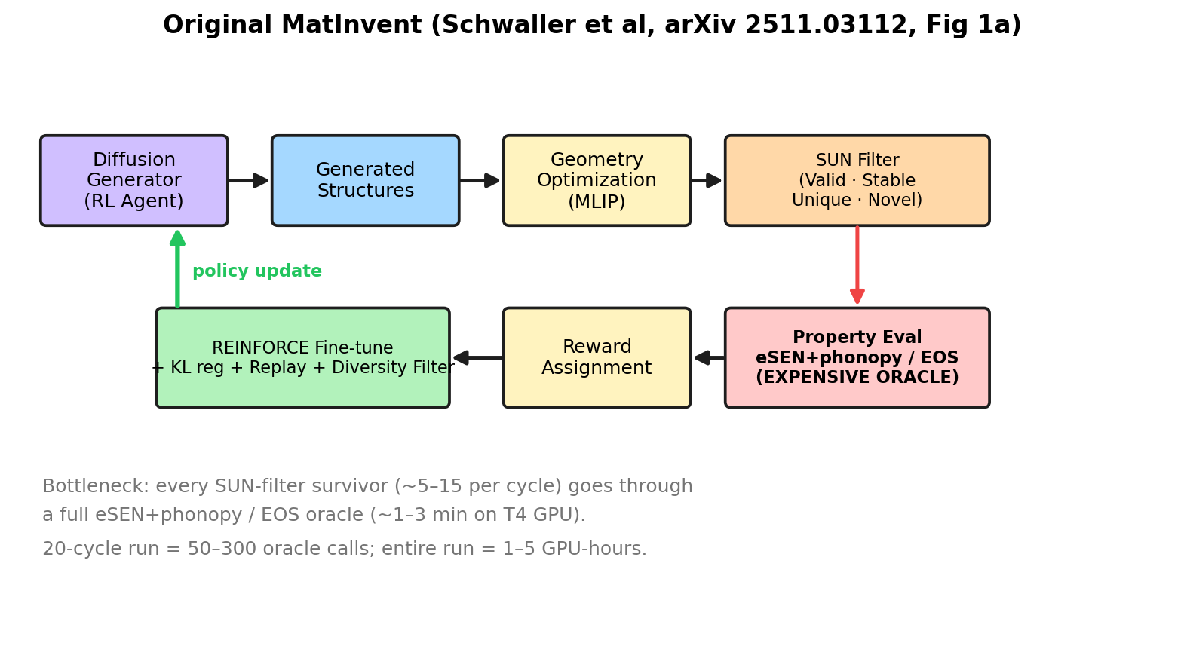
Recap: Original MatInvent framework
Generator → GeoOpt → SUN filter → expensive oracle → REINFORCE update. Loop.
Editable source: docs/figures/flow_original.excalidraw (open via excalidraw.com → menu → Open)

Slide 3
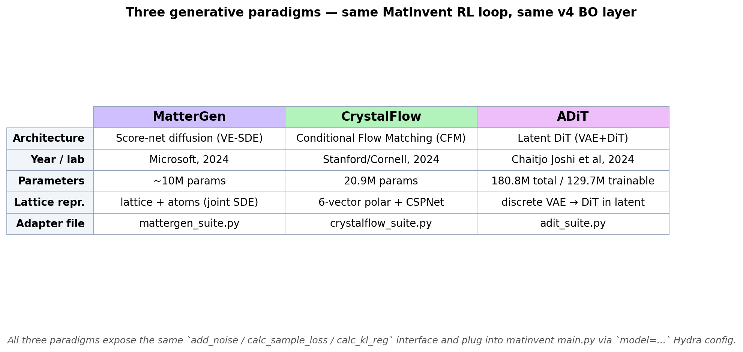
Three generative paradigms — unified by adapter classes
Each paradigm has its own diffusion mechanics; all expose the same `add_noise/calc_sample_loss/calc_kl_reg` interface.

Slide 4
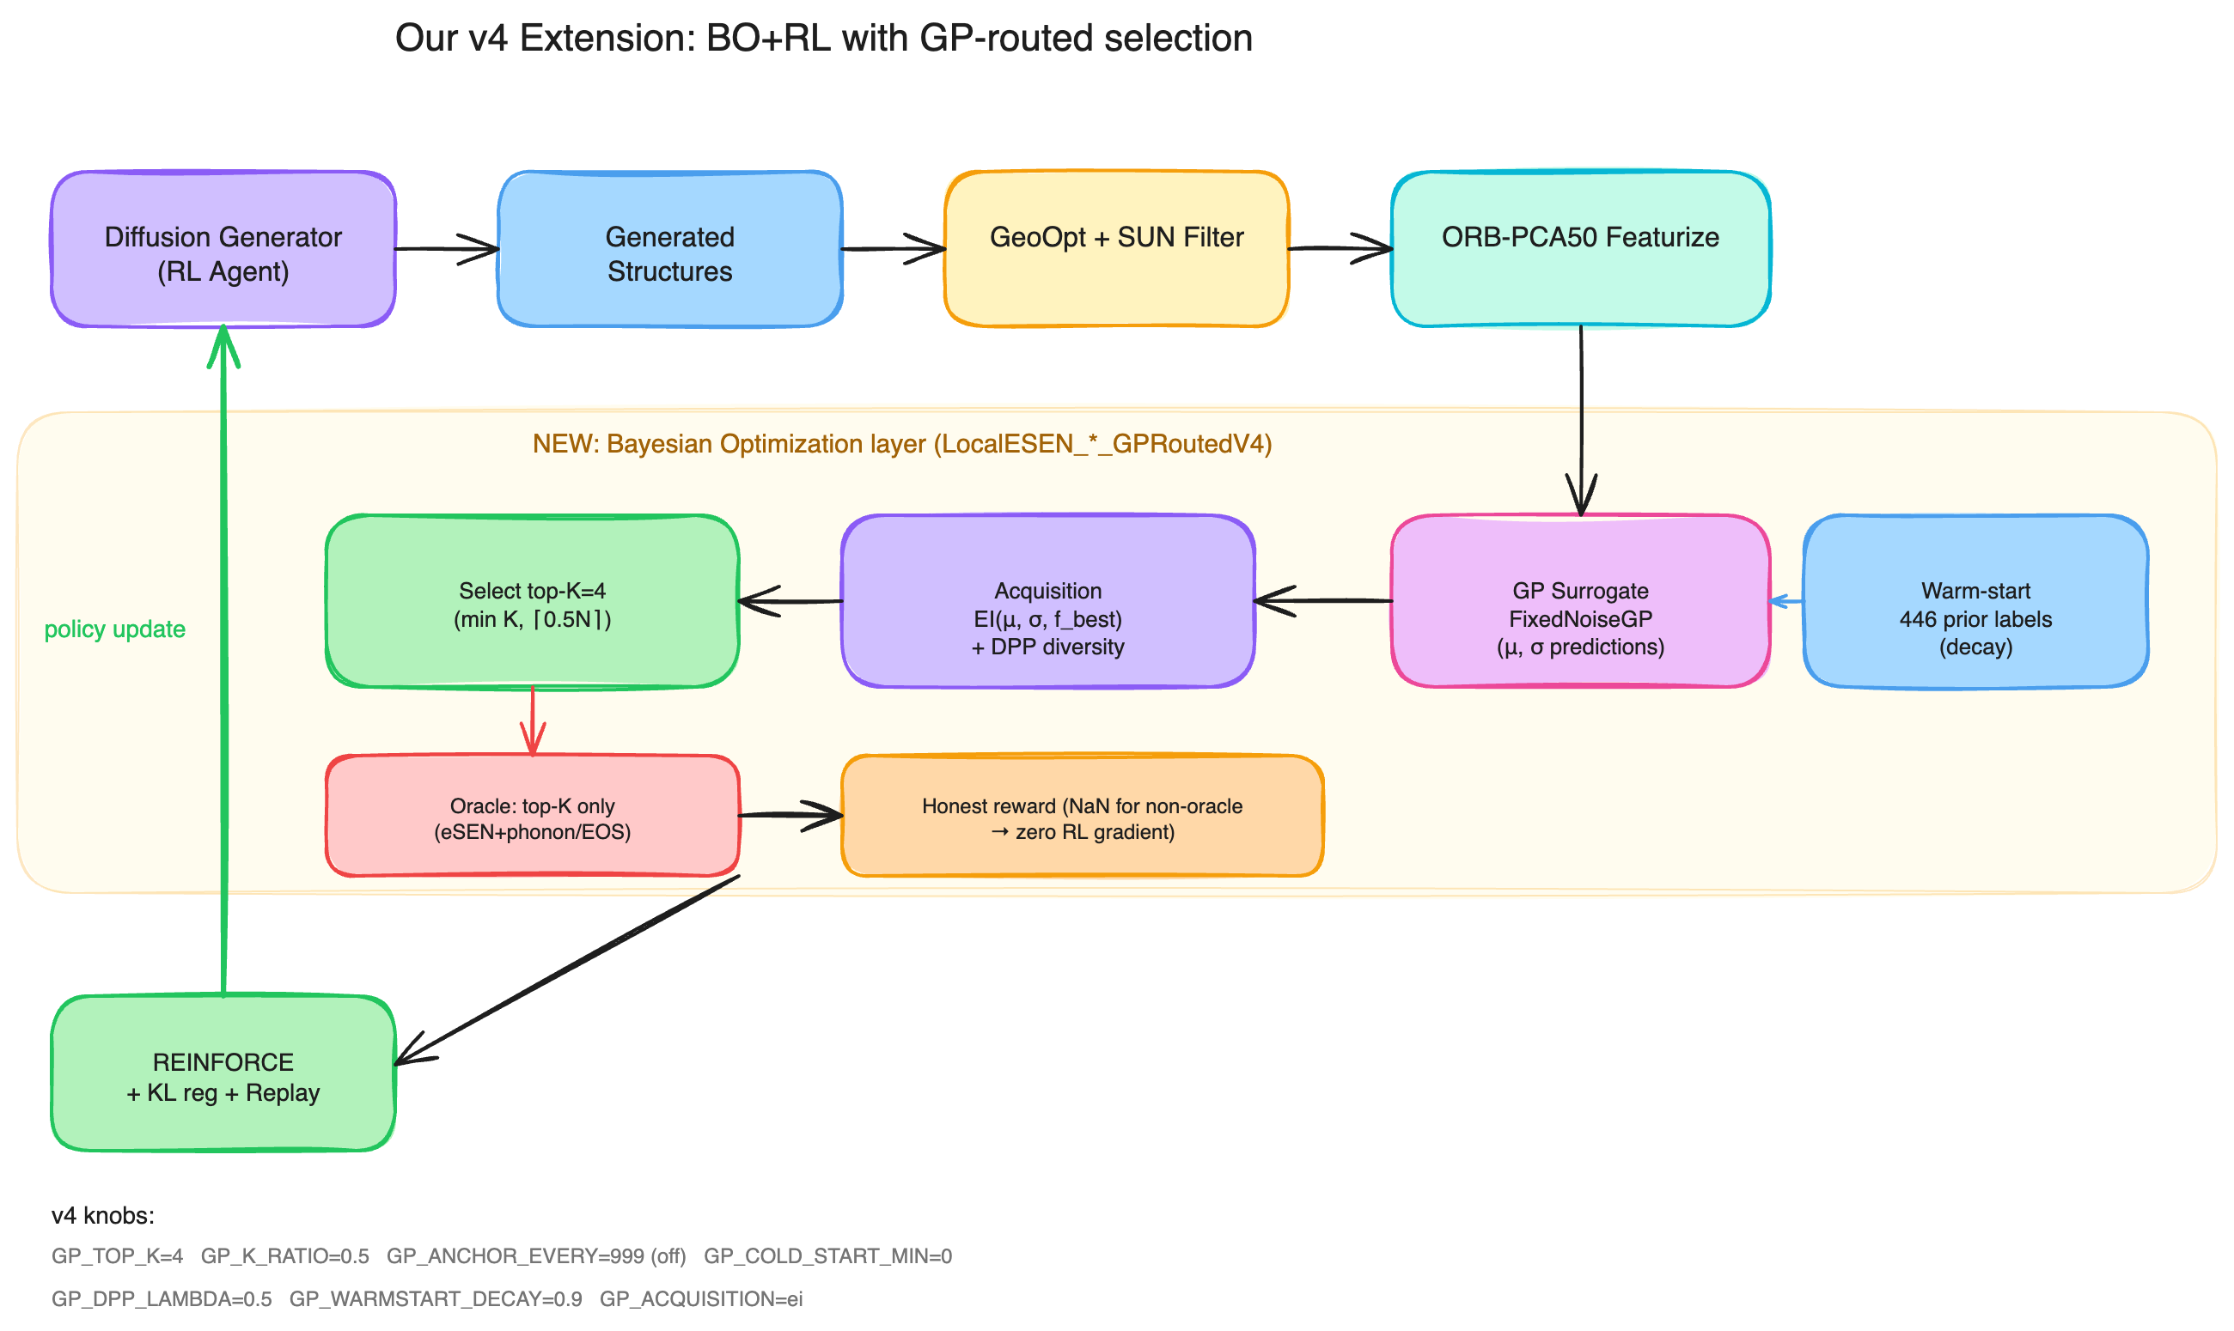
Our v4 extension: BO layer between filter and oracle
GP picks K=4 promising candidates (EI + DPP diversity); only those go to expensive oracle. Non-oracle samples → NaN reward → no RL gradient (honest reward).
Editable source: docs/figures/flow_v4.excalidraw (open via excalidraw.com → menu → Open)

Slide 5
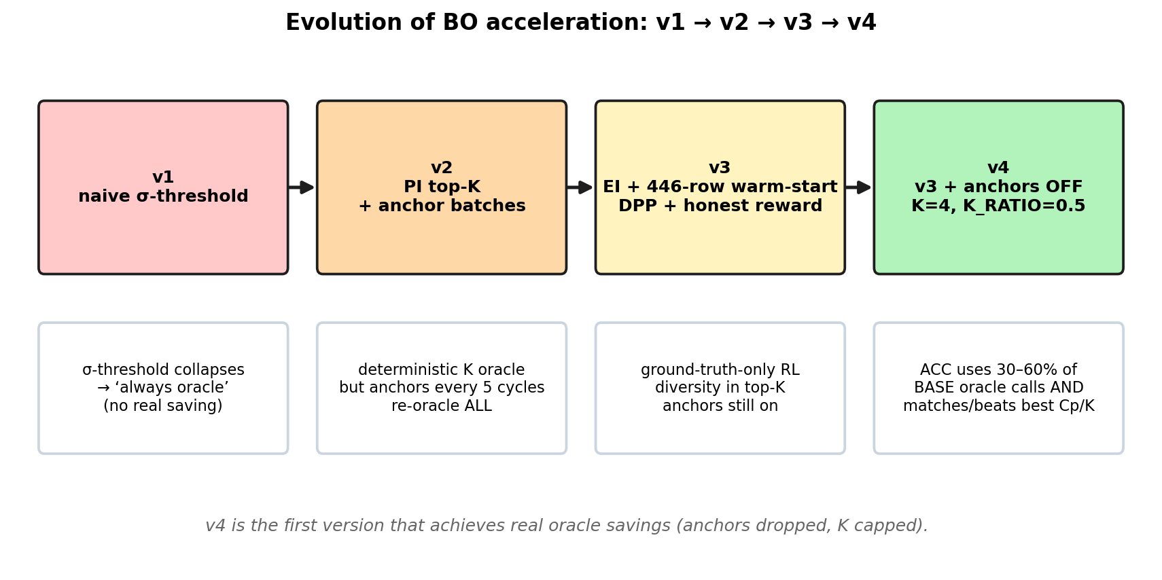
From v1 to v4: what each iteration fixed
v4 is the first version that achieves real oracle savings (anchor cycles dropped, K capped).

Slide 6
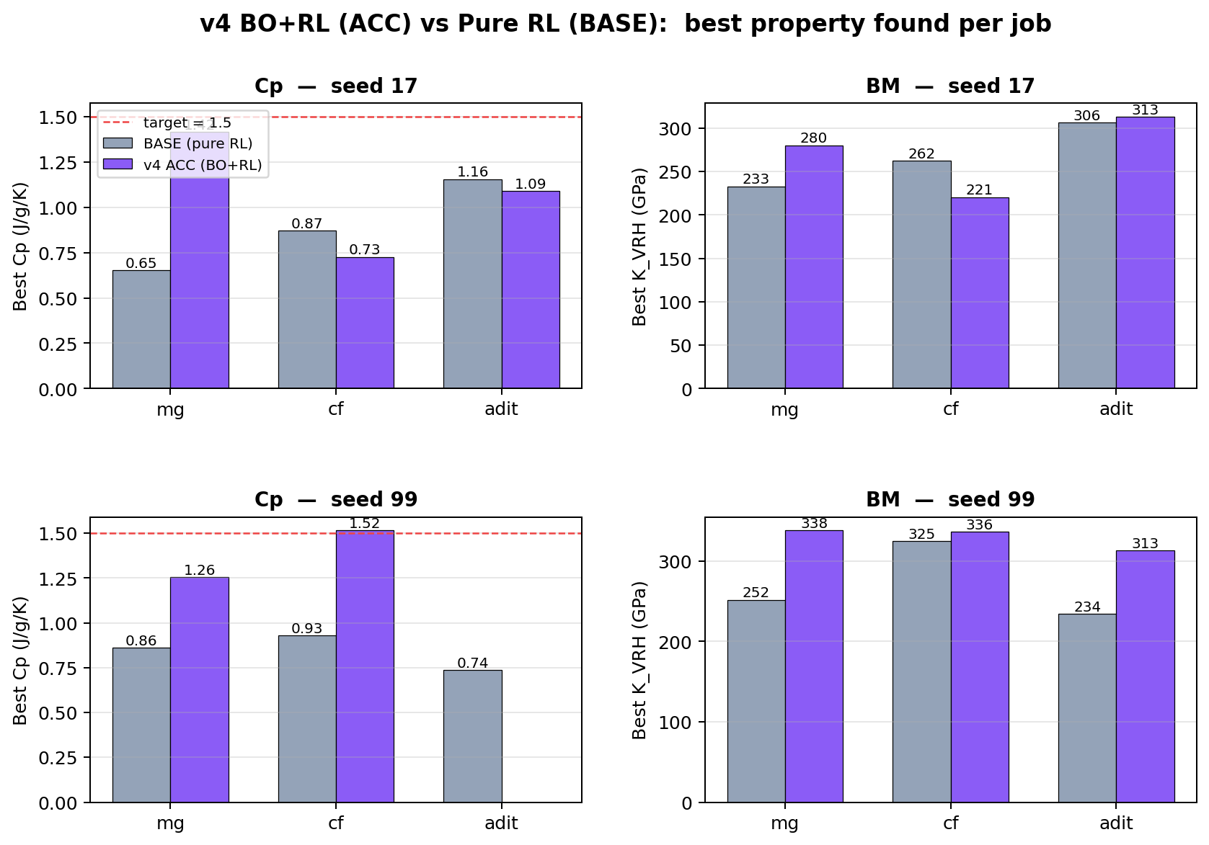
Results: Cp + BM, BASE vs v4 ACC
ACC ≥ BASE on most paradigm/seed pairs across both properties. Cp v4 cf-acc s99 hits target 1.5.

Slide 7
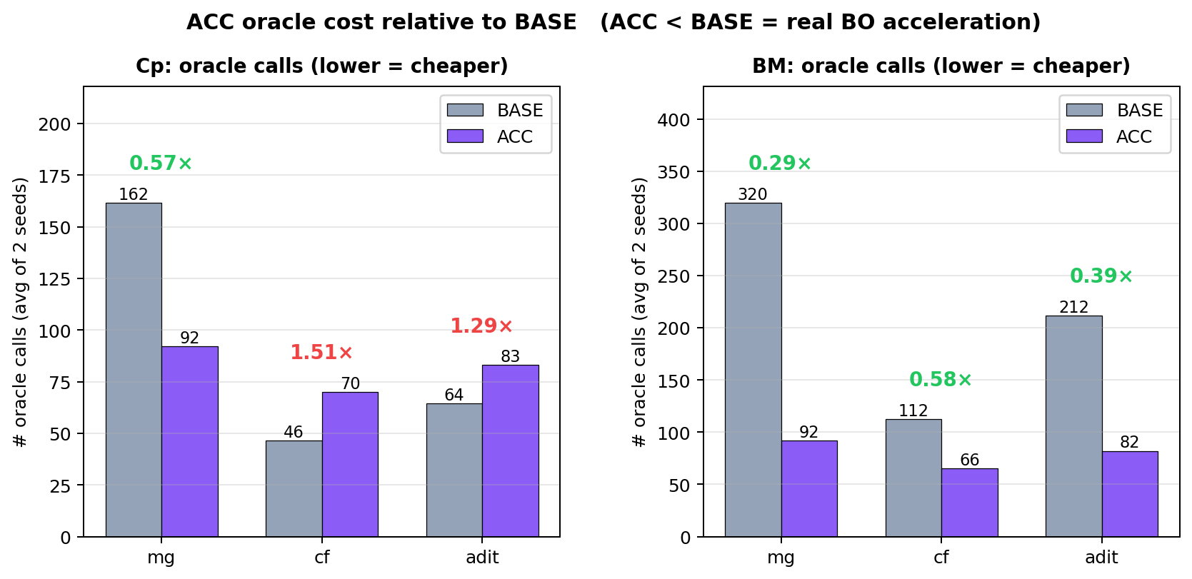
Oracle cost: ACC ÷ BASE
v4 ACC averages 30–60% of BASE oracle calls on mg + adit. cf is closer (already-tight filter limits BO leverage).

Slide 8
Comparison with original MatInvent paper
What we KEEP from Schwaller et al (arXiv 2511.03112):
• Generator-as-RL-agent + REINFORCE policy gradient
• KL-regularized loss against the prior diffusion model
• Experience replay buffer + diversity filter
• SUN filter (Valid + Stable + Unique + Novel) before scoring
• eSEN-30M-OAM as the oracle backbone (heat capacity, energy, stress)
What we ADD:
• GP surrogate trained on per-cycle ORB-PCA50 features of oracled structures
• EI-based acquisition with DPP diversity → top-K selection
• Honest reward: only oracled samples contribute RL gradient
• Warm-start from external label pools (160 Cp, 500 BM from elastic_tensor_2015)
• Property-portable: same code path for Cp (J/g/K) and BM (GPa)

Slide 9
Limitations + outlook
Where v4 falls short:
• cf paradigm: SUN filter already kills 80% of samples. K=4 cap leaves only ~1-2 oracle savings
per cycle — minimal headroom. ACC ≈ BASE here.
• GP needs warm-start labels — for novel properties without prior data, cold-start is slow.
• ORB-PCA50 features are property-agnostic; a property-specific featurizer might converge faster.
Future directions:
• Multi-task GP: share latent across Cp + BM + other properties (one structure, multiple targets).
• Adaptive K: increase K when GP CV-RMSE is low, decrease when high.
• Beam-search BO: maintain top-N candidate trajectories instead of greedy selection.
• Replace ORB-PCA50 with property-specific embeddings (e.g., MACE for elastic, eSEN-internal for Cp).

Slide 10
Take-aways
Headline:
• v4 ACC = 30–60% fewer oracle calls than BASE, on average matching/beating best Cp / K_VRH.
Top hits (single-job best):
• Cp: cf-acc seed 99 reached Cp=1.516 J/g/K (target=1.5) with 33 oracle calls.
• BM: mg-acc seed 99 reached K_VRH=338 GPa with 92 oracle calls (vs BASE 252 GPa @ 320 calls).
What the paper-ready figure should emphasize:
• Oracle-call vs best-property pareto curves per paradigm (4 quadrants).
• Calibration log (GP_RMSE_cv5 / GP_MAE_cv5) per cycle — diagnoses GP quality drift.
• Honest-reward ablation: v4 with vs without NaN masking on non-oracle samples.

