Slide 1
NexDesk
AI-Based IT Ticket Management System
PRODUCT HERO
128
14
Open Tickets
High Priority
An AI-powered IT helpdesk platform that automates ticket analysis,
issue classification, priority detection, root-cause identification,
similar-ticket retrieval, and solution recommendation.
642
3.2h
Resolved
Avg SLA
AI Analysis
Auto Classification
Priority Detection
Root-Cause
Similar Tickets
Recommendations
Product demo · Engineering review
Presented by AI Engineering Intern

Slide 2
01 · CONTEXT
The Problem: Why Traditional IT Support Fails
Pain points in legacy helpdesks
Traditional vs AI-Powered Support
▪ Manual ticket classification
▪ Slow ticket resolution
▪ Incorrect prioritization
▪ Duplicate tickets
▪ Repeated troubleshooting
▪ No intelligent recommendations
Triage
Manual / slow
Auto / instant
Priority
Guesswork
Sentiment-aware
Duplicates
Common
Detected & merged
Resolution
Repeated
Reuse past fixes
Insight
None
Live analytics
NexDesk · AI-Based IT Ticket Management System
02

Slide 3
02 · APPROACH
The Solution: How NexDesk Helps
!
Problems
⚡
AI Engine
✓
NexDesk Outcomes
• Manual intake
• Slow triage
• Duplicate work
• Analyze
• Classify
• Prioritize
• Retrieve
• Recommend
• AI issue analysis
• Auto classification
• Smart recommendations
• Similar-ticket detection
• Faster resolution
NexDesk · AI-Based IT Ticket Management System
03

Slide 4
03 · GOALS
Project Objectives
◆
Auto Issue Analysis
▣
Category Detection
◧
Department Detection
♥
Sentiment Priority
⚙
Root-Cause Analysis
⧉
Similar-Ticket Detection
✚
AI Troubleshooting
★
Smart Recommendations
NexDesk · AI-Based IT Ticket Management System
04

Slide 5
04 · ARCHITECTURE
System Architecture
User / Admin
AI PIPELINE (per message)
Employees + IT admins
1. Issue Analysis
Authentication
2. Category Detection
JWT · role-based
3. Department Detection
React Frontend
Dashboard · chat · tickets
4. Priority Detection
FastAPI Backend
5. Sentiment Analysis
REST API · logic
6. Root-Cause Analysis
AI Assistant
Classify · sentiment · similarity
7. Similar-Ticket Detection
8. Database → Ticket Mgmt
NexDesk · AI-Based IT Ticket Management System
05

Slide 6
05 · STACK
Technology Stack
Frontend
Backend
Database
Auth
AI Components
• React
• Vite
• Tailwind CSS
• FastAPI
• SQLAlchemy
• SQLite
• JWT
• Classification
• Sentiment
• Similar-Tickets
NexDesk · AI-Based IT Ticket Management System
06

Slide 7
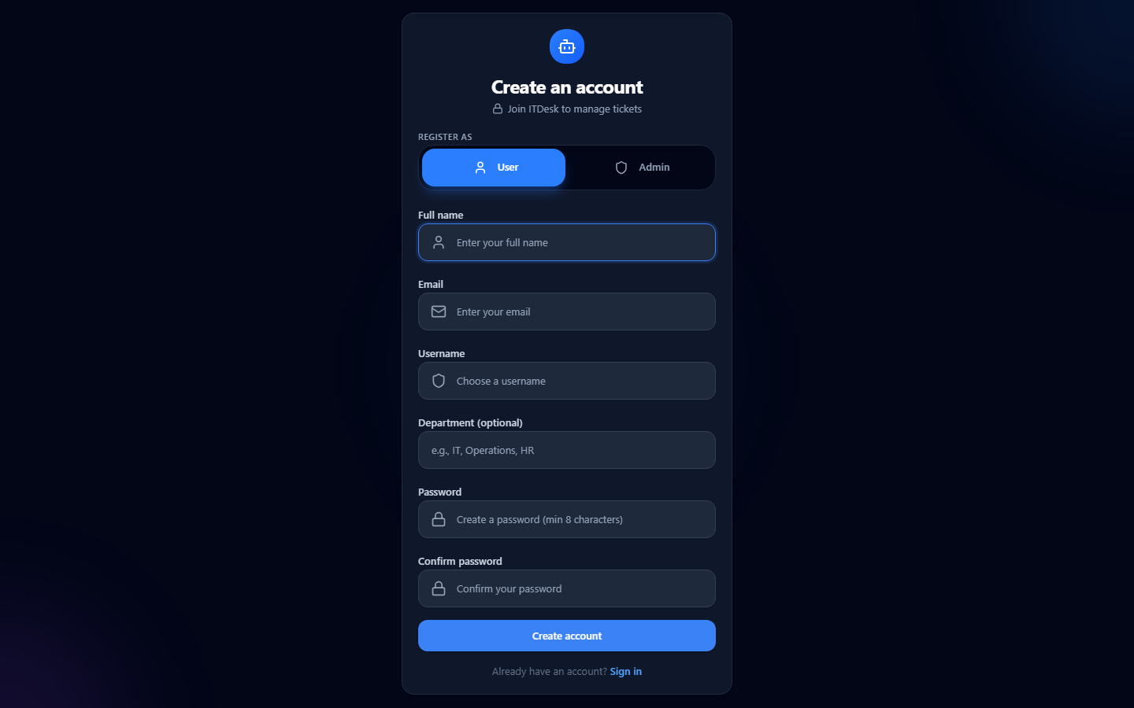
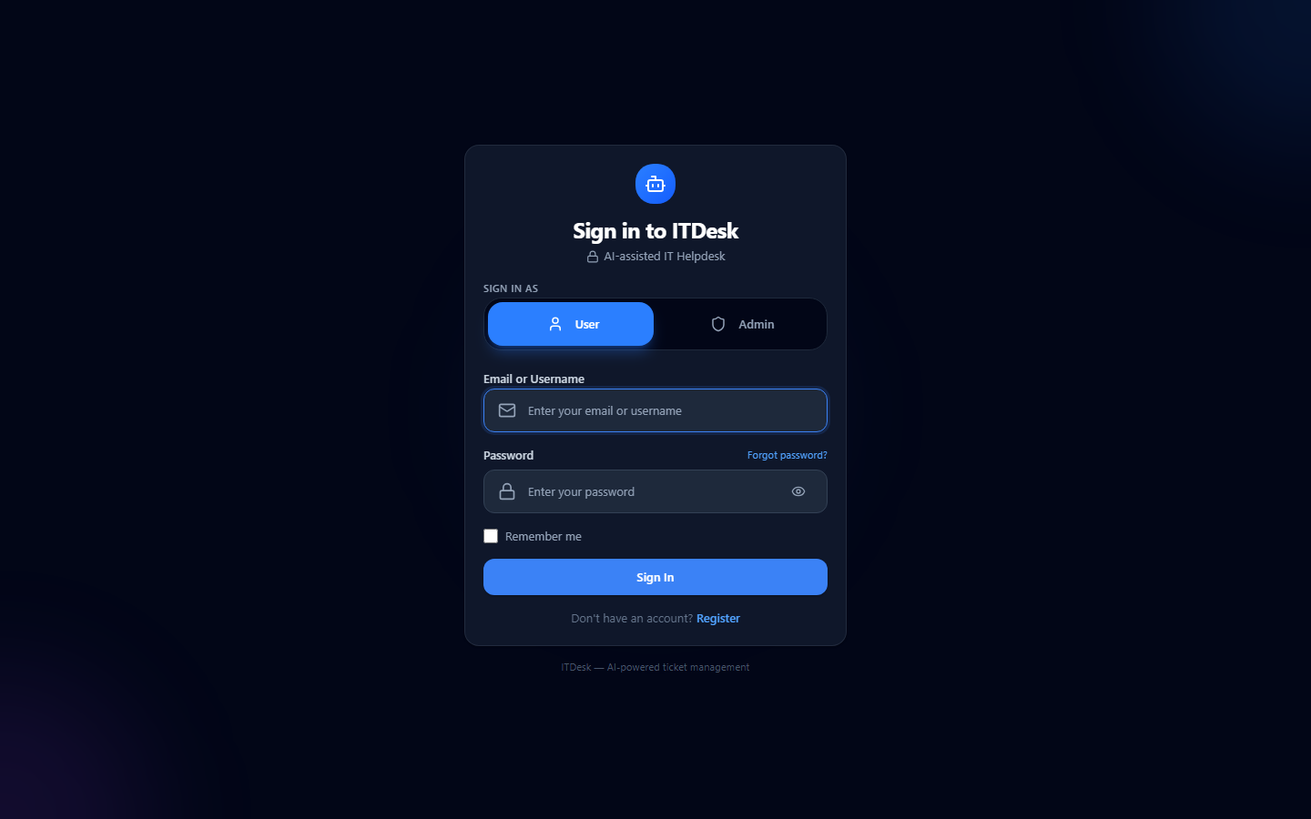
06 · ACCESS
User Authentication
▪ Registration
▪ User login
▪ Admin login
Visual: secure JWT auth with role selector
● Registration
● Login
ADMIN LOGIN
Admins select the Admin role,
authenticate via JWT, and gain
access to ticket management,
users, system health & reports.
NexDesk · AI-Based IT Ticket Management System
07

Slide 8
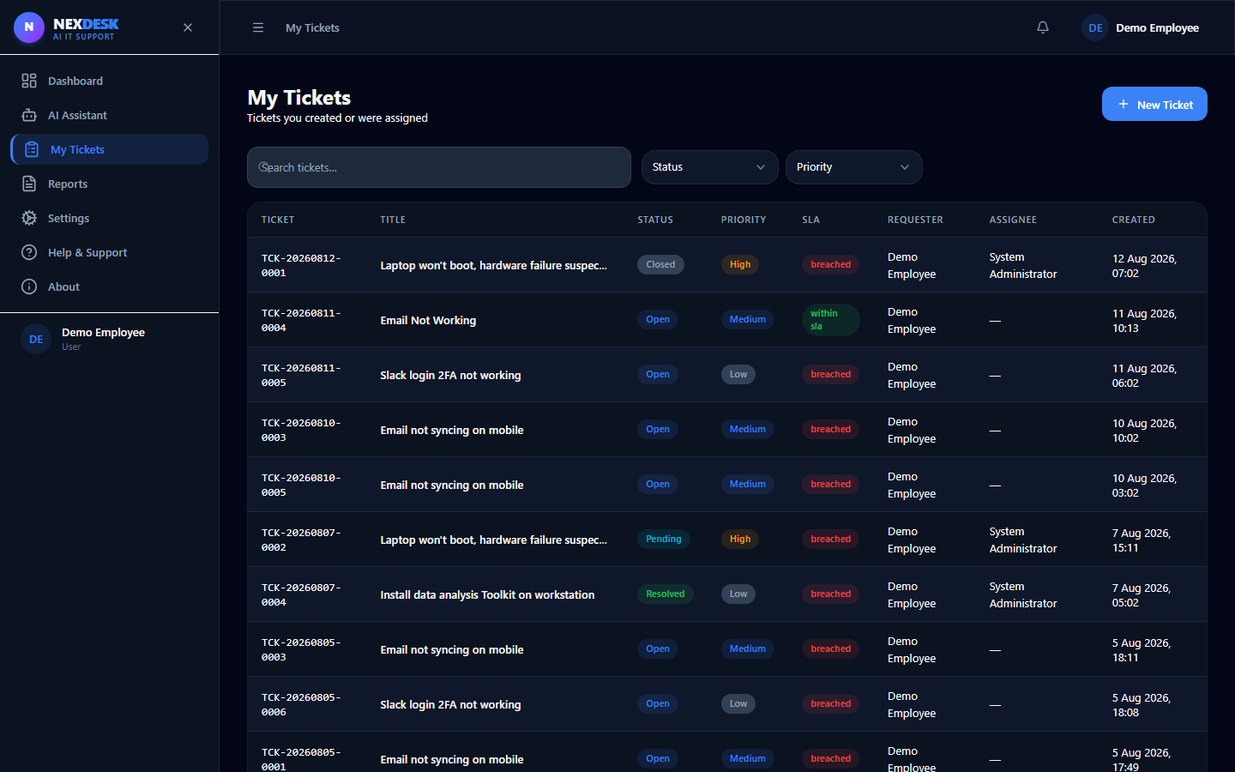
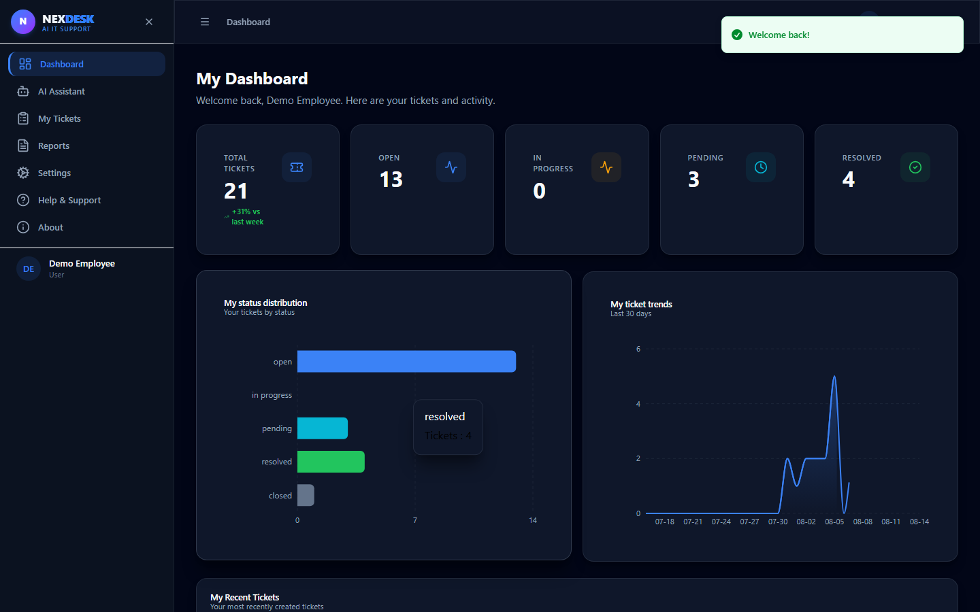
07 · USER VIEW
User Dashboard
▪ Total tickets
▪ Open tickets
▪ Pending tickets
▪ Resolved tickets
▪ Recent tickets
● My Tickets
● User Dashboard
NexDesk · AI-Based IT Ticket Management System
08

Slide 9
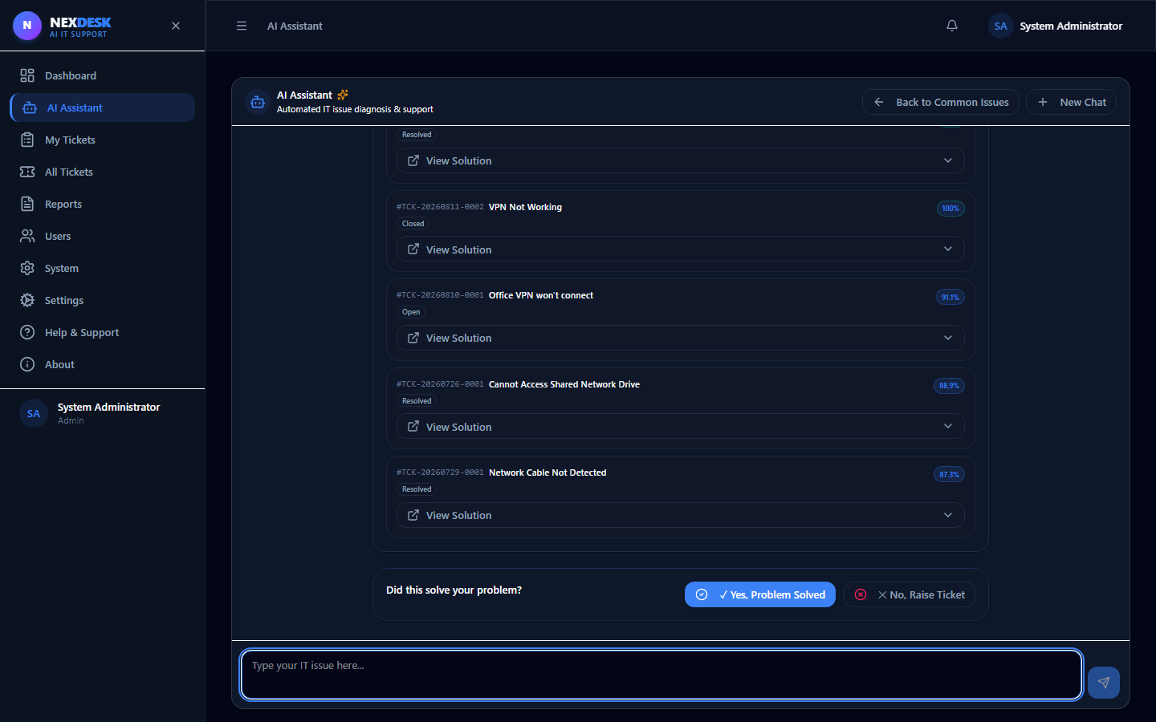
08 · CORE FEATURE
AI Assistant Pipeline
Issue
Category
Department
Priority
Sentiment
Root Cause
Recommended Resolution
Similar Tickets
Create Ticket
Each stage auto-enriches the ticket; output builds the draft the user confirms.
● AI Assistant — live conversation
NexDesk · AI-Based IT Ticket Management System
09

Slide 10

09 · INTELLIGENCE
AI Analysis — Worked Example
▪ Category detection
▪ Department detection
▪ Sentiment analysis
▪ Priority assignment
▪ Root-cause analysis
● AI Engine — analysis panel
VPN Not Working
Category: Network
Department: IT Support
Priority: High
Sentiment: Negative
Root Cause: VPN config failure
NexDesk · AI-Based IT Ticket Management System
10
AI Confidence: 95%

Slide 11
10 · TROUBLESHOOTING
AI Resolution Engine
● AI-Generated Solution
1. Basic Checks
2. Troubleshooting
Guided step in the resolution flow
Guided step in the resolution flow
3. Configuration Checks
4. Verification
Guided step in the resolution flow
Guided step in the resolution flow
5. Information Collection
6. Escalation
Guided step in the resolution flow
Guided step in the resolution flow
NexDesk · AI-Based IT Ticket Management System
11
7. Similar Tickets
Guided step in the resolution flow

Slide 12
11 · KNOWLEDGE REUSE
Similar Tickets
▪ Faster troubleshooting
▪ Knowledge reuse
▪ Reduced duplicate tickets
● Similar Tickets Page
⧉ VPN Not Working
⧉ Server Down
⧉ Email Not Working
⧉ Login Problems
NexDesk · AI-Based IT Ticket Management System
12

Slide 13
12 · INTAKE
AI-Assisted Ticket Creation
The AI automatically fills:
● Create Ticket Page
Category → auto-filled
Department → auto-filled
Priority → auto-filled
Workflow
Issue
AI Analysis
Ticket Creation
NexDesk · AI-Based IT Ticket Management System
13

Slide 14
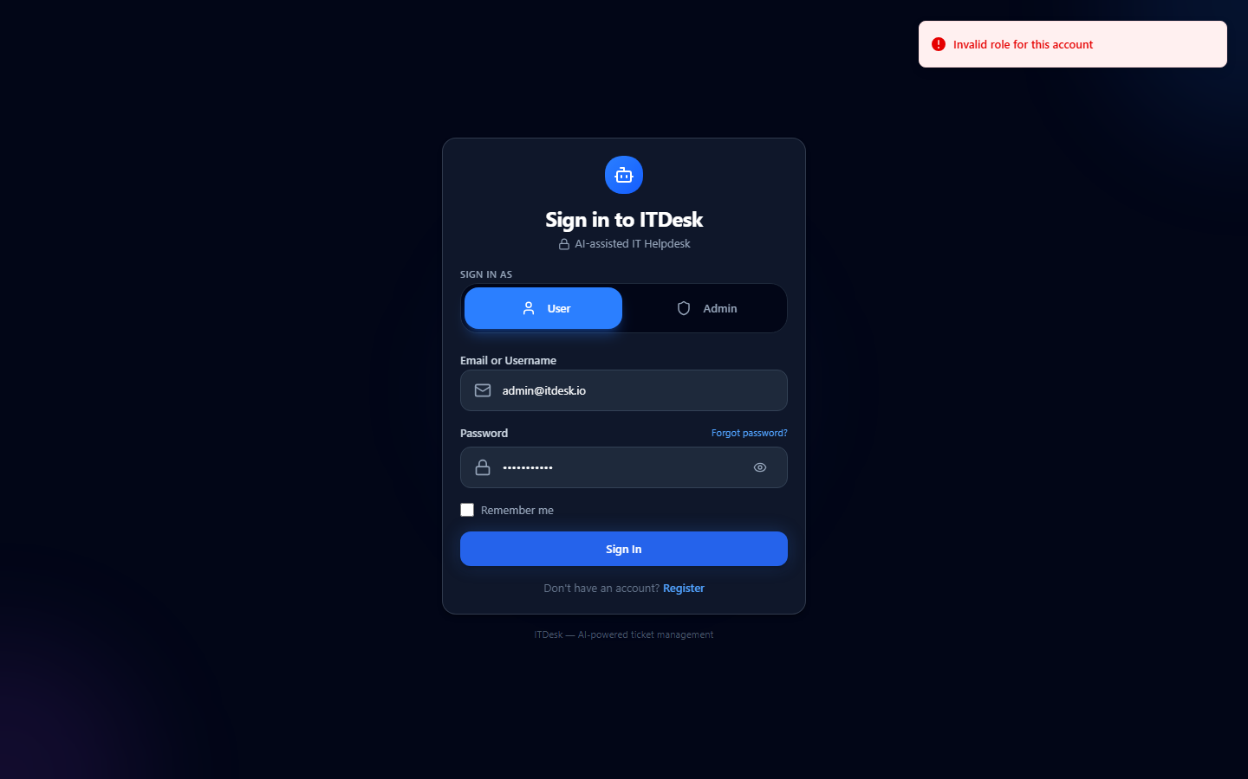
13 · OPERATIONS
Admin Dashboard
▪ Ticket monitoring
▪ Ticket statistics
▪ Recent tickets
▪ Analytics
● Admin Dashboard
128
14
Open
High
642
3.2h
Resolved
Avg SLA
NexDesk · AI-Based IT Ticket Management System
14

Slide 15
14 · WORKFLOW
Ticket Assignment
1. Ticket Created
2. AI Analysis
3. Admin Review
4. Assignment
5. Status Update
6. Resolution
● Ticket Management Page
NexDesk · AI-Based IT Ticket Management System
15

Slide 16
15 · RETROSPECTIVE
Challenges & Solutions
⚠
Challenges
✓
Solutions
• Category not loading
• Department not loading
• Priority not loading
• Assignment issues
• Auth errors
• Dashboard sync
• AI-based classification
• Department mapping
• DB synchronization
• API integration
• Role-based filtering
• Real-time SSE
Before → After: empty fields → auto-filled · manual triage → AI-assisted · sync lag → real-time
NexDesk · AI-Based IT Ticket Management System
16

Slide 17
16 · VALUE & ROADMAP
Impact & Future Enhancements
★
Benefits
ROADMAP
• Faster support
• Reduced manual work
• Better prioritization
• Improved UX
Q1
RAG + KB
Q2
Voice intake
Q3
Email alerts
Q4
Advanced LLM
Q5
Multilingual
→
Future Enhancements
• RAG integration
• Voice-based ticket creation
• Email notifications
• Knowledge-base link
• Advanced AI models
• Multilingual support
NexDesk · AI-Based IT Ticket Management System
17

Slide 18
Conclusion
NexDesk transforms traditional IT support into an AI-driven intelligent helpdesk.
Thank You
▪ AI improves ticket analysis
▪ AI improves troubleshooting
▪ AI reduces duplicate tickets
▪ AI improves ticket management
Questions?
NexDesk — AI-Based IT Ticket
Management System
AI Engineering Intern · Project Review
Demo: http://localhost:5173 · API docs: http://localhost:8000/docs

