Slide 1
Predicting a pulsar star

Slide 2
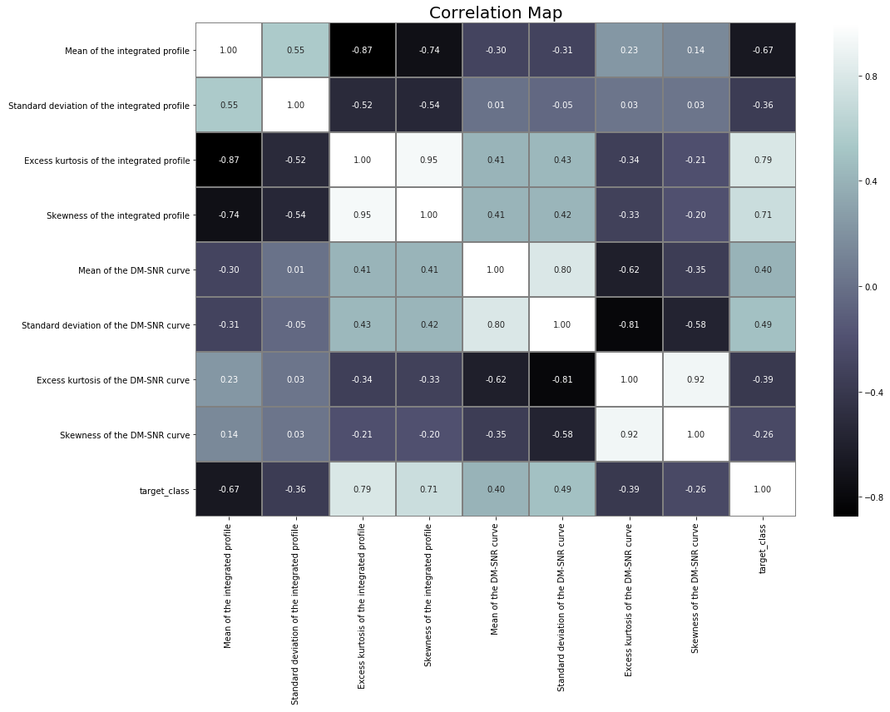
Properties of Dataset
Prediction of a pulsar star

Slide 3
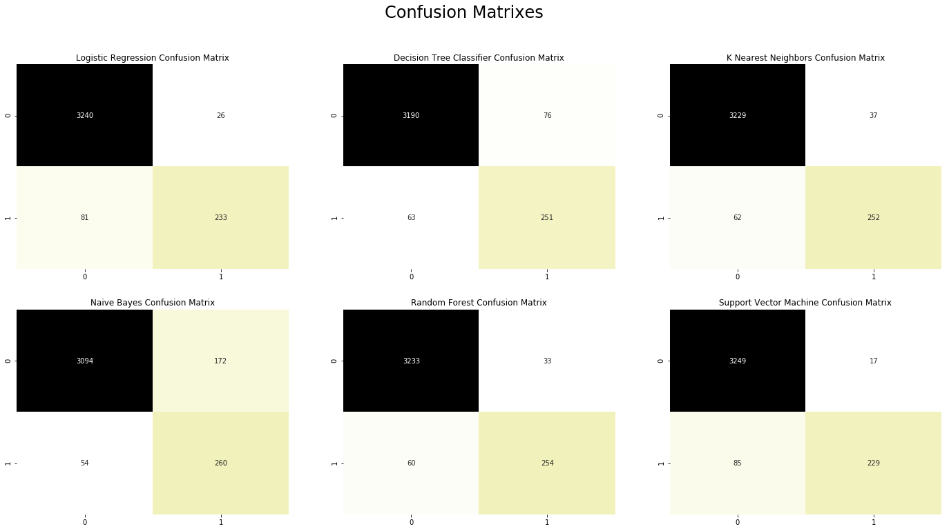
predictions
Confusion matrix

Slide 4
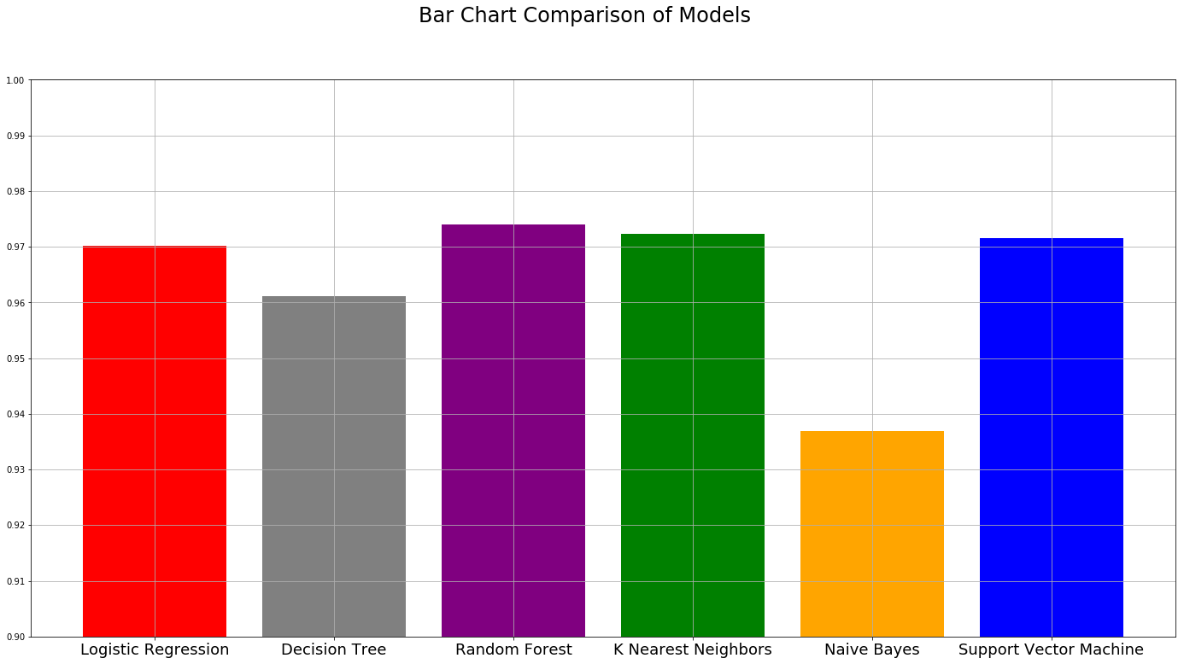
Scores
Comparison

