Slide 1
Compiler Course
Lab 5
CSE 440

Slide 2
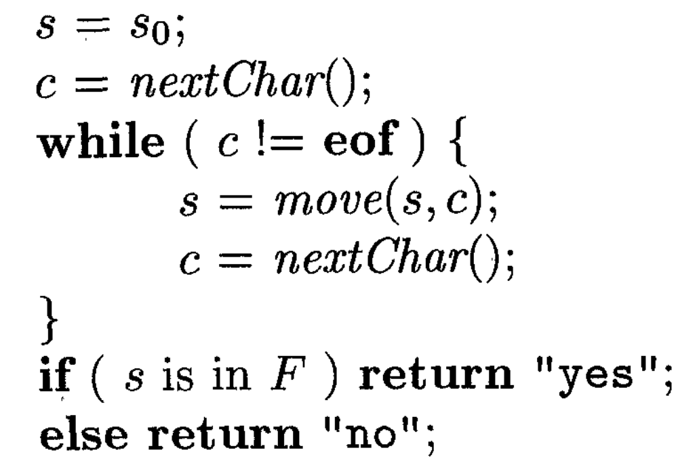
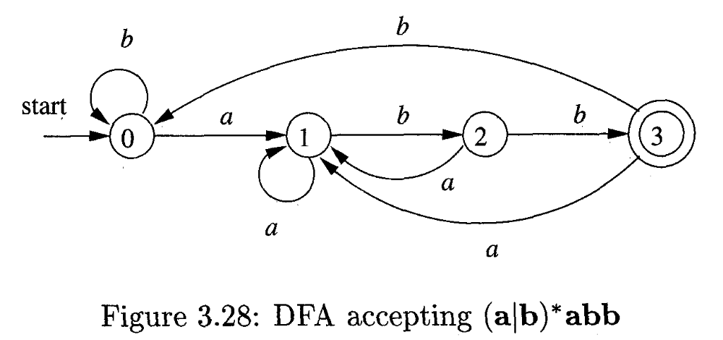
Task 1: Simulating an DFA. [file:DFA.c]
DFA transition table
4
2
1 0
1 2
1 3
1 0
1
3
State | a | b
0 | 1 | 0
1 | 1 | 2
2 | 1 | 3
3 | 1 | 0
Assumptions for States:
Maximum 10 states
Always starts from 0
0 is the starting state
Assumptions for Input Symbol:
Always small letters from alphabet
Maximum 26
Always starts from a
Input | Output
ababb | 0,1,2,1,2,3 yes
aba | 0,1,2,1 no
aaaabb | 0,1,1,1,1,2,3 yes
Input file: InputDFA.txt

Slide 3
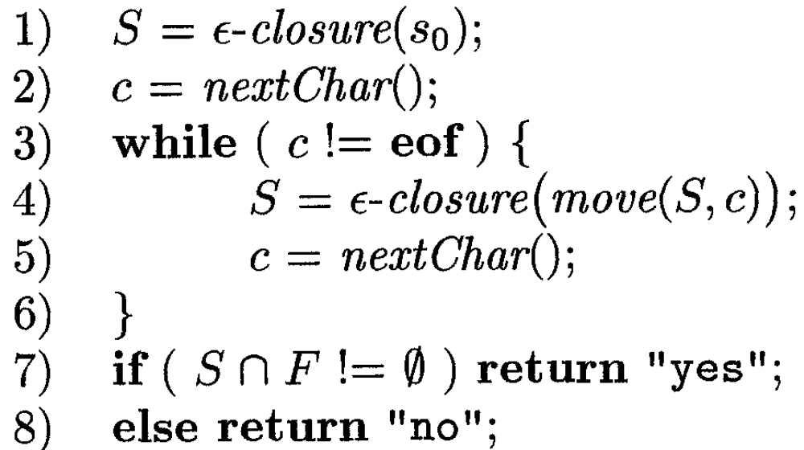
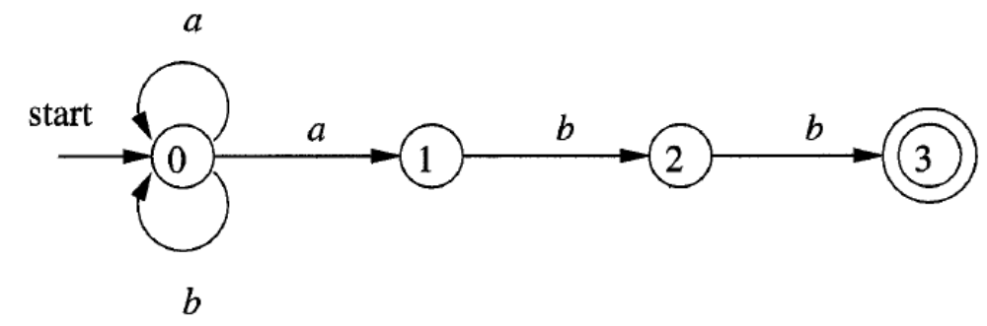
Task 2: Simulating an NFA. [file:NFA.c]
A NFA accepting (a|b)*abb
NFA transition table
State | a | b | 
0 | {0,1} | {0} | Φ
1 | Φ | {2} | Φ
2 | Φ | {3} | Φ
3 | Φ | Φ | Φ
4
2
01 0 f
f 2 f
f 3 f
f f f
1
3
Assumptions for States:
Maximum 10 states
Always starts from 0
0 is the starting state
Assumptions for Input Symbol:
Always small letters from alphabet
Maximum 26
Always starts from a
Input | Output
ababb | 0,01,02,01,02,03 yes
aba | 0,01,02,01 no
aaaabb | 0,01,01,01,01,02,03 yes
Input file: InputNFA.txt

